Slide 1


CSS IV
Bootstrap

Slide 2
Objective
Advantages of Bootstrap
How does Bootstrap work
How to use Bootstrap

Slide 3
What Is Bootstrap
Bootstrap is a front-end framework used to build pages faster using HTML and CSS.
Bootstrap provides a lot of useful CSS and HTML templates that you can use and modify.
It helps you to create websites that automatically adjust based on the device which they are being used on (aka a responsive website)
It’s free!

Slide 4




Advantages of bootstrap
Responsive features
Easy to use
Browser compatibility
Mobile-First approach

Slide 5
How To Use Bootstrap
To use Bootstrap in a web page, you need to link to it from your HTML files.
CDN (Content delivery network):a network of servers that work together to provide fast delivery of Internet content including stylesheets.
<head>
<link rel="stylesheet”
href="https://maxcdn.bootstrapcdn.com/bootstrap/3.3.6/css/bootstrap.min.css"
integrity="sha384-1q8mTJOASx8j1Au+a5WDVnPi2lkFfwwEAa8hDDdjZlpLegxhjVME1fgjWPGmkzs7”
crossorigin="anonymous”>
<link rel="stylesheet” href="main.css”>
</head>

Slide 6
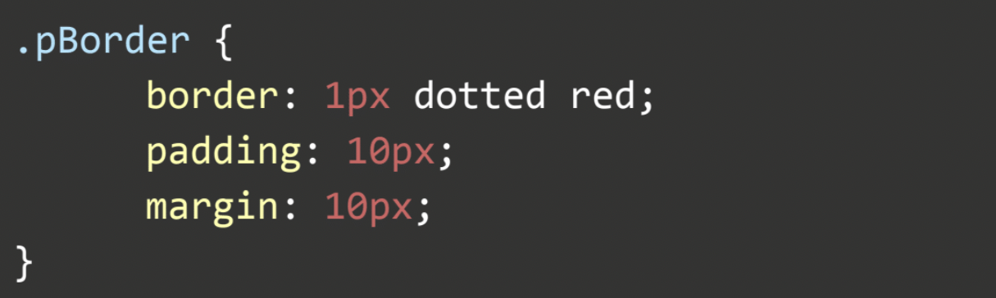
How Does Bootstrap Work
Bootstrap has predefined contexts which automatically format a selection
It makes using CSS more efficient
Style a border around a paragraph:
Bootstrap
Your own CSS

Slide 7
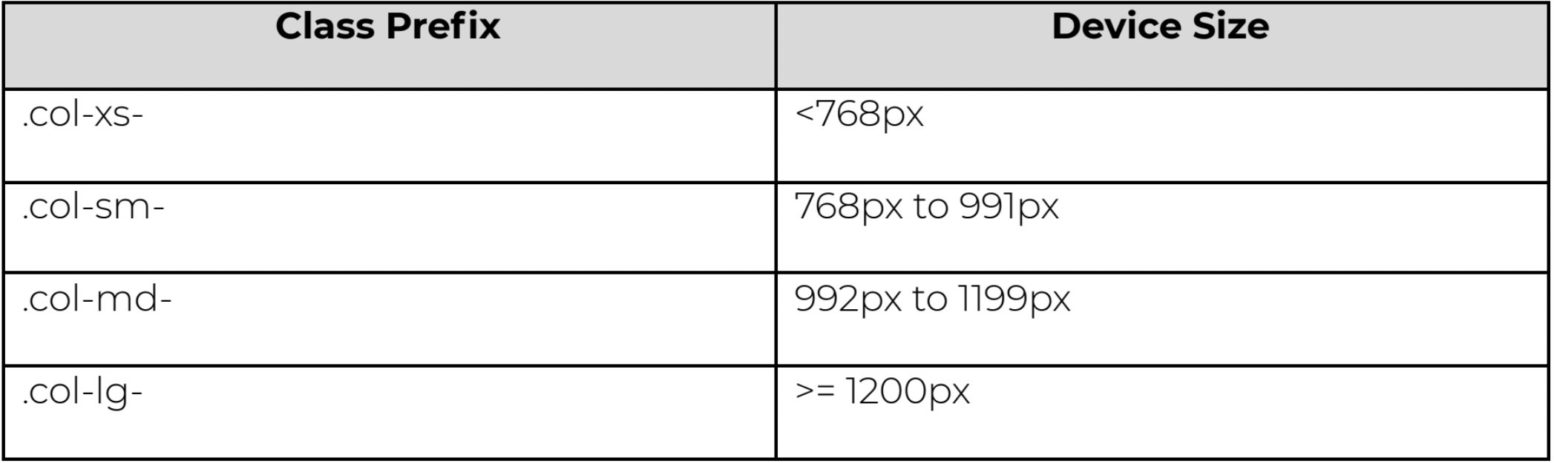
How Does Bootstrap Work
The Bootstrap Grid System: Allows you to create rows and columns and then place content in the “intersected” areas
You can create up to 12 columns and unlimited rows
Made up of:
Container
Rows
Column

Slide 8
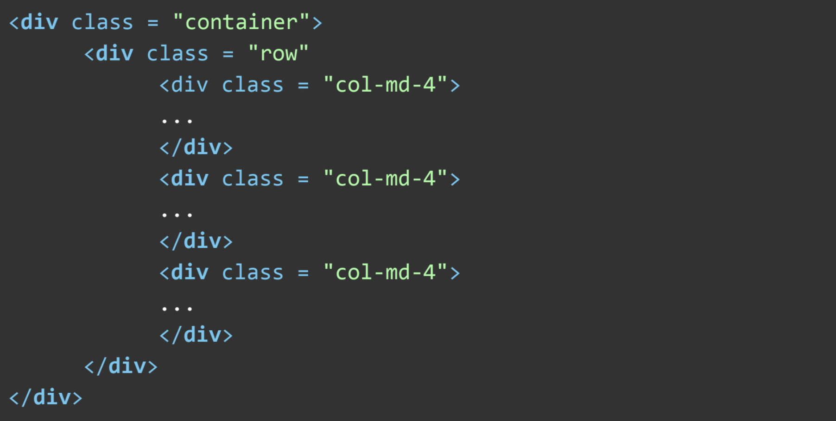
Examples of How to use Bootstrap
The Bootstrap Grid System:

Slide 9
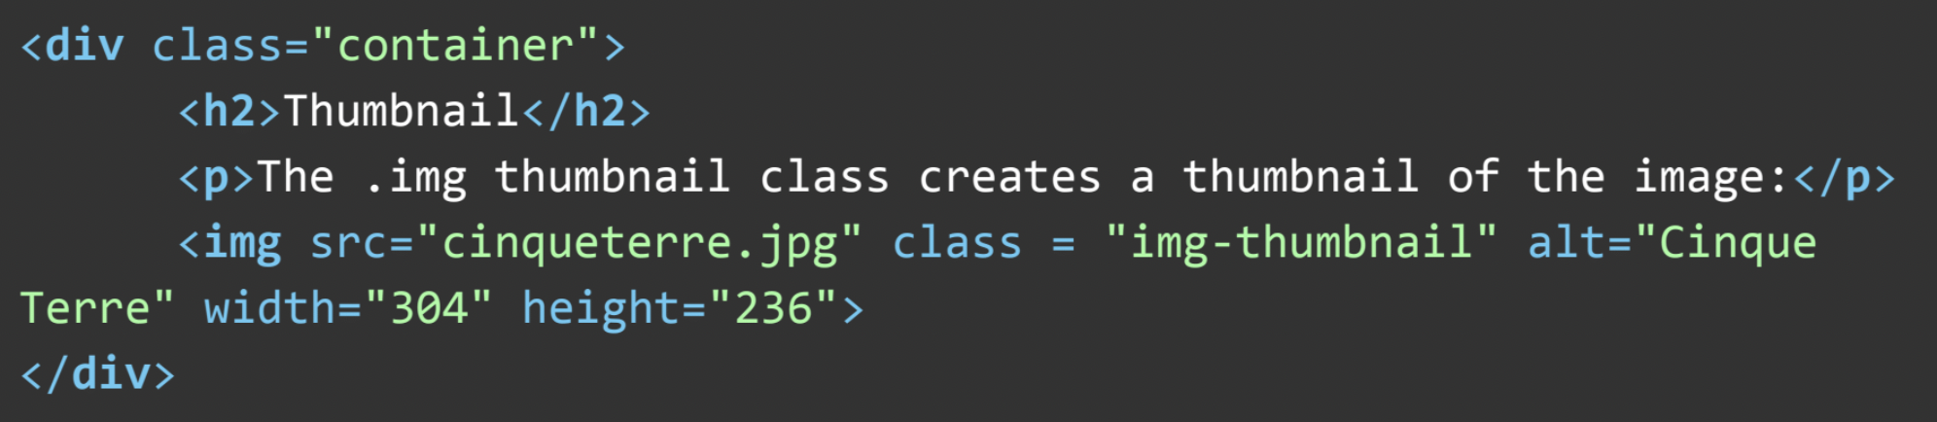
Examples of How to use Bootstrap
Bootstrap Thumbnails

Slide 10



Resources
Bootstrap Customize
Bootstrap Sass
Tutorials Point Bootstrap
Bootsnipp
12 Time Saving Bootstrap Examples
Built with Bootstrap
Bootstrapbay
Block Element Modifier methodology
Hipster Ipsum - Dummy placeholder "hipster" text
Semantic Class Names

Slide 11
Summary
Advantages of Bootstrap
How does Bootstrap work
How to use Bootstrap

