Slide 1


Express 1

Slide 2

What is Express.js?
Gives you access to a library of code (Node.js functions) that makes it easier for you to create web servers with Node
Although Express is minimalist, developers have created compatible middleware packages to address almost any web development problem
Unlike other frameworks, like Django, Express is an un-opinionated web framework
Notes:
It is also the underlying library for several other popular Node web frameworks. Express is a minimal and flexible web framework that provides a robust set of features for web and mobile applications. It is open source and maintained by the Node.js foundation.
Unopinionated frameworks have fewer restrictions regarding the best way to glue components together to achieve a goal, or even what components should be used, than opinionated frameworks. These frameworks allow developers to use the best tools to complete a particular task, but you need to find these tools yourself. It is very flexible and pluggable and has no “best way” of doing something. You can use almost any compatible middleware, in almost any order and you can structure your app however you like.

Slide 3
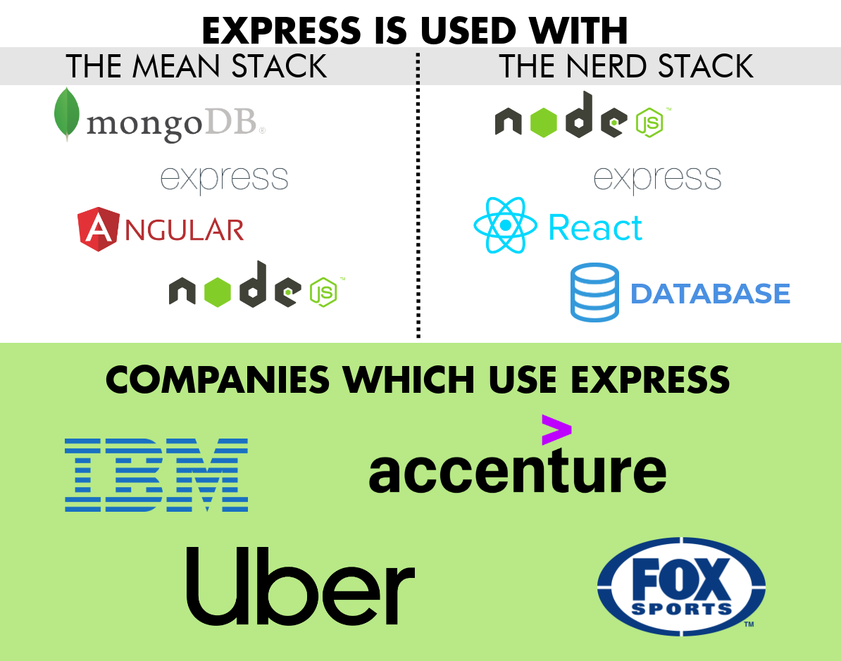

Slide 4
Why Use Express?
To speed up development and decrease the amount of boilerplate code you have to write.
We could write all the code we need without Express, but we will use Express to speed up development.

Slide 5
Install Express
Express is another package that you need to install using NPM.
Step 1: Open your terminal or command prompt.
Step 2: Create a directory using the mkdir command and then navigate into it using the cd command.
mkdir myapp
cd myapp

Slide 6
Install Express
Step 3: Use the npm init command to create a package.json file for your application. The command, npm init, will prompt you to enter several details, such as the package name, version, description, entry point, test command, etc.
npm init
Step 4: To display the package.json file enter cat package.json or type package.json

Slide 7
Install Express
Step 5: Install the Express library in the ‘myapp’ directory that you created and save it in the dependencies list of the package.json file:
npm install express
Step 6: Enter cat package.json or type package.json into your terminal again. The dependencies section of your package.json will now appear in the package.json file and will contain Express.

Slide 8
Install Express
cat package.json
{
"name": "myapp",
"version": "1.0.0",
"description": "",
"main": "index.js",
"scripts": {
"test": "echo \"Error: no test specified\" && exit 1"
},
"author": "",
"license": "ISC",
"dependencies": {
"express": "^4.15.4"
}
}

Slide 9
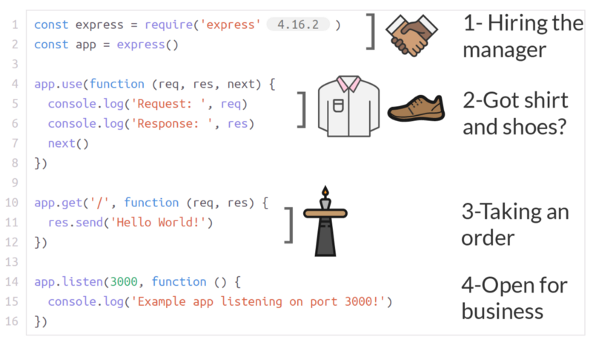
Restaurant analogy to explain four key parts of Express app
The require statements
Middleware
Routing
App.listen()/ Starting the server

Slide 10
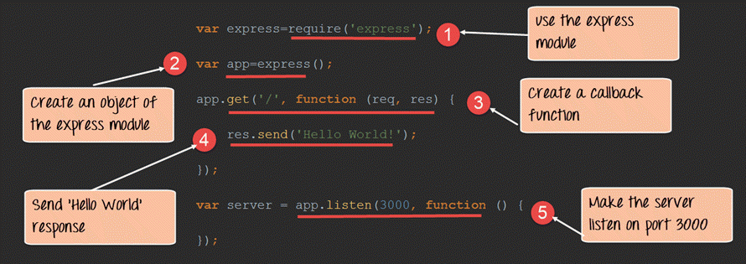
Restaurant analogy to explain four key parts of Express app

Slide 11
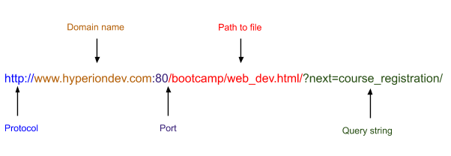
Routing
Routing: determining how an application responds to a client’s request to a particular endpoint. The request is made using a URI (or path) and a specific HTTP request method.
Remember that a URL contains a lot of information:
Notes:
URL:
It identifies the protocol being used to send information. In the example above, the protocol being used is HTTP.
It identifies the domain name of the web server on which the resource can be found, e.g. www.hyperiondev.com.
It identifies the port on the server. In this example, the port number is given as port 80. In reality, if the default HTTP ports are used (port 80 is the default for HTTP, port 443 for HTTPS) they don’t have to be given in the URL.
It gives the path to the resource on the web server, e.g. /bootcamp/web_dev.html
Data can be passed using parameters (as shown in the image on the next slide) or using a query string (as shown in the image above).

Slide 12
Routing
To perform routing, we are interested in the path section of the URL
With Express there are a few route methods used to perform routing: get, post, put and delete (we will use get):
app.get('/', function (req, res) {
res.send('Hello World!')
})
Notes:
The app.get() method takes two arguments:
The path. In this example, the path is ‘/’ the root route of our app. In development, the URL http://localhost:3000/ (where the server is running on port 3000) will match the route specified in the app.get('/', ...) method in our code example. If you wanted to add a route handler that would handle the HTTP request using the URL, http://localhost:3000/about, you would have to add an app.get('/about', …) function.
A callback function. The callback function that is passed as the second argument to the app.get() method acts as a route handler. In other words, in this example, when a get request is made to the homepage of the web app, a response object that simply contains the text ‘Hello World!’ will be sent from my server to the browser.
Now that we understand what routing is, let’s create a server with Express!

Slide 13
Creating a Server Using Express
In the root directory of your ‘myapp’ directory (the directory you created when you installed Express), create a file called ‘app.js’ and copy the code below into it:
const express = require('express')
const app = express()
app.get('/', function (req, res) {
res.send('Hello World!')
})
app.listen(8000, function () {
console.log('Example app listening on port 8000!')
})
Notes:
The code above is a simple “Hello World” Express web application. Let’s analyse this code line by line:
Line 1: require() is called to import the "express" module.
Line 2: Create an object called ‘app’ by calling the top level express() function. This object represents our Express application. The app object contains important methods that we use to create our server. Notice two of the methods in the code above: get() and listen(). You will also learn about app.use() in this task.
Line 4: Create a route handler that will respond to requests using the app.get() routing method.
Line 8: The app object also includes the listen() method. The listen() method specifies what port our app object (application server) will listen to HTTP requests on. The app.listen() method returns an http.Server object.

Slide 14

Creating a Server Using Express
To start the server, call node with the script in your terminal or command prompt
Now use your web browser to navigate to http://127.0.0.1:8000/. You should see the string “Hello World!” displayed in your browser!

Slide 15
Serving Static Files with Express
With Express it is easy to serve static resources by using the express.static built-in middleware function
To allow your app to serve static files:
Create a folder in your project directory to store the static files you want to serve.
Add all the static resources that you want your app to make available (images, HTML files etc) to this folder.
Add the following code to your app.js file: app.use(express.static('public'));
Notes:
Even dynamic web applications may have certain static components to display.
To allow your app to serve static files, simply do the following:
Create a folder in your project directory to store the static files you want to serve. This folder is usually called ‘public’.
Add all the static resources that you want your app to make available (images, HTML files etc) to this folder. Make sure that these files have meaningful names because, by default, you will use the file name of the resource to access it. Don’t store any files that you don’t want users of your app to see in this directory!!
Add the following code to your app.js file: app.use(express.static('public'));
We use app.use() to include any built-in middleware functions we need in our app. For a list of other built-in middleware functions for Express, see here.
Once you start your server (type node app.js in the terminal), you should be able to access these static resources from the browser. For example, if you added an HTML file called ‘example.html’ to the public folder, you could access it with this URL: http://localhost:3000/example.html (where you have created a server that listens for HTTP requests on port 3000).

Slide 16
Environment Variables
When creating back-end apps, it is important to be able to access environment variables.
Node.js allows us to access these variables using process.env.
To see some of the environment variables stored on your PC, add the following line of code to your app.js file and run it in the terminal:
console.log('The value of process.env is:', process.env);
Notes:
So far, the only variables we have used have been variables we have created using the keywords var, const or let. However, backend code needs to be able to access variables created and set in the environment in which the code is run (i.e. variables set by the server).

Slide 17
Environment Variables
An important environment variable that will be set on the server is the port number on which your application server will listen for HTTP requests.
To get the port number from the environment variables instead of hardcoding it, we use the following code:
const PORT = process.env.PORT || 8000;
app.listen(PORT, () => {
console.log(`Server is listening on port ${PORT}`);
});

Slide 18
Nodemon
Use Nodemon to enable server restarts on file changes.
After typing the command shown below into the command line interface, you should see that your package.json file now includes a reference to Nodemon in its devDependencies section.
npm install --save-dev nodemon
To run an app using Nodemon, type nodemon name_of_file in the terminal instead of node name_of_file.
Notes:
As you have probably experienced by now, it can be time-consuming to restart your server every time you make changes to your code!

Slide 19

Add a Start Script
It is recommended that you add a script to your package.json file for every application that you create that specifies how to start your app.
To start the application, we then type npm start. This will use the instruction specified in the start script in the package.json file to run the code.

Slide 20



Resources
https://www.freecodecamp.org/news/going-out-to-eat-and-understanding-the-basics-of-express-js-f034a029fb66/
https://www.coursereport.com/blog/what-is-express
https://www.guru99.com/node-js-express.html

