Slide 1


Express 2

Slide 2
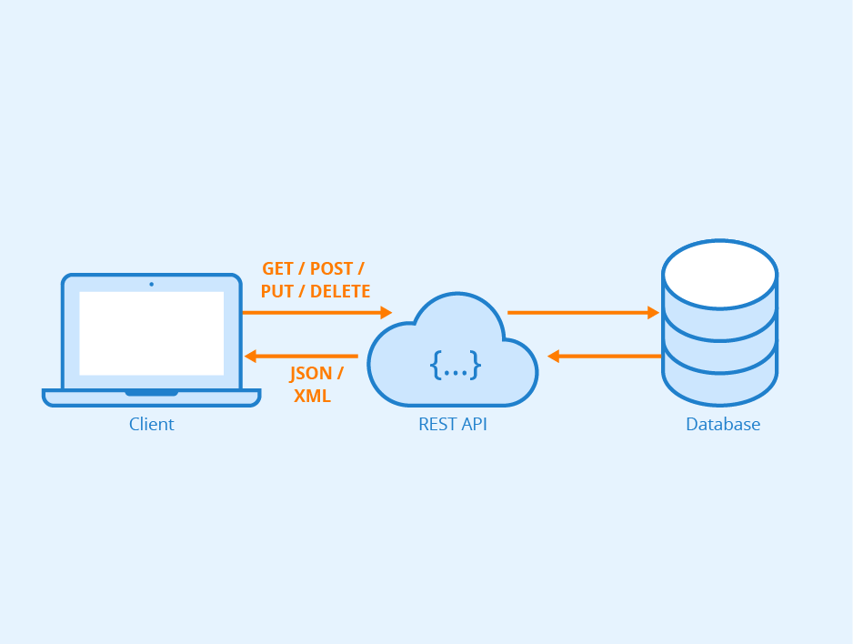
What is a Restful API?
API: an interface that sits between two applications or modules of code
Restful API: a client/server architecture that uses a stateless communication protocol like HTTP
RESTful web services are based on these principles:
RESTful web services expose resources using URIs.
Resources are manipulated using PUT, GET, POST, and DELETE operations.
PUT creates a new resource, DELETE deletes a resource, GET retrieves the current state, POST transfers a new state onto a resource.

Slide 3
What is a Restful API?
Resources are decoupled from their representation so that their content can be accessed in a variety of formats, such as HTML, XML, plain text, PDF, JPEG, JSON and others.
Interaction with resources is stateless. State information is exchanged using techniques like URI rewriting, cookies, hidden form fields and embedding state information in response messages.

Slide 4
Create a Custom Restful API Using Express
A Restful web API is code that is written to respond to HTML PUT, GET, POST and DELETE requests.
To create a Restful API, we are going to write JavaScript functions using Express and Node to handle each of these requests.
Like the app.get() method, each of these methods takes two arguments:
The route. These methods are used to perform routing.
A callback function.
Each route handler that we write will be used to either create (e.g. create a JSON file), read, update or delete data (CRUD)
Notes:
Express has built-in middleware routing functions to handle each of these HTTP request methods. In the previous task, we already used the app.get() function to respond to HTTP GET requests with the specified URL path ('/'). The app object contains methods to handle each of the HTTP verbs: app.post(), app.get(), app.put() and app.delete().
Like the app.get() method, each of these methods takes two arguments:
The route. These methods are used to perform routing. Routing refers to determining how an application responds to a client request to a particular endpoint, which is a URI (or path) and a specific HTTP request method (GET, POST, and so on).
A callback function. The callback function that is passed as the second argument to the app.get/post/put/delete() method acts as a route handler.
You create an API that receives a URI with an HTTP request and uses the appropriate Express routing middleware to call the corresponding functions that handle the CRUD operations.
If we are going to be able to add and update data on our servers though, we need a way to be able to pass our data from the browser to the server.

Slide 5
Create a Custom Restful API Using Express
HTTP verb | CRUD operation | Express method | Description
Post | Create | app.post() | Used to submit some data about a specific entity to the server.
Get | Read | app.get() | Used to get a specific resource from the server.
Put | Update | app.put() | Used to update a piece of data about a specific object on the server.
Delete | Delete | app.delete() | Used to delete a specific object.

Slide 6
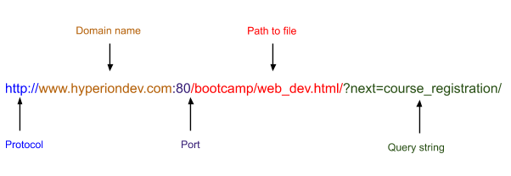
Passing Data Through to the Server Using the Request Object
Notes:
It identifies the protocol being used to send information. In the example above, the protocol being used is HTTP.
It identifies the domain name of the web server on which the resource can be found, e.g. www.hyperiondev.com.
It identifies the port on the server. In this example, the port number is given as port 80. In reality, if the default HTTP ports are used (port 80 is the default for HTTP, port 443 for HTTPS) they don’t have to be given in the URL.
It gives the path to the resource on the web server, e.g. /bootcamp/web_dev.html
Data can be passed using parameters (as shown in the image below) or using a query string (as shown in the image above).

Slide 7
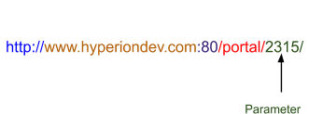
Passing Data Through to the Server Using the Request Object
Notes:
The image above illustrates what a URL may look like if parameters are added to the URL. In the example above, the parameter ‘2315’ may represent the id of a student at Hyperion.

Slide 8
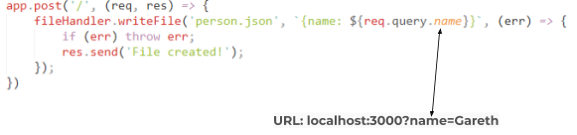
Passing Data Through to the Server Using the Request Object
To access the data passed through using the URL, we use the req object that is passed through as an argument to the app.post or app.put route handler.
Notes:
req.params is used to get parameters from a URL and req.query is used to get data from a query string.
See in the example below how the code req.query.name is used to get the value of the key-value pair where the key is ‘name’.

Slide 9
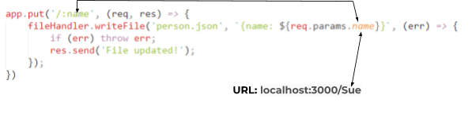
Passing Data Through to the Server Using the Request Object
See in the example below how the code req.params.name is used to get the value of the parameter ‘name’ that is defined in the route argument of the app.put() method.

Slide 10

Postman
Postman: a free API development environment.
Postman: It presents you with a friendly GUI for constructing requests and reading responses.
How to install: Download it from their website and install postman on your machine.
Test API in next slides using Postman 👨‍💻👩‍💻

Slide 11
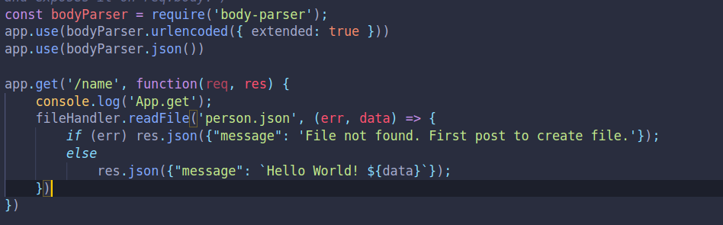
Working with Requests
Write a Get Method to get a files contents when you hit an end point as follows.

Slide 12
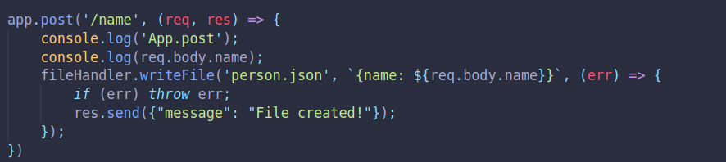
Working with Requests
Write a POST Method to add to a file like this.

