Slide 1


Functional component & Class component

Slide 2
Objective
Functional component
Class component
Life cycle methods

Slide 3
Functional component
The simplest way to define a component is to write a JavaScript function:
function Welcome(props) {
return <h1>Hello, {props.name}</h1>;
}

Slide 4
Class component
You can also use an ES6 class to define a component:
class Welcome extends React.Component {
render() { return <h1>Hello, {this.props.name}</h1>; }
}

Slide 5
Life cycle methods
componentDidMount()
This function is invoked immediately after the component is mounted to the DOM.
This method is a good place to set up any subscriptions. If you do that, don’t forget to unsubscribe in componentWillUnmount().
componentDidUpdate()
componentDidUpdate() is invoked immediately after updating occurs. This method is not called for the initial render.
Use this as an opportunity to operate on the DOM when the component has been updated.

Slide 6
Life cycle methods
componentWillUnmount()
The componentWillUnmount() is invoked immediately before a component is unmounted and destroyed.
Perform any necessary cleanup in this method, such as invalidating timers, canceling network requests, or cleaning up any subscriptions that were created in componentDidMount().

Slide 7
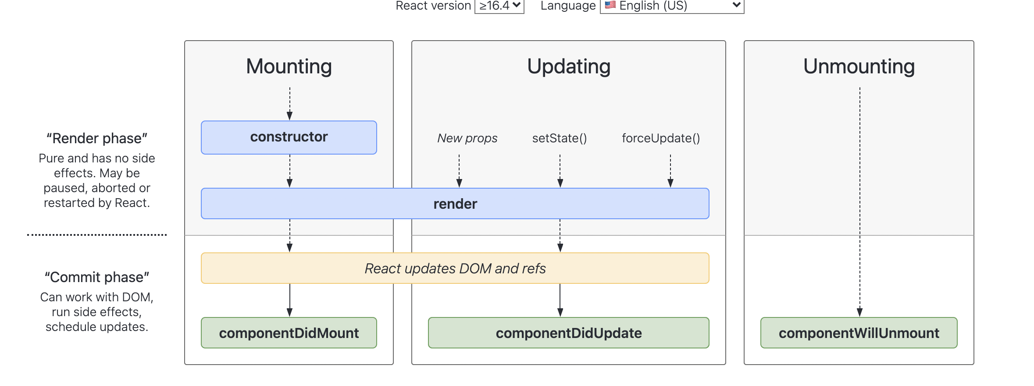
Life cycle methods

Slide 8



Resources
https://reactjs.org/docs/react-component.html#componentdidmount
https://reactjs.org/docs/react-component.html#componentdidupdate
https://reactjs.org/docs/react-component.html#componentwillunmount

Slide 9
Summary
Functional component
Class component
Life cycle methods

