Slide 1


ReactJS (Components)

Slide 2
Objective
UI design
Creating React Components
What Data Should be Stored in What State?
Props vs state
The app.js component
Dynamic React Components
Render Components using if Statements
Render Multiple Components Using Lists

Slide 3
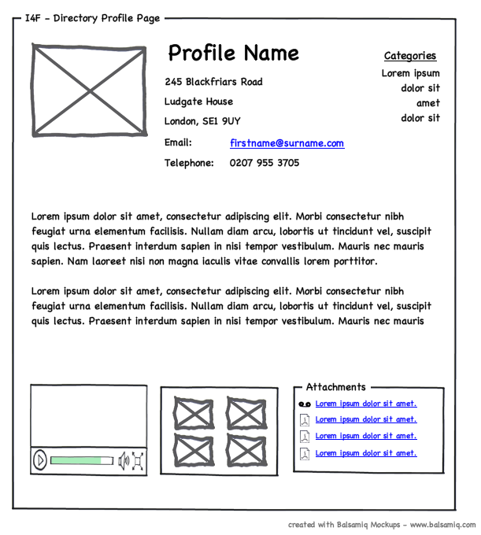
UI Design
Before you begin writing front-end code, you need to design the user interface (UI).
There are various ways to do this including, wireframing:

Slide 4
UI Design
As you design your UI, you will notice that there are certain elements that will be used over and over again.
According to Reacts’ documentation: “A good rule of thumb is that if a part of your UI is used several times (Button, Panel, Avatar), or is complex enough on its own (App, FeedStory, Comment), it is a good candidate to be a reusable component.”
A component can contain other components

Slide 5
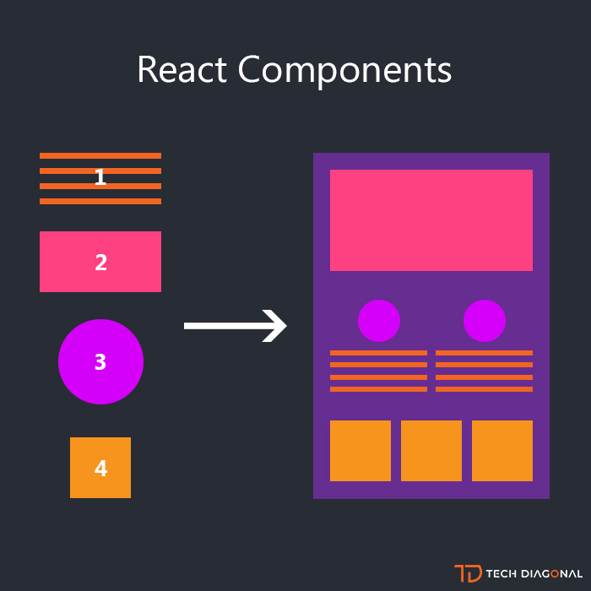
Creating React Components
“React components are small, reusable pieces of code that return a React element to be rendered to the page.” React
What is the difference between a React element and a React component?

Slide 6
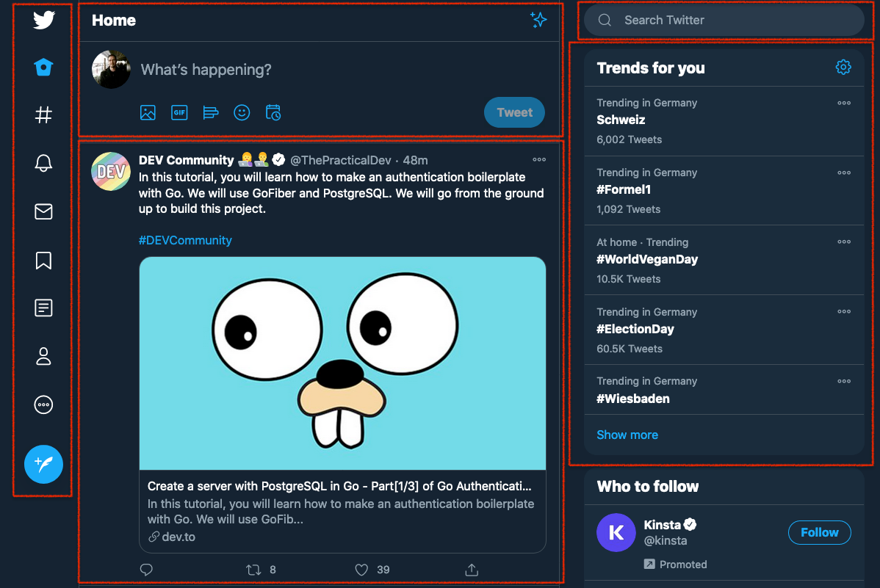
Creating React Components

Slide 7
Creating React Components
Notice that a React component is a piece of code (in this case a function) that accepts props as an input and returns a React element as output.
Function Welcome(props) { return <h1>Hello, {props.name}</h1>; } const element = <Welcome name="Sara" />; ReactDOM.render( element, document.getElementById('root') );

Slide 8
Creating React Components
Input | Processing | Output
props | React Component | React Element
name=”Sara” | function Welcome(props) { return <h1>Hello, {props.name}</h1>; } Components can be implemented using either functions or classes | <h1>Hello, Sara</h1>
Notes:
React components can be implemented using functions (as in the example above) or using React classes (which we will consider later).

Slide 9
Creating React Components
When creating React components it is extremely important that you always adhere to the following two rules:
ALWAYS start component names with a capital letter. React treats components starting with lowercase letters as DOM tags.
A component should NEVER modify its own props.
Props definition: “props are inputs to a React component. They are data passed down from a parent component to a child component.”
Notes:
At this point, you probably have some questions. For example, you may be wondering what the point of React is if you aren’t allowed to change anything. We’ve said previously that React elements are immutable (unchangeable) and now we are saying that React components are not allowed to change props. If we can’t change anything with React we are going to end up with static web pages and we may as well use HTML, right? Not to worry - the solution lies in the fact that React components can store state information.

Slide 10

What Data Should be Stored in What State?
State is used to store data related to a component that changes over time.
Notes:
For example, let's look at an email app such as Gmail. This app is made up of many components and the appearance of these components change as you interact with them. For example, the state of a checkbox can change from checked to unchecked as you interact with it. Similarly, a message can be read or unread. The component used to display the messages in the inbox will look different depending on the state of that component (i.e. whether the message is read or unread).
Using too much state will make a program more complex and unpredictable. Therefore, have as few components that use state (stateful components) as possible in your application. Save data using props instead of state wherever you can.
Use state when some data associated with a component changes over time. For example, you would need to store information about whether a checkbox is checked or not in its state. In other words, if a component needs to change one of its attributes over time, that attribute should be part of its state.
It is often the user that will change the state of a component by interacting with the UI.

Slide 11
What Data Should be Stored in What State?
Only components that are defined using classes (not functional components) can have state.
2 Principles to decide when to use stateful/stateless components (from Artemij Fedojev):
“The minority of your React components are stateful. They should be at the top of your components’ hierarchy. They encapsulate all of the interaction logic, manage the user interface state, and pass that state down the hierarchy to stateless components, using props.”
“The majority of your React components are stateless. They receive the state data from their parent components via this.props and render the data accordingly” (2015, Page 37).
Notes:
Stateful components must be implemented using classes but stateless components are usually implemented using functions.

Slide 12
Props vs. State
Props | State
can be used in functional and class components. used to pass data from parent elements to child elements. Props can only be passed from a parent to its children, not the other way around, i.e. top-down or unilateral data flow. read-only. They should not be modified by components. | only components defined as classes can have state private to its component. State is not accessible to any component other than the one that owns and sets it. Data about state can be sent as props. a component can change its state

Slide 13
How to Create a Stateful Component
Create a class component:
class NameOfClass extends React.Component { render() { return ( <div> <h1>Look at this example of a class component!</h1> </div> ); } }
Notes:
Note that the class has a single render() method that returns the React Element.
For the rest of this section, we are going to be looking at an example of a stateful component created by React. We use the example of a component called ‘Timer’ that displays the number of seconds that a user has been viewing the page containing the component for. To see an example of this code in action, see the stateful component section on this page. The ‘example’ code for this task also includes this component and detailed comments that explain the code in more detail.
The code for this Timer component is given below. We will now analyse this code to see the steps involved in creating a stateful component. Notice that each step is colour-coded to the match corresponding code.

Slide 14
How to Create a Stateful Component
2. Add a class constructor to assign the initial state.
3. Read the state info (using this.state) and use it to render the component using the render() method.
4. Allow modification of the state using this.setState(), which will usually be called in an event handler that handles a UI interaction. Never modify the state directly because this won’t re-render the component. Always use this.setState().
Notes:
Note that the class has a single render() method that returns the React Element.
For the rest of this section, we are going to be looking at an example of a stateful component created by React. We use the example of a component called ‘Timer’ that displays the number of seconds that a user has been viewing the page containing the component for. To see an example of this code in action, see the stateful component section on this page. The ‘example’ code for this task also includes this component and detailed comments that explain the code in more detail.
The code for this Timer component is given below. We will now analyse this code to see the steps involved in creating a stateful component. Notice that each step is colour-coded to the match corresponding code.

Slide 15
class Timer extends React.Component { constructor(props) { super(props); this.state = { seconds: 0 }; } tick() { this.setState(prevState => ({ seconds: prevState.seconds + 1 })); } componentDidMount() { this.interval = setInterval(() => this.tick(), 1000); }
componentWillUnmount() { clearInterval(this.interval); } render() { return ( <div> Seconds: {this.state.seconds} </div> ); } } ReactDOM.render(<Timer />, mountNode);
Notes:
Note that the class has a single render() method that returns the React Element.
For the rest of this section, we are going to be looking at an example of a stateful component created by React. We use the example of a component called ‘Timer’ that displays the number of seconds that a user has been viewing the page containing the component for. To see an example of this code in action, see the stateful component section on this page. The ‘example’ code for this task also includes this component and detailed comments that explain the code in more detail.
The code for this Timer component is given below. We will now analyse this code to see the steps involved in creating a stateful component. Notice that each step is colour-coded to the match corresponding code.

Slide 16
The App.js Component
It is a component that is created by default when using Create React App.
The App component is the container for all other React components.
import React from 'react'; import ReactDOM from 'react-dom'; import './index.css'; import App from './App'; import registerServiceWorker from './registerServiceWorker'; ReactDOM.render(<App />, document.getElementById('root')); registerServiceWorker();
Notes:
By default the App component is rendered by calling ReactDOM.render() in the index.js file.
Note: App.js must start with a capital letter (i.e. App.js instead of app.js) because we want React to treat App as a component. Remember that all component names must start with a capital letter.

Slide 17
Dynamic React Components
To make truly dynamic web applications, we need to be able to use React to do some logic.
In this task, you will learn to control how and when components are displayed on the browser using if statements and lists.

Slide 18
Render Components using if Statements
One of the most basic things you want to be able to do with a React application is to decide which components to display, based on some conditions.
Imagine you have already created the two components below:
function Welcome(props) { return <h1>Welcome back {props.name}!</h1>; } function SignUp(props) { return <button type="button">Sign in</button>; }

Slide 19
Render Components using if Statements
You could use the logic below to decide which component to show:
function Greeting(props) { const isLoggedIn = props.isLoggedIn; if (isLoggedIn) { return <Welcome name=”John” />; } return <SignUp />; } ReactDOM.render( <Greeting isLoggedIn={true} />, document.getElementById('root') );

Slide 20
Render Components using if Statements
You could also manipulate an element inline using JSX. Remember with JSX you can embed any JavaScript using curly braces.
render() { const isLoggedIn = this.state.isLoggedIn; return ( <div> The user is <b>{isLoggedIn ? 'currently' : 'not'}</b> logged in. </div> ); }

Slide 21
Render Multiple Components Using Lists
When designing UIs, you are also more than likely going to want to be able to add multiple instances of a component to your UI.
To do this using React, we make use of lists.
 | function NumberList(props) { const numbersArr = props.numbers; const listItems = numbersArr.map((number) => <li key={number.toString()}> {number} </li> ); return ( <ul>{listItems}</ul> ); } const nums = [1, 2, 3, 4, 5]; ReactDOM.render( <NumberList numbers={nums} />, document.getElementById('root') );
Notes:
If we analyse the code example shown above (taken from the React documentation) you will notice the following:
We create a functional component as usual (line 1 - line 11) and render it as usual (line 14 - 17).
To add multiple components, we also:
Create an array (Line 13). In most practical examples, this data would be read from a database or fetched from an API.
Pass the array we created using props to the component we are creating (Line 15, 1 and 2).
Use the map() function to create a new array with the results of calling a function for every array element (Line 3). For more info about the map() function see here.
Give each item in the array a key that will uniquely identify that item (Line 4).

