Slide 1


Redux

Slide 2
Objective
What is Redux?
Why to use Redux?
Redux flow
React Context API vs Redux

Slide 3

What is Redux?
State container that can be used with React to assist with site management
It stores all state information for an app in one central place.
The state information is stored in the store and the entire state of the application is stored in a single object known as the state tree.

Slide 4
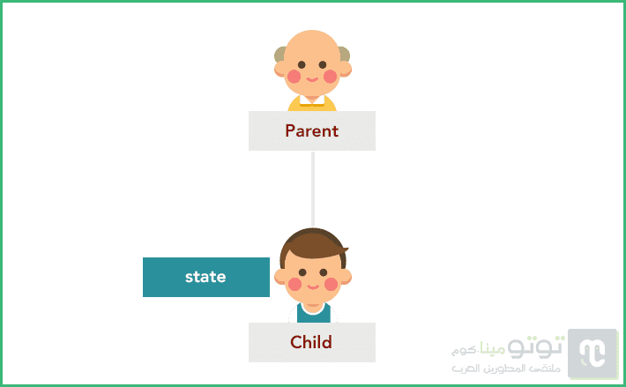
Why to use Redux?
We may be able to create complete applications using React.js, but we will soon discover the limitations of our options, especially when the complexity of the application increases and the interrelationships between its various components (components) increase.
For example, suppose we have a father component that has one son, and the latter has its own state. Note the following picture:

Slide 5
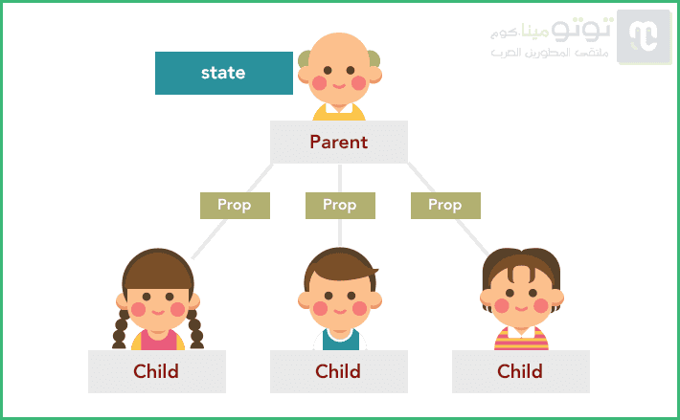
Why to use Redux?
When we started working on our project we didn't have a complete idea of ​​what the final application tree would look like (and it's really hard to tell), we thought that the parent component in the image would have an only son so we gave the latter a state of its own.
After a while, we realized that the father will have other children who need to access the state of the first child, which is impossible in React.js because the state is passed from top to bottom only by Props, and cannot be passed horizontally between components of the same level.
So the only solution will be to strip the first son of his state and raise it to the father so that the father can pass it again to the three sons in the form of Prop.

Slide 6
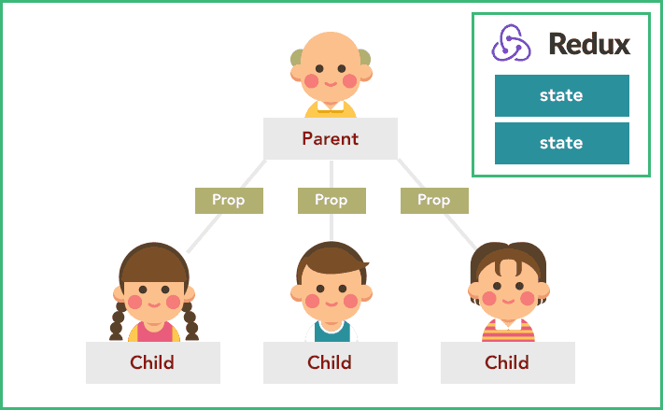
The Solution is: using Redux

Slide 7
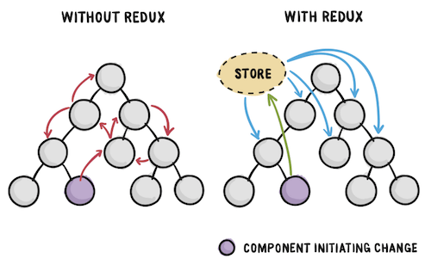
The Solution is: using Redux

Slide 8
Redux flow

Slide 9
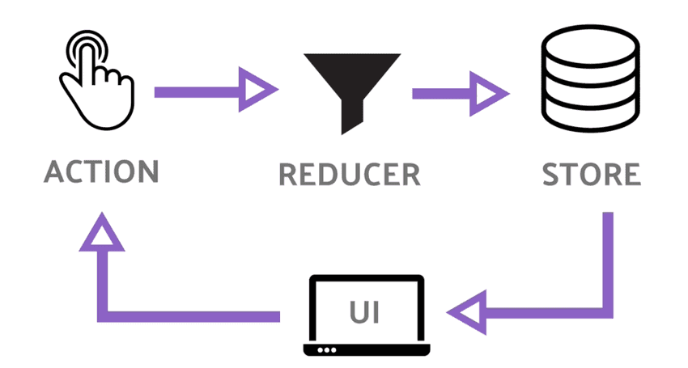
Redux flow
It all starts from the User Interface, where the user performs a specific behavior that translates in Redux into what is known as Action.
This action is received in pure functions known as Reducers. It usually accepts two arguments: the old state and the previously fired action, and returns the new state based on the information in the action.
The action is an object with two basic properties:
type : This property is mandatory and contains the type of action to be performed.
payload : This property is not mandatory - it can be called any name other than payload - and it contains the information that we want to send to the Store to be merged into the state of the application via Reducers.

Slide 10
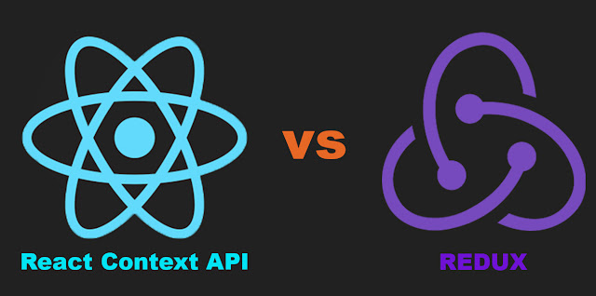
React Context API vs Redux
The Difference
In the react architecture if a react application is configured with Redux then there can be only one store. There are exceptional situations where multiple store can be considered. So if you look at the react component tree then redux has to seat on the top of that tree.
React Context API on the other hand , we can have multiple contexts across the application. It solves the problem of "Prop Drilling", whatever we have in the context something is updated that changed is passed to its children nodes via context an for achieving that we don't have to pass all the props unnecessarily.
When to use Redux
If we are working in an application which requires very frequent updates , like multiple updates per second then redux will be a better solution.
When to use Context API
When we are dealing with less frequent changes those data should be put in Context API , lets say if we are selecting theme for a website we can keep that data in context api, more over context api comes with react package we don't need to install any extra packages for that and its really easy to setup context api

Slide 11
React Context API vs Redux
Pros of using Redux
Redux is much powerful
As it is mentioned above redux internally uses context api, so it's much safer to use context api via react-redux than directly because if it changes the burden of updating code will be on react-redux not you
Context does not provide any features like Redux Devtools , which helps us to see state updates directly
We can have middleware to add centralised logic
Cons of using Redux
You need to install extra dependencies like redux, react-redux and a middleware (thunk , saga etc)
Installing extra dependencies increases bundle size
Initial setup takes little time, though very easy to use after these setup

Slide 12
React Context API vs Redux
Pros of using Context API
No prop drilling
No extra libraries needs to be installed
Less bundle size
Easy and quick setup
Cons of using Context API
Not a good solution for frequent update till date
No dev tools

Slide 13



Resources
https://www.tutomena.com/web-development/javascript/redux-library/
https://giters.com/Lazytangent/thunks
https://medium.com/@sumeet.ru/component-communication-in-react-without-redux-5006b7a6009d

