Slide 1


React Context

Slide 2
Objective
Component communication
What is the context.
When to Use Context?
How to use the context?
How to name context in React?
If-Else in JSX

Slide 3
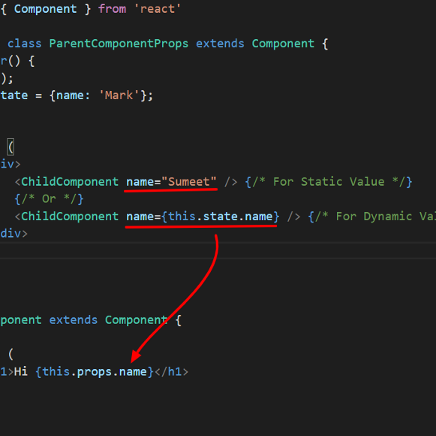
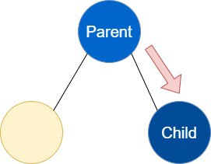
Component communication
React allows component communication in the following ways:
1. Parent to Child:
Using Props:

Slide 4
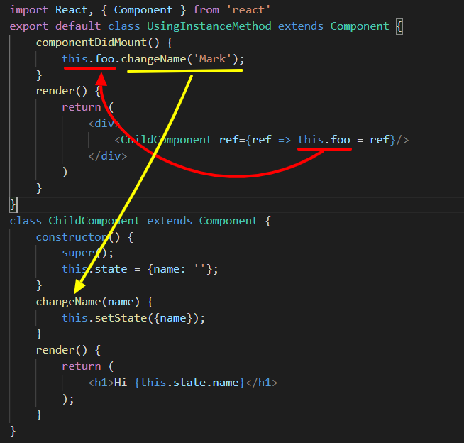
Component communication
Using the Instance method

Slide 5
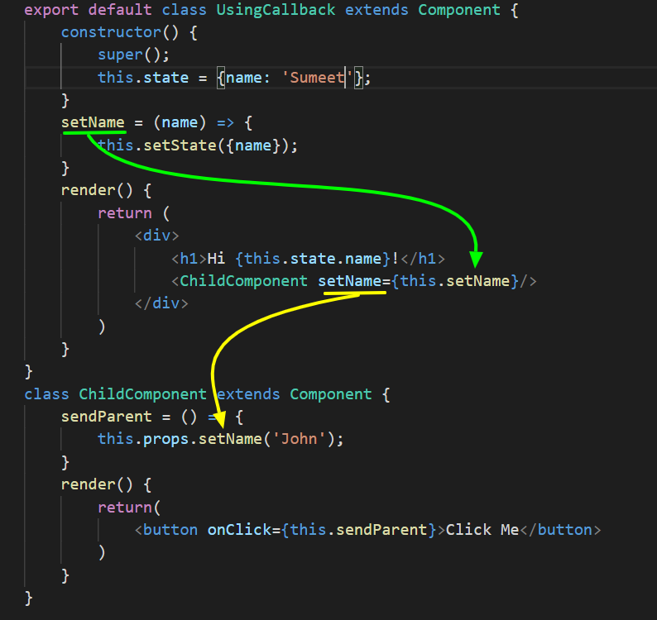
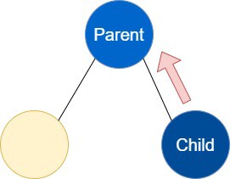
Component communication
2. Child to Parent
Create a callback method in parent and pass it to the child using props.
Child can call this method using “this.props.[yourCallbackName]” form child and pass data as argument.

Slide 6
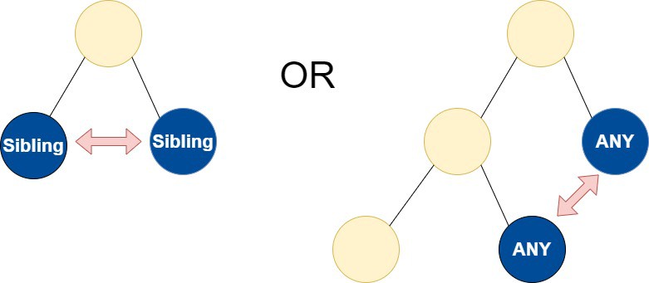
Component communication
3. Communication between Sibling / Any components:
React support one-way data flow. In order to send data from sibling 1 to sibling 2, you have to send data to parent and then from parent to sibling 2. This approach is a little complicated and difficult to maintain.

Slide 7
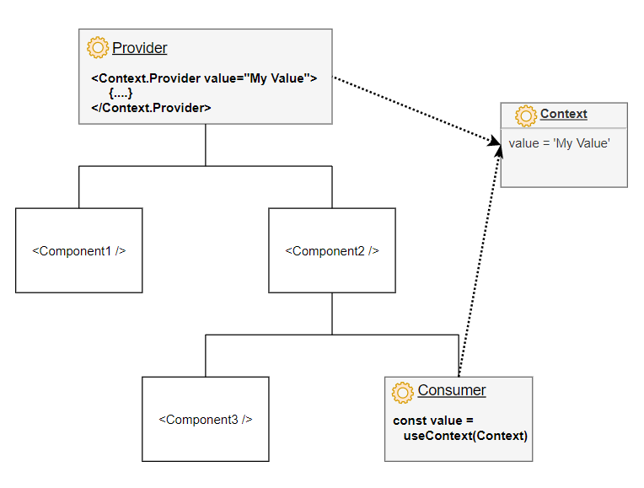
What is the Context?
Context provides a way to pass data through the component tree without having to pass props down manually at every level.
In a typical React application, data is passed top-down (parent to child) via props, but such usage can be cumbersome for certain types of props (e.g. locale preference, UI theme) that are required by many components within an application.
Context provides a way to share values like these between components without having to explicitly pass a prop through every level of the tree.

Slide 8
When to Use Context?
Context is designed to share data that can be considered “global” for a tree of React components, such as the current authenticated user, theme, or preferred language. For example, in the code below we manually thread through a “theme” prop in order to style the Button component:
Using context, we can avoid passing props through intermediate elements.
You can hold inside the context:
global state
theme
application configuration
authenticated user name
user settings
preferred language
a collection of services

Slide 9
How to use the context?
A. Creating the context
import { createContext } from 'react';
const Context = createContext('Default Value');

Slide 10
How to use the context?
B. Providing the context
Context.Provider component available on the context instance is used to provide the context to its child components, no matter how deep they are.
To set the value of context use the value prop available on the <Context.Provider value={value} />:function Main() {
const value = 'My Context Value';
return (
<Context.Provider value={value}>
<MyComponent />
</Context.Provider>
);
}

Slide 11
How to use the context?
C. Consuming the context
Consuming the context can be performed in 2 ways.
The first way, is to use the useContext(Context) React hook:
import { useContext } from 'react';
function MyComponent() {
const value = useContext(Context);
return <span>{value}</span>;
}
The hook returns the value of the context: value = useContext(Context). The hook also makes sure to re-render the component when the context value changes.

Slide 12
How to use the context?
C. Consuming the context
The second way is by using a render function supplied as a child to Context.Consumer special component available on the context instance:
function MyComponent() {
return (
<Context.Consumer>
{value => <span>{value}</span>}
</Context.Consumer>
);
}
Again, in case if the context value changes, <Context.Consumer> will re-render its render function.

Slide 13
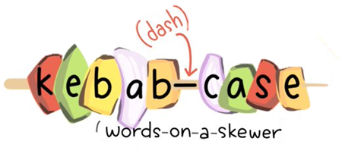
How to name context in React?

Slide 14
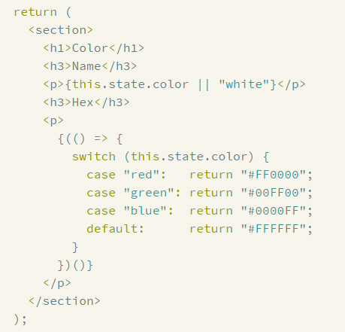
If-Else in JSX
if-else statements don't work inside JSX. This is because JSX is just syntactic sugar for function calls and object construction.
define immediately-invoked function expressions inside your JSX:

Slide 15



Resources
https://dmitripavlutin.com/react-context-and-usecontext/#1-how-to-use-the-context
https://reactjs.org/docs/context.html#when-to-use-context
https://ar.reactjs.org/docs/conditional-rendering.html
https://react-cn.github.io/react/tips/if-else-in-JSX.html
https://www.digitalocean.com/community/tutorials/7-ways-to-implement-conditional-rendering-in-react-applications

