Slide 1


CSS 1

Slide 2
Objective
Inline CSS
Internal CSS
External CSS
Box model and position

Slide 3
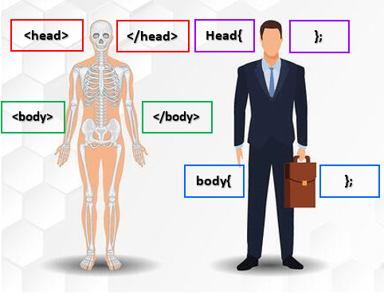
Introduction to CSS
HTML
CSS
Cascading Style Sheets (CSS): a language used to change the presentation and look of a particular document written in a markup language

Slide 4
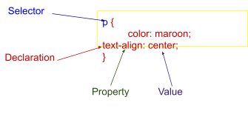
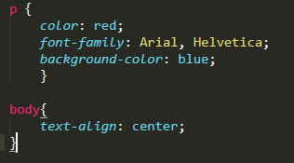
CSS Selectors
We have thus far only worked with one type of selector. Here the selector is always an element.
You can also use class and ID selectors
Class selector: .class
ID selector: #ID
Universal selector: *
Attributes
Pesudo classes
Combinators

Slide 5
Properties
properties are the styles you want to apply to the targeted element.
list properties
font properties
border properties
Other, here

Slide 6
Values
Values are written immediately after the colon that separates them from CSS properties.
text
integers
unit, measurement
URL
colours
auto, none, inherit

Slide 7
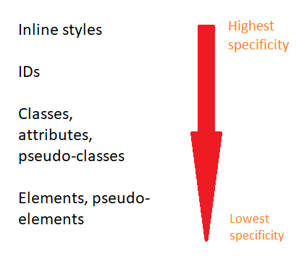
Cascade: Specificity
“Cascade” has to do with the order in which rules are applied
NB! The more specific a rule is, the higher its precedence

Slide 8
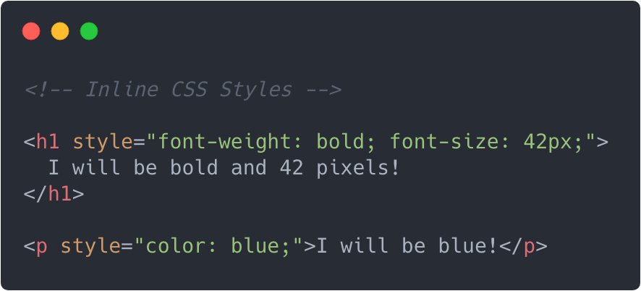
Inline Style
HTML elements are described using attributes and properties
To style an element individually by changing that element’s properties
Like all other attributes, the style attribute goes inside the element's beginning tag, right after the tag name. After specifying that you are changing the style attribute, you type =, and then, within double quotes, list the properties you want to change and after a colon specify the value for that property.

Slide 9
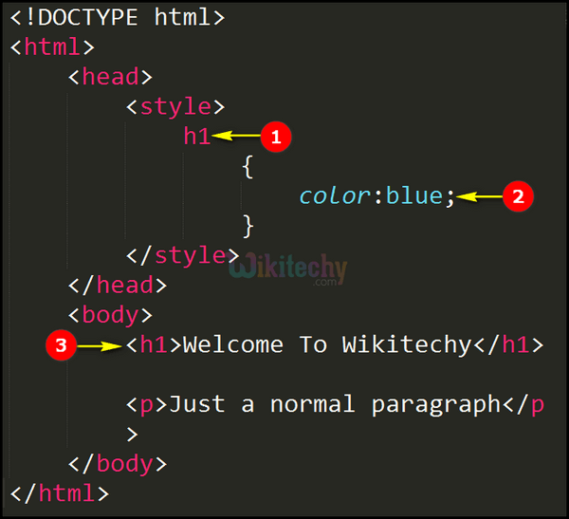
Internal CSS
The example shows how you can define a CSS rule in the head part of your HTML template. This is called internal CSS. The example below shows a CSS rule that will cause all h1 to be in the color blue.
CSS follows the following syntax: A style sheet consists of a selector and a declaration:
The selector indicates which HTML element you want to style
The declaration block contains one or more declarations separated by ;. A declaration always ends with a ; and is surrounded by {}. Each declaration includes a property and a value, separated by a :

Slide 10
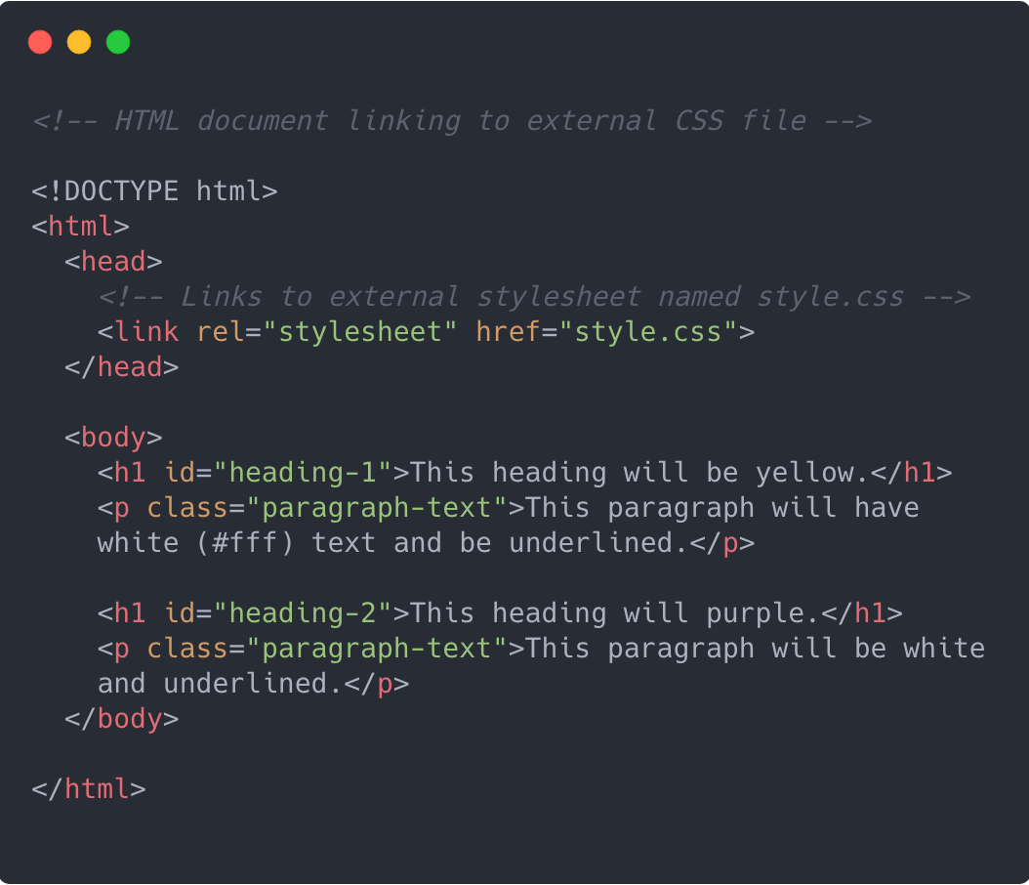
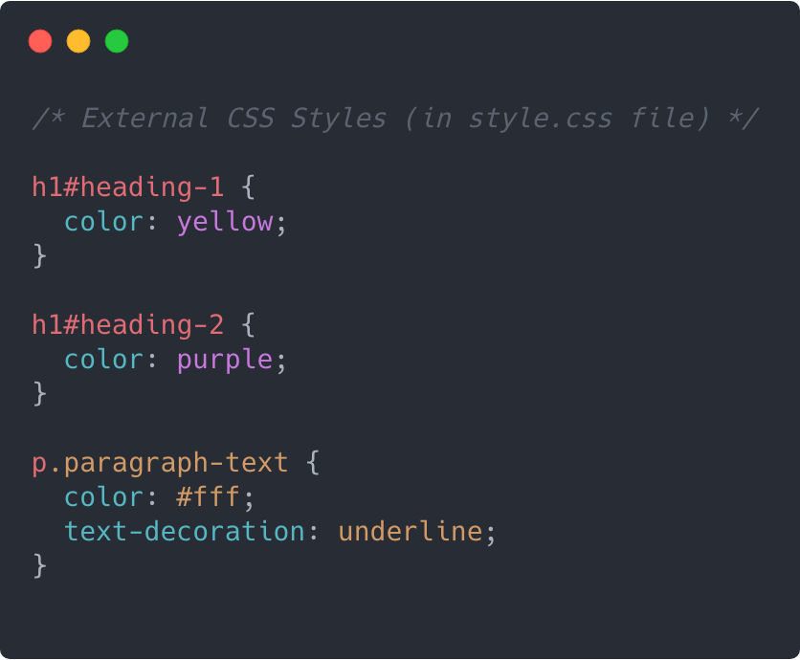
External CSS
If your website consists of many HTML files, you are likely to want to be able to apply the same style rules to all the web pages
Create a separate file with the extension .css
Within this file write all the style rules that you would like to specify
Link this external CSS file to all the HTML files in where you would like the style rules applied

Slide 11
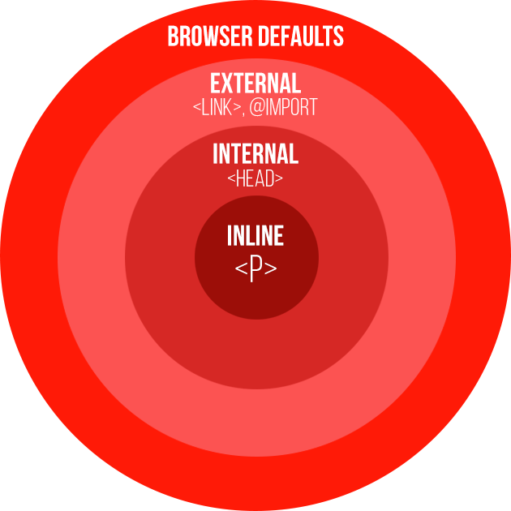
Cascade
You could use a combination of internal CSS (declared in the head of your HTML document) and inline style. How would the style rules apply?
Essentially, the closer to the element the style is the higher the precedence.
For example, if you had the internal CSS in your page but you wanted one paragraph to be styled differently from the rest, you would simply use inline style for that one paragraph and that would overwrite the rule specified by the internal CSS.

Slide 12
🤔Internal, External or Inline: Which is Best?
Generally, it is better to use external CSS wherever possible because:
Readability
Maintainability, If you wanted to update the look and feel of a website, this could easily be done by simply replacing the external CSS file if only external CSS is used for the website.
Easier to debug errors since all the CSS is in one place.

Slide 13

CSS Validator
You need to follow the rules for formatting your CSS rules exactly or unexpected errors will occur when you try to view your web page in the browser
Being able to identify and correct these errors becomes easier with time and is an extremely important skill to develop.
To help you identify errors in your CSS, use this helpful tool.

Slide 14
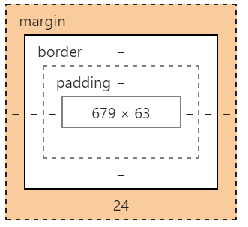
Box model
In CSS, the term "box model" is used when talking about design and layout.
There are 5 important properties that allow you to size and distribute your HTML elements:
Width.
Height.
Padding - Clears an area around the content. The padding is transparent.
Border - A border that goes around the padding and content.
Margin - Clears an area outside the border. The margin is transparent.

Slide 15
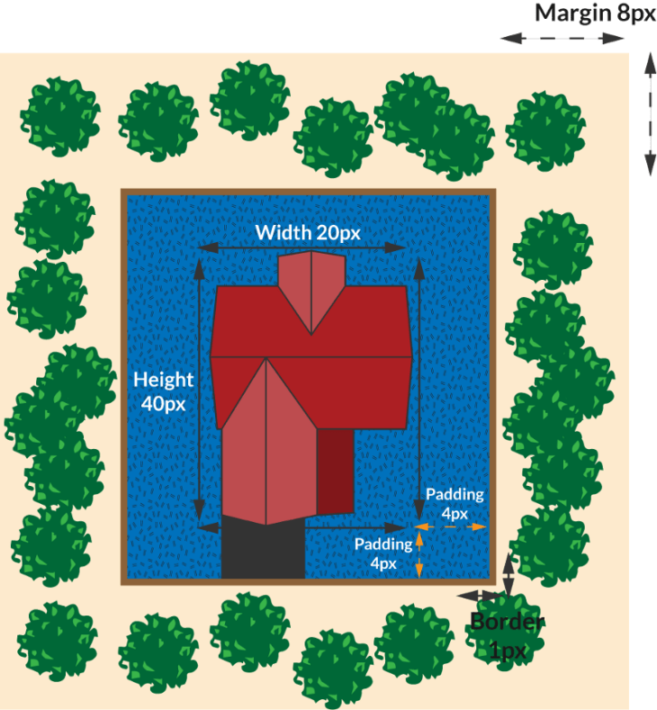
Box model
.myProperty{
width: 20px;
height: 40px;
padding: 4px;
border: 1px solid brown;
margin: 8px;
background-color:blue;
}

Slide 16
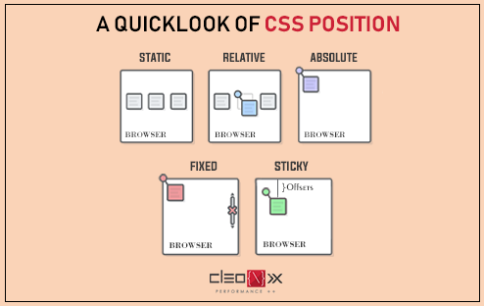
Position

Slide 17
Position
The position property specifies the type of positioning method used for an element.
There are five different position values:
Static (default), this will not effect by top, bottom, right, left.
Relative, setting the top, right, bottom, and left properties of a relatively-positioned element will cause it to be adjusted away from its normal position.
Absolute, change position based on it’s parent.
* If we want to change child position just in parent, we should give relative position for the parent.
Fixed, it will be in the same position always, EX: got to the top button.
Sticky, when you scroll and reach at specific point, the element will be sticky,
EX: when read an article and there is a links on the top, when scroll then links at the top will go down with you

Slide 18



Resources
CSS-Tricks
HTML Color Codes
Free Frontend
W3Schools Online Web Tutorials
CodeAnalogies | CSS,JavaScript Tutorials
Positioning
Interneting Is Hard | Web Development Tutorials For Complete Beginners
Learn CSS Layout

Slide 19
Summary
Inline CSS
Internal CSS
External CSS
Box model and position

