Slide 1


CSS III
Flexbox

Slide 2
Objective
Using CSS flexbox for layout

Slide 3
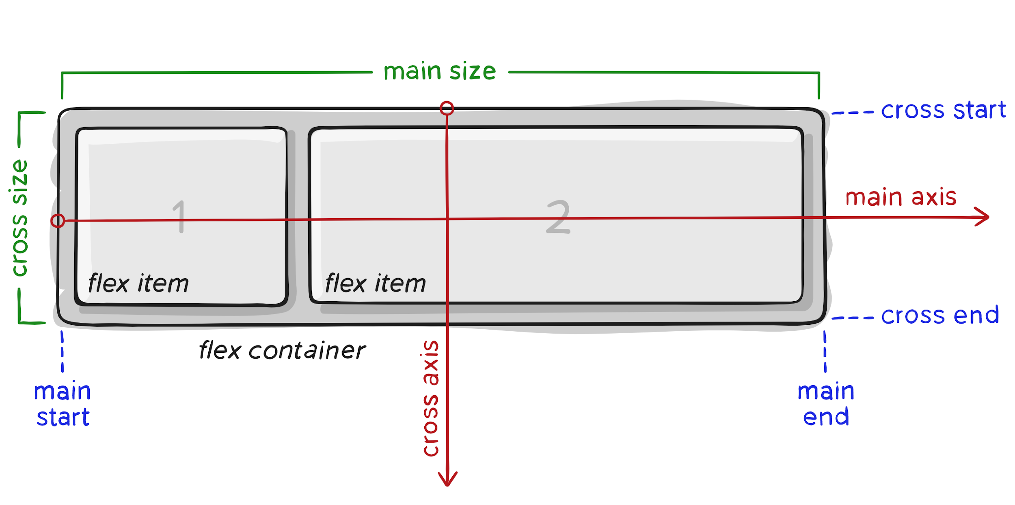
CSS Flexbox
The Flexible Box Layout Module, makes it easier to design flexible responsive layout structure without using float or positioning.

Slide 4
Dynamic Vertical and Horizontal Centering
Flexible Box enabled proper vertical alignment, so we can easily center a box.
Property | Value | Description
align-items | center | align our item on the cross axis, which in this case is the block axis running vertically.
justify-content | center | align the item on the main axis, which in this case the inline axis running horizontally.

Slide 5
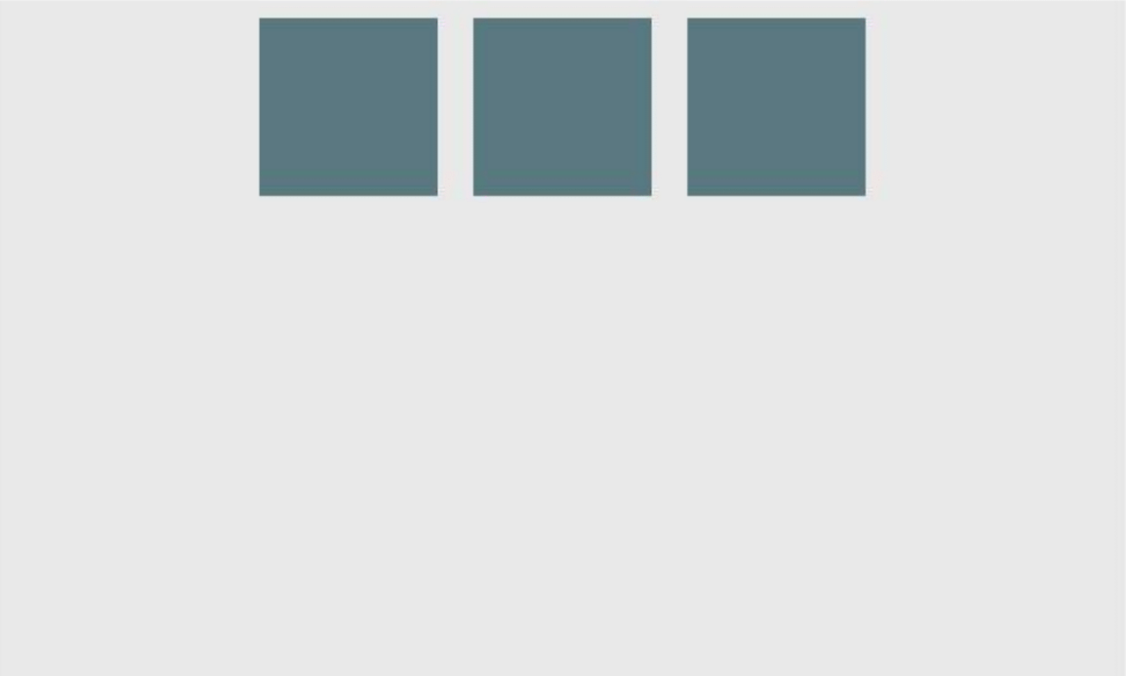
Example: justify-content: center on a horizontal flexbox
<div id="container">
<div></div>
<div></div>
<div></div>
</div>
div#container {
display: flex;
flex-direction: row;
justify-content: center; }

Slide 6

Example: justify-content: center on a vertical flexbox
div#container {
display: flex;
flex-direction: column;
justify-content: center; }

Slide 7
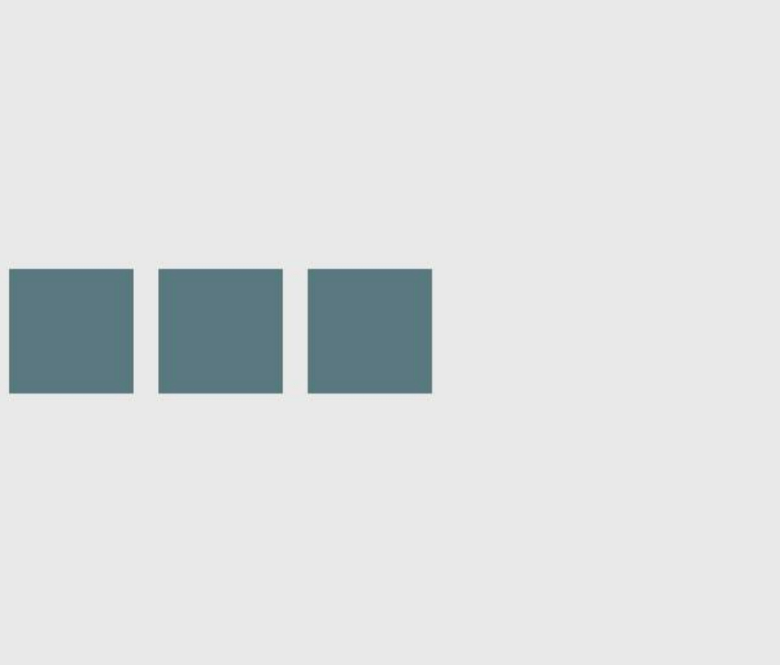
Example: align-content: center on a horizontal flexbox
div#container {
display: flex;
flex-direction: row;
align-item: center; }

Slide 8
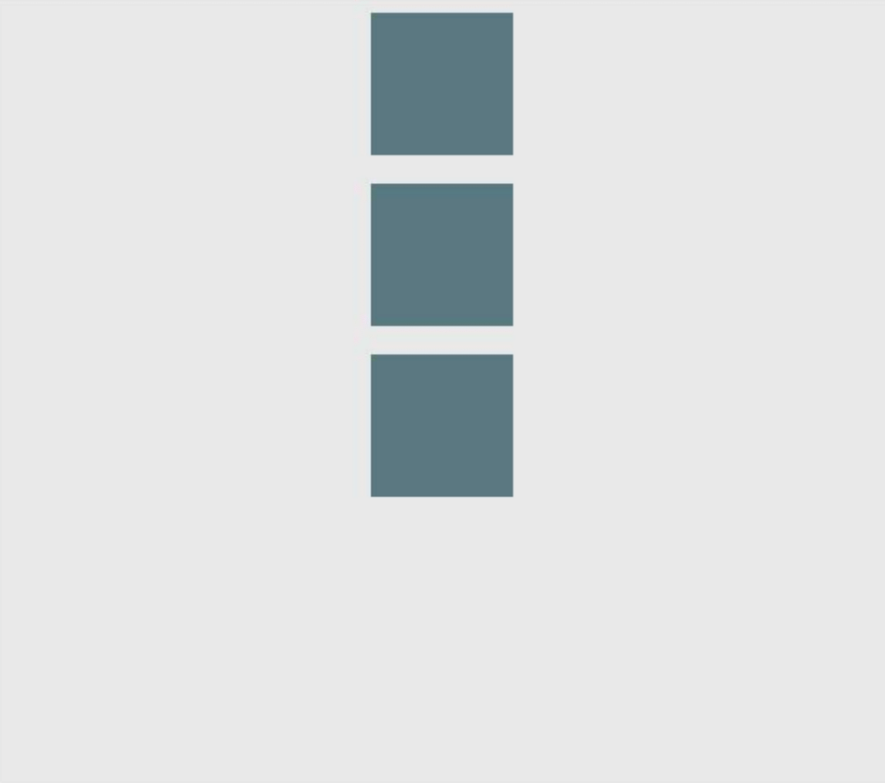
Example: align-content: center on a vertical flexbox
div#container {
display: flex;
flex-direction: column;
align-item: center; }

Slide 9

Example: Combination for centering both on horizontal flexbox
div#container {
display: flex;
flex-direction: row;
justify-content: center;
align-item: center; }

Slide 10
Example: Combination for centering both on vertical flexbox
div#container {
display: flex;
flex-direction: column;
justify-content: center;
align-item: center; }

Slide 11



Resources
Flexbox Defense
A Complete Guide to Flexbox
Flexbox Zombies
Flexbox Froggy - A game for learning CSS flexbox
A Complete Guide to Flexbox
https://github.com/sei-jed-10/W02D03-Responsive-Design

Slide 12
Summary
Using CSS flexbox for layout

