Slide 1


JWT

Slide 2

JWT
JWT (JSON Web Tokens) to use to authenticate users (login, register)
Authentication. JWT is mainly used for authentication. After a user logs into an application, the application will create a JWT and send it back to the user. Subsequent requests by the user will include the JWT. The token tells the server what routes, services, and resources the user is allowed to access

Slide 3
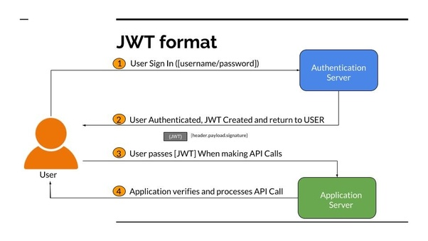
JWT Format
Image source: https://www.mongodb.com/blog/post/the-modern-application-stack-part-2-using-mongodb-with-nodejs
Notes:
As you can see in the image, we have a back-end server running Node.js. Using Express, we create an app.js module that handles all the routing and logic required for our web server. One of the things that the app must be able to do for data-driven apps, is to communicate with the database. We can write the code (e.g. db.js in the image above) for communicating with the database in two possible ways:
by writing code that uses MongoDB’s Node.js driver to interact with MongoDB directly or
by writing code that uses Mongoose. Mongoose is a library that sits on top of MongoDB’s Node.js driver and abstracts some of the boilerplate code for you.

Slide 4
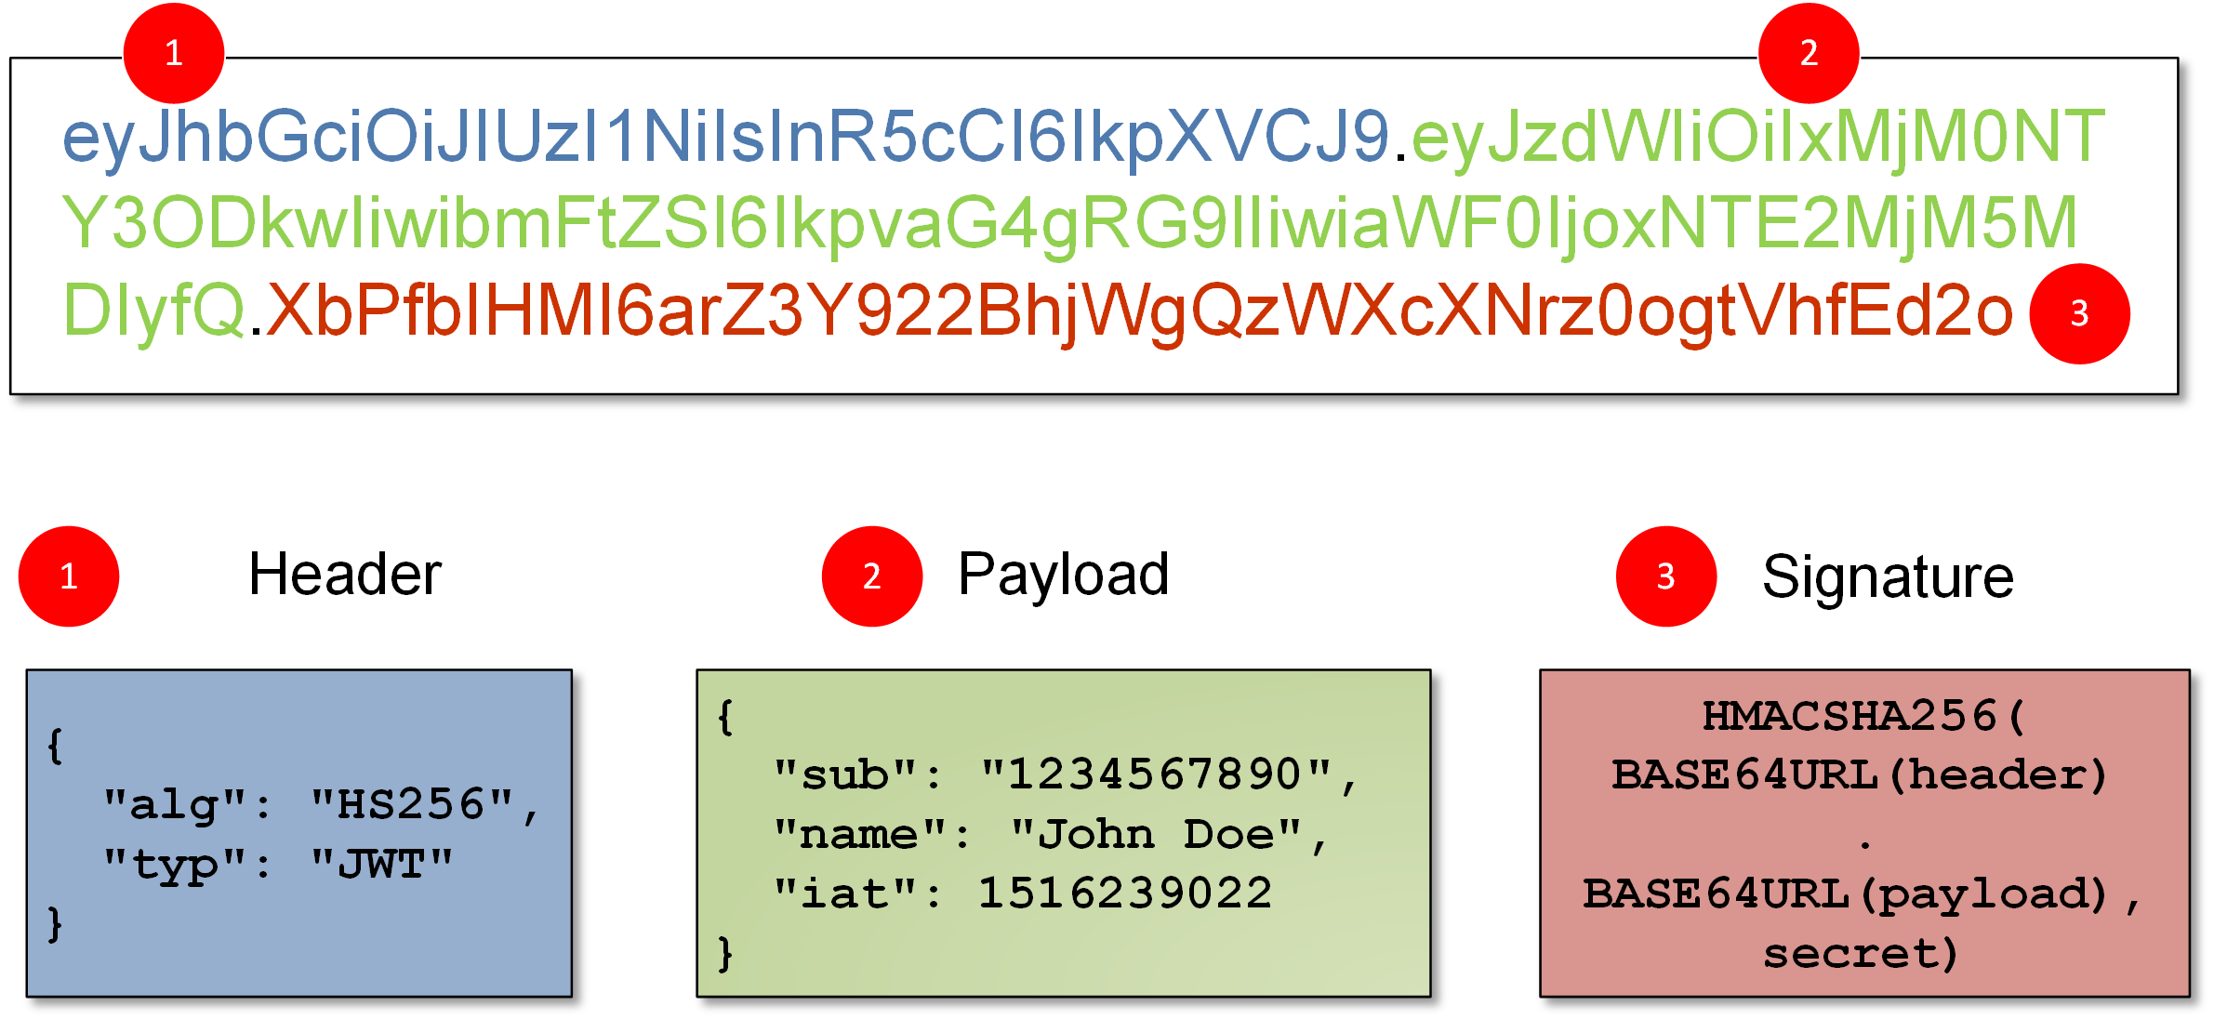
What is JWT token structure
Header:
The header typically consists of two parts: the type of the token, which is JWT, and the signing algorithm being used, such as HMAC, SHA256 or RSA.
Payload :
The second part of the token is the payload, which contains the claims ( which has 3 claims ), Some of them are: iss (issuer), exp (expiration time), sub (subject)

Slide 5
What is JWT token structure
Signature:
To create the signature part you have to take the encoded header, the encoded payload, a secret, the algorithm specified in the header, and sign that.
The signature is used to verify the message wasn't changed along the way, and, in the case of tokens signed with a private key, it can also verify that the sender of the JWT is who it says it is.

Slide 6
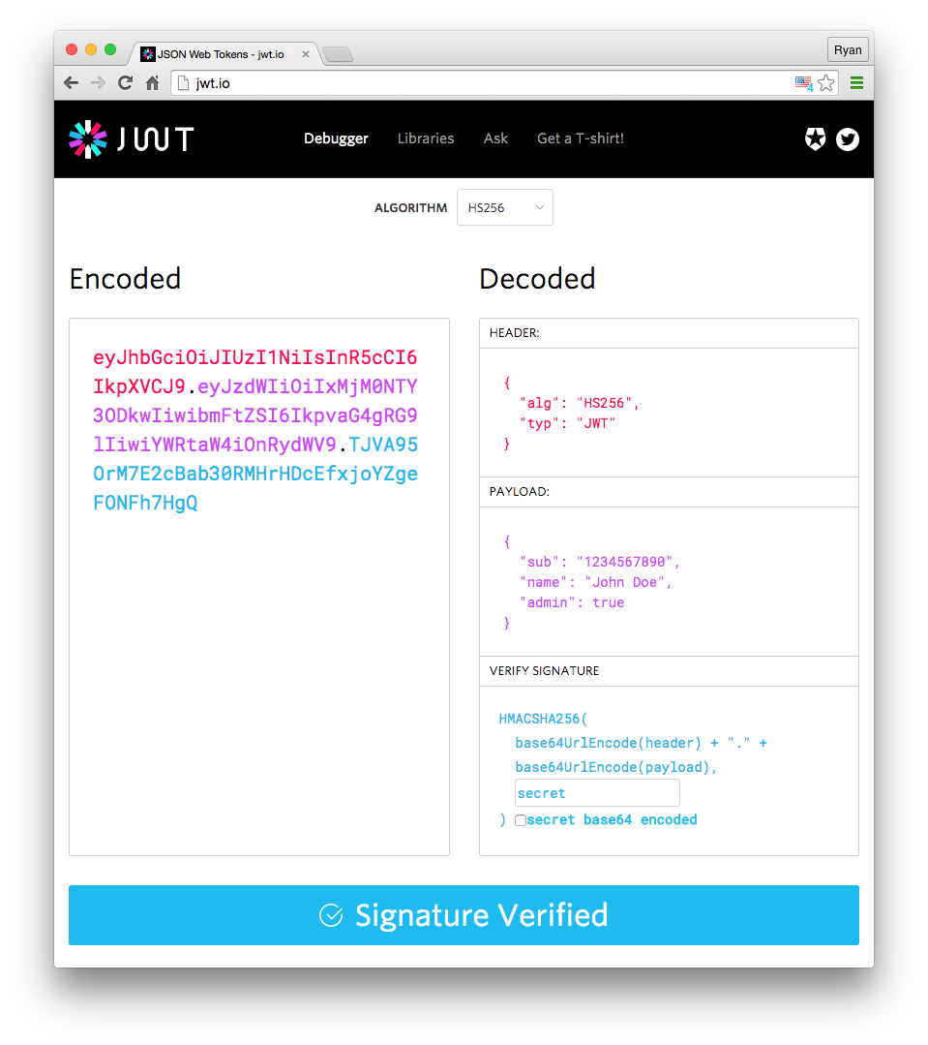
How the Token Looks
For more on JWT

Slide 7

install
npm I jsonwebtoken

Slide 8
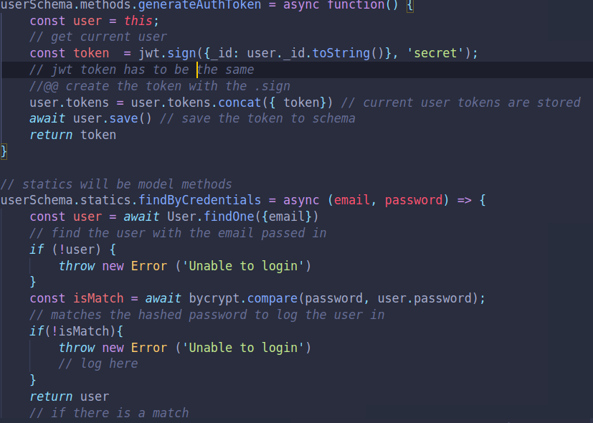
Working with JWT in User Model
We will need to make sure that we encrypt and secure users when they are logged into the app

Slide 9
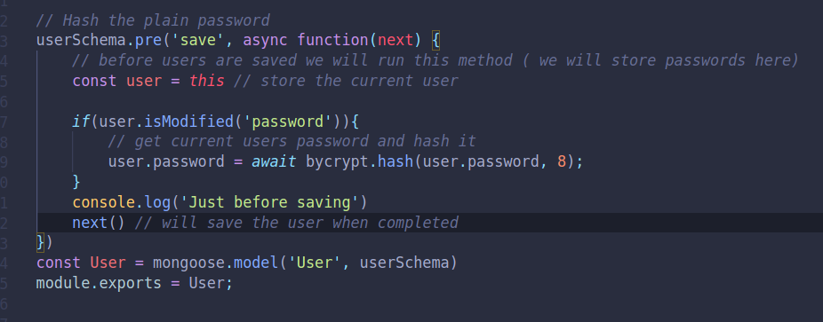
Working with JWT in User Model
Hashing the password for security
Notes:
// Will first add tests/dummy data
const mongoose = require('mongoose');
const Schema = mongoose.Schema;
const validator = require('validator');
const bycrypt = require('bcryptjs')
const jwt = require('jsonwebtoken')
const userSchema = new Schema({
name: {
type: String,
required: true,
trim: true
},
email: {
type: String,
required: true,
unique: true,
trim: true,
lowercase: true,
validate(value){
// more specific email validation
if(!validator.isEmail(value)){
throw new Error('email is not valid')
}
}
},
password: {
type:String,
required: true,
trim: true,
minlength: 7,
validate(value) {
if(value.toLowerCase().includes('password')){
// Not a good password
throw new Error('Password is not good')
} else {
console.log('Password is strong');
}
}
},
tokens: [{
token: {
type: String,
required: true
}
}]
})
userSchema.virtual('Todo', {
ref: 'Todos',
localField: '_id',
foreignField: 'owner',
})
userSchema.methods.generateAuthToken = async function() {
const user = this;
// get current user
const token = jwt.sign({_id: user._id.toString()}, 'secret');
// jwt token has to be the same
//@@ create the token with the .sign
user.tokens = user.tokens.concat({ token}) // current user tokens are stored
await user.save() // save the token to schema
return token
}
// statics will be model methods
userSchema.statics.findByCredentials = async (email, password) => {
const user = await User.findOne({email})
// find the user with the email passed in
if (!user) {
throw new Error ('Unable to login')
}
const isMatch = await bycrypt.compare(password, user.password);
// matches the hashed password to log the user in
if(!isMatch){
throw new Error ('Unable to login')
// log here
}
return user
// if there is a match
}
// Hash the plain password
userSchema.pre('save', async function(next) {
// before users are saved we will run this method ( we will store passwords here)
const user = this // store the current user
if(user.isModified('password')){
// get current users password and hash it
user.password = await bycrypt.hash(user.password, 8);
}
console.log('Just before saving')
next() // will save the user when completed
})
const User = mongoose.model('User', userSchema)
module.exports = User;

Slide 10
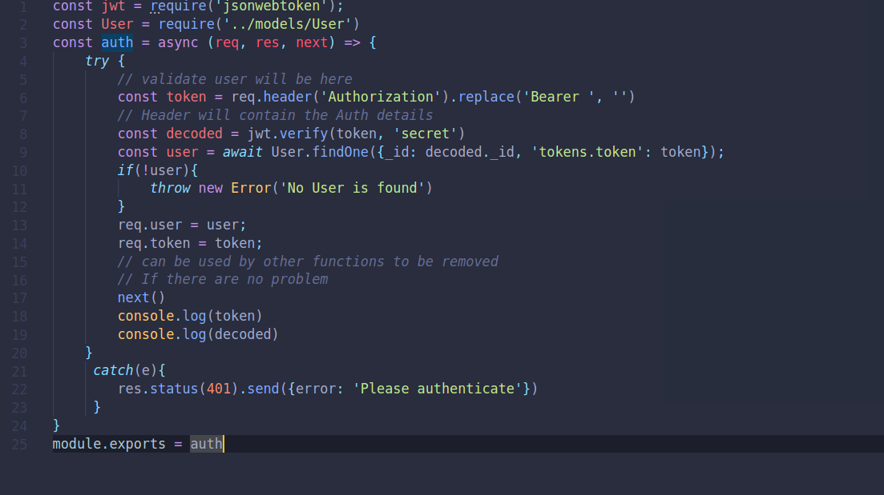
Authentication Middleware
Notes:
const jwt = require('jsonwebtoken');
const User = require('../models/User')
const auth = async (req, res, next) => {
try {
// validate user will be here
const token = req.header('Authorization').replace('Bearer ', '')
// Header will contain the Auth details
const decoded = jwt.verify(token, 'secret')
const user = await User.findOne({_id: decoded._id, 'tokens.token': token});
if(!user){
throw new Error('No User is found')
}
req.user = user;
req.token = token;
// can be used by other functions to be removed
// If there are no problem
next()
console.log(token)
console.log(decoded)
}
catch(e){
res.status(401).send({error: 'Please authenticate'})
}
}
module.exports = auth

Slide 11



Resources
Node.js API Authentication With JWT: https://www.youtube.com/watch?v=7nafaH9SddU
What are Json? : https://www.freecodecamp.org/news/what-are-json-web-tokens-jwt-auth-tutorial/

