Slide 1

Air Defense
JavaScript DOM & UI: Teamwork

Slide 2
Table of Contents
Game description
Game architecture
Model design
View design
Control design
Participants and organization
Additional requirements covered
Remaining issues

Slide 3
Game description
"Air Defense" is a game where you have to defense from continues incoming targets. The player have to fix the target with its radar and destroy it. Each destroyed target add points to the current player. If the target is not destroyed within some time, it destroys the player and game is over. The game keeps a scoreboard with top 5 players.

Slide 4
Architecture
Implemented completely in Vanilla JavaScript
No HTML tags used (only dynamic DOM manipulation)
OOP Model-View-Controller design
Different views (Canvas, SVG, animation)

Slide 5
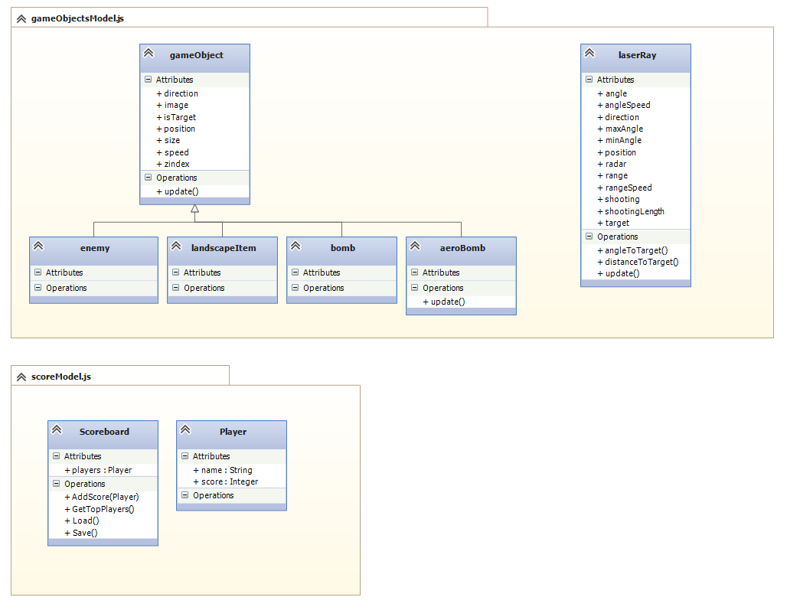
Model design

Slide 6
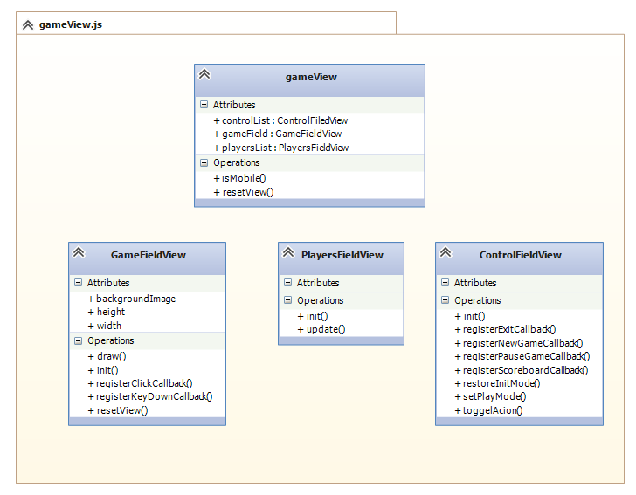
View Design

Slide 7
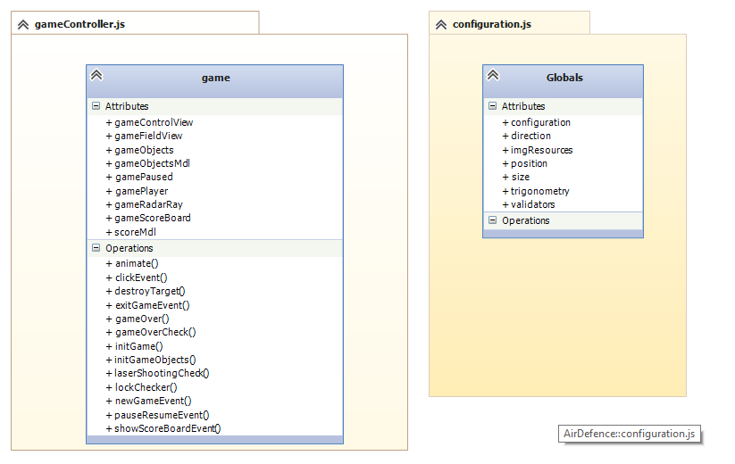
Control design

Slide 8
Participants
Atanas Georgiev – global architecture creation, project organization, control view implementation
Nikola Vushkov – proposed game idea, game laser logic and fight target implementation
Todor Dakov – SVG view implementation

Slide 9
Participants
Stanimira Kormeva – object models improvement and validation implementation, Unit Tests creation
Dimo Milkovski – canvas implementation, design and game responsiveness implementation
Valentin Rangelov – scoreboard and player model implementation. Documentation creation

Slide 10
Participants
All team members:
Proposed ideas
Continues code improvement
Shared global implementation
Very active skype communication
Helped in task planning and organization
Promised to drink beer after project defense ☺

Slide 11
Additional requirements
Git separated in issues and milestones with fixed dates (architecture complete, code complete, code freeze)
Different views combined in single game
OOP principles followed through the complete lifecycle
High quality code rules followed and continues code reviews done between all participants
Complete JS DOM implementation
Unit tests to prove correct game behavior

Slide 12

Remaining issues

