Slide 1

Air Defense
JavaScript DOM & UI: Teamwork

Slide 2
Table of Contents
Game description
Participants
Game Architecture
Model design
View design
Control design
Additional requirements covered

Slide 3
Game description

Slide 4
Participants

Slide 5
Architecture
Implemented completely in Vanilla JavaScript
No HTML tags used (only dynamic DOM manipulation)
No CSS used
OOP Model-View-Controller design
Different views (Canvas, SVG, animation)
High-quality code (naming, formatting, strong cohesion, loose coupling)
Unit tests
Stored and organized in GitHub

Slide 6
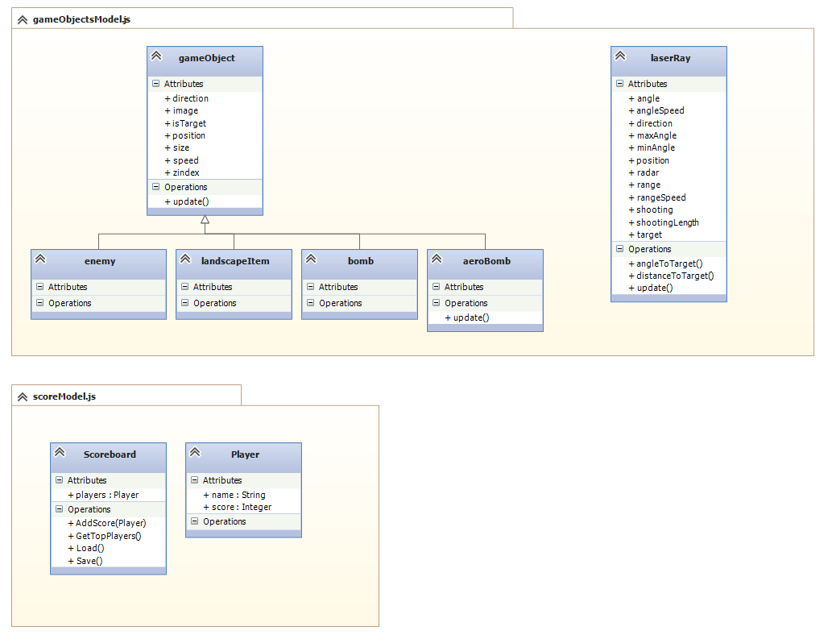
Model design

Slide 7
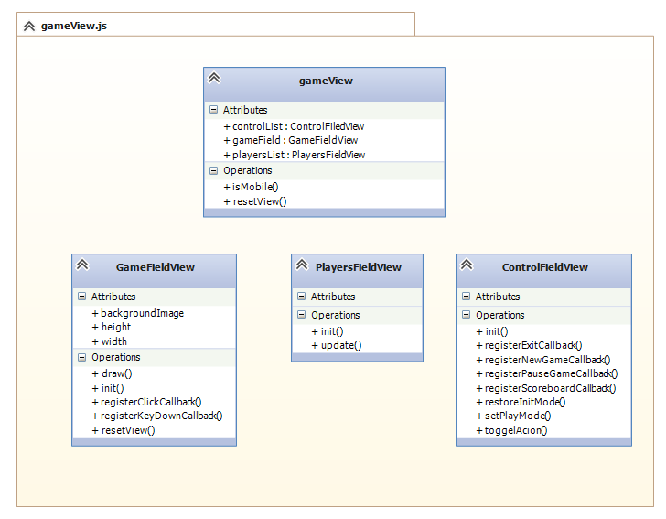
View Design

Slide 8
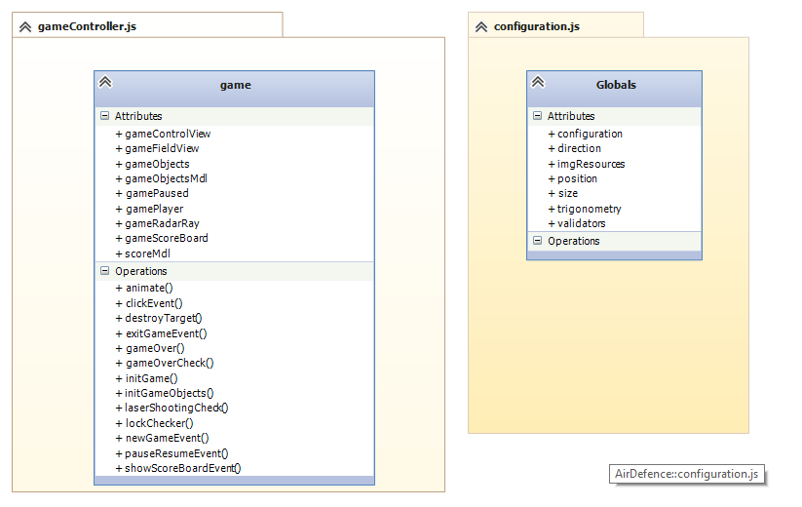
Control design

