Slide 1
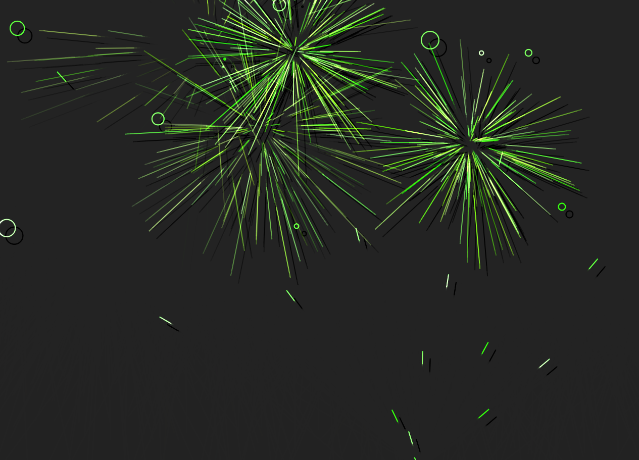
Fireworks JS
Team “Daegon”

Slide 2
Team members
Ventsislav Georgiev (ventsislav.georgiev)
Martin Georgiev (martingeorgiev)
Katalina Dimitrova (lina94)
Radi Shikerov (archangelmichael)
Tancho Mihov (tancho.mihov)
Ivan Tochev (ivan.tochev.18)

Slide 3
Project purpose
Our project is an independent library which can be loaded on a given website.
Its purpose is to make the web page fun and dynamic as it adds fireworks to its background.
The user can change the appearance and the effects of the fireworks.

Slide 4
Preset effects
Max Gravity
Inversed Gravity
Rocket Launcher
New Year
Distortion
Exploding Star
Super Nova and more…

Slide 5
Options 1/3
Greeting
Line
Width
Shadow
Timings
Timer Total
Timer Tick

Slide 6
Options 2/3
Firework
Trail
Speed
Acceleration
Target Radius
Show Target

Slide 7
Options 3/3
Particle
Trail
Count
Friction
Gravity
Alpha

Slide 8
Git Hub https://github.com/ JS2014TeamDaegon

