Slide 1
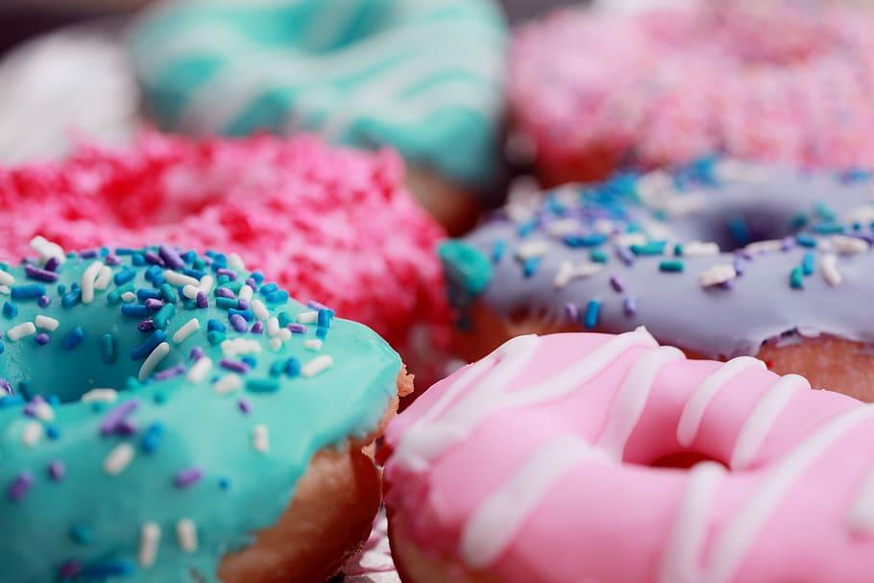
Best location in Toronto for a Vegan Donut Shop
Applied Data Science
Capstone Project
Jennifer S

Slide 2
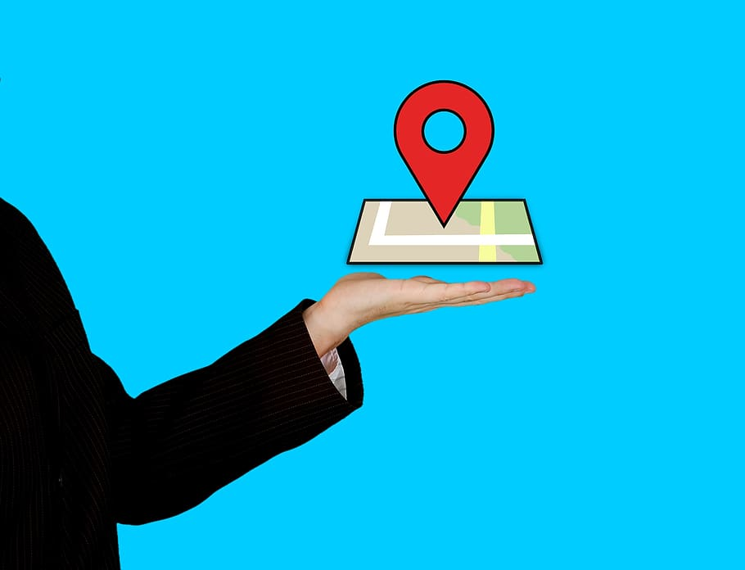
Introduction: Business Problem
A baker has found a niche market for vegan donuts. In searching for a location for their new shop, they have laid out two requirements.
The location should be in downtown Toronto.
The location should be near many existing vegan restaurants.

Slide 3
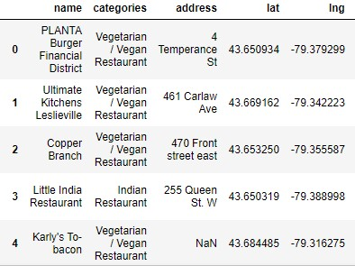
Data
The primary source for data was Foursquare.
This service was used to locate existing vegan restaurants and donut shops.
The final data set included 46 vegan and vegetarian restaurants.

Slide 4
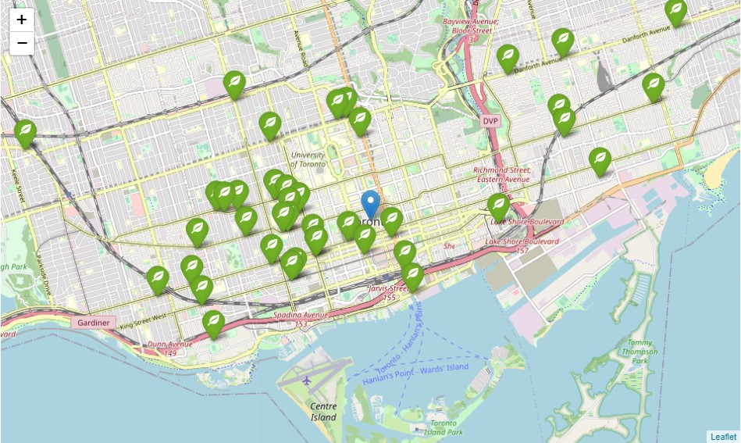
Methodology
I used Foursquare’s data of vegan and vegetarian restaurants to create a map of all the locations.

Slide 5
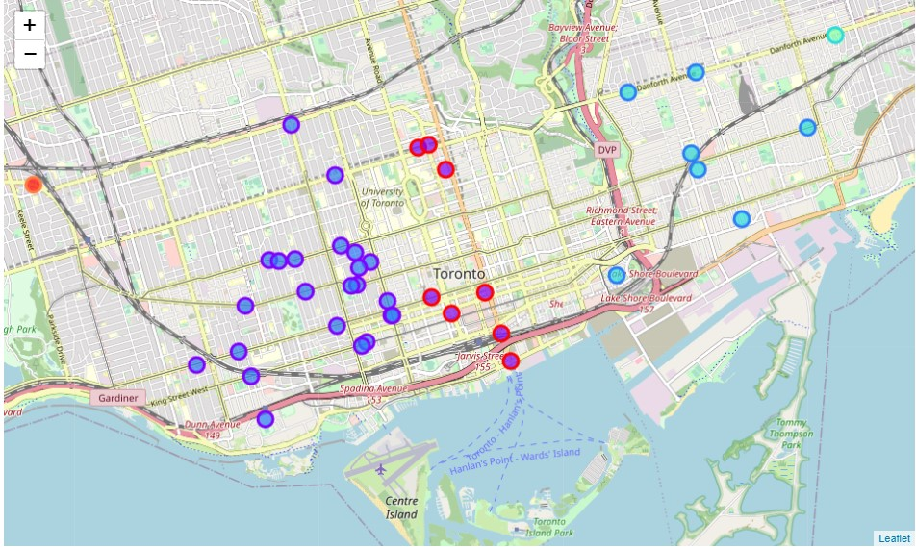
K-Means
I utilized Machine Learning method k-Means to locate the clusters of vegan restaurants.

Slide 6
Results
Cluster 2 provided a many vegan and vegetarian restaurants in a small geographical area.

Slide 7
Discussion and Conclusion
Cluster 2, indicated with purple map markers, provided a large number of vegan and vegetarian restaurants in a small geographical area within downtown Toronto. A new vegan donut shop should do well in this area with the increased foot traffic of vegan restaurant goers.

