Slide 1
git basics
Nicole Sultanum
JSC 270

Slide 2

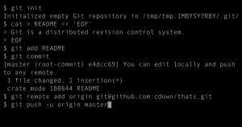
What is git?
https://git-scm.com/
Git is a version control system
It allows you to have multiple collaborators working on the same project at the same time
Various permission levels
Branches – i.e., versions of a project that can be worked on in parallel
Also useful for one-person projects, to keep track of different versions of a code base
Can be used to track ‘binary’ files, but is really meant to keep track of ‘text’ files – more specifically code files

Slide 3
What is github?
http://github.com/
Github is an online service to host git repositories
For teams: a centralized source to maintain a shared codebase
For one-person projects: maintain repository backups and facilitate working on a project from multiple machines
Although you can always create and maintain your own local git repository on your machine ☺
Every contributor of a repository gets a copy of the repo to work independently
Many other similar services, e.g. Bitbucket and Gitlab

Slide 4
The typical (and very simplified) anatomy of a github based project
“Contributors”
can push changes
Github repo
“Read-only”
permissions
All users that clone a repo
get a local copy of the repo
When ready to share with colleagues, push to github repo… if you have proper permissions!
Users can commit changes to their local repos without affecting other users
user repo

Slide 5
How to use Github Classroom

Slide 6
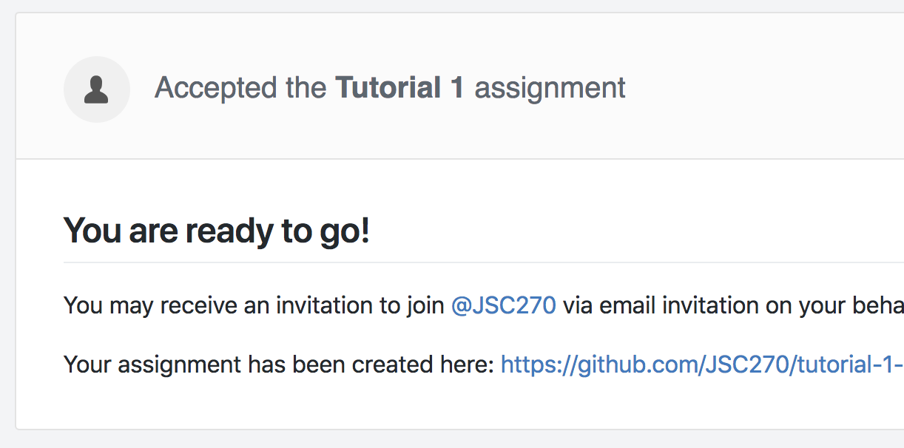
How to clone
a shared github repo
into a local repo
@ teach.cs
1. Navigate to the Tutorial 1 repository in Github Classroom and accept the assignment
classroom.github.com
https://classroom.github.com/a/VSn3JxaH
Your assignment has been created here:
https://github.com/JSC270/tutorial-1-<your-username>
2. Copy the link!

Slide 7
For Mac/Linux
How to clone
a shared github repo
into a local repo
@ teach.cs
3. Open the terminal, and log into your teach.cs account
ssh –l <your_username> teach.cs.toronto.edu
Access to your remote workspace at teach.cs. Param:
-l login (for more param options, check ssh -h)
4. (Optional) Create a folder to store course tutorials/assignments
mkdir jsc270
Creates a new folder in the current directory called jsc270
cd jsc270
Navigates to the newly created folder
Hint: Prior to creating the folder, make sure you have already navigated
to the directory you want that folder in.

Slide 8
For Mac/Linux
How to clone
a shared github repo
into a local repo
@ teach.cs
5. Clone the repository
git clone https://github.com/JSC270/tutorial-1-<your-username>
Cloning into 'tutorial-1-<your-username>'...
remote: Enumerating objects: 3, done.
remote: Counting objects: 100% (3/3), done.
remote: Total 3 (delta 0), reused 3 (delta 0), pack-reused 0
Unpacking objects: 100% (3/3), done.
6. Navigate to the repo folder and start working!
cd tutorial-1-<your-username>
jupyter notebook
Creates a jupyter notebook (or restarts, if it already exists) in the current folder

Slide 9
How to clone
a shared github repo
into a local repo
@ teach.cs
Useful commands:
mv <name_before> <name_after>
Renames <name_before> file or folder to <name_after>
cd ..
Navigates to the parent folder
ls
Lists files and folders in the current folder

Slide 10
How to modify
The local repo
1. Add files to be tracked
git add <my_notebook>.ipynb
A ”<my_notebook>.ipynb"
You can also ‘add’ more than one file at a time:
git add <file1> <file2> <file3>
...
2. Commit to save a set of changes on tracked files
git commit –a -m "<commit messsage>"
Commits ➔ save points
If that’s a state you might want to revert back to if you mess up in the near future, then commit.
-a auto stage all modified files
-m commit message
You should always write a little something to describe what changes you made at the time
Files that were not ‘added’ to the commit (via git add) will not be saved. Use –a to “stage” all modified (tracked) files, or git add manually if you want to control which files are staged in that commit.
M "<my_notebook>.ipynb"
M "<my_notebook>.ipynb"
Unstaged
Staged

Slide 11
How to modify
The local repo
Useful commands:
git status
Show status of repo, including modified and untracked files
git status -s
A summarized version of the above
git checkout <filename>
Loads most recent committed version – i.e., discard local uncommited changes.
Use with caution!

Slide 12
Working with the
central repo
Push your local changes to the central repository
git push
Push your local changes to the repo from where you cloned your local repo, into a default “master” branch

Slide 13
Working with
collaborators
Retrieve changes from your collaborators, merge, then commit
git pull
Pulls your collaborators’ changes to your local repo, and tries to merge them with your local changes
If two or more collaborators change the same parts in a file, conflicts will show up. You need to fix these before continuing. Git will modify these files to indicate where conflicts appeared.
git commit –a –m “<merge msg>”
Create a “checkpoint” for your local repo plus your collaborator’s changes
git push
Save the merged version to the central repo

Slide 14
If you are ready for more….
git documentation
https://git-scm.com/doc
nice git tutorials
https://try.github.io/
https://www.atlassian.com/git/tutorials

