Slide 1
Diabetes Risk Prediction by Patient Health Indicators
MIS 401 · BUSINESS INTELLIGENCE & ANALYTICS
FINAL PROJECT
Comparing logistic regression, KNN, and a tuned decision tree on 253,680 patients.
Joshua Ermert
UCI x CDC
Dr. Xialu Liu · 7 May 2026
Notes:
## Slide 1 — Title
**Main point:**
Introduce the project quickly and confidently.
**Say naturally:**
Hi, I’m Joshua Ermert, and my final project topic is *Diabetes Risk Prediction by Patient Health Indicators*.
The goal was to compare logistic regression, KNN, and a tuned decision tree on CDC/UCI health-indicator data to see how well they classify **NoDiabetes, Prediabetes, and Diabetes**.
This topic is personally meaningful because Type II diabetes has affected my family, and professionally relevant because I’m interested in healthcare analytics and business intelligence.
**Transition:**
I’ll start with why this topic matters.
---

Slide 2
02 — CONTEXT
Why This Matters
“
Public-health weight
Diabetes is a leading U.S. public-health condition with high cost and uneven distribution.
Identify which patient indicators predict diabetes — and turn that signal into earlier screening and targeted prevention.
Three classifiers, one comparison
Multinomial logistic regression, KNN, and a tuned decision tree applied to the same 70/30 split.
Personal stake
Type II diabetes in the family, plus prior biopharma BI/AI analytics work — applied analytics in a real healthcare context.
The driving question for this project.
Diabetes Risk Prediction by Patient Health Indicators · J. Ermert · MIS 401
2 / 10
Notes:
## Slide 2 — Why This Matters
**Main point:**
This project is about turning health survey data into useful screening insight.
**Say naturally:**
This slide frames the reason for the project: identifying which patient indicators predict diabetes and turning that signal into earlier screening and prevention.
Diabetes matters because it affects long-term health, healthcare cost, and quality of life.
From an analytics perspective, the question is not just whether a model can make predictions. The real question is whether those predictions can help identify risk earlier and support better prevention.
For this project, I compared three methods from class — logistic regression, KNN, and a decision tree — on the same dataset to see which indicators carried the strongest signal.
**Transition:**
The data used for that comparison comes from the CDC diabetes health indicators dataset.
---

Slide 3
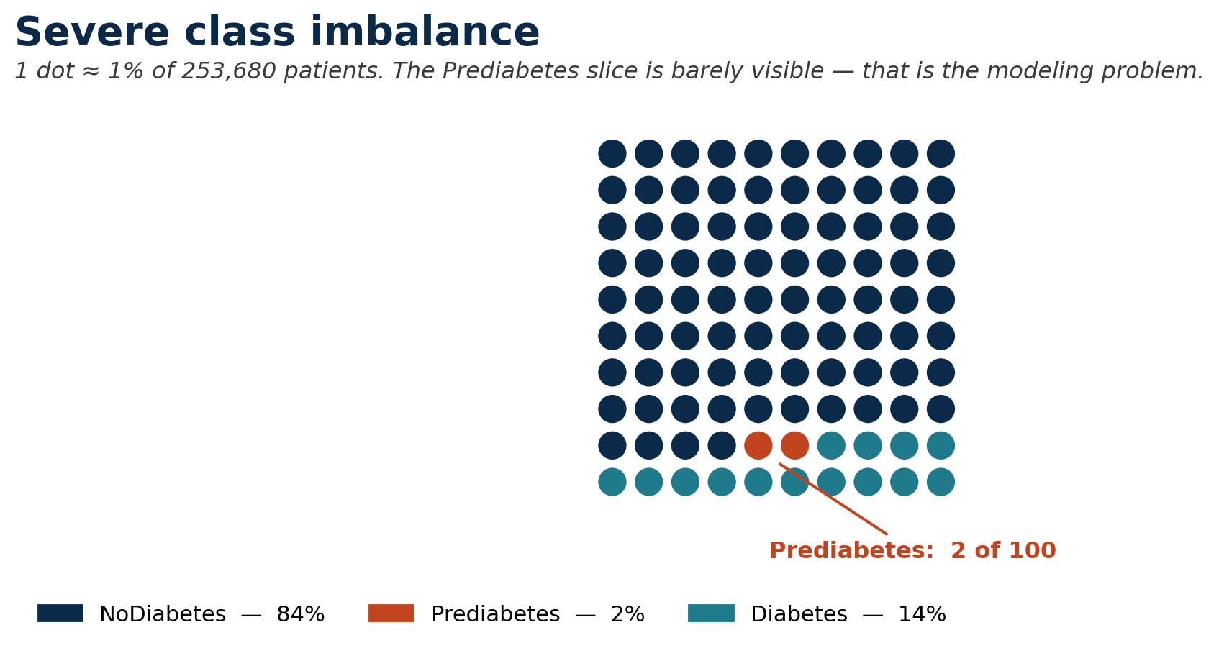
03 — DATA
Dataset and Response Variable
SOURCE
CDC Diabetes Health Indicators (UCI ML Repository, BRFSS-derived)
OBSERVATIONS
253,680
PREDICTORS
21 + 1 response (Diabetes_012)
MISSING VALUES
None
KEY TAKEAWAY
84.24 / 1.83 / 13.93 — class imbalance is the single most important property of this dataset.
Diabetes Risk Prediction by Patient Health Indicators · J. Ermert · MIS 401
3 / 10
Notes:
## Slide 3 — Dataset and Response Variable
**Main point:**
The dataset is large, but heavily imbalanced.
**Say naturally:**
This slide gives the basic dataset structure: **253,680 observations**, **21 predictors**, and no missing values.
The response variable has three classes: **NoDiabetes, Prediabetes, and Diabetes**.
I chose to keep Prediabetes as its own class instead of simplifying the project into diabetes versus no diabetes. I wanted the analysis to stay realistic, because in real life the transition from no diabetes, to prediabetes, to diabetes is where prevention can happen.
That was also personally meaningful to me because Type II diabetes affected my father before he realized he was pre-diabetic.
The visual on this slide is meant to make the imbalance obvious: most of the dataset is NoDiabetes, Prediabetes is a very small slice, and Diabetes is smaller than NoDiabetes but still clinically important.
The tradeoff is that this made the task harder. Prediabetes is only about **1.8%** of the data, while NoDiabetes is about **84.2%**.
**Transition:**
That imbalance becomes one of the most important themes in the results.
---

Slide 4
04 — PREDICTORS
Variables Used
CATEGORICAL / BINARY
CONTINUOUS / ORDINAL
14 predictors
7 predictors
• HighBP
• HighChol
• CholCheck
• Smoker
• Stroke
• HeartDiseaseorAttack
• PhysActivity
• Fruits
• Veggies
• HvyAlcoholConsump
• AnyHealthcare
• NoDocbcCost
• DiffWalk
• Sex
• BMI
• GenHlth (1 excellent – 5 poor)
• MentHlth (days in past 30)
• PhysHlth (days in past 30)
• Age (1 youngest – 13 oldest)
• Education
• Income
Categorical predictors → factors for logit + tree. KNN → numeric encoding with z-score scaling fit on the training set.
Diabetes Risk Prediction by Patient Health Indicators · J. Ermert · MIS 401
4 / 10
Notes:
## Slide 4 — Variables Used
**Main point:**
The predictors combine health, lifestyle, and demographic indicators.
**Say naturally:**
This slide shows the 21 predictors used in the models.
On the left are the binary or categorical predictors, like high blood pressure, high cholesterol, smoking, physical activity, difficulty walking, and sex.
On the right are the continuous or ordinal predictors, like BMI, general health, physical health days, mental health days, age, education, and income.
For logistic regression and the decision tree, I treated categorical predictors as factors. For KNN, I used numeric encoding and z-score scaling because KNN is distance-based and can be distorted by variables on different scales.
**Transition:**
Before fitting the models, I first looked at the exploratory patterns in the data.
---

Slide 5
05 — EDA
Preliminary Analysis — EDA highlights
BMI
↑
Age
↑
GenHlth
↑
Median rises 27 → 30 → 31
Median age category 8 → 9 → 10
Markedly worse self-rated health in Diabetes group
magnitude
magnitude
magnitude
HighBP
↑
HighChol
↑
PhysActivity
↓
~3× more common in Diabetes group than NoDiabetes
Same direction at slightly smaller magnitude
Lower in Diabetes group; Sex effect weaker
magnitude
magnitude
magnitude
STRONGEST EARLY SIGNALS
HighBP · GenHlth · HighChol · BMI · Age
These five predictors should reappear in the modeling output. Hold onto them — they show up again on slide 9.
Diabetes Risk Prediction by Patient Health Indicators · J. Ermert · MIS 401
5 / 10
Notes:
## Slide 5 — Preliminary Analysis / EDA
**Main point:**
The strongest early signals were HighBP, GenHlth, HighChol, BMI, and Age.
**Say naturally:**
This slide summarizes the Step 2 EDA visually. The arrows show the direction of the relationship, and the magnitude dots show which patterns were strongest.
BMI increased across the diabetes classes, and age category also moved upward from NoDiabetes to Diabetes.
General health was noticeably worse in the Diabetes group.
High blood pressure was one of the strongest visual signals, and high cholesterol showed the same direction.
Physical activity moved the opposite way: people reporting physical activity tended to have a lower observed Diabetes rate.
The bottom of the slide is the main takeaway: the strongest early signals were **HighBP, GenHlth, HighChol, BMI, and Age**.
**Transition:**
Those same signals show up again after the models are trained.
---
---

Slide 6
06 — MODELS
Methods
Same split for all three models · set.seed(401) · 70/30 · Train n = 177,576 Test n = 76,104
STATISTICAL
INSTANCE-BASED
RULE-BASED
Multinomial Logistic Regression
K-Nearest Neighbors
Decision Tree
nnet::multinom
class::knn
rpart (method = "class")
Factor-coded predictors. Interpretable coefficients per non-reference class (Prediabetes, Diabetes vs. NoDiabetes).
z-score scaling fit on training set. Tuned k ∈ {3, 5, 7, 9}; reports best K.
Default cp = 0.01 refused to split. Tuned to cp = 0.001, minsplit = 2000, minbucket = 1000, maxdepth = 5 (honest tuning, not deep optimization).
Evaluation: confusion matrix + overall test accuracy + decision-tree variable importance.
Diabetes Risk Prediction by Patient Health Indicators · J. Ermert · MIS 401
6 / 10
Notes:
## Slide 6 — Methods
**Main point:**
All three models used the same split, so the comparison is fair.
**Say naturally:**
This slide shows the three modeling methods and keeps the setup consistent.
I used the same **70/30 train-test split** for all three models, with `set.seed(401)`. That gave me **177,576 training rows** and **76,104 testing rows**.
The first model was multinomial logistic regression, which fits the three-class response directly.
The second was KNN, tuned over **k = 3, 5, 7, and 9**.
The third was a decision tree. One important thing happened there: the default tree did not split because the majority class was already so dominant. So I tuned the tree conservatively with `cp = 0.001`, `minsplit = 2000`, `minbucket = 1000`, and `maxdepth = 5`.
That produced a shallow, interpretable tree without pretending this was a deep optimization process.
**Transition:**
Here is how the models compared on the test set.
---

Slide 7
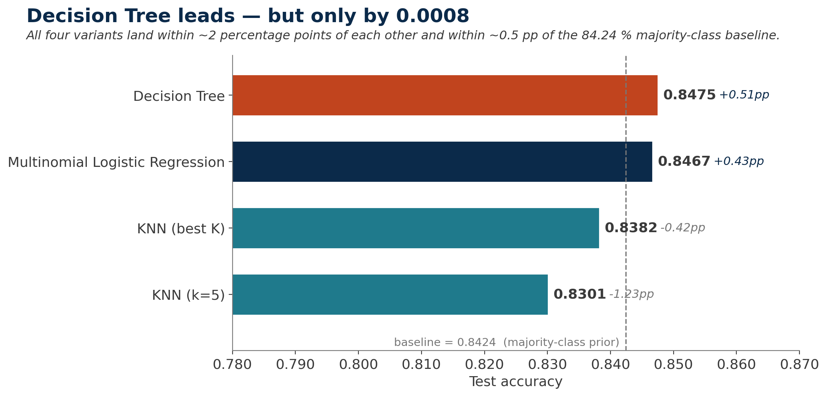
07 — RESULTS
Model Comparison — Test accuracy
HEADLINE
0.8475
Decision Tree wins —
by 0.0008 over logit
GAP FROM BASELINE
Tree
+0.51 pp
Logit
+0.43 pp
KNN k=9
−0.42 pp
KNN k=5
−1.23 pp
Accuracy alone is misleading on this dataset — per-class evidence on slide 9.
Diabetes Risk Prediction by Patient Health Indicators · J. Ermert · MIS 401
7 / 10
Notes:
## Slide 7 — Model Comparison
**Main point:**
The Decision Tree wins by raw accuracy, but only narrowly.
**Say naturally:**
This slide shows the model accuracy comparison.
The tuned Decision Tree had the highest test accuracy at **0.8475**.
Logistic regression was extremely close at **0.8467**.
The best KNN model was **k = 9**, with accuracy of **0.8382**, and the initial KNN model at **k = 5** had accuracy of **0.8301**.
So if we only look at raw accuracy, the Decision Tree wins.
But the right-side panel is the important part: it shows that even the winning tree is only about **+0.51 percentage points** above the majority-class baseline.
That means accuracy alone is not enough to understand model quality here.
**Transition:**
To understand what the tree is actually doing, we need to look at its structure.
---

Slide 8
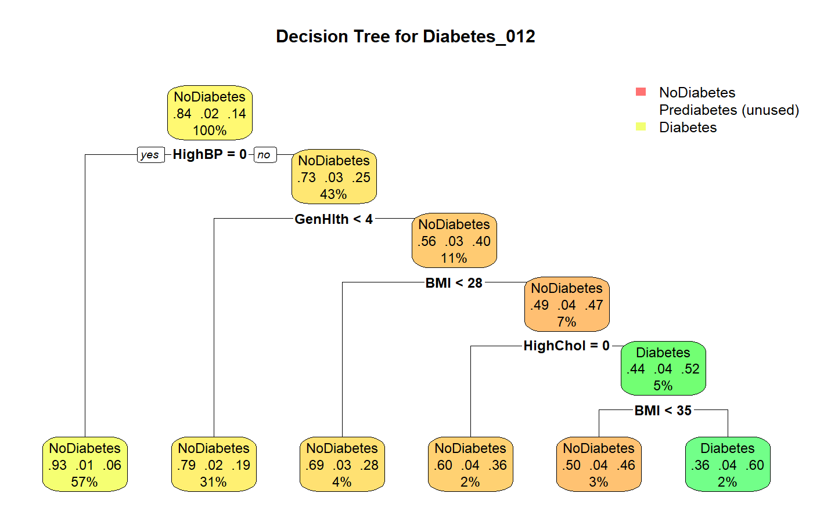
08 — TREE STRUCTURE
Decision Tree — Structure
One Diabetes-predicting leaf: HighBP=1 ∧ GenHlth ≥ 4 ∧ BMI ≥ 28 ∧ HighChol=1 ∧ BMI ≥ 35 → n = 3,961, ~60 % Diabetes.
Diabetes Risk Prediction by Patient Health Indicators · J. Ermert · MIS 401
8 / 10
Notes:
## Slide 8 — Decision Tree Structure
**Main point:**
The tree creates one large low-risk branch and one small high-risk Diabetes leaf.
**Say naturally:**
Reading the tree from top to bottom, the first split is **HighBP**, or high blood pressure.
That first split immediately separates a large lower-risk group from the rest of the sample.
When HighBP equals 0, the model places patients into a large low-risk branch. That branch has about **101,437 patients** and only about a **6% Diabetes rate**.
On the high blood pressure side, the tree continues splitting by general health, BMI, and high cholesterol.
The tree only predicts Diabetes in one final leaf: patients with high blood pressure, poor general health, BMI at least 28, high cholesterol, and BMI at least 35.
That group has **3,961 patients**, with about a **60% Diabetes probability**.
So the tree is not a broad screening tool, but it is useful for identifying a concentrated high-risk group.
**Transition:**
The variable importance tells the same story from another angle.
---

Slide 9
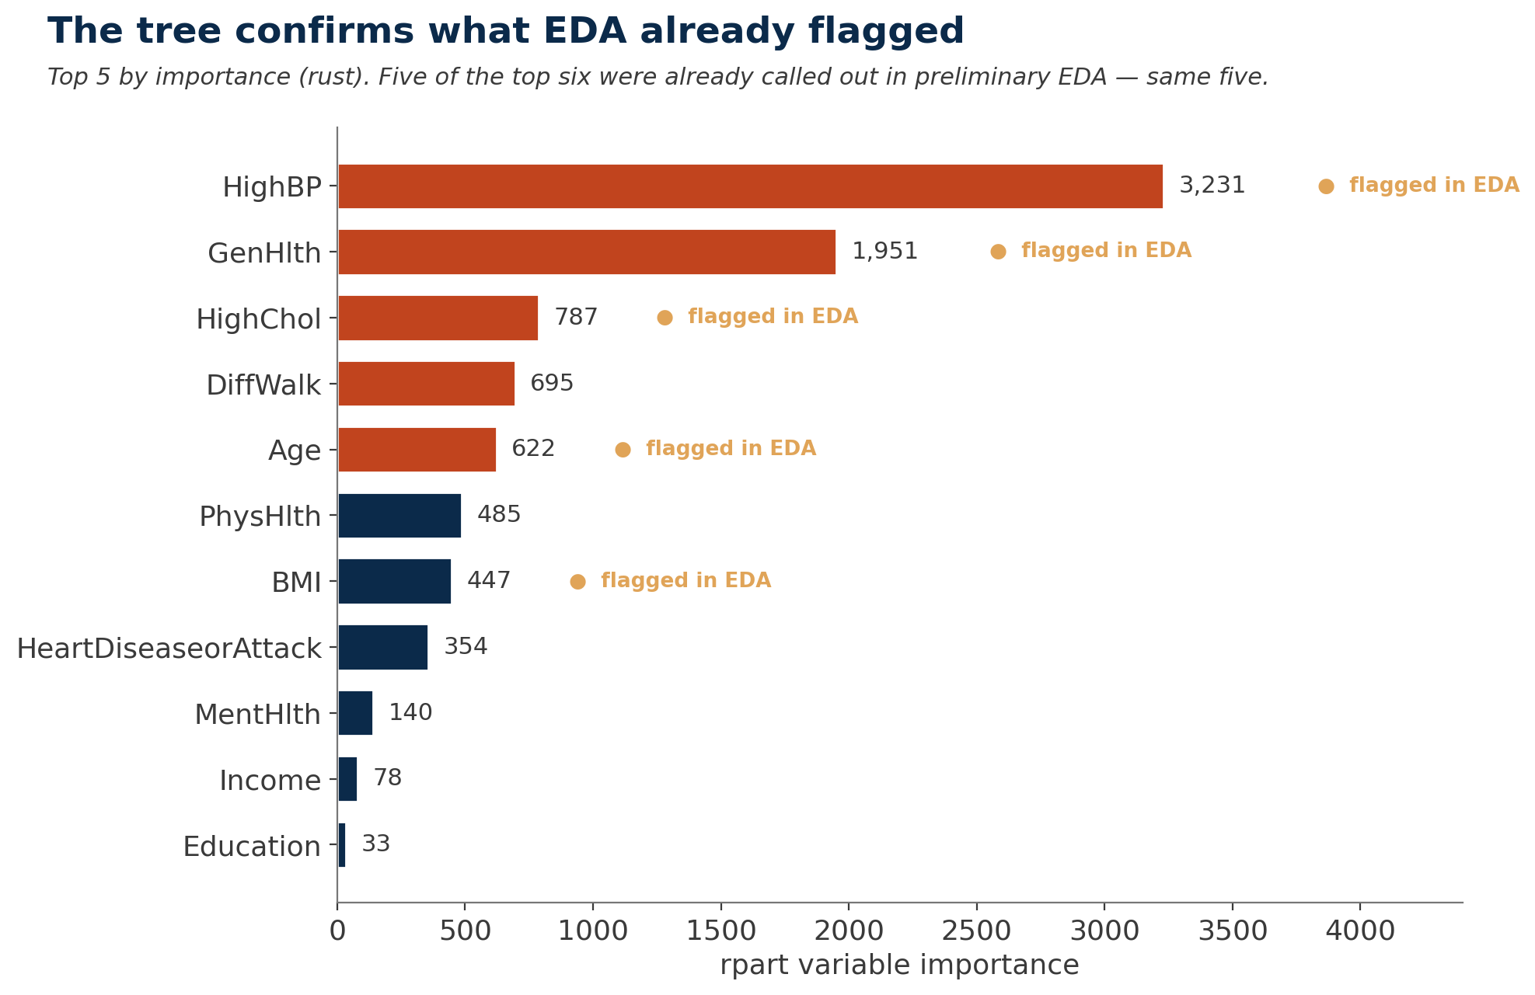
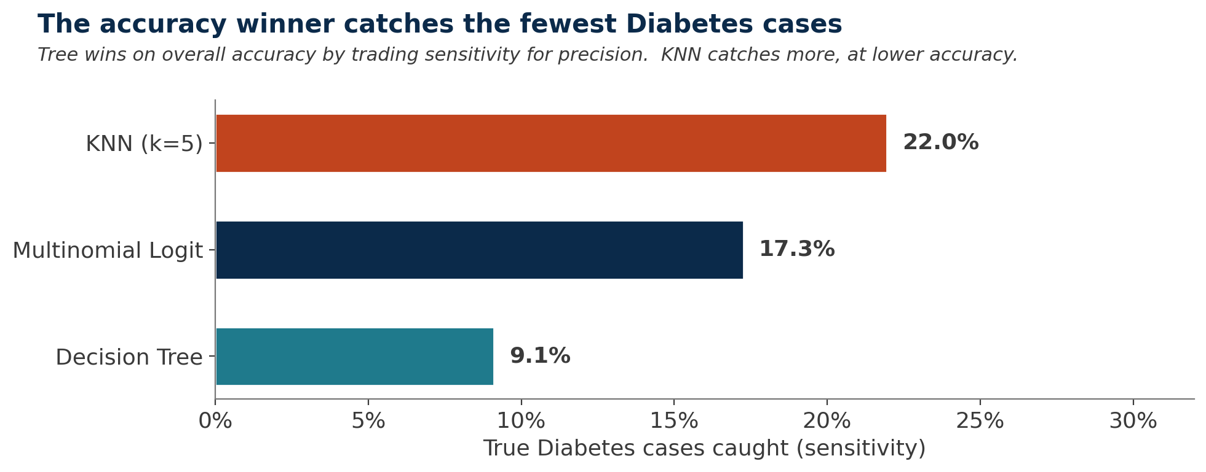
09 — INTERPRETATION
Variable Importance and Per-Class Story
WHAT THIS MEANS
Tree wins on accuracy by trading sensitivity for precision.
Logit roughly doubles Diabetes recall — most balanced single deployable model.
Only KNN k=5 ever predicts Prediabetes (88 times, 2 correct).
Top 5 (rust) align directly with the EDA findings — same five variables.
Diabetes Risk Prediction by Patient Health Indicators · J. Ermert · MIS 401
9 / 10
Notes:
## Slide 9 — Variable Importance and Per-Class Story
**Main point:**
The top model signals match the EDA, but minority-class detection is weak.
**Say naturally:**
On the left, the variable-importance chart shows the same signals from the EDA coming back in the model.
The most important tree variable is **HighBP**, followed by **GenHlth**, **HighChol**, **DiffWalk**, **Age**, **PhysHlth**, and **BMI**.
That lines up well with the preliminary analysis. The same variables that looked important visually also became important in the model.
On the right, the per-class story explains why accuracy by itself is not enough.
The Decision Tree wins on accuracy, but it catches only about **9%** of true Diabetes cases.
Logistic regression catches about **17%**, so it is more balanced for Diabetes detection even though its overall accuracy is slightly lower.
Prediabetes is the hardest class. Logistic regression and the tree never predict it, and KNN k = 5 predicts it only 88 times, with just 2 correct.
That is the clearest evidence that the three-class version is realistic, but difficult.
**Transition:**
So the final takeaway is practical, but cautious.
---

Slide 10
10 — PRACTICAL VALUE
Practical Value and Conclusion
RULE-OUT BRANCH
HIGH-RISK LEAF
~40% of patients
~2% of patients
101,437
3,961
patients with HighBP = 0
BMI ≥ 35 + HighChol + poor GenHlth + HighBP
Only 6 % Diabetes rate. Safe to deprioritize from intensive screening.
~60 % Diabetes rate — about 5× the population base rate. Tractable population for targeted intervention.
HONEST FRAMING
Accuracy ≈ baseline; class imbalance dominates. Best next step is methodological — class weights, oversampling, or a cost-sensitive threshold — not a different algorithm.
AI disclosure: generative AI organized + polished structure; data, methods, and analytical decisions are the author's, supported by validated R outputs.
Diabetes Risk Prediction by Patient Health Indicators · J. Ermert · MIS 401
10 / 10
Notes:
## Slide 10 — Practical Value and Conclusion
**Main point:**
The project finds useful risk signals, but the model is not ready for clinical deployment.
**Say naturally:**
This final slide turns the model into a practical decision-support story: one group to deprioritize and one group to prioritize.
The low-risk branch is patients with no high blood pressure, where the Diabetes rate is only about **6%**.
The high-risk leaf is much smaller, but has about a **60% Diabetes rate**, which is roughly five times the population base rate.
So this could help prioritize outreach or screening, but it should not be treated as a clinical decision-maker.
The biggest limitation is class imbalance. The best next step would be class weights, oversampling, or a cost-sensitive threshold, especially if the goal is to detect more Diabetes or Prediabetes cases.
Generative AI helped organize and polish the report and presentation structure, but the data, modeling decisions, R code, and final results are grounded in my actual outputs.
**Closing line:**
Thank you so much for listening, and I hope you enjoyed my presentation.

