Slide 1
Diabetes Risk Prediction by Patient Health Indicators
UCI x CDC | MIS 401: Business Intelligence & Analytics
Joshua Ermert
Dr. Xialu Liu
7 May 2026
Diabetes Risk Prediction by Patient Health Indicators | J. Ermert | MIS 401 | Slide 1 of 10

Slide 2
Why This Matters
• Diabetes is a leading U.S. public-health condition with high cost and uneven distribution.
• Identifying which patient indicators predict diabetes supports earlier screening and targeted prevention.
• Question: how well do classification methods separate Diabetes / Prediabetes / NoDiabetes — and which indicators carry the signal?
• Personal motivation: Type II diabetes in family + prior biopharma BI/AI analytics work.
Diabetes Risk Prediction by Patient Health Indicators | J. Ermert | MIS 401 | Slide 2 of 10

Slide 3
Dataset and Response Variable
• Source: CDC Diabetes Health Indicators (UCI ML Repository, BRFSS-derived).
• 253,680 observations | 21 predictors + Diabetes_012 | No missing values.
• Response Diabetes_012 has three classes:
– 0 = NoDiabetes — 213,703 (84.24 %)
– 1 = Prediabetes — 4,631 (1.83 %)
– 2 = Diabetes — 35,346 (13.93 %)
• Severe class imbalance is the single most important property of the dataset.
Diabetes Risk Prediction by Patient Health Indicators | J. Ermert | MIS 401 | Slide 3 of 10

Slide 4
Variables Used
Categorical / binary
• HighBP
• HighChol
• CholCheck
• Smoker
• Stroke
• HeartDiseaseorAttack
• PhysActivity
• Fruits
• Veggies
• HvyAlcoholConsump
• AnyHealthcare
• NoDocbcCost
• DiffWalk
• Sex
Continuous / ordinal
• BMI
• GenHlth (1 excellent – 5 poor)
• MentHlth (days in past 30)
• PhysHlth (days in past 30)
• Age (1 youngest – 13 oldest)
• Education
• Income
Categorical predictors converted to factors for logit + tree; KNN used numeric encoding with z-score scaling.
Diabetes Risk Prediction by Patient Health Indicators | J. Ermert | MIS 401 | Slide 4 of 10

Slide 5
Preliminary Analysis (EDA Highlights)
• BMI shifts upward with diabetes status (median ~27 → 30 → 31).
• Age category increases with diabetes status (median 8 → 9 → 10).
• Self-rated General Health is markedly worse in the diabetes group.
• HighBP is roughly 3× more common in the diabetes group than in NoDiabetes.
• HighChol shows the same direction at slightly smaller magnitude.
• PhysActivity is somewhat lower; Sex effect present but weaker than the four above.
• Strongest early signals: HighBP, GenHlth, HighChol, BMI, Age.
Diabetes Risk Prediction by Patient Health Indicators | J. Ermert | MIS 401 | Slide 5 of 10

Slide 6
Methods
• Same 70/30 train/test split with set.seed(401) for all three models.
• Train n = 177,576 | Test n = 76,104.
• Multinomial Logistic Regression — nnet::multinom on factor-coded predictors.
• KNN — class::knn on z-scored numeric predictors; tuned over k ∈ {3, 5, 7, 9}.
• Decision Tree — rpart with method = 'class'.
– Default rpart (cp = 0.01) refused to split — tuned to cp = 0.001, minsplit = 2000, minbucket = 1000, maxdepth = 5 to grow a usable shallow tree.
• Evaluation: confusion matrix + overall test accuracy + tree variable importance.
Diabetes Risk Prediction by Patient Health Indicators | J. Ermert | MIS 401 | Slide 6 of 10

Slide 7
Model Comparison (Test Accuracy)
Rank | Model | Test Accuracy
1 | Decision Tree (cp = 0.001, depth = 5) | 0.8475
2 | Multinomial Logistic Regression | 0.8467
3 | KNN (best K = 9) | 0.8382
4 | KNN (k = 5) | 0.8301
• All four variants land within ~2 points of each other — and within ~0.5 points of the 84.2 % majority-class baseline.
• Accuracy alone is misleading on this dataset; per-class evidence follows.
Diabetes Risk Prediction by Patient Health Indicators | J. Ermert | MIS 401 | Slide 7 of 10

Slide 8
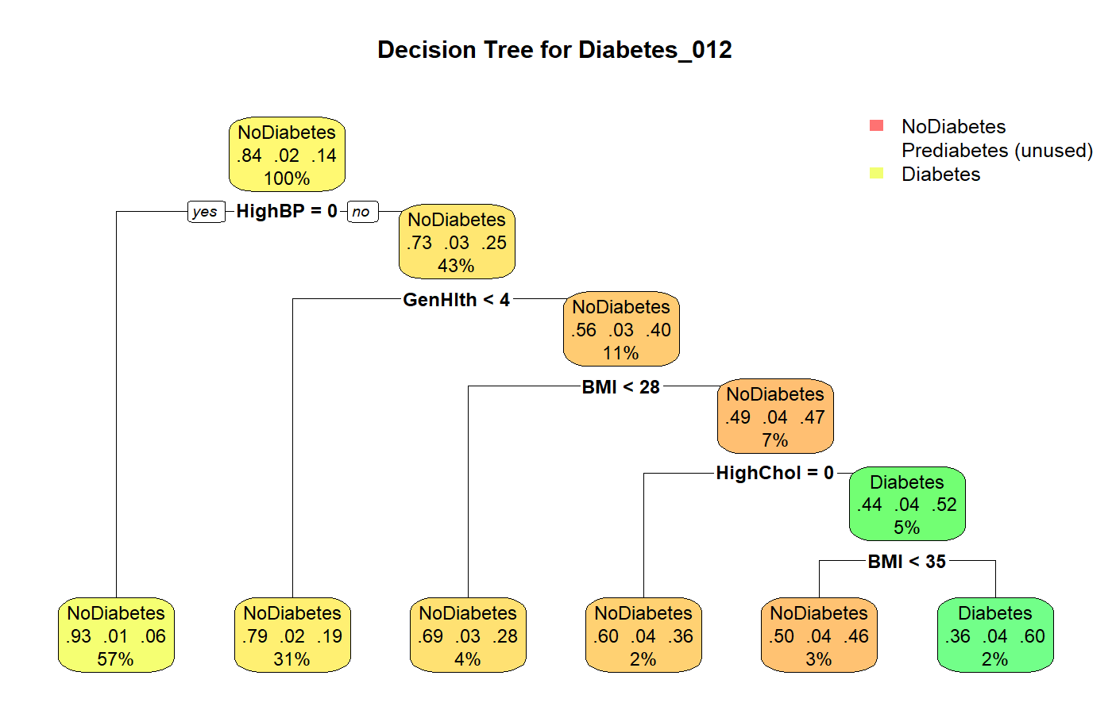
Decision Tree — Structure
One Diabetes-predicting leaf: HighBP=1 ∧ GenHlth ≥ 4 ∧ BMI ≥ 28 ∧ HighChol=1 ∧ BMI ≥ 35 (n = 3,961, ~60 % Diabetes).
Diabetes Risk Prediction by Patient Health Indicators | J. Ermert | MIS 401 | Slide 8 of 10

Slide 9
Variable Importance and Key Insights
• Decision-tree variable importance (top): HighBP > GenHlth > HighChol > DiffWalk > Age > PhysHlth > BMI > HeartDiseaseorAttack.
– Lines up directly with EDA: HighBP, GenHlth, HighChol, BMI, Age.
– Aligns with established Type II diabetes risk-factor literature.
• All models predict NoDiabetes for ~98 % of test rows; only KNN k = 5 ever predicts Prediabetes (88 times, 2 correct).
• Diabetes-class sensitivity: Tree 9 % | Logit 17 % | KNN k=5 22 %.
• Decision Tree wins on accuracy by trading sensitivity for precision; logit is the most balanced single deployable model.
Diabetes Risk Prediction by Patient Health Indicators | J. Ermert | MIS 401 | Slide 9 of 10

Slide 10
Practical Value and Conclusion
• Even at modest sensitivity, the tree is operationally useful in two ways:
– "Rule-out" branch: 101,437 patients with HighBP = 0 → only 6 % Diabetes rate. Safe to deprioritize from intensive screening.
– "High-risk" leaf: 3,961 patients (BMI ≥ 35 + HighChol + GenHlth poor + HighBP = 1) → ~60 % Diabetes rate, ~5× the population base rate.
• Honest framing: accuracy ≈ baseline; class imbalance dominates results.
• Clearest improvement path is methodological — class weights, oversampling, or a cost-sensitive threshold — not a different algorithm.
• AI disclosure: generative AI organized + polished structure; data, methods, and analytical decisions are the author's, supported by validated R outputs.
Diabetes Risk Prediction by Patient Health Indicators | J. Ermert | MIS 401 | Slide 10 of 10

