Slide 1
Diabetes Risk Prediction by Patient Health Indicators
MIS 401 · BUSINESS INTELLIGENCE & ANALYTICS
FINAL PROJECT
Comparing logistic regression, KNN, and a tuned decision tree on 253,680 patients.
Joshua Ermert
UCI x CDC
Dr. Xialu Liu · 7 May 2026

Slide 2
02 — CONTEXT
Why This Matters
“
Public-health weight
Diabetes is a leading U.S. public-health condition with high cost and uneven distribution.
Identify which patient indicators predict diabetes — and turn that signal into earlier screening and targeted prevention.
Three classifiers, one comparison
Multinomial logistic regression, KNN, and a tuned decision tree applied to the same 70/30 split.
Personal stake
Type II diabetes in the family, plus prior biopharma BI/AI analytics work — applied analytics in a real healthcare context.
The driving question for this project.
Diabetes Risk Prediction by Patient Health Indicators · J. Ermert · MIS 401
2 / 10

Slide 3
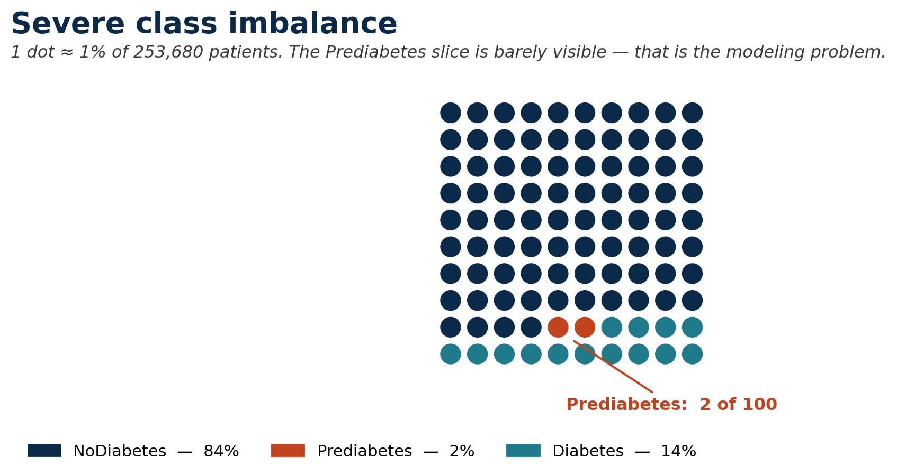
03 — DATA
Dataset and Response Variable
SOURCE
CDC Diabetes Health Indicators (UCI ML Repository, BRFSS-derived)
OBSERVATIONS
253,680
PREDICTORS
21 + 1 response (Diabetes_012)
MISSING VALUES
None
KEY TAKEAWAY
84.24 / 1.83 / 13.93 — class imbalance is the single most important property of this dataset.
Diabetes Risk Prediction by Patient Health Indicators · J. Ermert · MIS 401
3 / 10

Slide 4
04 — PREDICTORS
Variables Used
CATEGORICAL / BINARY
CONTINUOUS / ORDINAL
14 predictors
7 predictors
• HighBP
• HighChol
• CholCheck
• Smoker
• Stroke
• HeartDiseaseorAttack
• PhysActivity
• Fruits
• Veggies
• HvyAlcoholConsump
• AnyHealthcare
• NoDocbcCost
• DiffWalk
• Sex
• BMI
• GenHlth (1 excellent – 5 poor)
• MentHlth (days in past 30)
• PhysHlth (days in past 30)
• Age (1 youngest – 13 oldest)
• Education
• Income
Categorical predictors → factors for logit + tree. KNN → numeric encoding with z-score scaling fit on the training set.
Diabetes Risk Prediction by Patient Health Indicators · J. Ermert · MIS 401
4 / 10

Slide 5
05 — EDA
Preliminary Analysis — EDA highlights
BMI
↑
Age
↑
GenHlth
↑
Median rises 27 → 30 → 31
Median age category 8 → 9 → 10
Markedly worse self-rated health in Diabetes group
magnitude
magnitude
magnitude
HighBP
↑
HighChol
↑
PhysActivity
↓
~3× more common in Diabetes group than NoDiabetes
Same direction at slightly smaller magnitude
Lower in Diabetes group; Sex effect weaker
magnitude
magnitude
magnitude
STRONGEST EARLY SIGNALS
HighBP · GenHlth · HighChol · BMI · Age
These five predictors should reappear in the modeling output. Hold onto them — they show up again on slide 9.
Diabetes Risk Prediction by Patient Health Indicators · J. Ermert · MIS 401
5 / 10

Slide 6
06 — MODELS
Methods
Same split for all three models · set.seed(401) · 70/30 · Train n = 177,576 Test n = 76,104
STATISTICAL
INSTANCE-BASED
RULE-BASED
Multinomial Logistic Regression
K-Nearest Neighbors
Decision Tree
nnet::multinom
class::knn
rpart (method = "class")
Factor-coded predictors. Interpretable coefficients per non-reference class (Prediabetes, Diabetes vs. NoDiabetes).
z-score scaling fit on training set. Tuned k ∈ {3, 5, 7, 9}; reports best K.
Default cp = 0.01 refused to split. Tuned to cp = 0.001, minsplit = 2000, minbucket = 1000, maxdepth = 5 — honest tuning, not deep optimization.
Evaluation: confusion matrix + overall test accuracy + decision-tree variable importance.
Diabetes Risk Prediction by Patient Health Indicators · J. Ermert · MIS 401
6 / 10

Slide 7
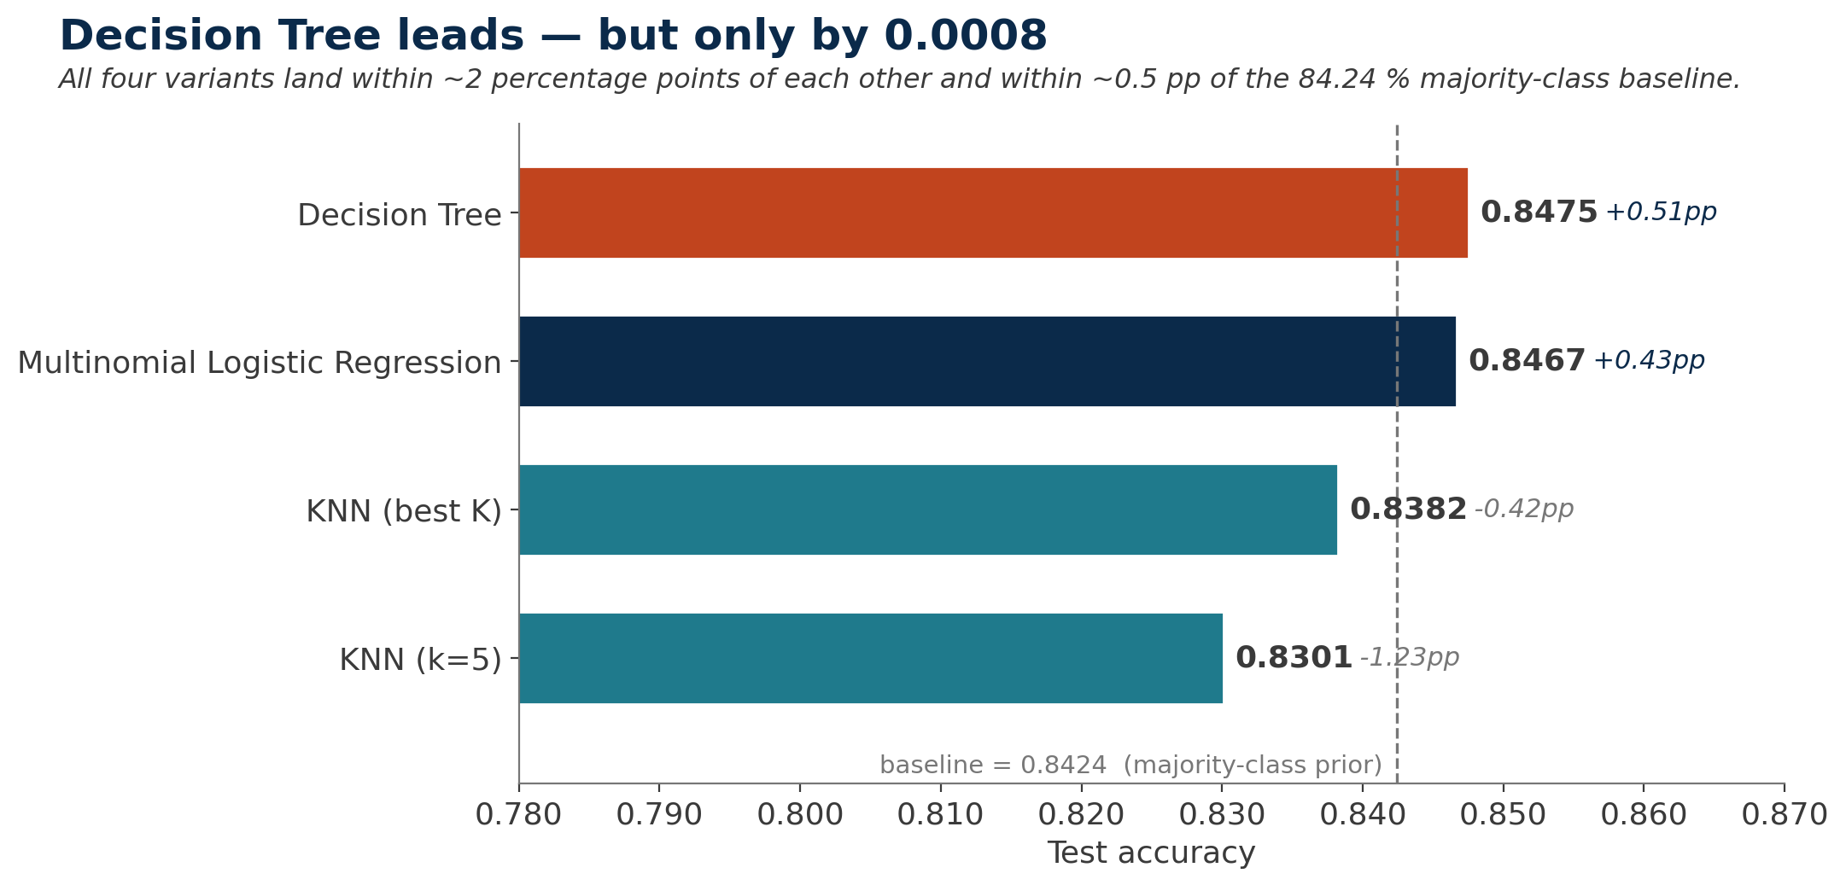
07 — RESULTS
Model Comparison — Test accuracy
HEADLINE
0.8475
Decision Tree wins —
by 0.0008 over logit
GAP FROM BASELINE
Tree
+0.51 pp
Logit
+0.43 pp
KNN k=9
−0.42 pp
KNN k=5
−1.23 pp
Accuracy alone is misleading on this dataset — per-class evidence on slide 9.
Diabetes Risk Prediction by Patient Health Indicators · J. Ermert · MIS 401
7 / 10

Slide 8
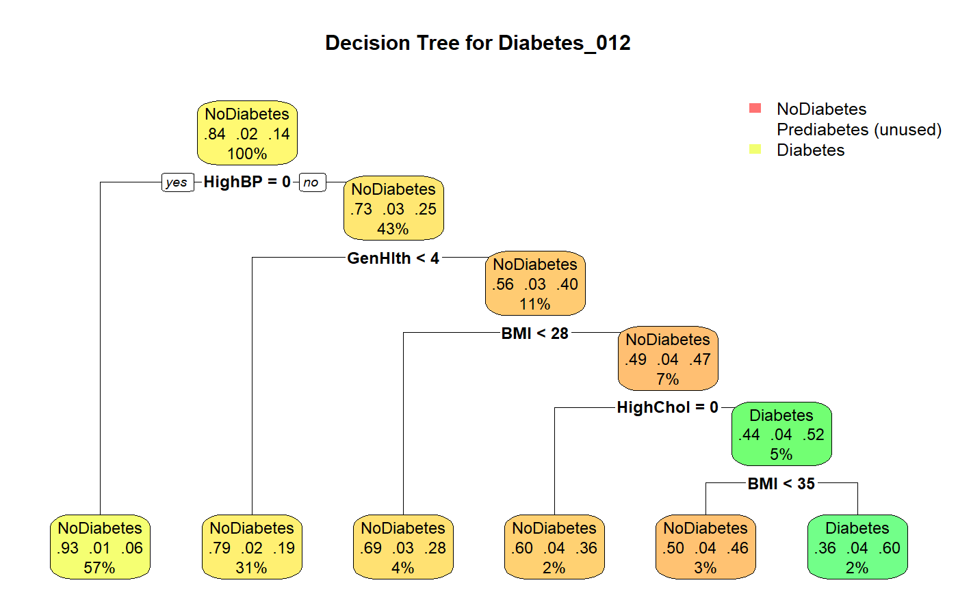
08 — TREE STRUCTURE
Decision Tree — Structure
One Diabetes-predicting leaf: HighBP=1 ∧ GenHlth ≥ 4 ∧ BMI ≥ 28 ∧ HighChol=1 ∧ BMI ≥ 35 → n = 3,961, ~60 % Diabetes.
Diabetes Risk Prediction by Patient Health Indicators · J. Ermert · MIS 401
8 / 10

Slide 9
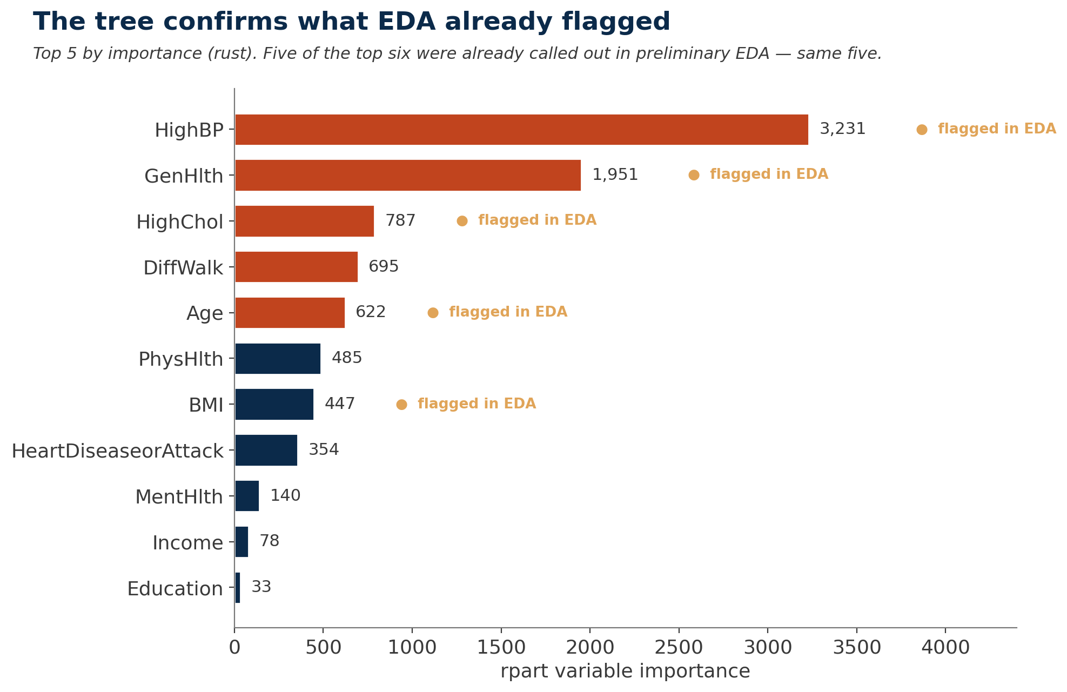
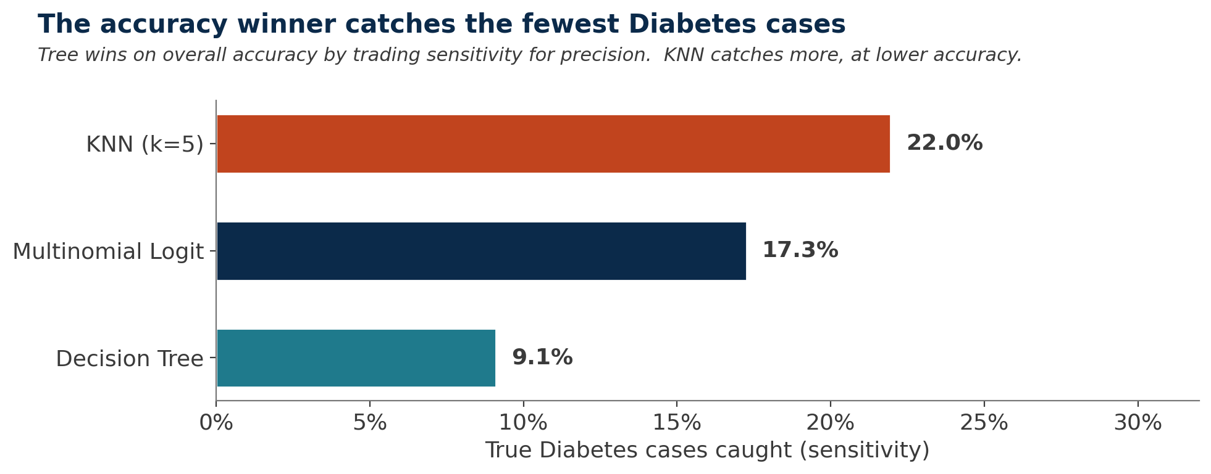
09 — INTERPRETATION
Variable Importance and Per-Class Story
WHAT THIS MEANS
Tree wins on accuracy by trading sensitivity for precision.
Logit roughly doubles Diabetes recall — most balanced single deployable model.
Only KNN k=5 ever predicts Prediabetes (88 times, 2 correct).
Top 5 (rust) align directly with the EDA findings — same five variables.
Diabetes Risk Prediction by Patient Health Indicators · J. Ermert · MIS 401
9 / 10

Slide 10
10 — PRACTICAL VALUE
Practical Value and Conclusion
RULE-OUT BRANCH
HIGH-RISK LEAF
~40% of patients
~2% of patients
101,437
3,961
patients with HighBP = 0
BMI ≥ 35 + HighChol + poor GenHlth + HighBP
Only 6 % Diabetes rate. Safe to deprioritize from intensive screening.
~60 % Diabetes rate — about 5× the population base rate. Tractable population for targeted intervention.
HONEST FRAMING
Accuracy ≈ baseline; class imbalance dominates. Best next step is methodological — class weights, oversampling, or a cost-sensitive threshold — not a different algorithm.
AI disclosure: generative AI organized + polished structure; data, methods, and analytical decisions are the author's, supported by validated R outputs.
Diabetes Risk Prediction by Patient Health Indicators · J. Ermert · MIS 401
10 / 10

