Slide 1
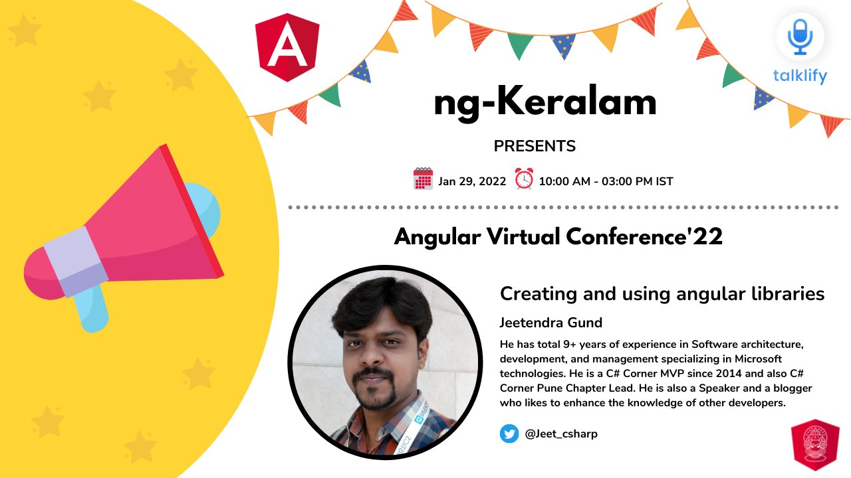

Slide 2

About me
Jeetendra Gund
Senior Software Engineer at e-Zest Solutions Ltd
9 years of experience
C# Corner MVP
C# Corner Pune Chapter Lead
Blogger, Speaker
Follow me on:
Twitter - https://twitter.com/Jeet_csharp
LinkedIn - https://www.linkedin.com/in/jeetendra-gund/
C# Corner - https://www.c-sharpcorner.com/members/jeetendra-gund

Slide 3
Agenda
Why to build Library?
Creating first angular library
How to use Library to another project?
Steps to publish the library on NPM

Slide 4
Why to build Library?
A library is a great way to share content/solutions with several apps.
Share the code across projects
Faster app build time
Promote cleaner design & best practices

Slide 5
Application1
Library
Toast-notification
Application2
Application3

Slide 6
Creating first angular library
Command - ng new app-jeet --create-application=false
Command - cd app-jeet
Command - ng g library app-jeet-lib
Command - ng g application app-jeet-lib-test
Command - ng build app-jeet-lib(copy the to path)
Import the library module into app.module.ts
Add library directive in app.component.html
Command - ng serve app-jeet-lib-test

Slide 7
Using the library into angular application
Command - ng new app-other
Command - npm install path-to-lib
Import the library module into the app.module.ts
Add library directive in app.component.html
Command - ng serve

Slide 8


Slide 9
Steps to publish the library on NPM
Command - npm adduser
username/password
goto dist folder and library
Command - npm publish
you can see the libname and version
goto npmjs.com and see the package

Slide 10
Summary
Why to build Library?
Creating first angular library
How to use Library to another project?
Steps to publish the library on NPM

Slide 11
References
Angular Library - https://angular.io/guide/creating-libraries
Pluralsight - https://app.pluralsight.com/library/courses/structuring-angular-applications-angular-libraries/table-of-contents

Slide 12

Follow me on:
Twitter - https://twitter.com/Jeet_csharp
LinkedIn - https://www.linkedin.com/in/jeetendra-gund/
C# Corner - https://www.c-sharpcorner.com/members/jeetendra-gund

