Slide 1
Finding the Optimal Location for a Meat-Free Kebab Shop in Berlin
Joshua Stevenson-Hoare

Slide 2
Plant-based and Optimal Location
Getting the correct location to open up any business, especially a food service business, is vital for financial success and social popularity
The meat-free and plant-based diet movement is a growing trend, with business exploring all venue types
In Germany, in particular in Berlin, the Döner Kebab is a beloved national dish, but there have been few efforts to make plant-based fast food alternatives to this dish
Most fast food kebab consumers are late night customers, making proximity to consumer-supplying venues (ie. bars) very important

Slide 3
Data Acquisition and Wrangling
Berlin regional data were acquired from a list of localities on Wikipedia, and collated with coordinate data from their respective pages
Some alterations were made to locality names to ensure the correct wikipedia page was accessed
Bar and Kebab venue data was collected using the FourSquare API
Vegan/Vegetarian venue data was collected via using of the HappyCow database
Data were formed into a dataframe of all venues, their respective category, and the locality within which they reside.

Slide 4
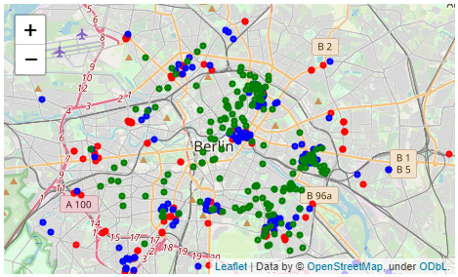
Visualisation of Venues
All venue locations overlaid on a map of Berlin. Blue dots are bar venues, red dots are kebab venues, and green dots are vegan/vegetarian venues.

Slide 5
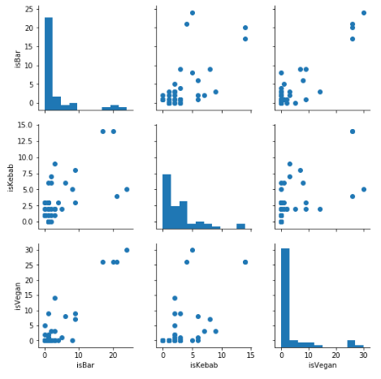
Correlation of Venue Categories
Correlations were performed between the number of each venue category within each locality
All venues positively correlated with each other, which indicates venue density overall
All correlations were statistically significant (p <0.001)

Slide 6
Clustering with k-Means
K-Mean clustering was used to categories localities
3 clusters were generated
Descriptions were based on mean num of each category
Cluster # | Mean # Bars | Mean # Kebabs | Mean # Vegan
0 | 1.2 | 2.0 | 0.4
1 | 20.5 | 9.3 | 27.0
2 | 5.6 | 4.2 | 9.4
0) Low number of all venues
Many bars and vegan, some kebabs
2) Moderate number of all venues

Slide 7
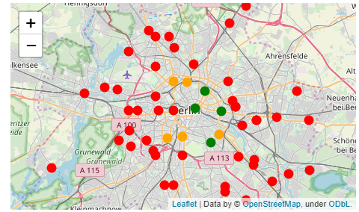
Cluster Visualisation
Clusters visualised on a map of Berlin. Red dots are cluster 0, green dots are cluster 1, and orange dots are cluster 2.

Slide 8
Conclusions
The optimal locations to open a meat-free kebab shop in Berlin are these localities [cluster 1]
Prenzlauer Berg, Mitte, Friedrichshain, and Neukölln
Localities in cluster 1 are optimal
High number of bars, providing a large potential customer base
High number of vegan venues, showing customer interest in plant-based alternatives
Moderate number of traditional kebab shops, indicating high footfall for the late-night fast food consumer
The model /method used here could be applied to any city and/or popular dish, so is very useful for prospective business owners everywhere

