Slide 1
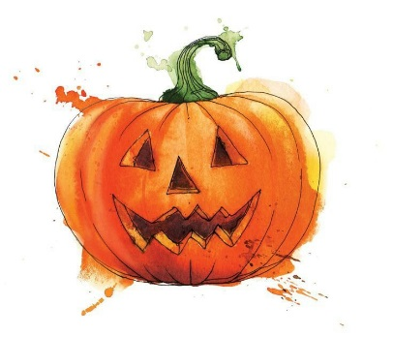
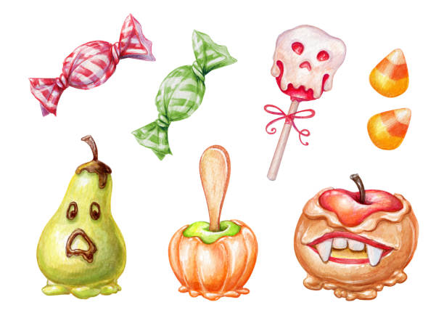





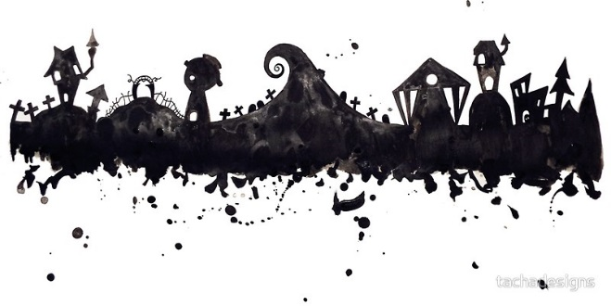
Our little
PUMPKIN
is turning ONE!
Please join us for some
HALLOWEEN FUN
in honor of
Maxwell James Jarquio
Deanna Rose Children’s Farmstead
SATURDAY
13800 Switzer Rd,
Overland Park, KS 66221
OCT 27th
RSVP by September 21st to Dannielle @ 816.805.8610
1pm-4pm

Slide 2

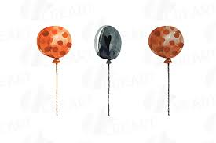

Pumpkin Patch Party FAQs
Join us in the Party Coral for Cake, Cider & refreshments from 1:00-2:30
&
PUMPKIN HOLLOW
Come and get lost in our patch of pumpkins from 2:30-4pm
Where a horse-drawn wagon ride will take you to and from the patch where each guest gets to take home a pumpkin!
At the patch, you can also:
Get lost in a corn maze, Climb a hay pyramid, Play in a corn box & Slide down the hay slide.
Children can ride the Pumpkin Hollow express!
Additional Info:
Visit the birthday party check-in gate upon arrival to receive your paid admission passes. The check-in gate is located to the east of the main Farmstead entrance.
Follow the birthday party signs in the parking lot and enter at the birthday party check-in gate.
Party participants must park in the main Farmstead parking lot.
Reminder:
We will be outdoors so please dress for the weather & wear comfy shoes since we will be walking. Strollers & Wagons are welcome for little ones. Don’t forget to wear your Halloween Costume to add to the fun!

