Slide 1
윈도우 Fluentd 설치
https://docs.fluentd.org/installation/install-by-msi

Slide 2
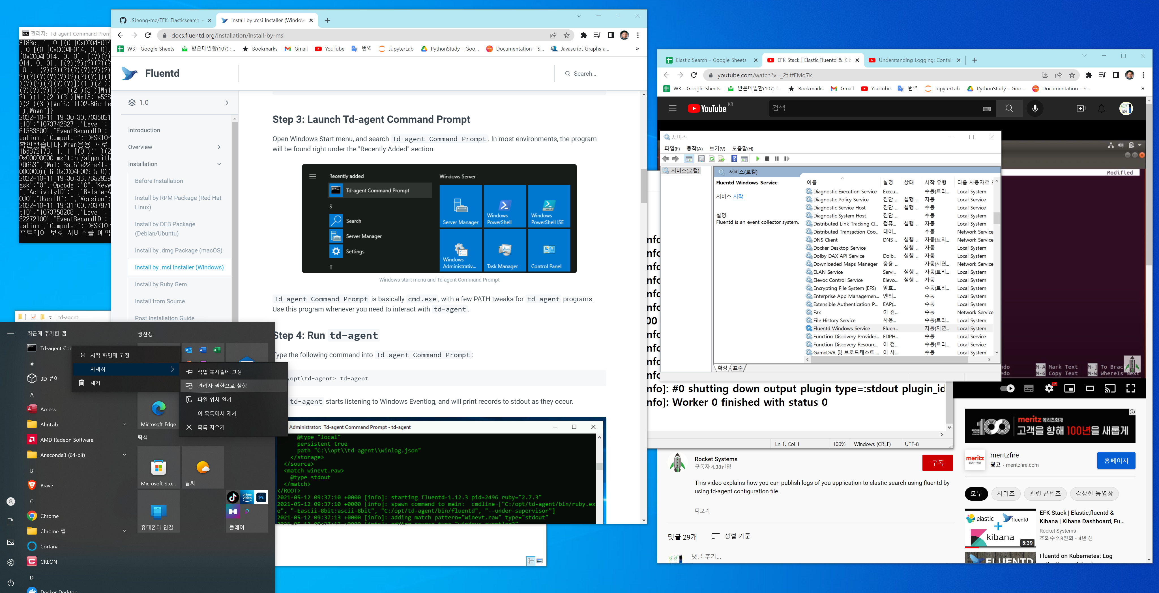

Slide 3
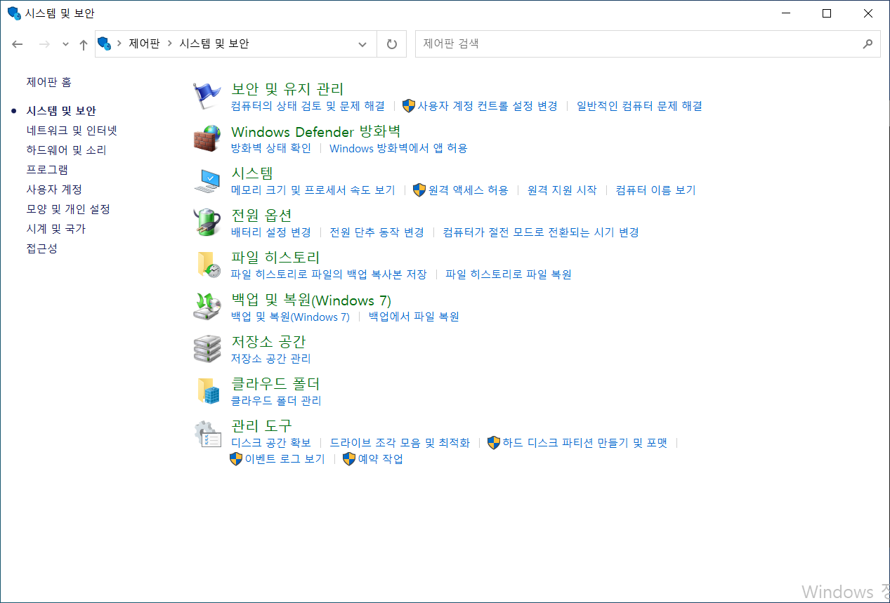
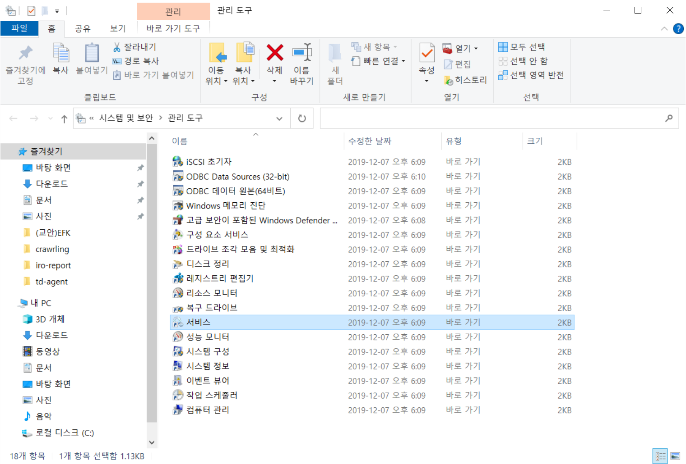
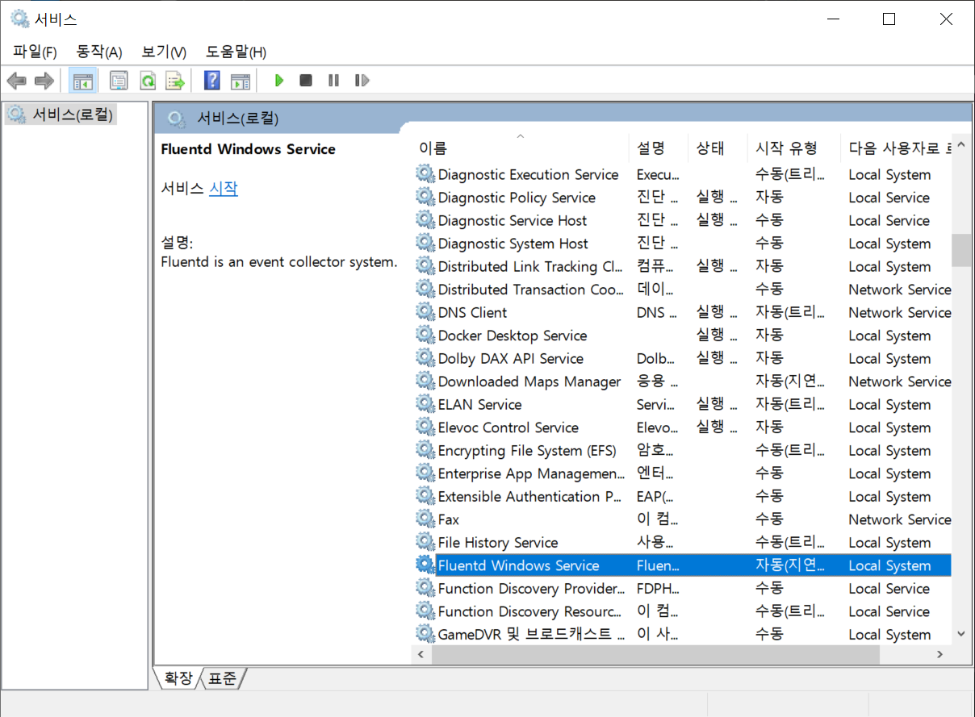
실행(GUI): td-agent
Control Panel -> System and Security -> Administrative Tools -> Services
Fluentd Window Service -> click Start

