Slide 1
Numpy – Machine Learning
2021. 3. 22
정 준 수 Ph.D.

Slide 2
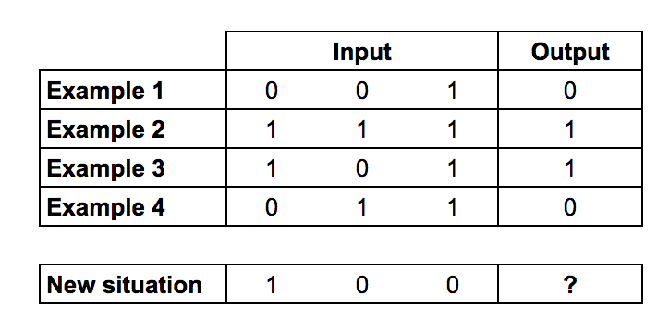




Machine Learning - Training

Slide 3
from numpy import exp, array, random, dot
training_set_inputs = array([[0, 0, 1], [1, 1, 1], [1, 0, 1], [0, 1, 1]])
training_set_outputs = array([[0, 1, 1, 0]]).T
random.seed(1)
synaptic_weights = 2 * random.random((3, 1)) - 1
for iteration in range(10000):
output = 1 / (1 + exp(-(dot(training_set_inputs, synaptic_weights))))
synaptic_weights += dot(training_set_inputs.T, (training_set_outputs - output) * output * (1 - output))
print (1 / (1 + exp(-(dot(array([1, 0, 0]), synaptic_weights)))))
출처: https://medium.com/technology-invention-and-more/how-to-build-a-simple-neural-network-in-9-lines-of-python-code-cc8f23647ca1

