Slide 1
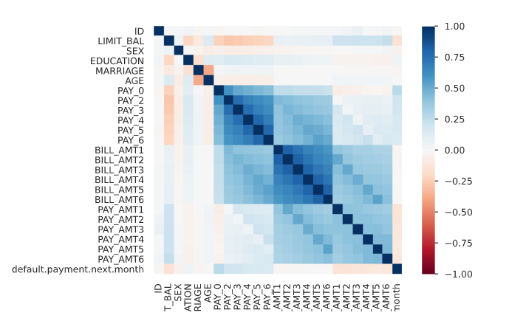

Slide 2
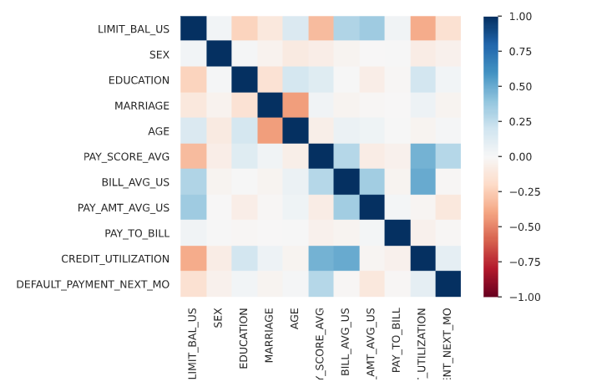

Slide 3
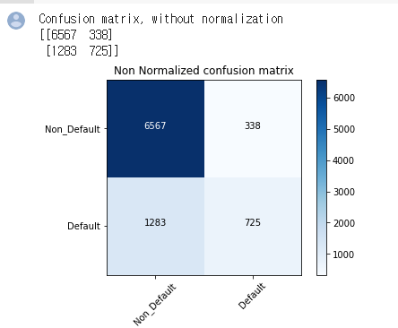

Slide 4
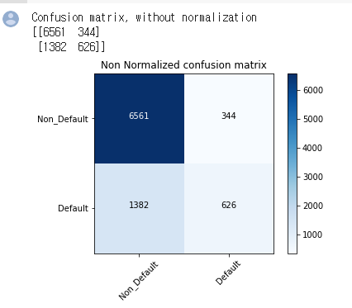

Slide 5
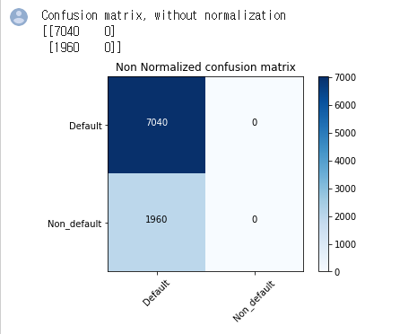
Logistic Regression

Slide 6
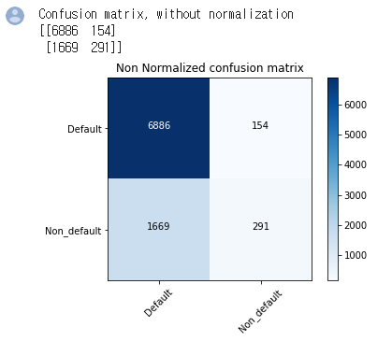
Logistic Regression

Slide 7
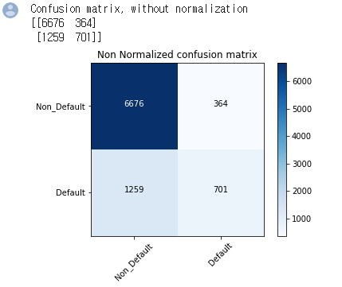
Random Forest – 23 columns

Slide 8
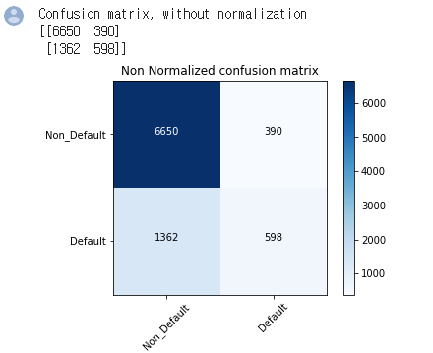
Random Forest – 10 columns

Slide 9
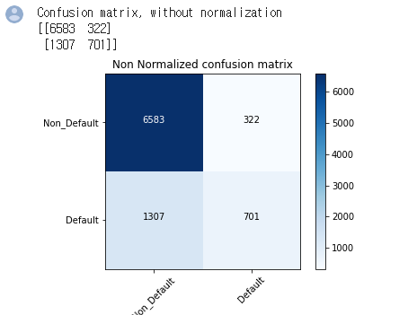
XGB – classification – 23 columns

Slide 10
XGB – classification – 10 columns

Slide 11
GBM – classification – 23 columns

Slide 12
GBM – classification – 10 columns

Slide 13
DNN Keras – classification – 23 columns

Slide 14
DNN Keras – classification – 10 columns

