Slide 1
JavaScript와 Tensorflow.js로 배우는 머신러닝
Day 2
2020. 8. 4
정 준 수 Ph.D.

Slide 2
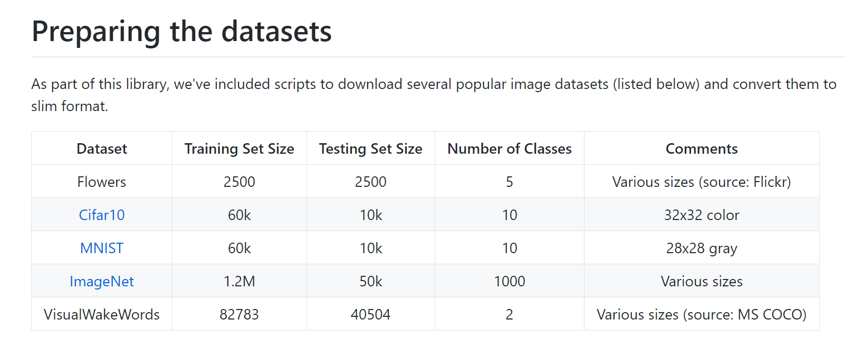

Slide 3
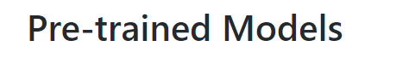
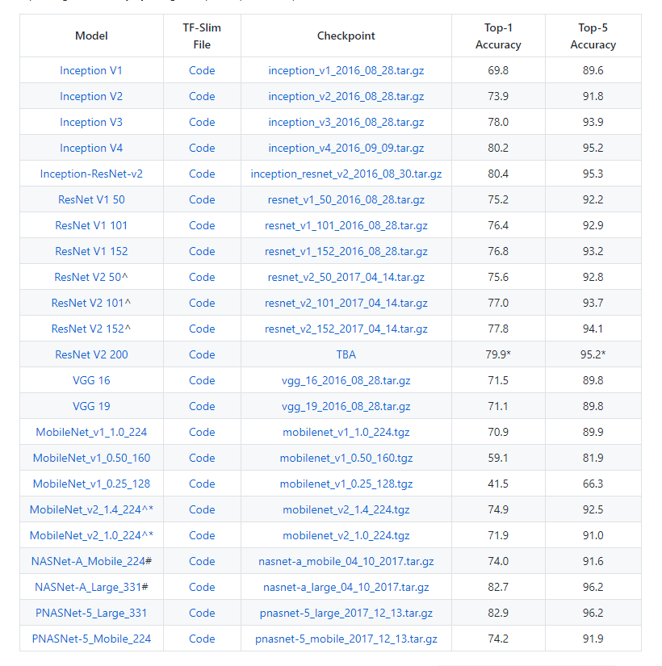

Slide 4
Top-1 accuracy is the conventional accuracy: the model answer (the one with highest probability) must be exactly the expected answer.
Top-5 accuracy means that any of your model 5 highest probability answers must match the expected answer.
For instance, let's say you're applying machine learning to object recognition using a neural network. A picture of a cat is shown, and these are the outputs of your neural network:
Tiger: 0.4
Dog: 0.3
Cat: 0.1
Lynx: 0.09
Lion: 0.08
Bird: 0.02
Bear: 0.01
Using top-1 accuracy, you count this output as wrong, because it predicted a tiger.
Using top-5 accuracy, you count this output as correct, because cat is among the top-5 guesses.

Slide 5
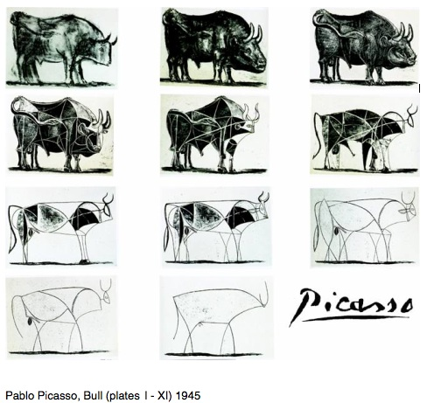
◈ 추상화 (Abstract)

Slide 6
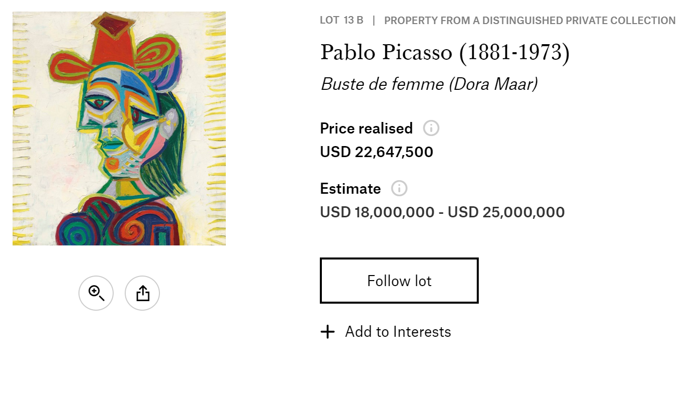

Slide 7
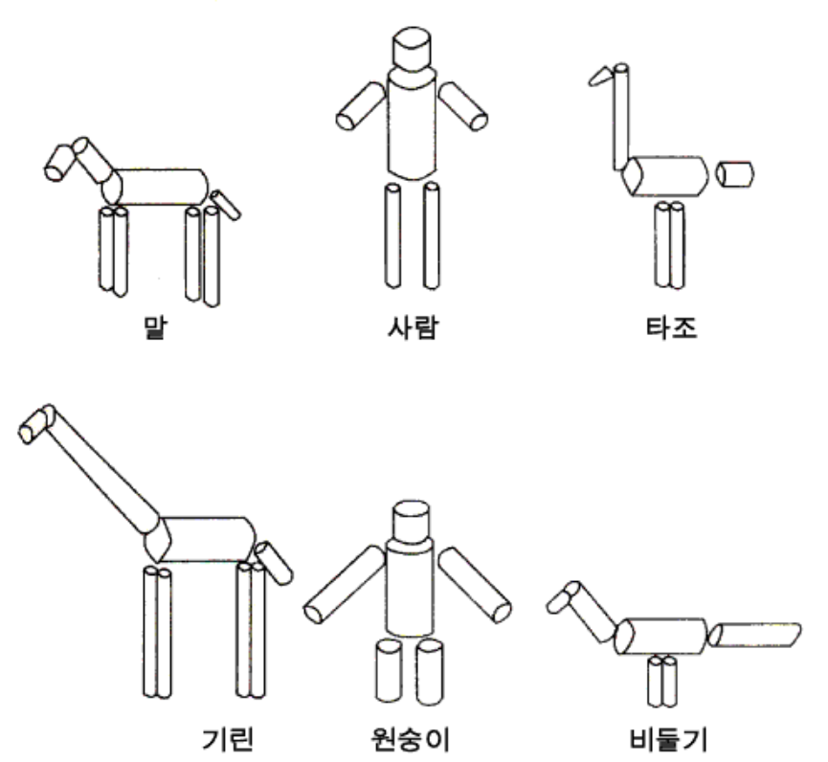
◈ 사람의 물체(시각) 재인 방식
친숙한 물체들을 기본 원통 형태로 분할한 것. (Marr & Nishihara. 1978)

Slide 8
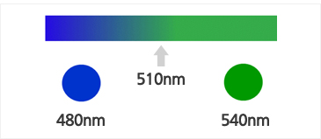
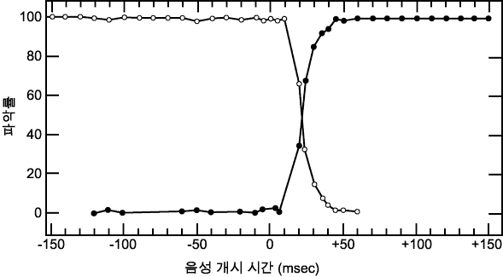
◈ 범주화 지각은 사람의 기본적 속성
소리 (Sound)
색깔 (Color)
사람들은 음소들이 하나의 연속적 차원에서 다르더라도 이들이 별개의 범부에서 유래한다고 지각하는 경향이 있다.
510nm에서 540nm로 변화할 경우 여전히 같은 색에 있다고 생각하지만 480nm로 변화하면 우리는 전혀 다른 범주의 색으로 느끼게 된다.

Slide 9
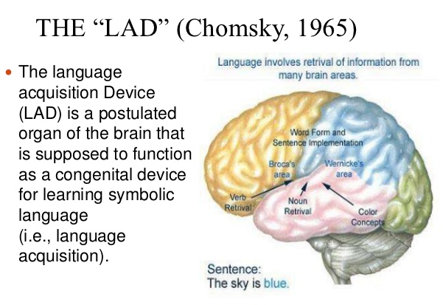
사람은 누구나 태어나면서부터 언어를 쉽게 터득할 수 있도록 언어습득장치(LAD)를 가지고 태어난다.

Slide 10
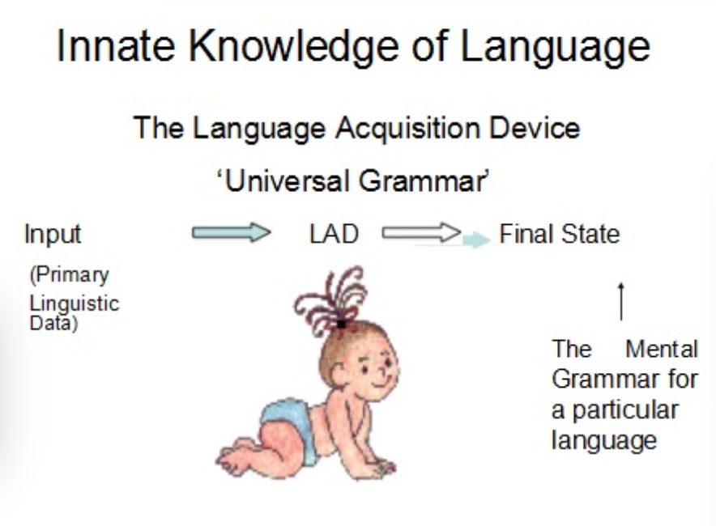

Slide 11
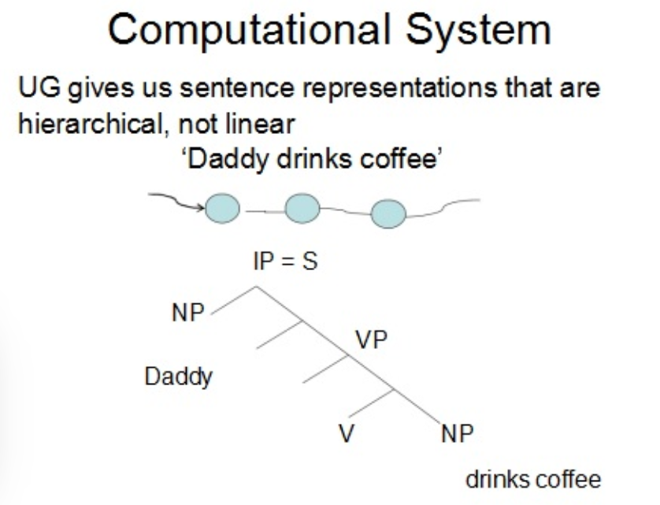

Slide 12
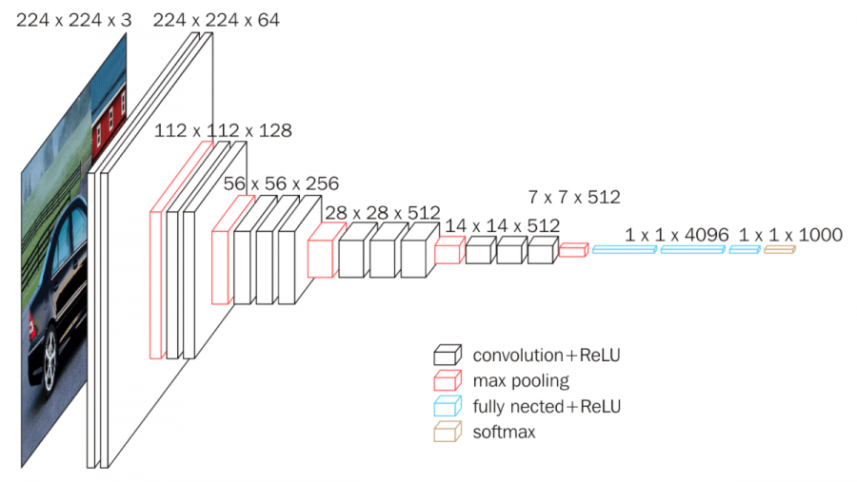
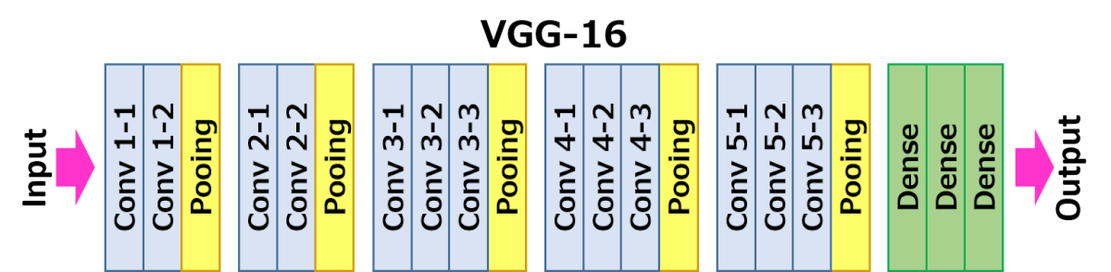
https://neurohive.io/en/popular-networks/vgg16/

Slide 13
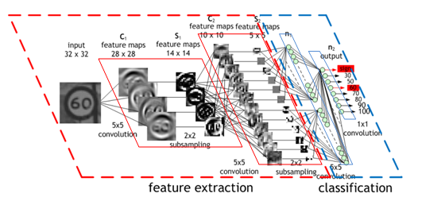
https://github.com/raghakot/keras-resnet
ResNet 1,000 classification
http://blog.creation.net/mxnet-part-5-vgc16-resnet152

Slide 14
‪C:\Users\heine\Desktop\교원그룹\교원그룹(실습)\Transfer_Learning\activation_functions.ipynb
‪C:\Users\heine\Desktop\교원그룹\교원그룹(실습)\Transfer_Learning\Image_Classification.ipynb

Slide 15
Transfer Learning 1
https://wikibook.co.kr/transfer-learning/
https://github.com/Transfer-Learning-with-Python/handson-Code/blob/master/Chapter05/practice_chapter5.ipynb
C:\Users\heine\Desktop\교원그룹\교원그룹(실습)\Transfer_Learning\transfer-learning-master(ch5)\Chapter05

Slide 16
Transfer Learning 2
C:\Users\heine\Desktop\교원그룹\교원그룹(실습)\Transfer_Learning\statefarm_distracted_driver_detection

Slide 17
Stanford-Dogbreeds: A Transfer Learning Tutorial
https://www.kaggle.com/jingw222/stanford-dogbreeds-a-transfer-learning-tutorial

Slide 18
http://www.immersivelimit.com/tutorials/create-coco-annotations-from-scratch
COCO annotations are inspired by the Common Objects in Context (COCO) dataset.
"COCO is a large-scale object detection, segmentation, and captioning dataset. COCO has several features: Object segmentation, Recognition in context, Superpixel stuff segmentation, 330K images (>200K labeled), 1.5 million object instances, 80 object categories, 91 stuff categories, 5 captions per image, 250,000 people with keypoints."

Slide 19
Gaussian Process Regression in TensorFlow Probability
https://www.tensorflow.org/probability/examples/Gaussian_Process_Regression_In_TFP

Slide 20
Down Load 받아 주세요!
https://github.com/JSJeong-me/NeuralNet

Slide 21
https://blog.tensorflow.org/2019/03/regression-with-probabilistic-layers-in.html

Slide 22

정 준 수 Ph.D.
heinem@naver.com
010-5359-3644

