Slide 1


HEY Provider !!!
Hasmukh Goswami College of Engineering
Name : Prajapati Kishan A.
Enr no : 160240107072
Email id: prajapatikishan009@gmail.com
Name : Sabuwala Smit G.
Enr no : 160240107077
Email id: sabuwalasmit@gmail.com
Name : Maniar Jay J.
Enr no : 160240107507
Email id: jaymaniar92@gmail.com

Slide 2
Problem Definition
Customer Problem:-
Services provided by local technician given to customers are not satisfactory, like…
Less work and more money.
Less knowledge about their profession.
Work not done in flexible time.
Unprofessional behavior by the service provider.
Technician Problem:-
Bad behavior by the customer.
After completing work customer bargain for money.
If customer is not available on time, so it’s waste of time for technician.

Slide 3
Need of Project
Best service and satisfactory work done by professional’s to customers.
HEY Provider is one stop destination for all routine lifestyle services.
Transparent pricing and easy payments.
You can book services at your home at the time convenient you.

Slide 4
Literature Review
https://www.researchgate.net/publication/226527931_Consumer_Satisfaction_for_Internet_Service_Providers_An_Analysis_of_Underlying_Processes

Slide 5
Requirement
Technology: JAVA, HTML5, CSS3.
Framework: Spring, Angular 8, Bootstrap4.
Database: MySQL.
Software: Visual Code, Eclipse, MySQL.

Slide 6
Time duration
MONTHS | ACTIVITY PROGRESS
JUNE | Decide project language and type.
JULY | Analysis of project, name of project and keywords.
AUGUST | Survey of current problem in project and solution for it.
SEPTMBER | Basic paper work of project and presentation on project using various types of diagram.
OCTOBER | Temporary design UI for website of our project.
NOVEMBER | Changes made for design of UI for website and making it permanent.
DECEMBER | Coding part(Backend)
JANUARY | Coding implementation.
FEBRUARY | Testing and updating .
MARCH | Deployment .

Slide 7
User Characteristics
No technical experience is required basic knowledge of handling system is sufficient.

Slide 8
Admin Characteristics
Good knowledge of programming.
Good communication skill.
Good management skill.
Easy to solve problems.
Able to take responsibility.
Good knowledge of technology which they are used.

Slide 9
Problem Of Current System
Some of the services which we are providing is not available at any other platform.
Else services are available but in different-different platform.
Some time customer have to sacrifice his time.
Customer get the serviced but they are not satisfy due to lack of knowledge of profession.

Slide 10
SYSTEM DIAGRAMS

Slide 11
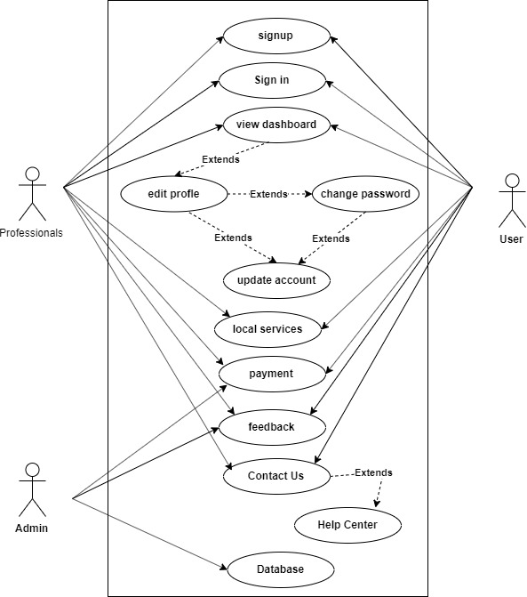
Use Case diagram

Slide 12
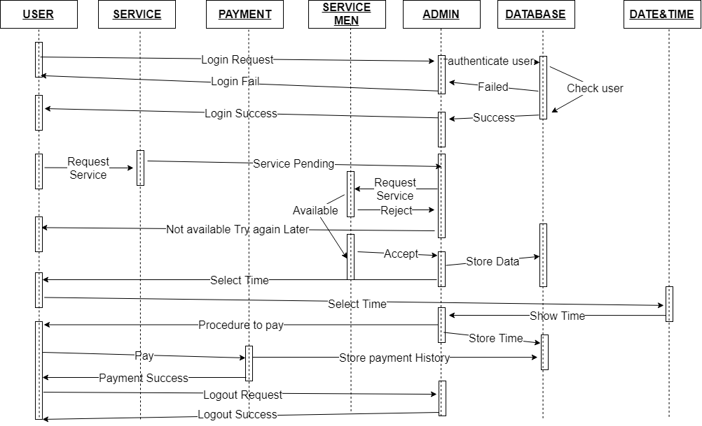
SEQUENCE DIAGRAM

Slide 13
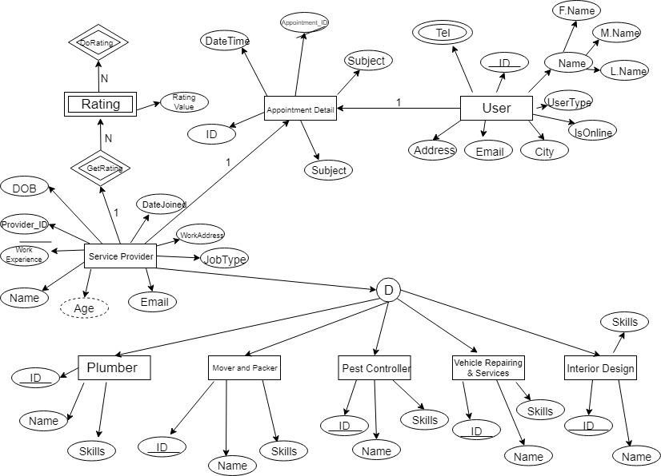
E-R DIAGRAM

Slide 14
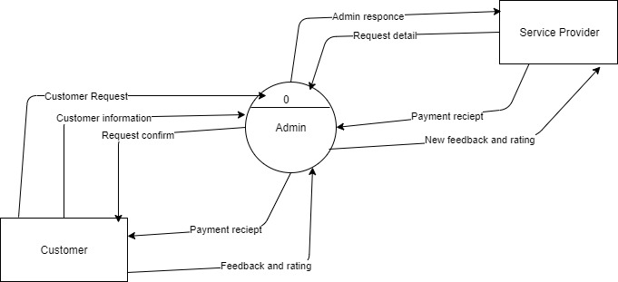
DATA FLOW DIAGRAM
Level-0

Slide 15
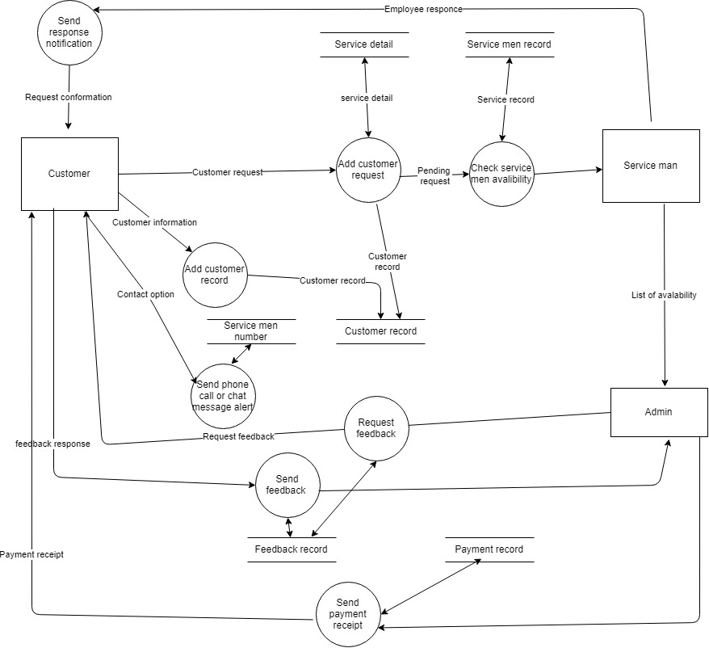
Level-1

Slide 16
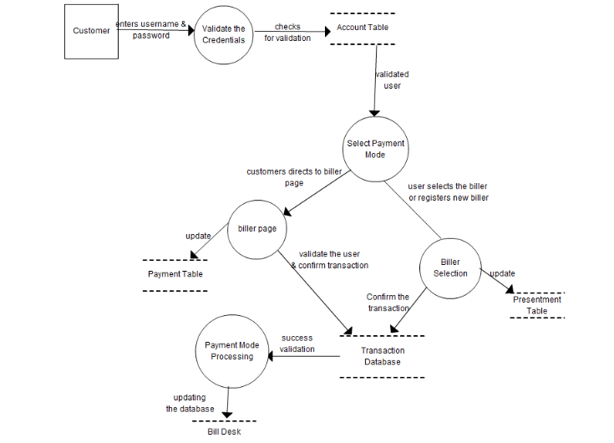
Level-2

Slide 17
Data Dictionary
Attribute | Data Type | Description | Size
Customer_Id | LONG | Customer Id | 15
First_Name | String | First name of customer | 50
Last_Name | String | Last name of customer | 50
Middel_Name | String | Middel Name | 50
Email | Varchar2 | Email of customer | 30
Phone_Number | Long | Phone Number of Customer | 10
Password | Varchar2 | Create password | 20
Address | Varchar2 | Customer’s Address | 20
Customer’s Table

Slide 18
Attribute | Data Type | Description | Size
Professional_Id | LONG | Customer Id | 15
First_Name | String | First name of customer | 50
Last_Name | String | Last name of customer | 50
Middel_Name | String | Middel Name | 50
Email | Varchar2 | Email of customer | 30
Phone_Number | Long | Phone Number of Customer | 10
Password | Varchar2 | Create password | 20
Address | Varchar2 | Customer’s Address | 20
AdharCard_Number | Integer | AdharCard_Number | 16
Pancard_Number | Integer | Pancard_Number | 10
Field | String | Specific Field of Professionals | 20
Professional’s Table

Slide 19
Attribute | Data Type | Description | Size
Customer_Name | String | Name of the customer | 20
Name of services | Varchar2 | Services name | 30
Service id | Varchar2 | Customer Unique Id | 30
Price of service | number | Price of service | 10
Date | string | Service Date | 10
Time | String | Time of the service | 10
Address | Varchar2 | Address of the customer | 50
Service Table

Slide 20
Attribute | Data Type | Description | Size
Feedback_Id | Integer | Feedback Id | 20
Rating | Integer | Rating of service | 5
Notes | Varchar2 | Feedback of customer | 100
Feedback Table

Slide 21
Application
Easily available of Services at customer’s door steps.
Getting trusted high end Services.
Provider’s passion is converted into profession at this platform.

Slide 22
Expected Outcomes
One destination for all types of Services.
Door to door services in less and flexible time.
No payment issues between customers and service providers.
Satisfactions of customers.
Feedback from customers for service requested by them.

Slide 23
Future Scopes
HEY Provider helps you find the right service professionals for activities important to you.
Services provided by HEY Providers :
Design your Home.
Get your appliances serviced/repaired.
Get your vehicles serviced/repaired.
Pest Control.
Tattoo artist.
Get your events managed by us.
And many more…
HEY Provider helps you fulfill all your services needs.

Slide 24
References
https://en.wikipedia.org/wiki/Service_provider
https://www.urbanclap.com
https://www.researchgate.net/publication/226527931_Consumer_Satisfaction_for_Internet_Service_Providers_An_Analysis_of_Underlying_Processes

