Slide 1
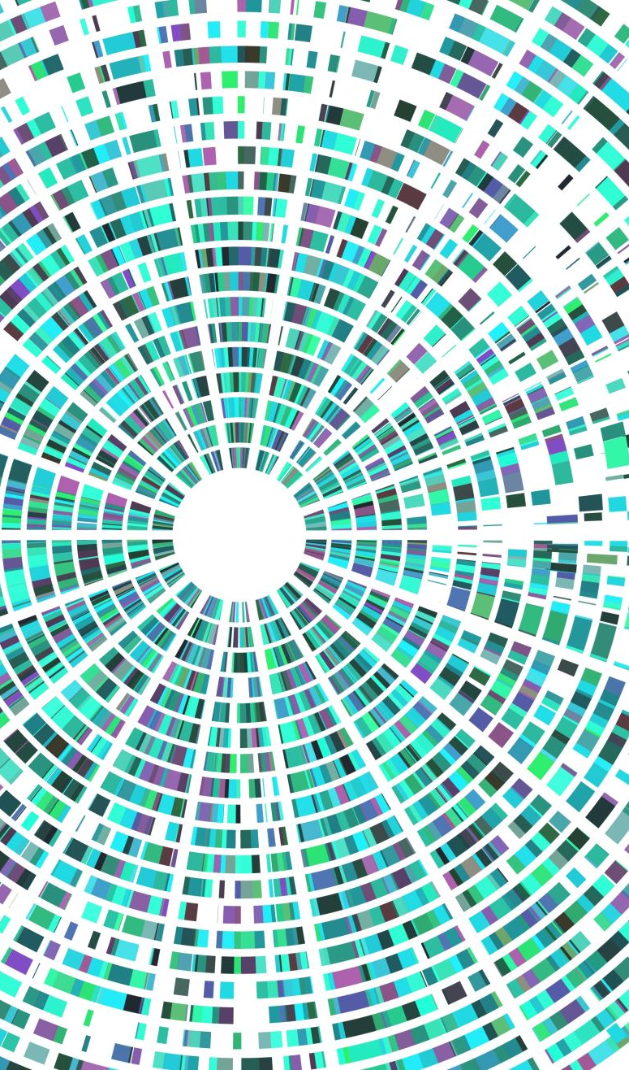
Shedding Some Light on the Light-Up Puzzle with Artificial Intelligence
COMP 6600/6606 Final Project
James Browning
Roberto Perera Aguiar
Libo Sun

Slide 2
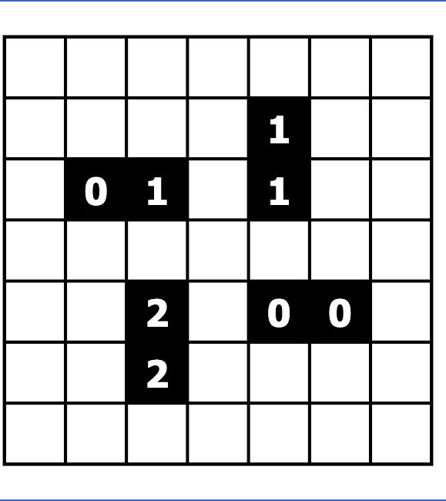
Initial puzzle

Slide 3
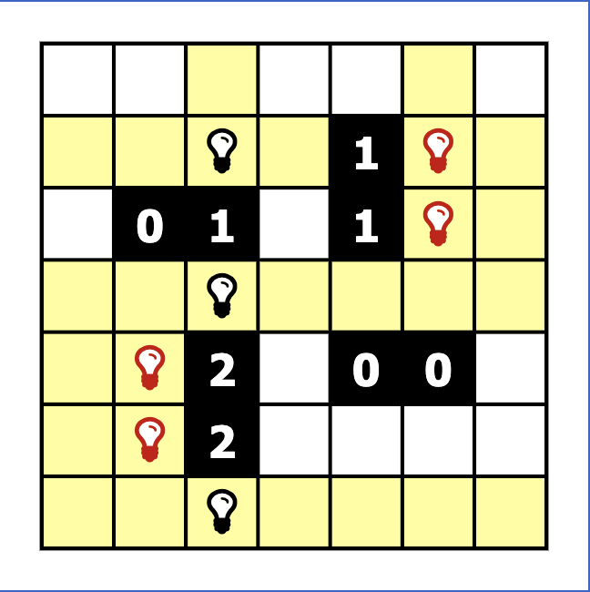
Initialization
Random
Blindly add bulbs to meet the black cell adjacency.
Violations
Rule violations include…
Two bulbs shining on each other.
The number of bulbs next to a black cell not being equal to the number inside that cell.

Slide 4
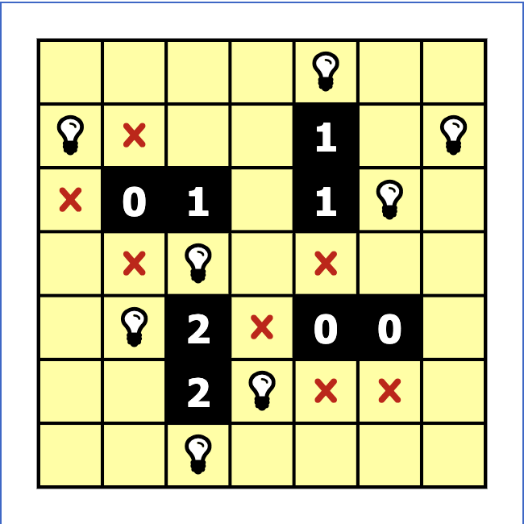
Goal State
Maximum number of white cells are lit up.
Minimum number of violations made.
Algorithms to be used include…
Hill climbing
Simulated annealing
Deep neural networks.

Slide 5
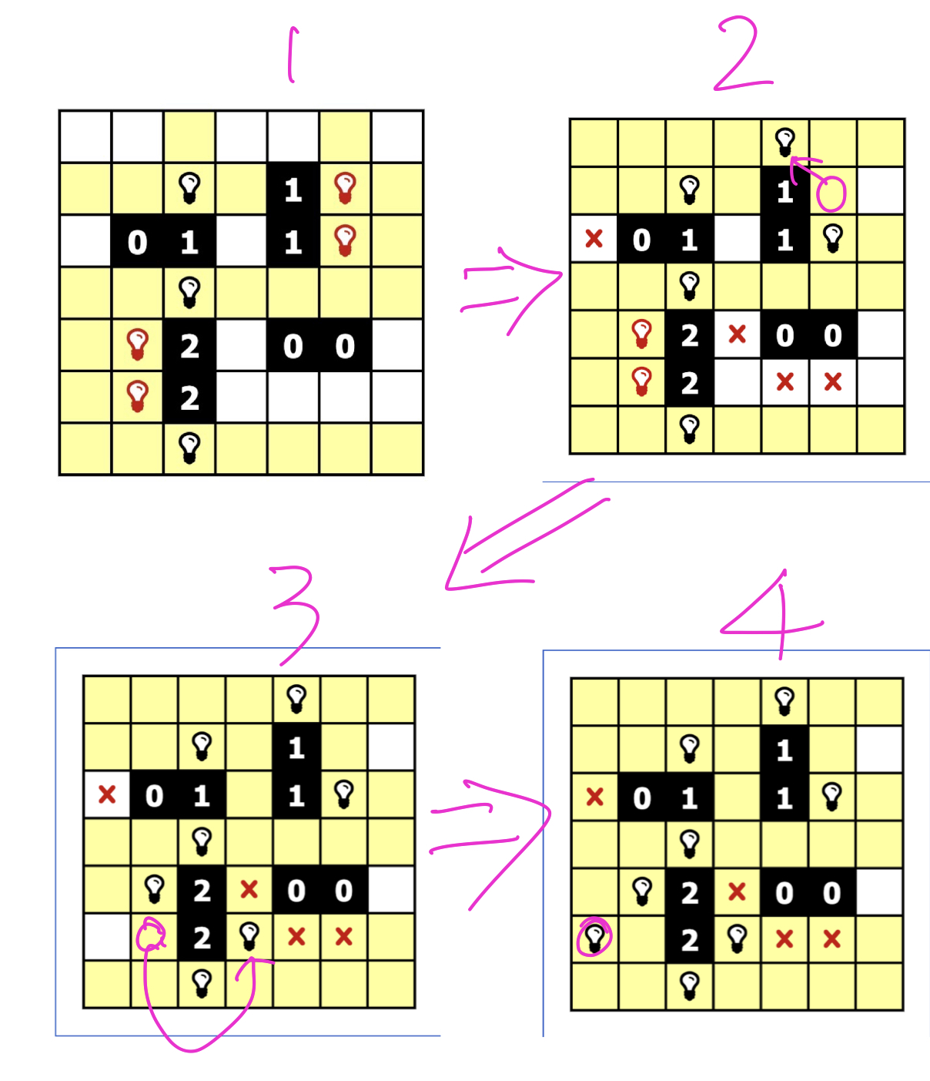
Generating neighbor(s)
Possible actions: 1. Removing a bulb from a cell.
2. Adding a bulb into an empty cell.
3. Moving a bulb from one cell to another empty cell.
Fitness score:
Positive: number of lit up cells
Negative: number of violations

Slide 6
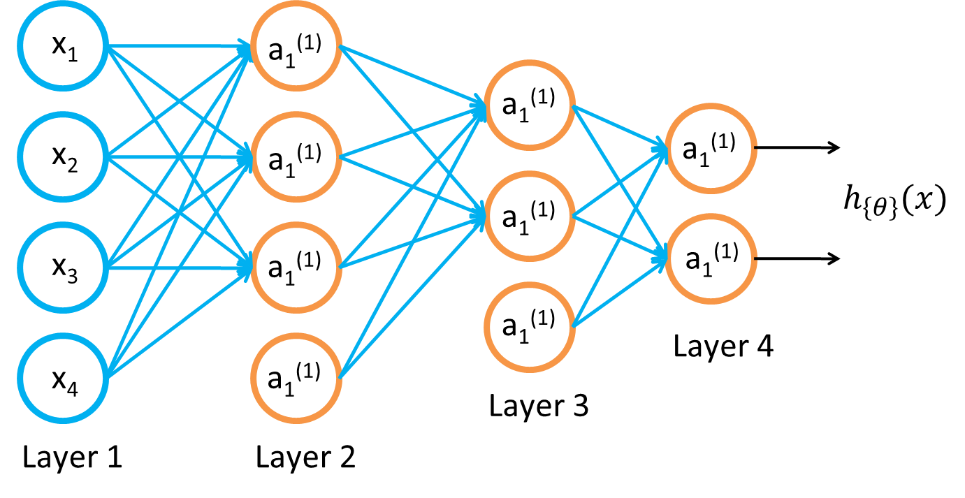
Baseline III: Training a neural network
Given training set (x₁, y₁), (x₂, y₂), (x₃, y₃ ), …
Adjust parameters θ (for every node) to make:
(Use gradient descent. “Backpropagation” algorithm. Susceptible to local optima.)

Slide 7
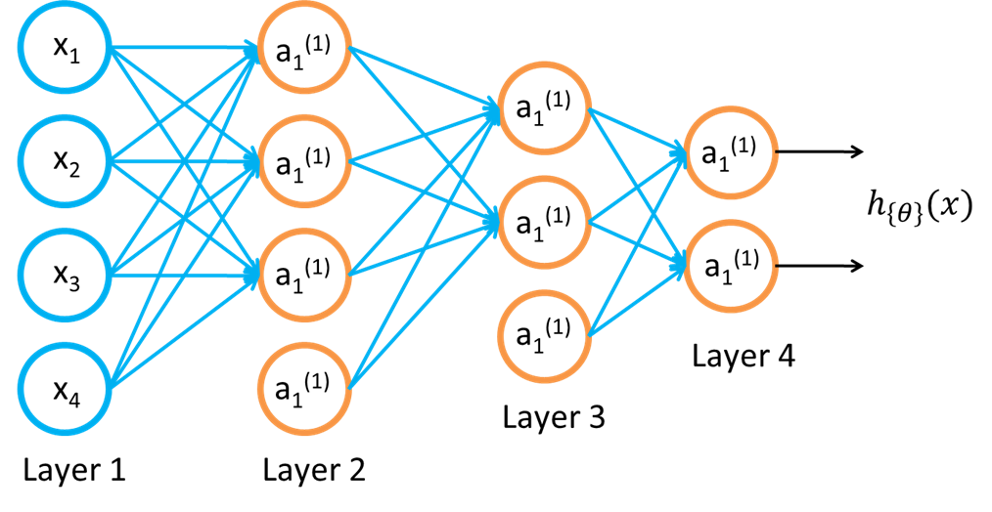
Approach
Inputs:
Initial States
Initialized Positions
Outputs:
Vector of moves to solve puzzle
Note: Puzzles which require less moves will have 0 at remaining output vector space.
Activation Functions:
Sigmoid: Classification
SoftMax: Classification
Tanh: Regression within hidden layers
ReLU: Regression within hidden layers
Optimization Method:
Stochastic Gradient Descent
Tunning Parameters:
Learning Rate
Number of Neurons & Hidden Layers
Once the simulated annealing algorithm has been successfully developed, our goal is to:
Run Simulated Annealing for approximately one week in order to store a large dataset of Initial States, Initialized Positions, and Solution steps to solve the puzzle.
Use Deep Neural Networks to predict the Solution Steps given any Initial Configuration.

