Slide 1
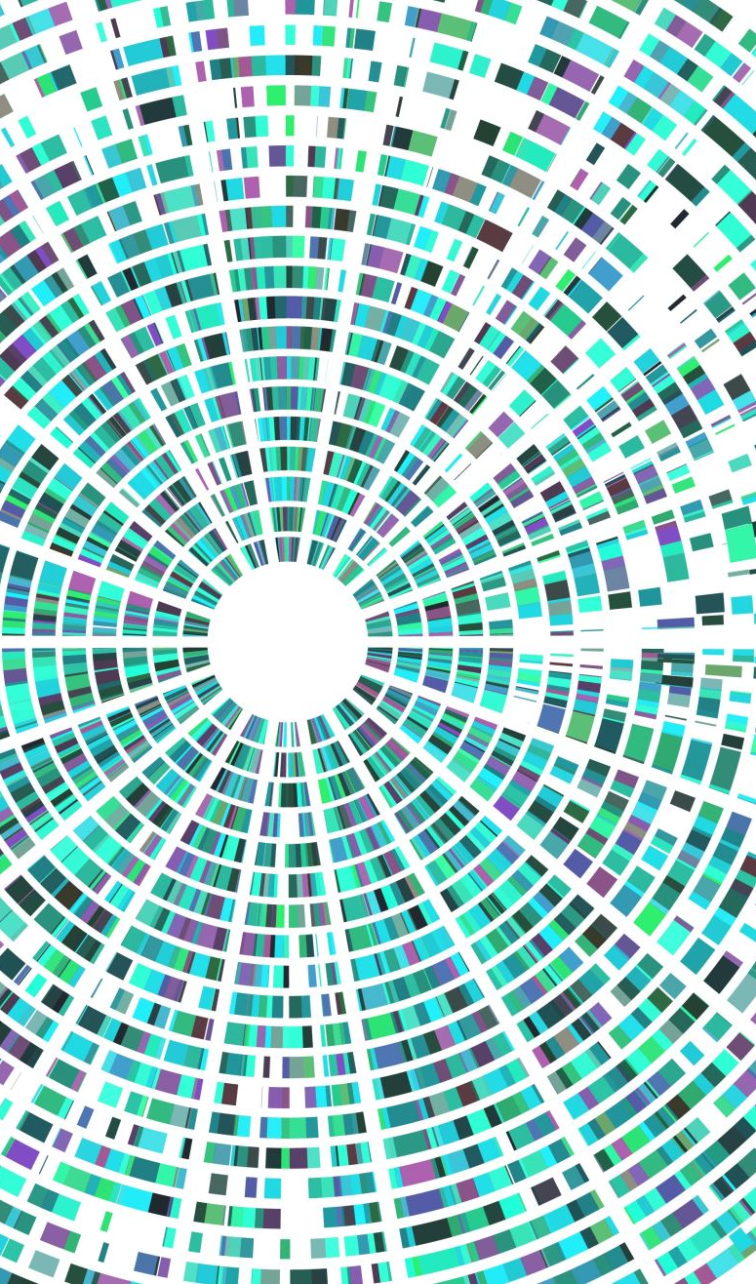
Hill Climbing Implement on Light-up puzzle
COMP6600 Final Project
James Browning
Roberto Perera
Libo Sun

Slide 2
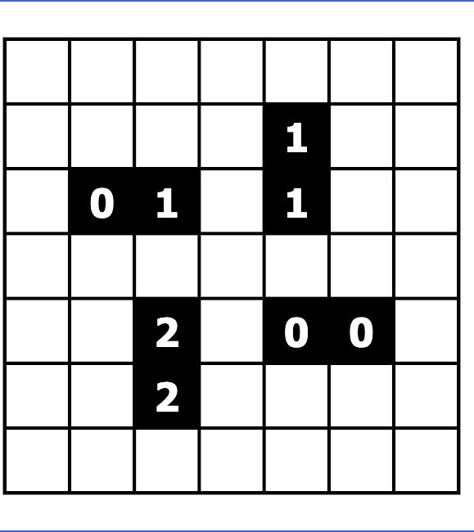
Initial puzzle

Slide 3
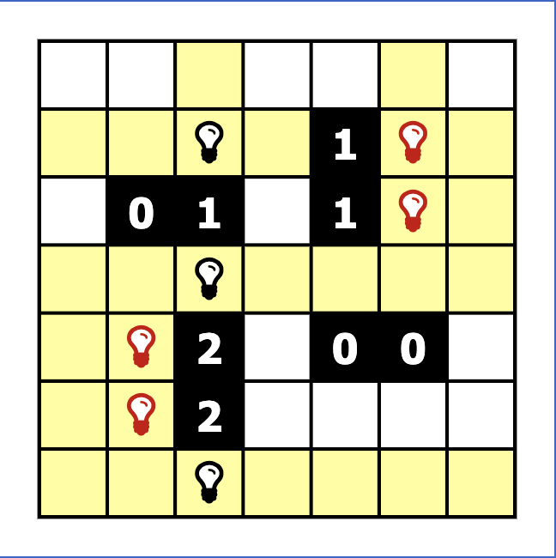
Initialization
Random
Blindly add bulbs to meet the black cell adjacency.
Violations
No two light bulbs shine on each other.
The numbers black cell adjacency

Slide 4
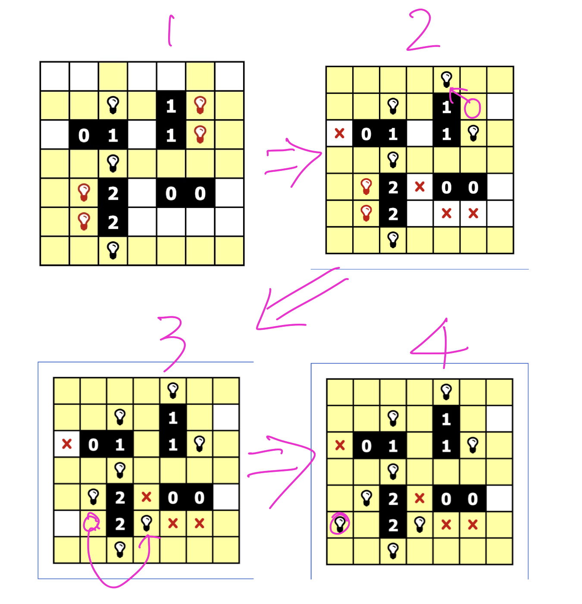
Generating neighbor(s)
Algorithms:
Hill climbing, Simulated annealing, and deep neural networks.

Slide 5
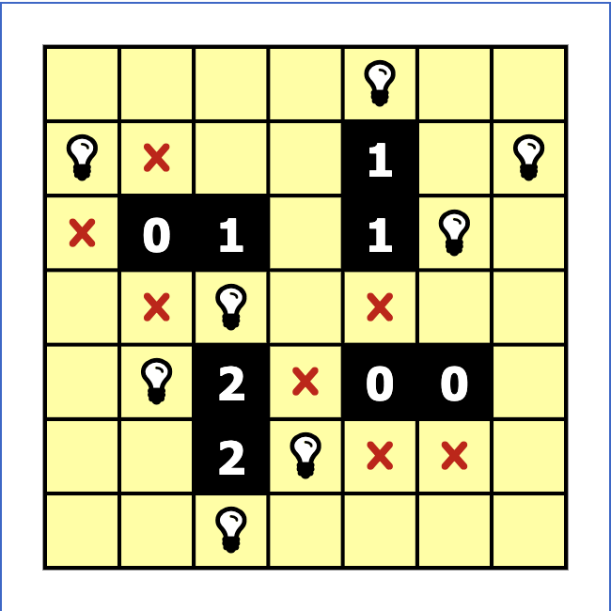
Best solution
Maximum cells lit up
Minimum violations

