Slide 1
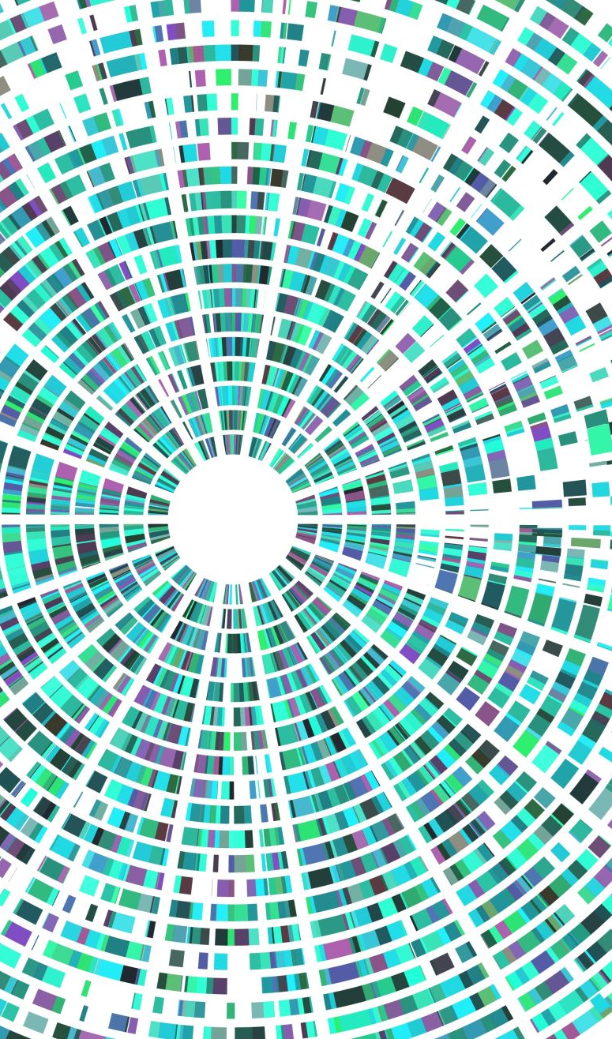
Hill Climbing Implement on Light-up puzzle
COMP6600 Final Project
James Browning
Roberto Perera Aguiar
Libo Sun

Slide 2
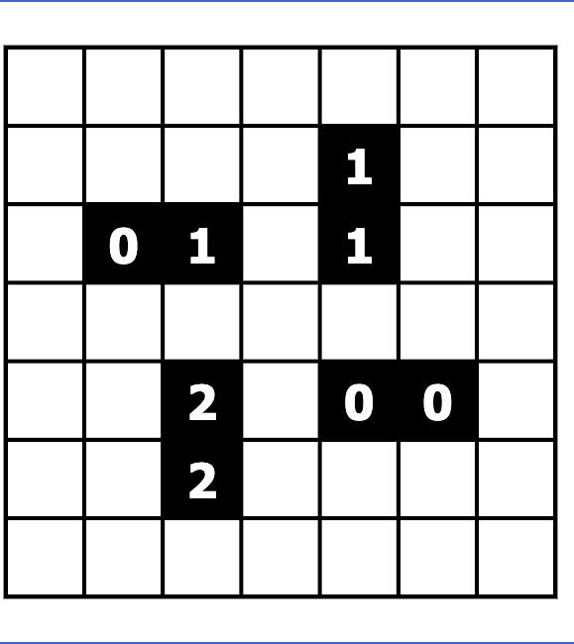
Initial puzzle

Slide 3
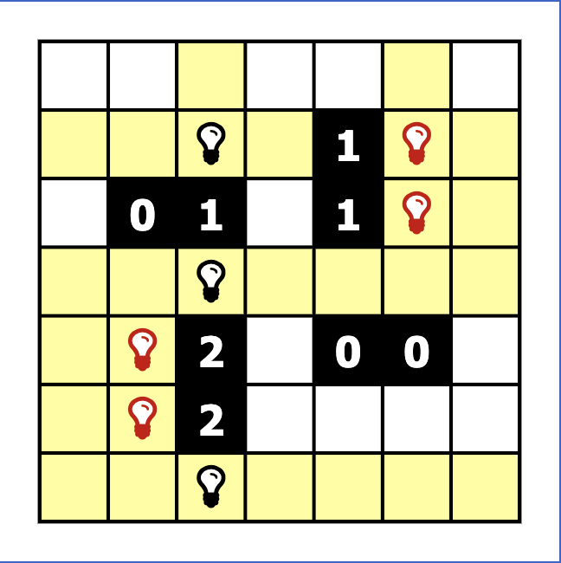
Initialization
Random
Blindly add bulbs to meet the black cell adjacency.
Violations
No two light bulbs shine on each other.
The numbers black cell adjacency

Slide 4
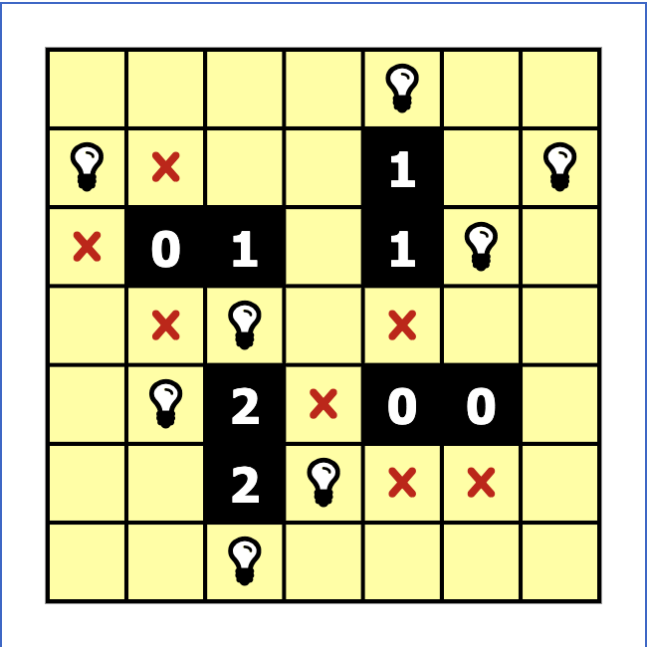
Goal State
Maximum cells lit up
Minimum violations
Algorithms:
Hill climbing, Simulated annealing, and deep neural networks.

Slide 5
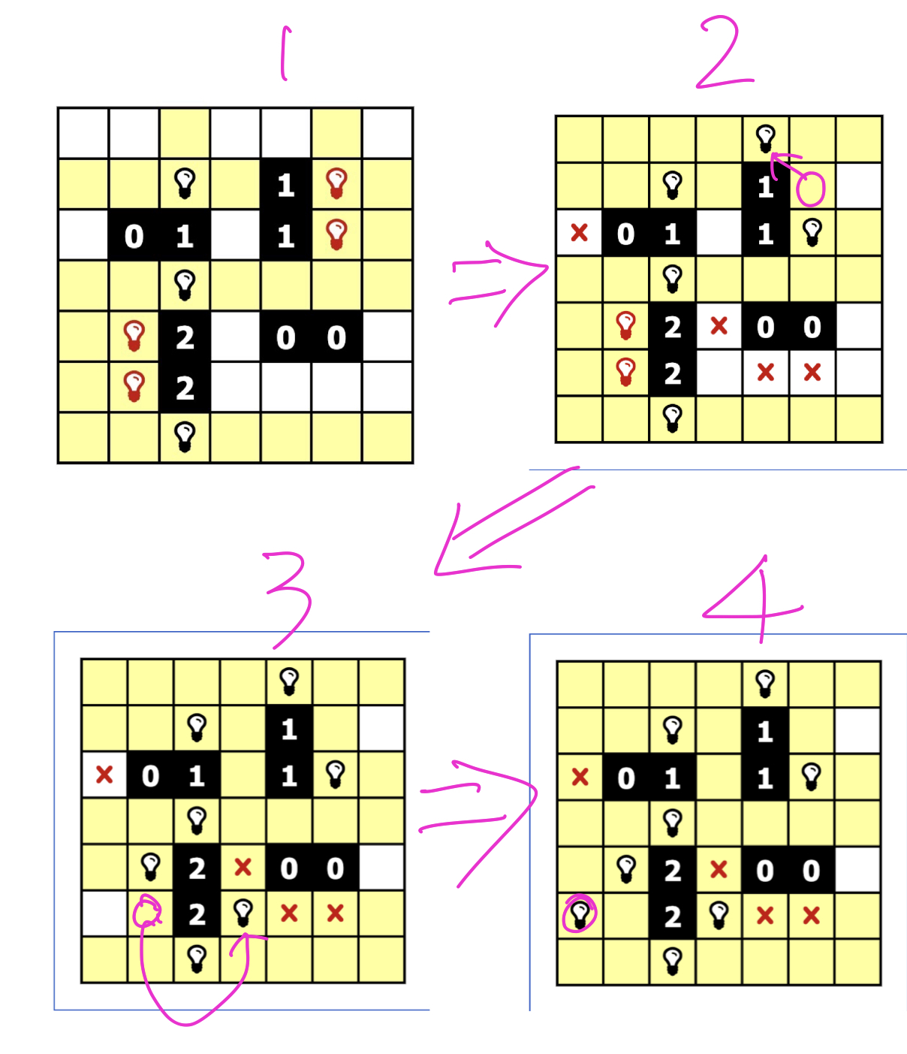
Generating neighbor(s)
Actions: 1.Removing a bulb from a cell
2. Adding a bulb into an empty cell
3. Moving a bulb from one cell to another empty cell
Fitness score:
Positive: number of lit up cells
Negative: number of violations
Algorithms:
Hill climbing, Simulated annealing, and deep neural networks.

Slide 6
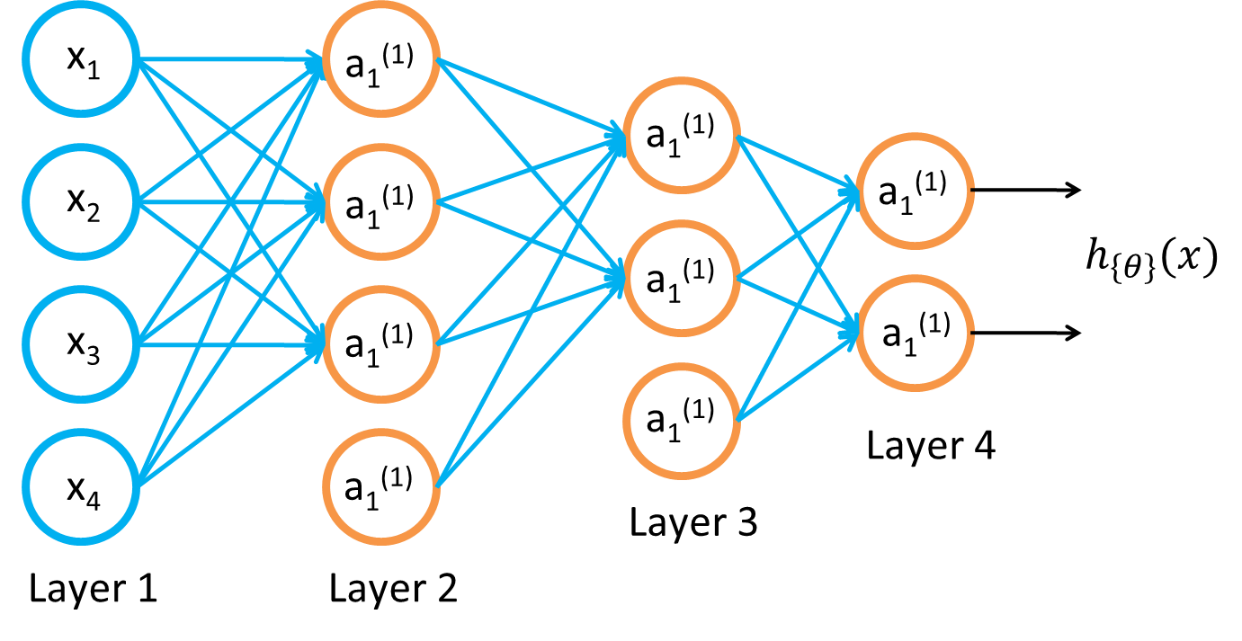
Baseline III: Training a neural network
Given training set (x₁, y₁), (x₂, y₂), (x₃, y₃ ), ….
Adjust parameters θ (for every node) to make:
(Use gradient descent. “Backpropagation” algorithm. Susceptible to local optima.)

Slide 7
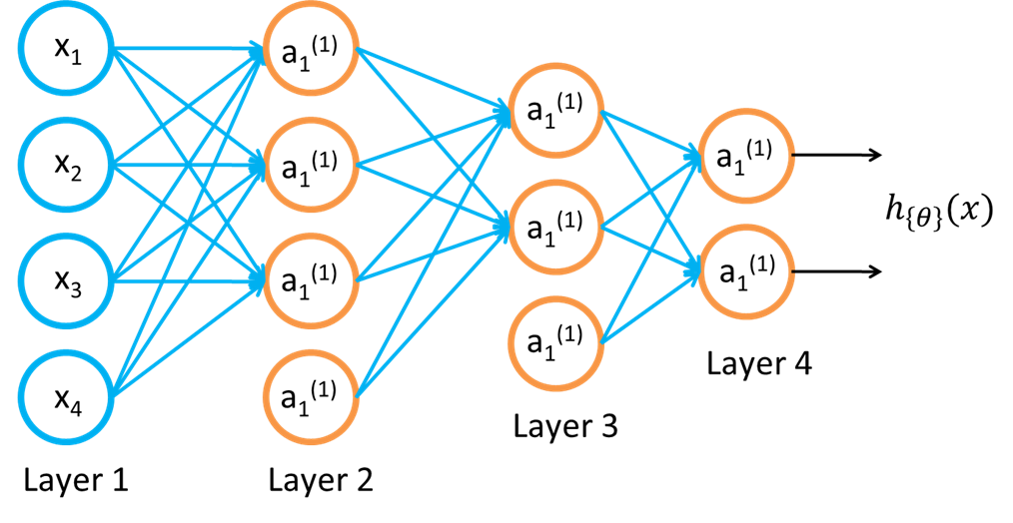
Approach
Inputs:
Initial States
Initialized Positions
Outputs:
Vector of moves to solve puzzle
Note: Puzzles which require less moves will have 0 at remaining output vector space.
Activation Functions:
Sigmoid: Classification
SoftMax: Classification
Tanh: Regression within hidden layers
ReLU: Regression within hidden layers
Optimization Method:
Stochastic Gradient Descent
Tunning Parameters:
Learning Rate
Number of Neurons & Hidden Layers
Once the Simulated Annealing AI algorithm has been successfully developed, the goal is to:
Run Simulated Annealing for approximately one week in order to store a large dataset of Initial States, Initialized Positions, and Solution steps to solve the puzzle.
Use Deep Neural Networks to predict the Solution Steps given any Initial Configuration.

