Slide 1

Beauty and Joy of Computing (BJC))
COMP 6620
Kevin Boyd, Lacey Wright, Tausif Muzaffar, Adam Payne, Rohit Pendyala, Kanesha Belyeu

Slide 2
Objectives
Introduction to the BJC Project
Background
Methodology
Demo/Implementation
Evaluation
Future Work
Conclusion

Slide 3
Project Overview
E-learning is becoming an increasingly important teaching and learning method in educational institutions.
This website aims to provide an educational platform for developing effective and engaging new high school curricula in computing.
digital simulations, video tutorials, and educational gaming applications
Create a teaching aid targeted towards educators and student in the high school level of education pursuing the area of Computing

Slide 4
Background
The Need for E-Learning
Importance of E-Learning
Using E-Learning in the Classroom
Designing An Effective Interface

Slide 5
Conceptual Model

Slide 6
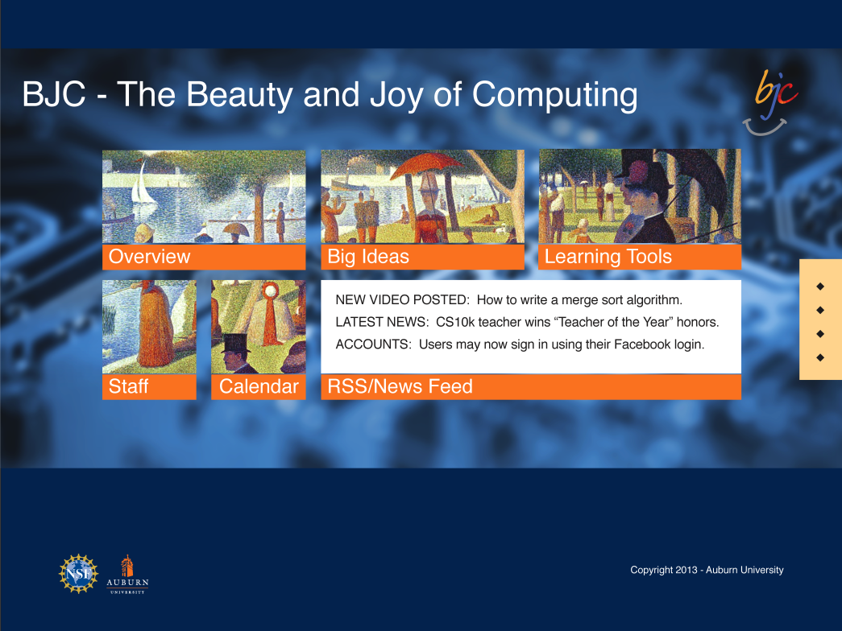
Homepage
Clearly Defined Title
Flat Interface
Reflective of Windows 8 Metro UI
Expanding Menu from Right Side for Signing In and Contact Information.

Slide 7
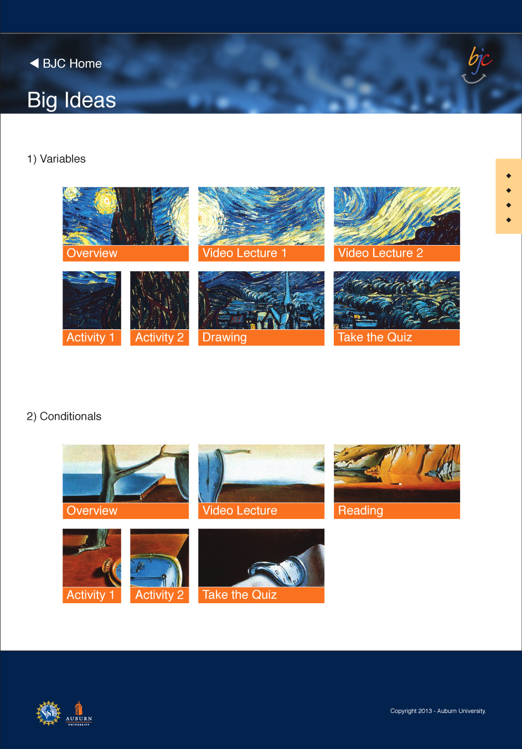
Subpage
Clearly Defined Title
Reflective of Homepage interface.
Placed on White Background for simplicity.
Back Button for Easy Navigation back home.

Slide 8

Functional Requirements

Slide 9
Overall
Provide information about Computing in the form of lectures and games
Safe and Secure environment to stimulate the learning of computing ideals
Easy Accessibility

Slide 10
Homepage Requirements
Tiled-App format
Links contained in tiles
Manage User base:
Professional: Upload to the website or post comments

Slide 11
Security Requirements
Users must have account to access site
Users:
Teacher, Parent, or Student

Slide 12
Content Pages Requirements
Host games and lectures relevant to the computing area selected by user
After accessing the first lecture or game, the user must login or create an account
Registered Users get full website access
Professional users will be verified by admin

Slide 13
Interface Requirements
Information should be easily visible for the user to select
Information should be shown in a rotational manner with descriptions

Slide 14
Demo/Implementation

Slide 15
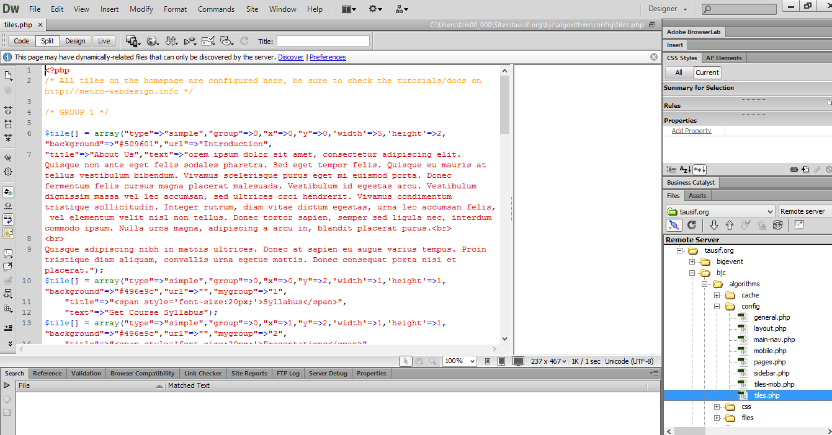
Backbone of Design
PHP
Template design

Slide 16
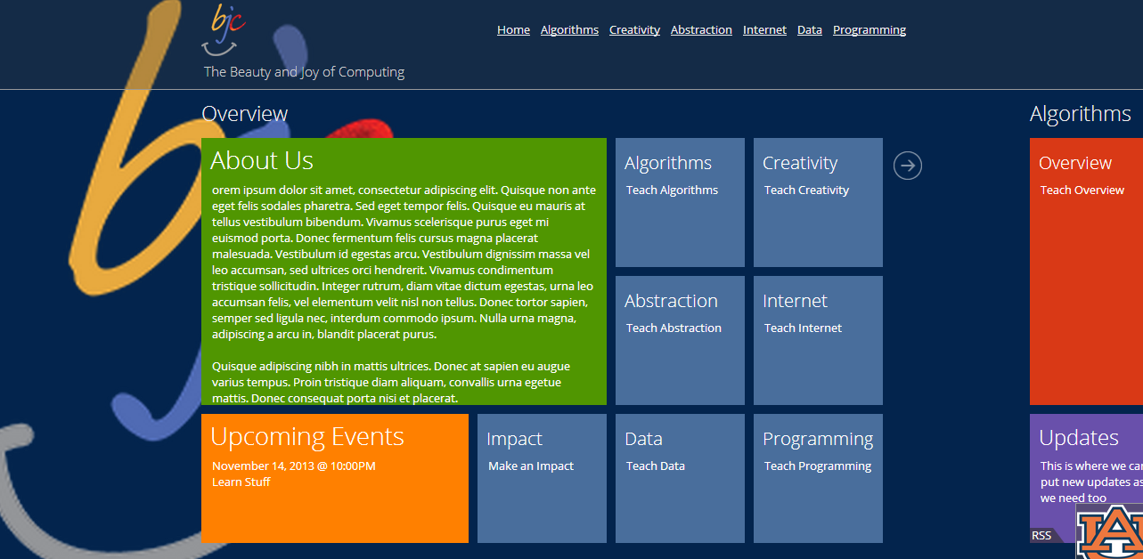
Implementation of Design
Created Title Layout
Added themes and color scheme
Click here

Slide 17
Evaluation

Slide 18
Usability Evaluation
Learnability
Page and topics are clearly labeled and links give users what is expected.
Efficiency
Numerous routes to various sections around the site increase efficiency.
Memorability
Redundancy of navigation routes and Windows 8 style interface promote easy re-establishment of proficiency.
Errors
Simplicity of the site contributes to very few user errors.
Satisfaction
After making a few tweaks to the initial implementation, users seem to be very satisfied with the design and aesthetics.

Slide 19
RAD Process Model
Extreme Programming-
Changing Customer requirements
Frequent releases
Allows programming in pairs
XP is a lightweight discipline of software development based on principles of simplicity, communication and feedback

Slide 20
XP Practices Followed
The Planning Process
Small Releases
Simple Design
Testing
Refactoring
Pair Programming
On-site Customer

Slide 21

Future Work

Slide 22
Future Work
Manage User Log in
Database Setup
Add More Lecture/Game content
Professional Blog
Streamline Uploading Process

Slide 23
Conclusion
E-learning is becoming very popular and effective in education
There are many different E-learning methods and techniques
There are numerous benefits to E-learning
Notes:
-Methods and techniques include blended learning (partial in class, partial online) Ex. Putting assessments online, delivering pre-work online, etc.
-E-learning allows for students to learn from anywhere and at the time that is most convenient for them

