Slide 1
Case: SmartGrid
By: Julian, Mark & Sebastiaan

Slide 2
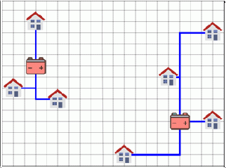
Introductie Case
Houses and Solarpanels
Store the excess energy in batteries
Goal: place houses and batteries in an optimal cost-efficient configuration
Specifications
A house is connected to only 1 battery
Cables can cross, but are not connected
Cables are allowed to cross houses
Difficulties
Little room between total capacity houses and batteries
State Space enlarges with latter half of the case

Slide 3
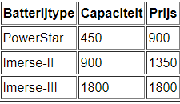
Parts of Case
1: Able to connect each house with a battery
Same batteries, fixed locations
2: Able to calculate the total cost
3: Able to relocate the batteries
At more cost-efficient locations
4: Optimize battery types
With given battery types
Given battery types (part 4)
Notes:
Optie 1
Per huis top 5 batterijafstand te maken
Welke huizen hebben prioriteit: dichstbijzijnde en verafstaande
Als batterij volle capaciteit bezit, zoek de volgende dichstbijzijnde batterij
Optie 2
Alle huizen verbinden met dischtbijzijnde
Welke batterijen zitten vol? → verplaats verbindingen naar de volgende dichstbijzijnde
Rinse repeat

Slide 4
State Space
Subpart 1 & 2
#houses ^#batteries : 150^5
Subpart 3
Poss. Batt. Locs. : gridsize^ #batteries = 2500^5
Poss. connections: #houses^ #batteries = 150^5
Total: #houses ^ #batteries + gridsize ^ #batteries
2500^5 + 150^5
Subpart 4
Largest battery set: 17 batteries
Max state space = 2500^17 + 150^17

Slide 5
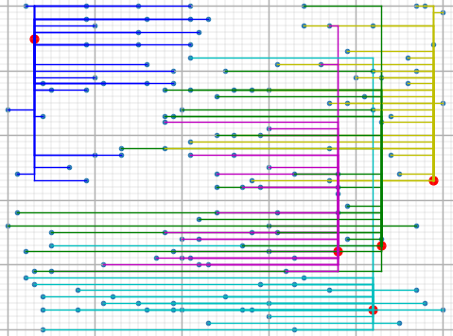
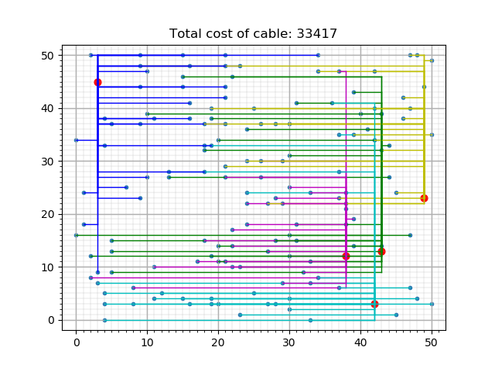
Algorithms
Step-Down
Step-Down
Connects all houses to closest batteries
Reconnects houses of overloaded batteries
Deterministic
Greedy
Connect random houses to closest battery
If battery is full, next closest
If configuration possible, next iteration
Else, restart iteration
Greedy

Slide 6
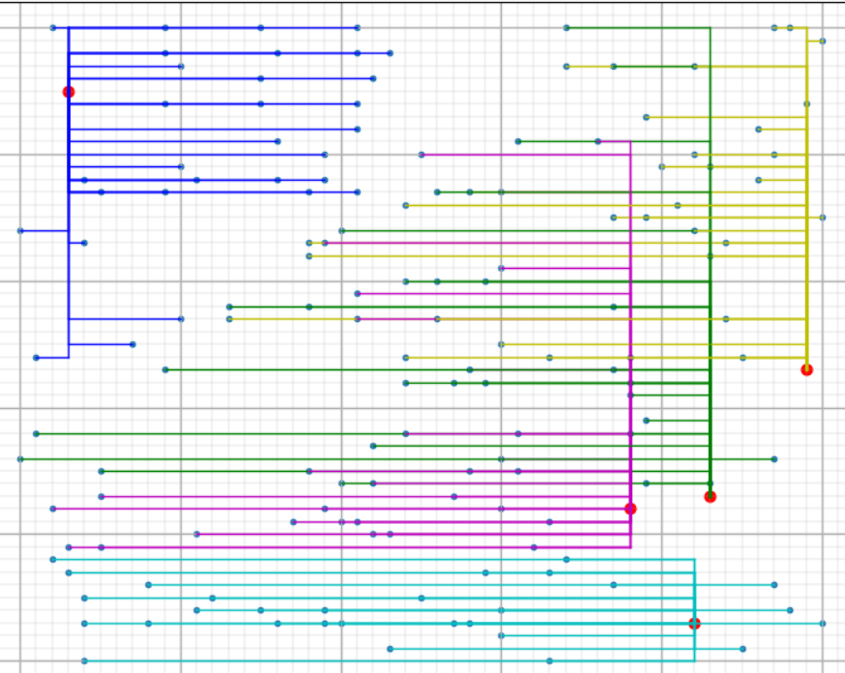
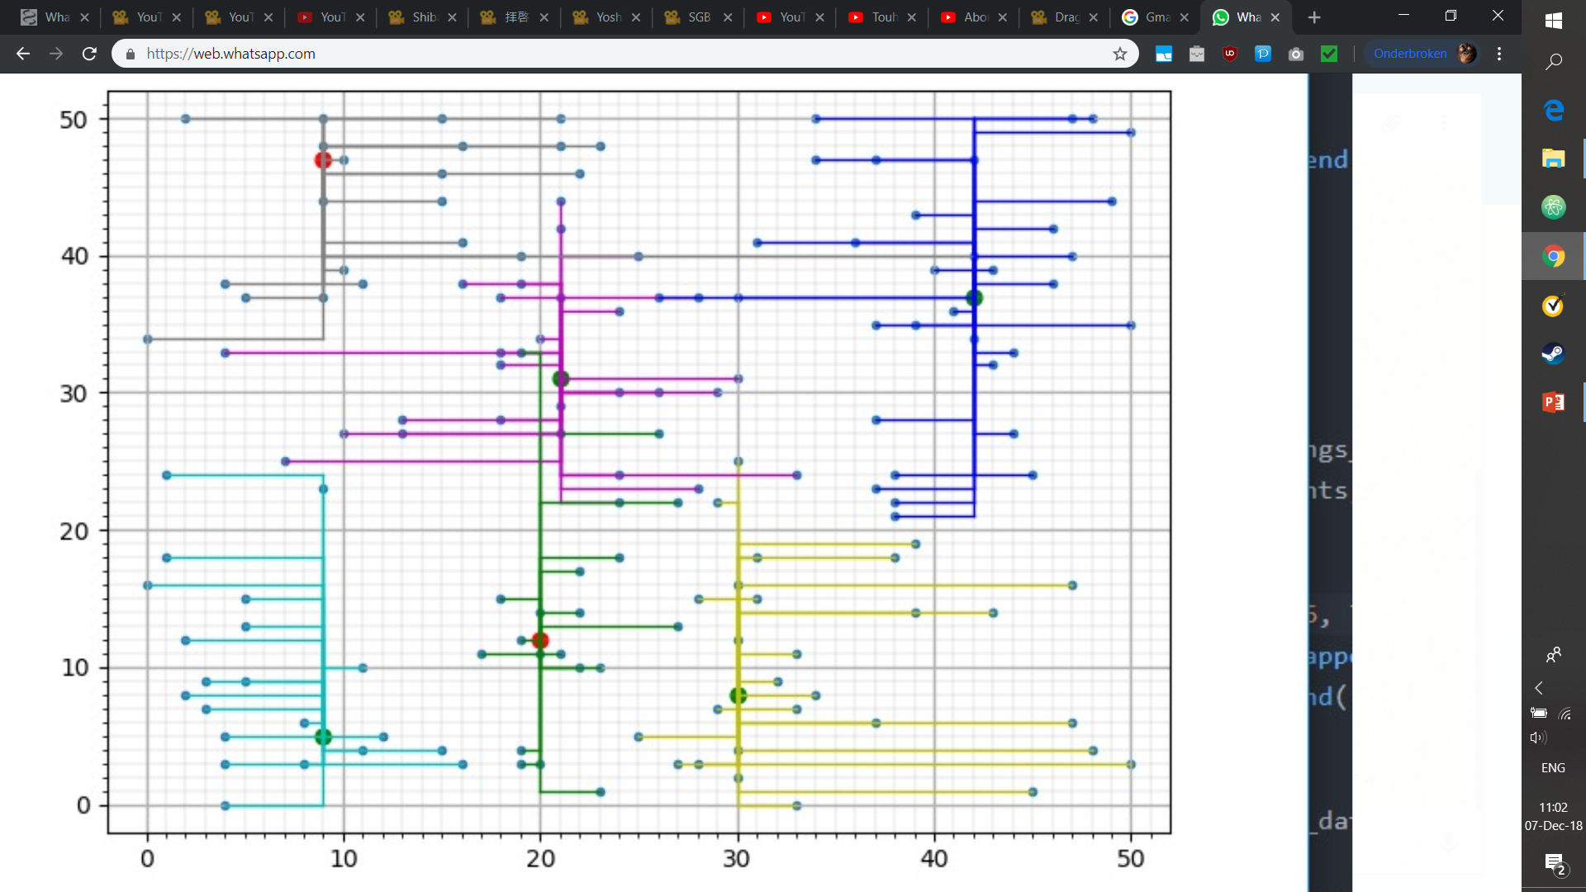
Algorithms
Hill Climber
Hill Climber
Random configuration within constraints
Switches random sequences of houses
Until no further improvements
Depth-First, Branch-n-Bound
Tries every configuration
Breaks a branch if it breaks certain restrictions
(no data yet)
Cluster + greedy

Slide 7
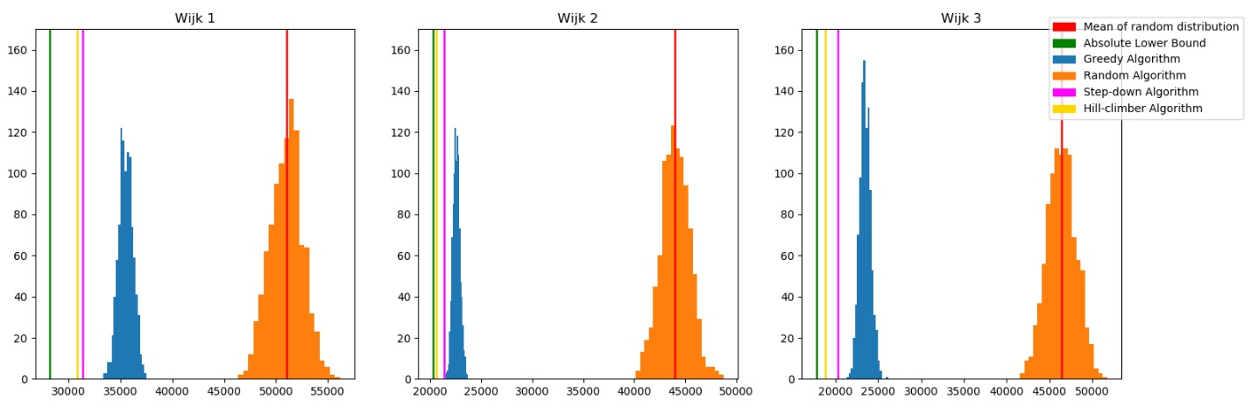
Algoritmes, pre-reallocation
Notes:
Hill climber lijn omdat de grafiek anders onduidelijk wordt

Slide 8
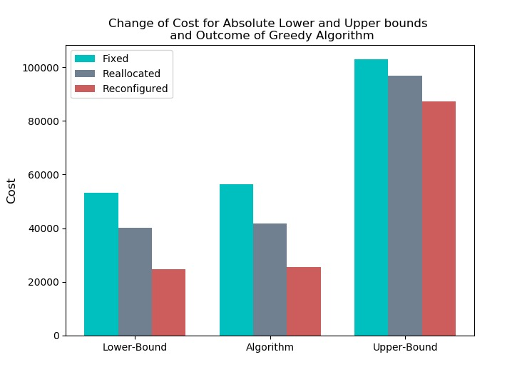
Battery movement
Battery set-ups
Fixed location
Reallocated locations
Reconfigured battery types
Every variable is lowered after relocation
Further lowered when reconfigured

Slide 9
Algoritmes vergelijken, wijk 1
 | Step-Down | Greedy | HillClimber | BranchnBound
Tijd | <1 sec/wijk | ~2 sec/wijk | ~2-3 uur/wijk | ~1 uur
Kosten | 56401 | 58417 | 55843 | xxx
Kwantificatie | 6.45% | 10.49% | 5.32% | Xxx
Kosten | 41686 | 42406 | xxx | xxx
Kwantificatie | 2.57% | 3.84% | xxx | xxx
Kosten | xxx | 27774 | xxx | xxx
kwantificatie | xxx | 2.097% | xxx | xxx
Standaard Batterijen
Verplaatste Batterijen
+ Andere batterijen

