Slide 1
Case: SmartGrid
By: Julian, Mark & Sebastiaan

Slide 2
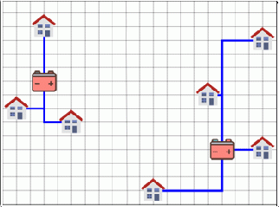
Case Introduction
Houses and Solarpanels
Store the excess energy in batteries
Goal: place houses and batteries in an optimal cost-efficient configuration
Specifications
A house is connected to only 1 battery
Cables can cross, but are not connected
Cables are allowed to cross houses
Difficulties
Little room between total capacity houses and batteries
State Space grows more than exponentially in the latter half of the case
Notes:
Zebez

Slide 3
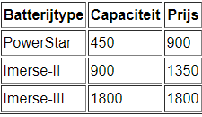
Parts of Case
1: Able to connect each house with a battery
Same batteries, fixed locations
2: Able to calculate the total cost
3: Able to relocate the batteries
At more cost-efficient locations
4: Optimize battery types
With given battery types
Given battery types (part 4)
Notes:
Relocate en Configure mogelijk uitleggen?

Slide 4
State Space
Subpart 1 & 2
#houses ^#batteries : 150^5
Subpart 3
Poss. Batt. Locs. : gridsize^ #batteries = 2500^5
Poss. connections: #houses^ #batteries = 150^5
Total: #houses ^ #batteries + gridsize ^ #batteries
2500^5 + 150^5
Subpart 4
Largest battery set: 17 batteries
Max state space = 2500^17 + 150^17
Notes:
zebaz

Slide 5
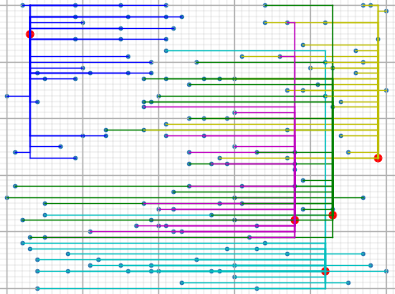
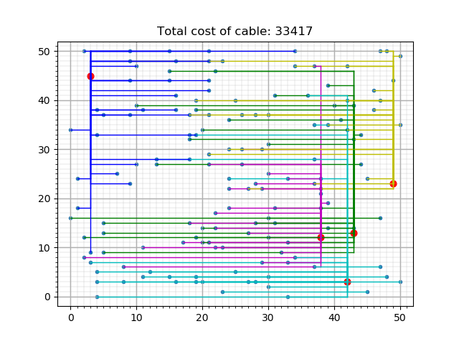
Algorithms
Step-Down
Step-Down
Connects all houses to closest batteries
Reconnects houses of overloaded batteries
Deterministic
Greedy
Connect random houses to closest battery
If battery is full, next closest
If configuration possible, next iteration
Else, restart iteration
Greedy
Notes:
jul

Slide 6
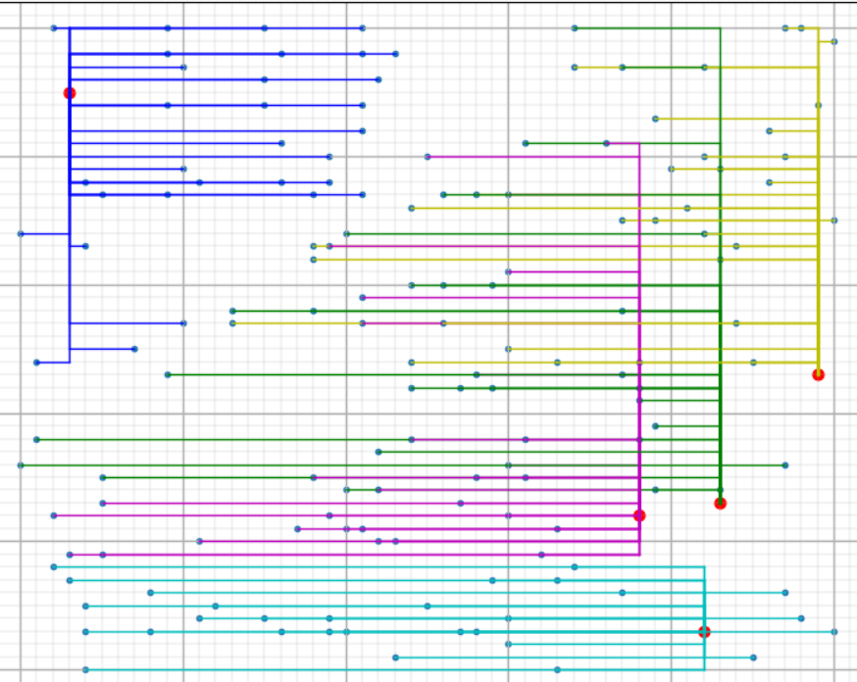
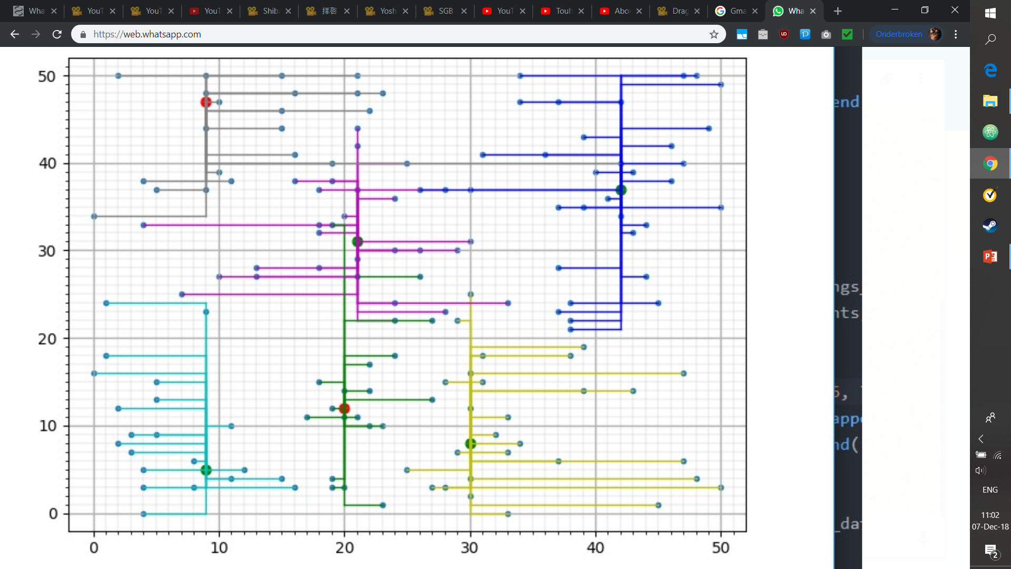
Algorithms
Hill Climber
Hill Climber
Random configuration within constraints
Switches random sequences of houses
Until no further improvements
Depth-First, Branch-n-Bound
Tries every configuration
Breaks a branch if it breaks certain restrictions
Battery not realistically efficient
Battery capacity already too high
Total costs already too high
(no data yet)
Cluster + greedy
Notes:
jul

Slide 7
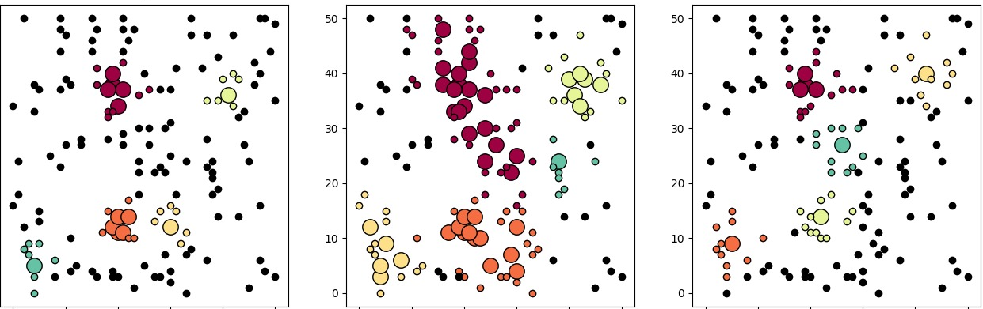
Part 3: Relocate batteries
Find better locations for batteries
DB Scan
Cluster algorithm
Returns multiple variations
Select variations
Through Greedy
Notes:
jul

Slide 8
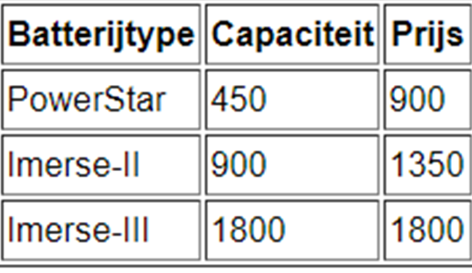
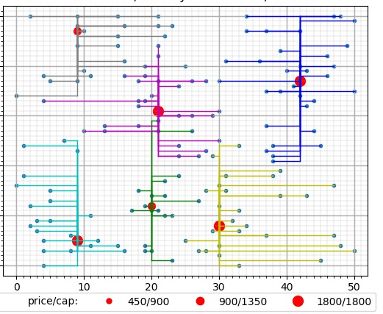
Part 4: Reconfigure
New battery types
Battery sets: possible combinations of batterytypes
More than 5 batteries per set
Find n clusters for the possible combinations of battery types
Calculate weight/cluster
Give each cluster a battery type based on its weight
Notes:
jul

Slide 9
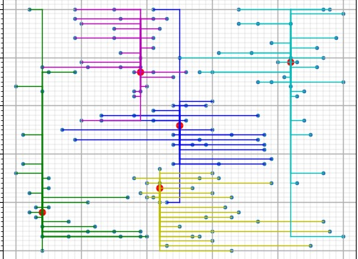

Result per battery set-up
Fixed-batteries
Relocated batteries
Reconfigured battery types

Slide 10
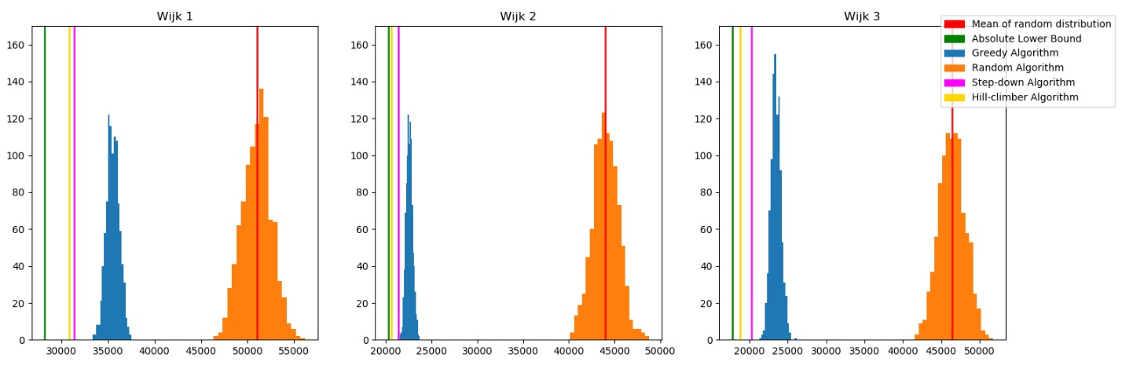
Algoritmes, pre-reallocation
Notes:
Hill climber lijn omdat de grafiek anders onduidelijk wordt

Slide 11
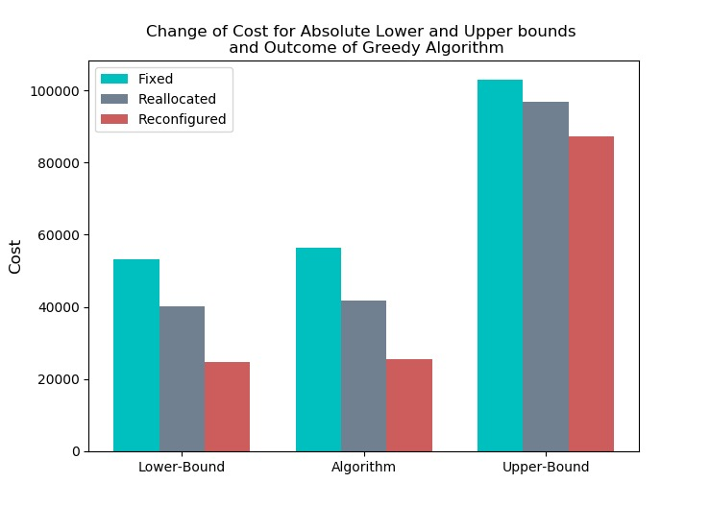
Battery movement
Battery set-ups
Fixed location
Reallocated locations
Reconfigured battery types
Every variable is lowered after relocation
Further lowered when reconfigured

Slide 12
Algorithms compare, wijk 1
 | Step-Down | Greedy | HillClimber | BranchnBound
Tijd | <1 sec/wijk | ~2 sec/wijk | ~2-3 uur/wijk | 12+ uur
Kosten | 56401 | 58417 | 55843 | xxx
Kwantificatie | 6.45% | 10.49% | 5.32% | Xxx
Kosten | 41686 | 42406 | xxx | xxx
Kwantificatie | 2.57% | 3.84% | xxx | xxx
Kosten | xxx | 27774 | xxx | xxx
kwantificatie | xxx | 2.097% | xxx | xxx
Standaard Batterijen
Verplaatste Batterijen
+ Andere batterijen

Slide 13
Conclusion
Best result
End product

