Slide 1
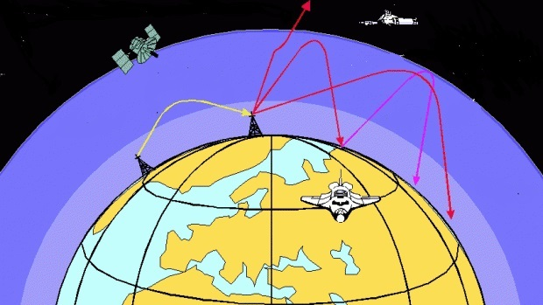
A simple model and applications of ray tracing through plasma
Alex Cobo Zarzuelo
Andrés Leiva Genre
COMPUTING AND NUMERICAL METHODS

Slide 2
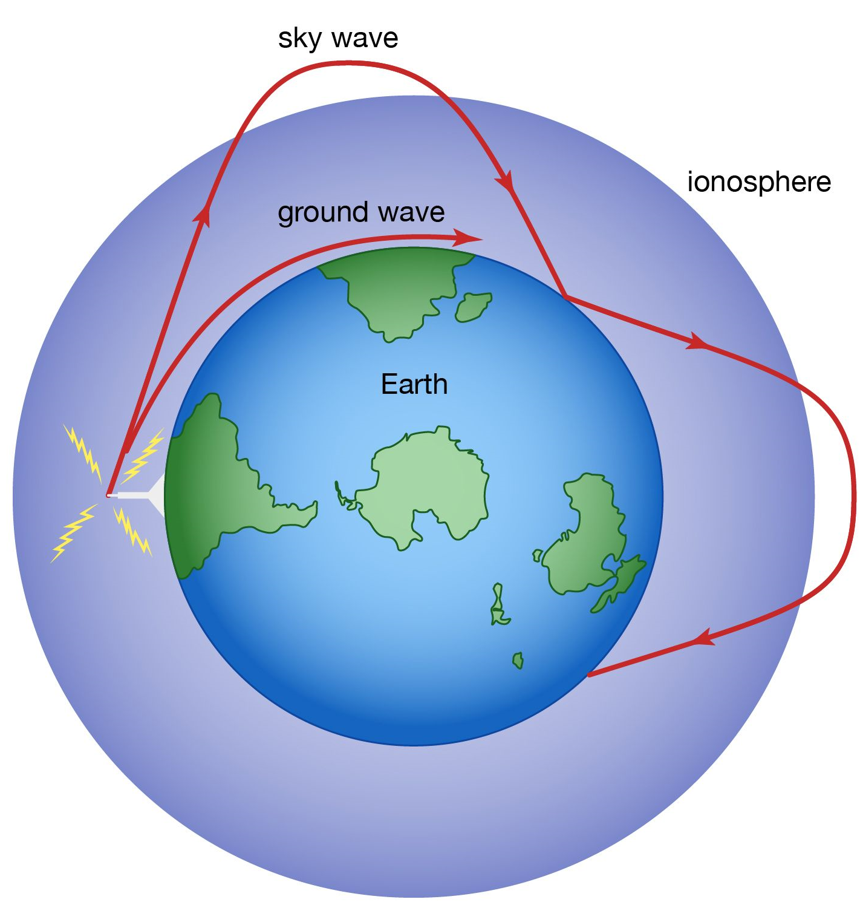
INDEX
Introduction
Theoretical framework
Code & Implementation
Process
Applications
Conclusions & Future work

Slide 3

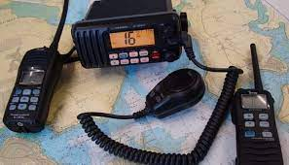
INTRODUCTION
Radio waves propagation around the Earth
Long distance communication

Slide 4
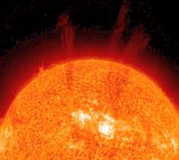
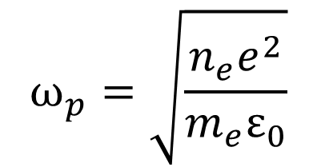
THEORETICAL FRAMEWORK
Plasma
Free electrons
$$ω_{p}=\sqrt{\frac{n_{e}e^{2}}{m_{e}ε_{0}}}$$

Slide 5
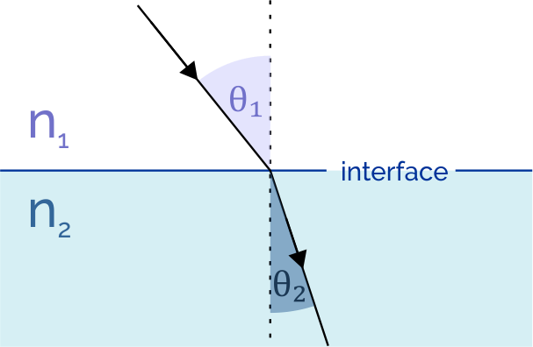
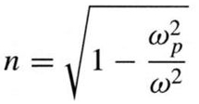

THEORETICAL FRAMEWORK
Time reversal property
Snell law:

Slide 6
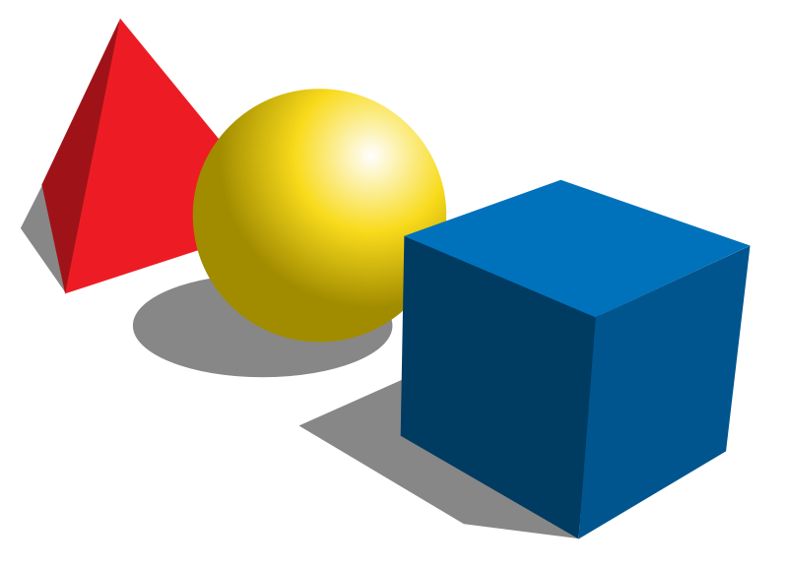
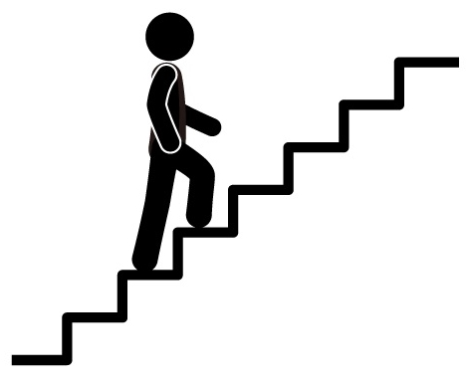
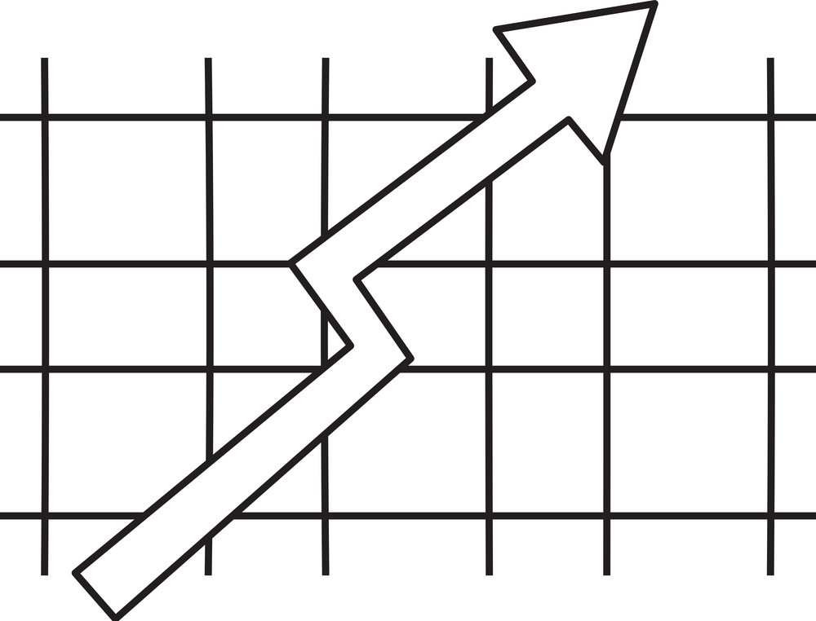
CODE & IMPLEMENTATION
&
Grid
1
Geometry
2
Steps

Slide 7
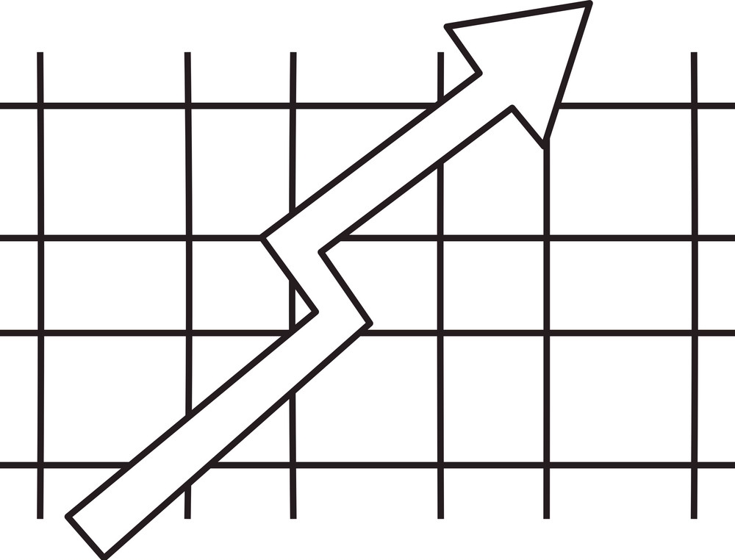
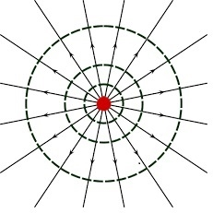
1) GEOMETRY
y
n
n
x
Plane
Polar

Slide 8

2) STEPS
Plane
x0=step_t*(c/n0)*np.cos(theta0)
y0=step_t*(c/n0)*np.sin(theta0)
x = x0 * np.cos(ubre) - y0*np.sin(ubre)
y = x0 * np.sin(ubre) + y0*np.cos(ubre)
Circle
if (abs(sum_h+y)>=delta_y):
current_index+=1 #We go to the next grid
#See if changes refraction index:
if (n1==n0):
sum_h+= y - delta_y #Goes to next cell normal
ray.append([ray[i-1][0]+x,ray[i-1][1]+y])
else:
Sum_h 2
Sum_h 3
Sum_h 1
$$Δy$$

Slide 9
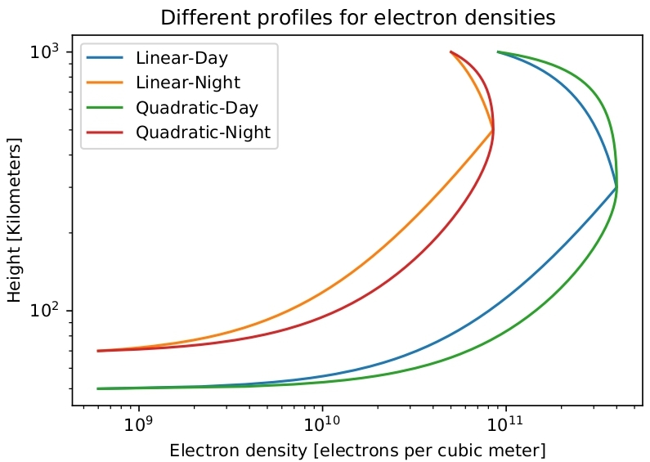

PROCESS
$$1^{st}$$
Choose electron density
Define refraction index

Slide 10
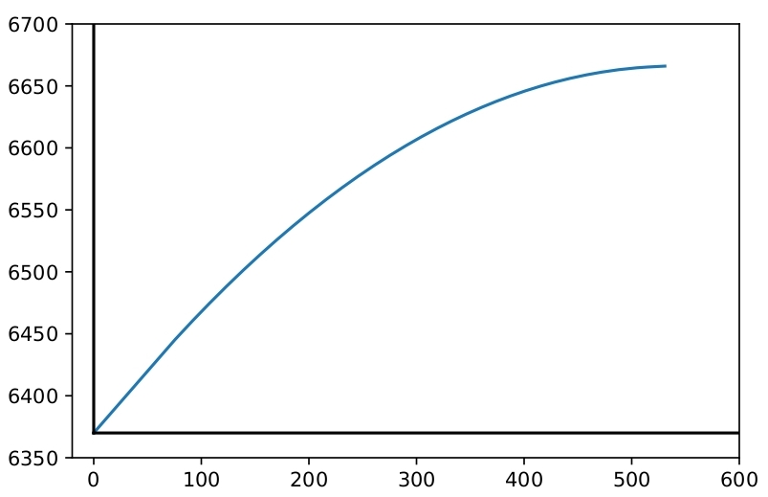
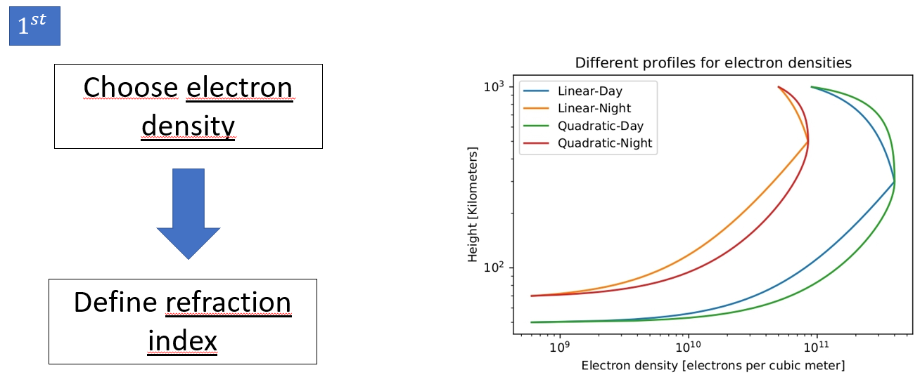
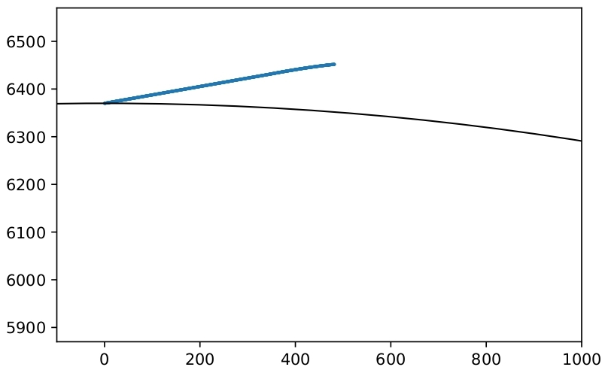
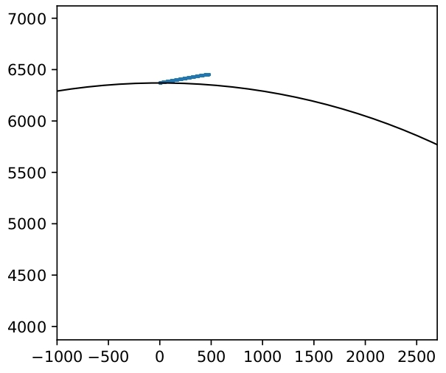

PROCESS
PLANE
$$2^{nd}$$
POLAR

Slide 11
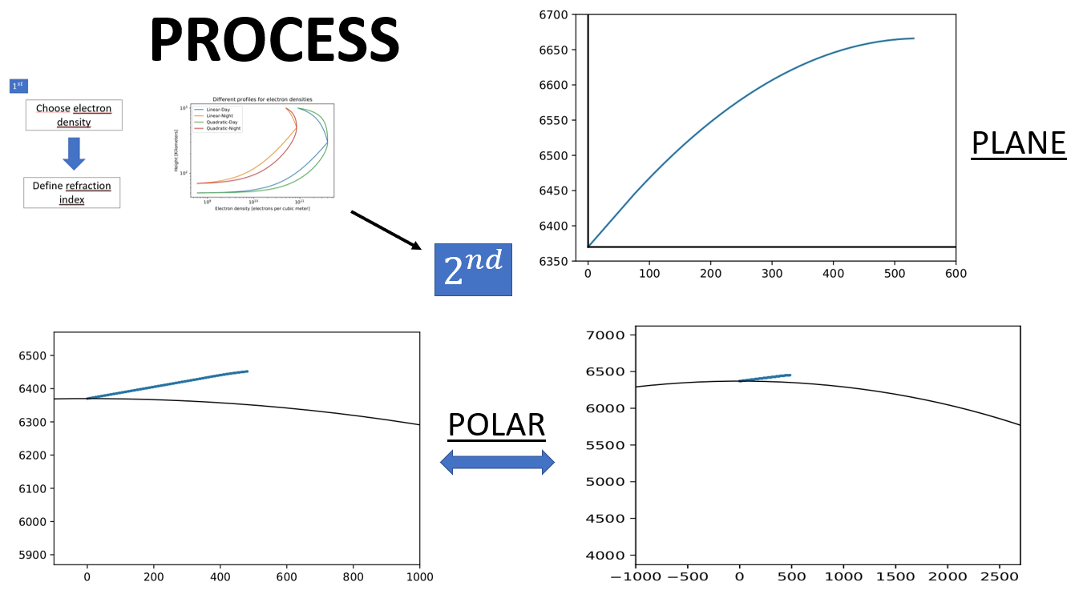
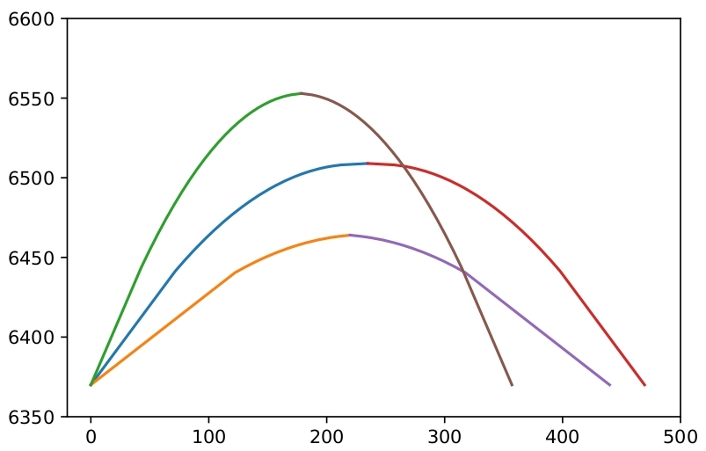
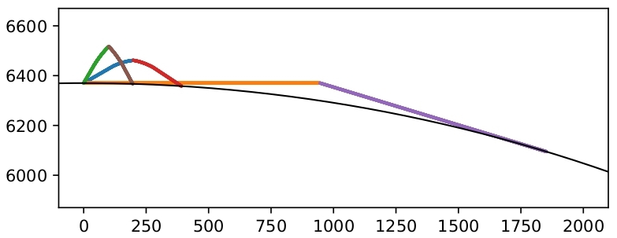
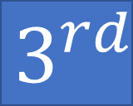
PROCESS
$$3^{rd}$$
Getting ANDRÉS

Slide 12
APPLICATIONS
1
FREQUENCY [Hz] | ANGLE [Degrees] | DISTANCE [Km]
3E6 | 45 | 137.1
8E6 | 45 | 137.1
1.5E7 | 45 | 152.9
2E7 | 45 | 221.2
FREQUENCY [Hz] | ANGLE [Degrees] | DISTANCE [Km]
2E7 | 0 | 1879.3
2E7 | 15 | 482.6
2E7 | 30 | 235.6
2E7 | 45 | 221.2
2E7 | 60 | 126.7

Slide 13
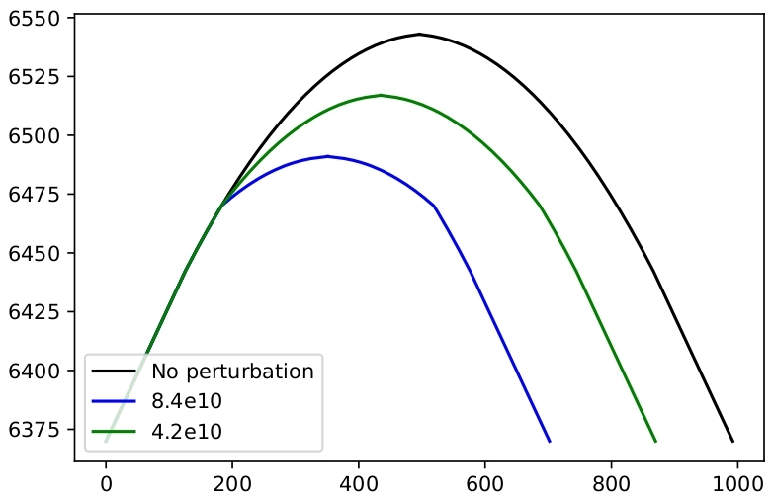
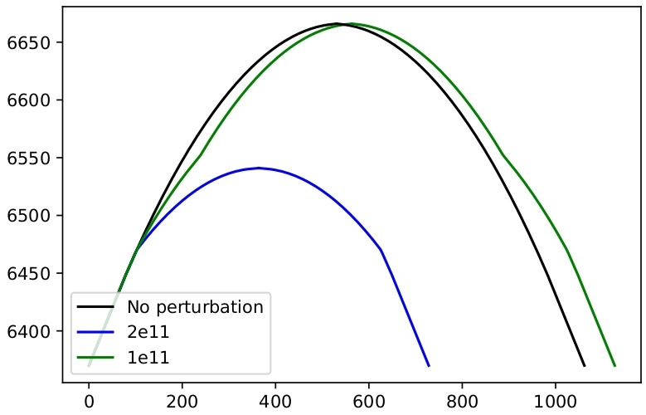
APPLICATIONS
2
Linear Day
Quadratic Day
Perturbation from 100 to 180 km

Slide 14
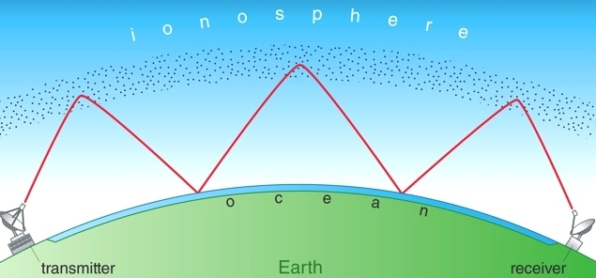
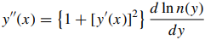
CONCLUSIONS AND FUTURE WORK
Multiple transmisions
Directly solve Fermat’s principle

Slide 15

QUESTIONS?

