Slide 1

Spring Boot
Made with ♥ by @jsomsanith

Slide 2
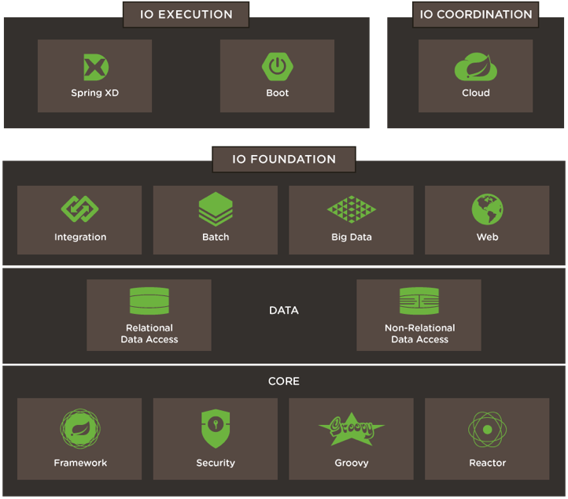

Spring
Made with ♥ by @jsomsanith

Slide 3
Spring boot motivations
Single entry point for every spring part
Code boilerplate
Common default non functional features
Choice to change default quickly
—> Quick start
—> Less configuration, more dev
Made with ♥ by @jsomsanith
Notes:
Spring promote énormément boot
Chaque partie (starter) vient avec une configuration par défaut
Finalité : facilité la vie du dev avec moins de conf

Slide 4
Requirements
Easy requirements
JDK 6+
Mvn 3.2+ / Gradle 1.12+
Made with ♥ by @jsomsanith

Slide 5
Tooling and getting started
CLI
STS (Spring Tool Suite)
IntelliJ Idea 14.1
Website : start.spring.io
Made with ♥ by @jsomsanith

Slide 6
Web Deployment
War
Jar
with embedded web container
java -jar / mvn spring-boot:run

Slide 7
Demo CLI
DEMO CLI TIME
>wget start.spring.io/spring.zip
>spring-xxx/bin/spring --version
>spring run xxx.groovy [--watch]
Notes:
@RestController
class Hello {
@RequestMapping("/hello/{name}")
public String sayHello(@PathVariable("name") final String name) {
return "Hello " + name + " !!!!";
}
}
Spring resolve dependencies and imports ! Generate main, grab web container and launch it

Slide 8
Demo web
DEMO WEB TIME
Site : start.spring.io
Notes:
Generate project from start.spring.io
import in IntelliJ
Describe file architecture
Resource : application.properties
Class : main and main annotation
Demo :
pom.xml : import starter
<dependency>
<groupId>org.springframework.boot</groupId>
<artifactId>spring-boot-starter-web</artifactId>
</dependency>
Create hello/HelloController.java
package demo.hello;
import org.springframework.web.bind.annotation.PathVariable;
import org.springframework.web.bind.annotation.RequestMapping;
import org.springframework.web.bind.annotation.RestController;
@RestController
public class HelloController {
@RequestMapping("/hello/{name}")
public String sayHello(@PathVariable("name") final String name) {
return "Hello " + name + " !!";
}
}
Data :
<dependency>
<groupId>org.springframework.boot</groupId>
<artifactId>spring-boot-starter-data-mongodb</artifactId>
</dependency>
Configure mongodb
spring.data.mongodb.host=localhost
spring.data.mongodb.port=27017
spring.data.mongodb.database=demo
Create customer entity
@Id
private String id;
private String firstName;
private String lastName;
public Customer() {}
public Customer(String firstName, String lastName) {
this.firstName = firstName;
this.lastName = lastName;
}
@Override
public String toString() {
return String.format(
"Customer[id=%s, firstName='%s', lastName='%s']",
id, firstName, lastName);
}
public String getId() {
return id;
}
public void setId(String id) {
this.id = id;
}
public String getFirstName() {
return firstName;
}
public void setFirstName(String firstName) {
this.firstName = firstName;
}
public String getLastName() {
return lastName;
}
public void setLastName(String lastName) {
this.lastName = lastName;
}
Create customer repository (interface)
public interface CustomerRepository extends MongoRepository<Customer, String> {
Customer findByFirstName(final String firstName);
List<Customer> findByLastName(final String lastName);
}
Expose rest entity as resource —> Add rest-data starter in pom.xml
<dependency>
<groupId>org.springframework.boot</groupId>
<artifactId>spring-boot-starter-data-rest</artifactId>
</dependency>
Make entity implements serializable and Configure repository class
@RestResource
@Param("firstname")

Slide 9
Create a starter
We can create custom starters
Auto-Configuration using annotations (ex: @ConditionalOnMissingBean)
Configurable properties class (bean) (@ConfigurationProperties)
Notes:
Properties
@ConfigurationProperties("hello")
public class HelloProperties {
/**
* Prefix of the welcome message.
*/
private String prefix = "Hello";
/**
* Target of the welcome message.
*/
private String target = "World";
public String getPrefix() {
return prefix;
}
public void setPrefix(String prefix) {
this.prefix = prefix;
}
public String getTarget() {
return target;
}
public void setTarget(String target) {
this.target = target;
}
}
Service
public class Hello implements HelloService {
@Autowired
private HelloProperties properties;
@Override
public String sayHello(final String name) {
return properties.getPrefix() + " " + name + " !!";
}
}
Configuration
@Configuration
@ConditionalOnClass(HelloService.class)
@EnableConfigurationProperties(HelloProperties.class)
public class HelloConfiguration {
@Bean
@ConditionalOnMissingBean
public HelloService helloService() {
return new Hello();
}
}
META-INF/spring.factories
org.springframework.boot.autoconfigure.EnableAutoConfiguration=hello.HelloConfiguration
—> use in controller

Slide 10
Industrialization
Starter “actuator”
(With security starter : properties management.role to define the access role)
/env : env and app variables
/autoconfig : auto-config details for each starter
/mappings : service mappings
/beans : beans in context
/dump : thread dump
/info : infos properties (info.xxx)
/metrics : app run metrics
/trace : call traces
Notes:
Pom.xml
<dependency>
<groupId>org.springframework.boot</groupId>
<artifactId>spring-boot-starter-actuator</artifactId>
</dependency>

Slide 11
Industrialization : Healthcheck
Health check : /health (actuator)
Options properties (ex: management.health.mongo.enabled)
Details in authenticated mode
Custom checks
DEMO
Notes:
@Component
public class DBHealthCheck implements HealthIndicator {
private boolean fail = false;
@Override
public Health health() {
//do some checks
if(fail) {
return Health.down().build();
}
else {
return Health.up().build();
}
}
}
————————————
Security
<dependency>
<groupId>org.springframework.boot</groupId>
<artifactId>spring-boot-starter-security</artifactId>
</dependency>
@Configuration
public class SecurityConfig extends GlobalAuthenticationConfigurerAdapter {
@Override
public void init(AuthenticationManagerBuilder auth) throws Exception {
auth.inMemoryAuthentication()
.withUser("user").password("user").roles("USER").and()
.withUser("hero").password("hero").roles("USER", "ADMIN");
}
}

Slide 12
Infos
Devoxx de zéro à héros avec Spring boot
https://speakerdeck.com/snicoll/de-zero-a-heros-avec-spring-boot
Code of this presentation
https://github.com/JSO-Technologies/presentations/tree/master/spring-boot

Slide 13








Questions ?
Made with ♥ by @jsomsanith

