Slide 1
Supervised Contour-Based Pipeline for Butterfly Scale Pedicel Validation
Julian Soto

Slide 2
Main Pipeline Structure:
Raw Microscopy Image Dataset
Contour and Mask Extraction (ERISE_scale_shape_extraction.ipynb)
Annotation-Based Pedicel Reference (scale_shape_ansalysis GUI)
Positive Training Contour Generation (pedicel_classification.ipynb)
Negative Training Contour Generation (pedicel_classification.ipynb)
Fourier Transformations (pedicel_classification.ipynb)
Supervised ML Dataset Construction (pedicel_classification.ipynb)
Model Training (pedicel_classification.ipynb)
Model Evaluation (pedicel_classification.ipynb)

Slide 3
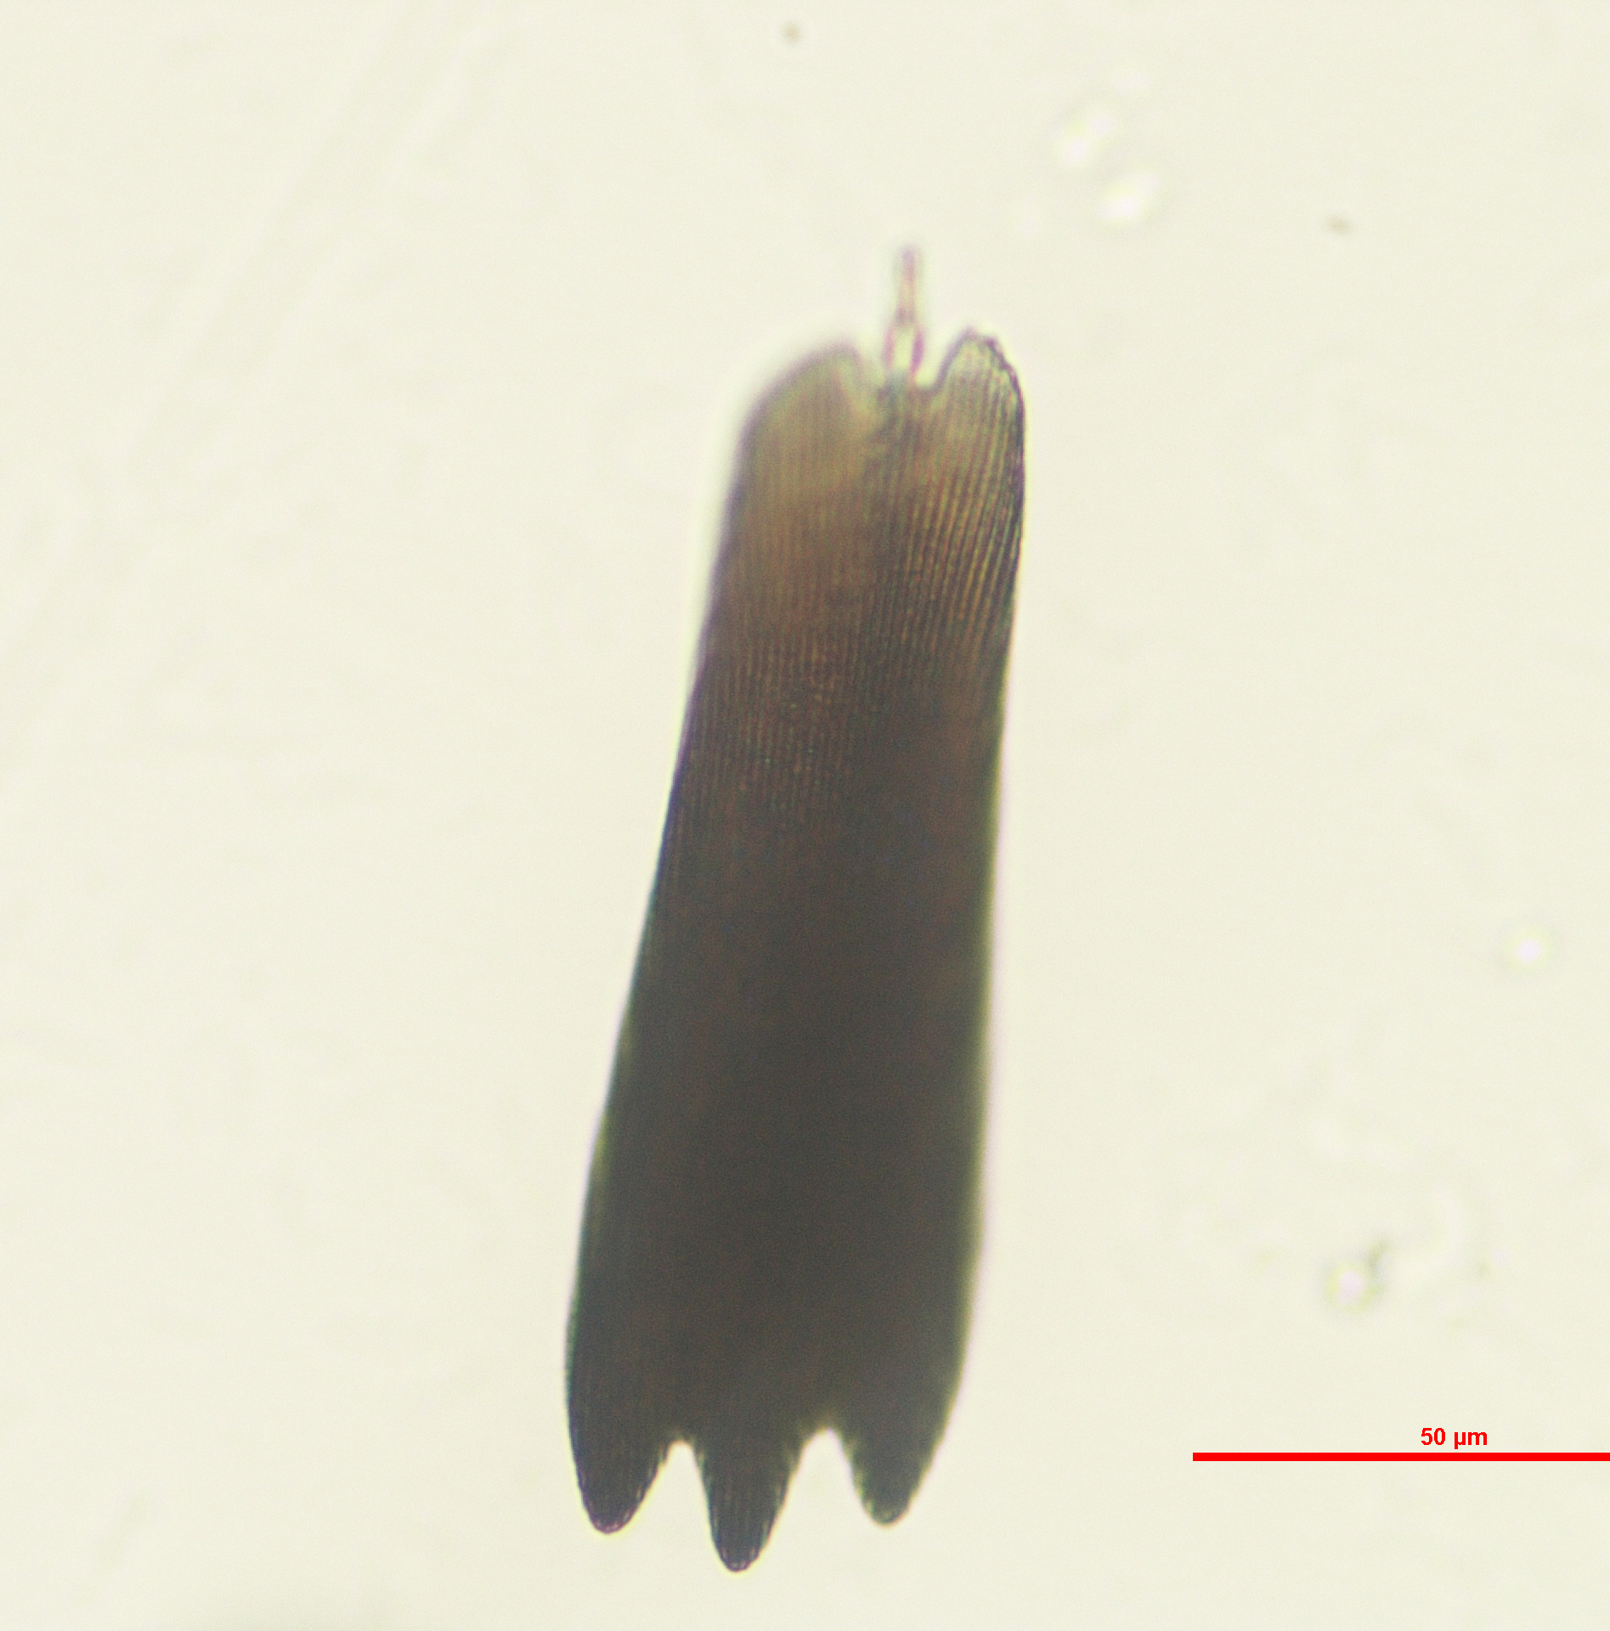
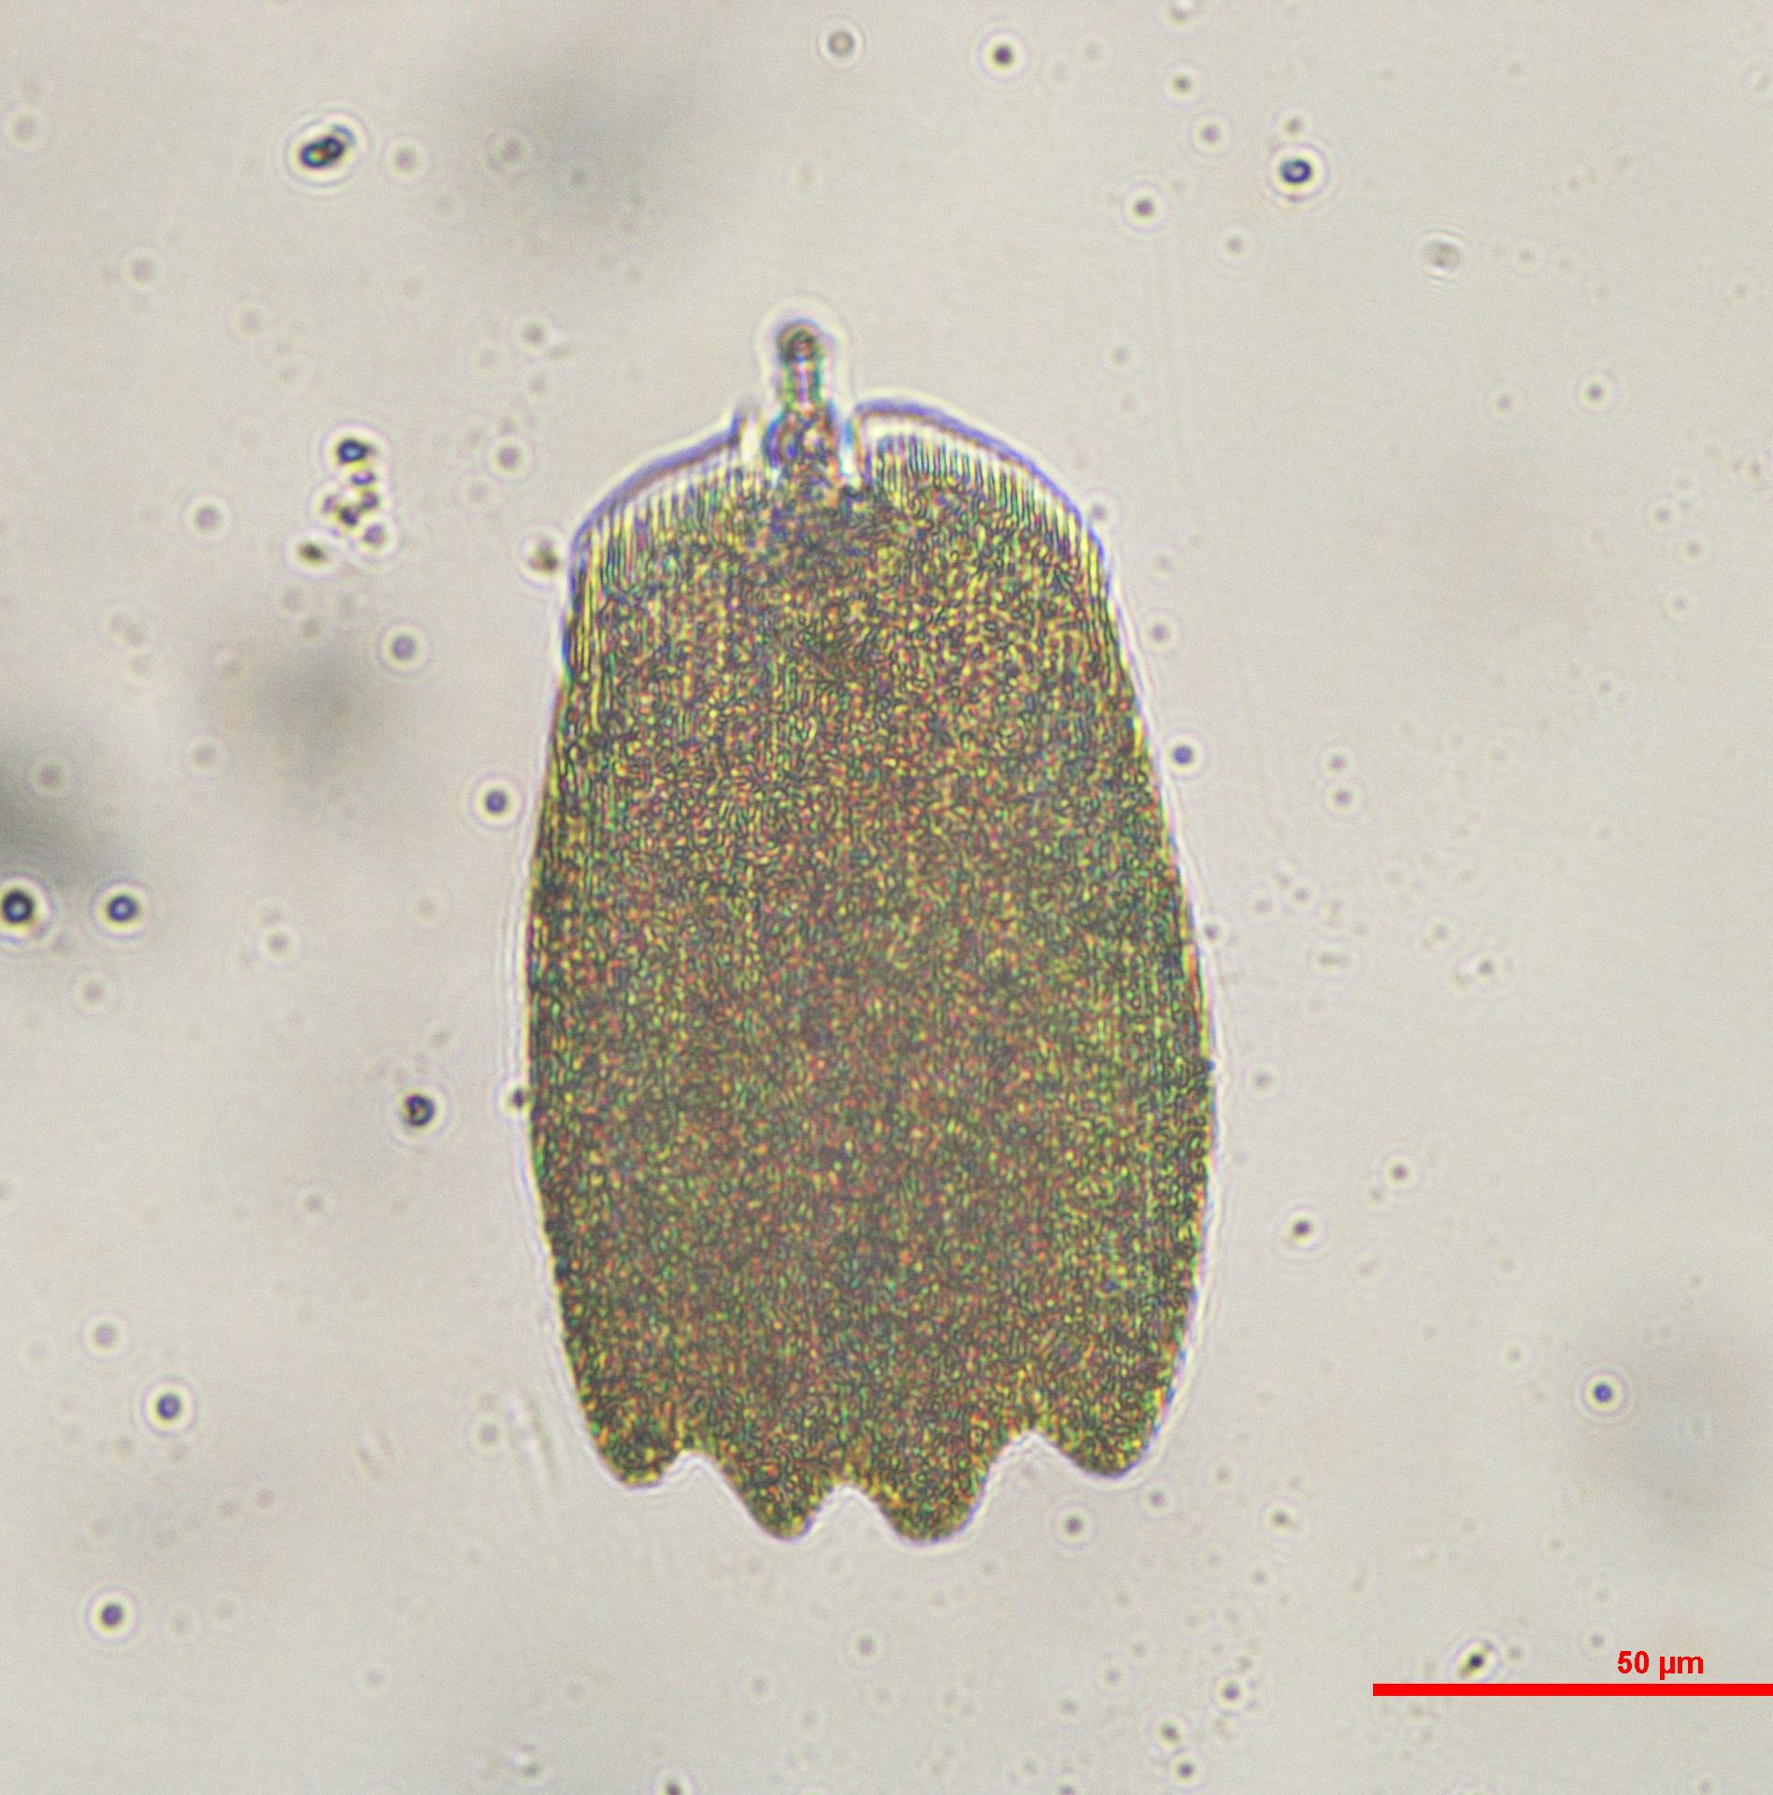
Raw Microscopy Image Dataset
The project begins with approximately 13,000 microscopy images of butterfly scales. These images represent the original visual dataset from which then contour information is extracted.

Slide 4
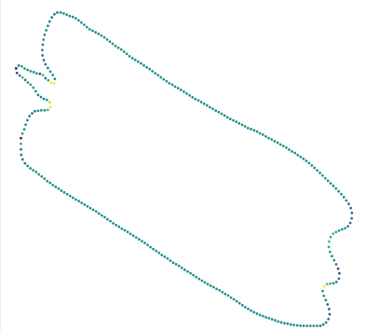
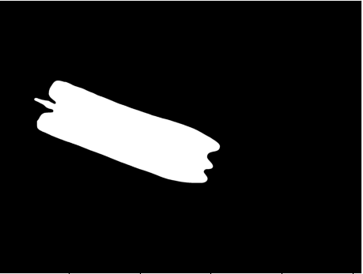
Contour and Mask Extraction
The raw images are processed through an existing contour and mask extraction pipeline. This produces an abstracted contour dataset, where each butterfly scale is represented as an ordered sequece of contour points.

Slide 5
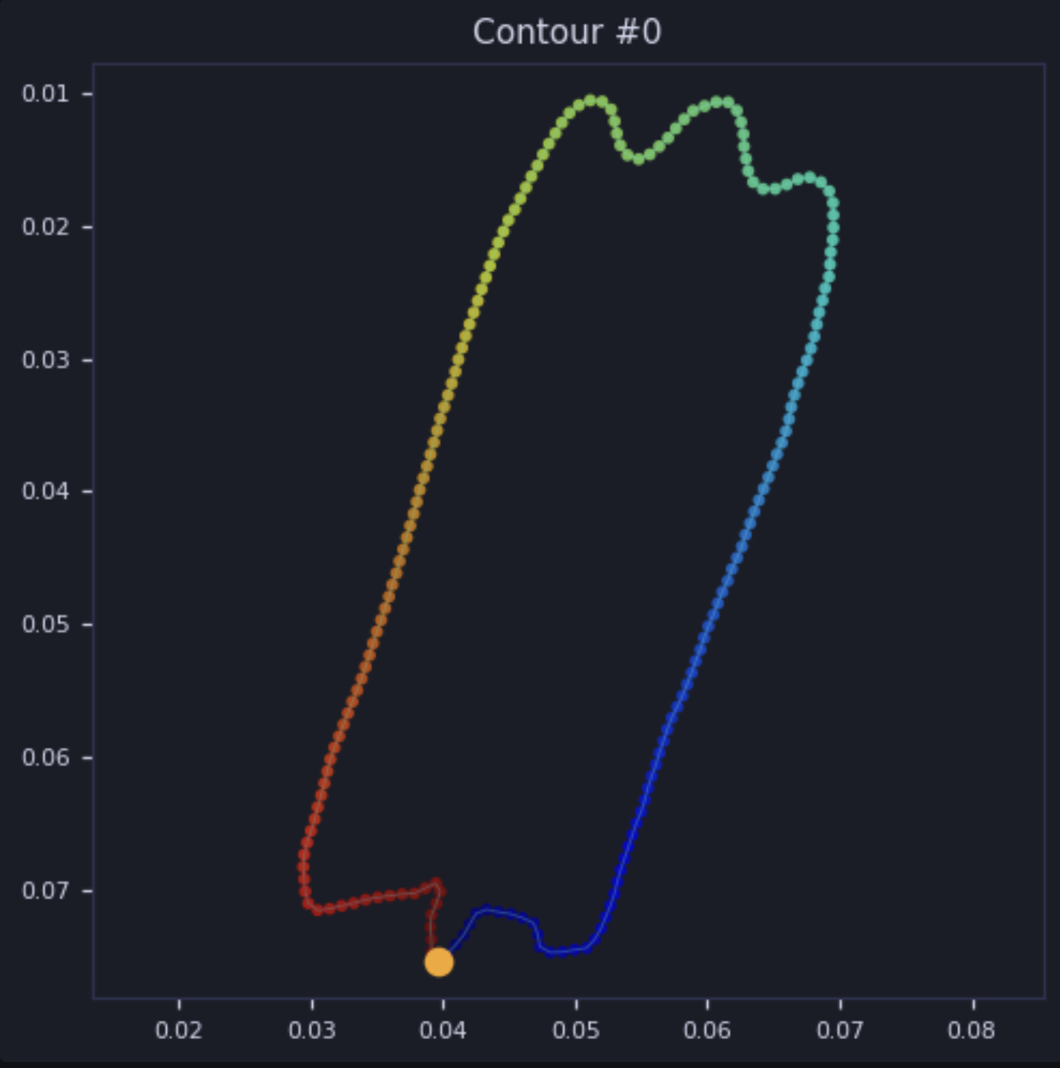
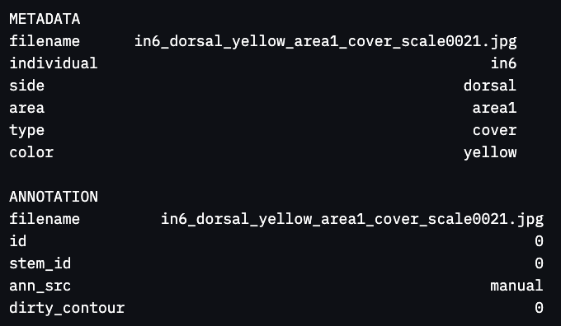
Annotation-Based Pedicel Reference
Each contour is linked to an annotated stem (pedicel) point, identified by stem_id_ann. This point serves as the reference location for the true stem and is used to construct positive training examples.
https://github.com/megretlab/scale_shape_analysis/tree/main/scale_shape_analysis

Slide 6
Positive Training Contour Generation
For valid pedicel examples, each contour is rolled, translated and centered around the the annotated pedicel point. This makes the pedicel the origin of the contour representation, allowing the model to learn the geometric structure associated with a correctly identified stem. We also take neighboring points from 1 poin in each direction to represent other potential points that could be selcted via manual annotation.

Slide 7
Negative Training Contour Generation
Incorrect pedicel examples are generated by selecting high-curvature (Convex from outside of shape) points from the original contour that are not the annotated pedicel. These points are treated as false candidate stems. To represent points that could be selected algoritmically based on curvature patterns. The contour is then rolled and traslated around each selected high curvature point to represent what an incorrectly centered contour looks like.

Slide 8
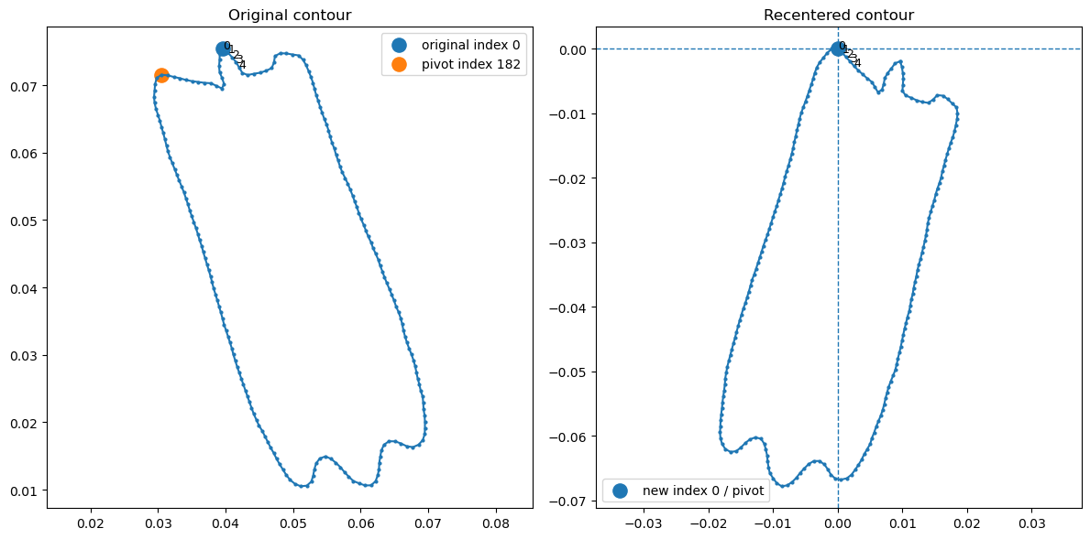

Slide 9
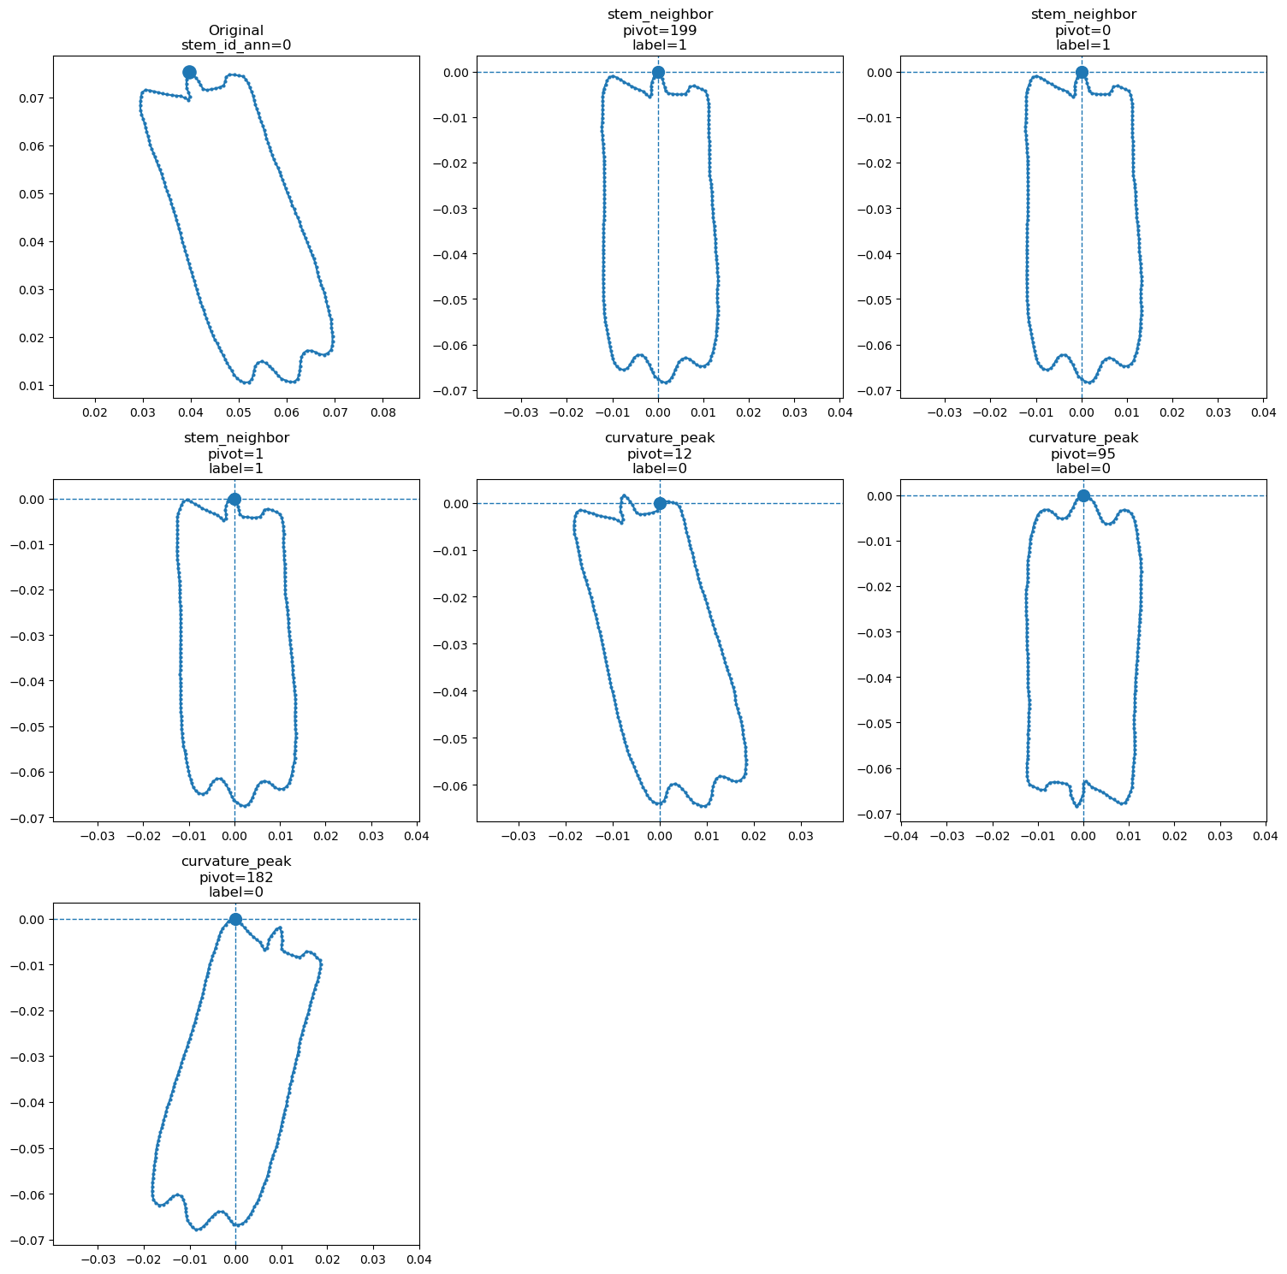

Slide 10
Supervised Dataset Construction: Fourier Transforms
Utilizing the modified contours from the previous steps we will obtain Fourier Descriptors. These will allow us to convert each contour into a compact numerical fingerprint of its shape, making it easier for a machine learning model to compare butterfly scales.

Slide 11
Supervised Dataset Construction
Contour points (x, y)
Combine
Complex signal x + iy
Fourier descriptors
Normalize and keep first N
Compact shape features
Split real / imaginary
sklearn feature matrix
Fourier Transform

Slide 12
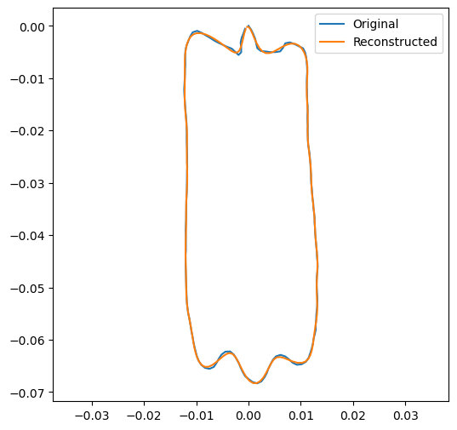

Slide 13
Model Training
A supervised classification model is best to distiguish between correctly and incorrectly centered contours. Instead of relying on raw images, the model learns from the raw numbers, interpreting them as energy, frequency, and phase values and not positional data.
What will the model look at (Random Forest): Given the shape of the contour relative to this candidate point, did this candidate have a properly identified pedicel?

Slide 14
Data Structure:
Columns:
'fd_real_0’ - 'fd_real_n’ (20 used in this case)
'fd_imag_0’ - 'fd_imag_n’ (20 used in this case)
'label’
'filename’ (original image it is tide to)
Training / Testing split: The dataset is split into independent training (80) and testing (20) subsets ensuring a filename is not included in both training and testing. Stratification is used to preserve class proportions across both partitions, ensuring a fair evaluation of model performance.

Slide 15
Model Evaluation
The trained model is evaluated based on its ability to identify whether a contour has been centered around a valid pedicel point.
Evaluation would include the following classification metrics:
Precision: How many predicted valid stems are actually correct.
Recall: How many true stems are being succesfully detected.
F1-score: Measure of a model's accuracy that balances both Precision and Recall.

Slide 16
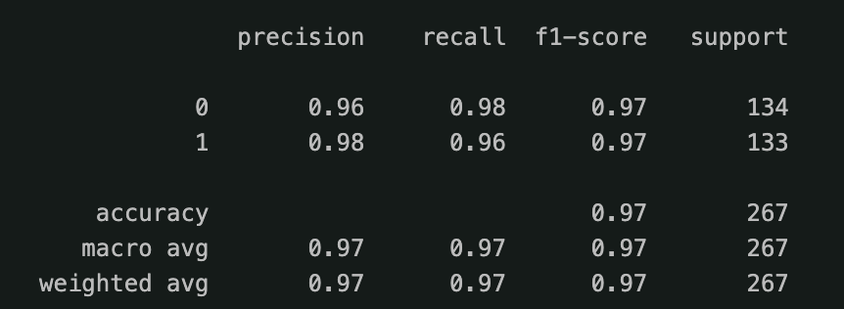

Slide 17
Stem Validation and Prediction
After training, the model can be used to evaluate new candidate pedicel points. A candidate is accepted if the contour structure resembles the learned pattern of valid pecidel-centered contours.

