Slide 1

Smart Lost & Found
One stop solution to find lost items
Submitted by: (CPG No. - 256)
Garv Bareja (101917111)
Raghav Virmani (101917115)
Deepshikha Dohare (101917124 )
Jaskaran Singh Purewal (101917129)
Under The Mentorship of:
Dr. Harkiran Kaur
Assistant Professor
CSED

Slide 2
Table of Contents
Project Definition
Project Scope
Project Objectives
Literature Survey
Project Design
Project Workflow
Snapshots
Tools/Platform Used
Algorithm Approach Used
Performance Parameters
Cost Analysis
Project Outcomes
Roles/Contribution of Team Members
Future Work Plan

Slide 3
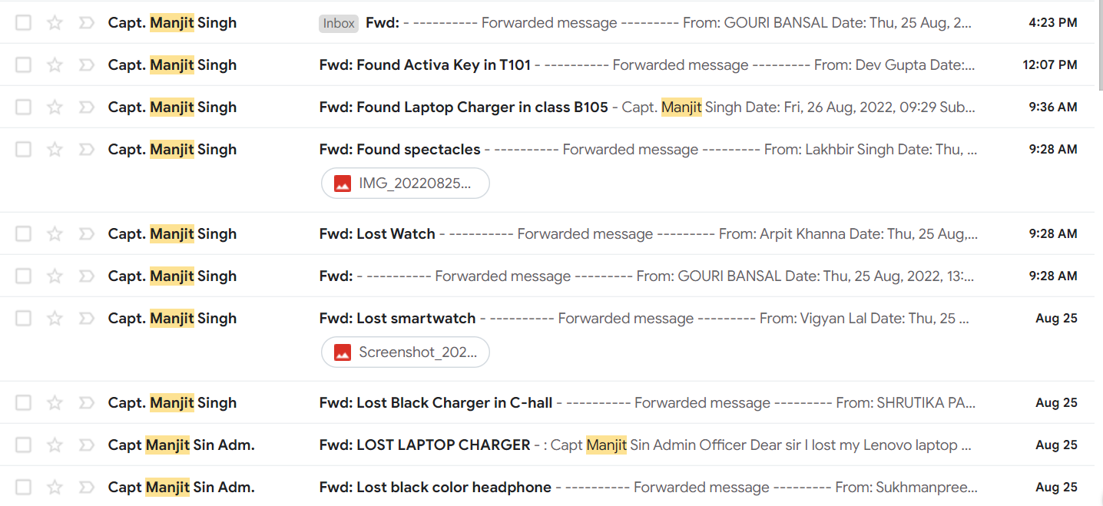
Problem Definition
The current TIET students' email system is not viable, and at certain times the emails are considered spam.
There is no dedicated system for managing the lost and found items in our campus.
The students face difficulties if they ever lose personal belongings, and the method of retrieval and authentication of lost items is quite time-consuming as all the work is done manually.

Slide 4
Project Scope
Project Objectives
Our project aims to bridge this gap between the available technology and the technology utilized on the campus while centralizing the data and relevant processes.
The information related to lost items will be stored on a centralized database, and the online portal will enable the users and admin to carry out all the processes smoothly, minimizing the hassle and paperwork.
To create a cross-platform centralized web-based portal for management of lost and found items.
Enable login/signup functionality.
Reduce in-person verification of lost items and automate the process.
To make a user-friendly, easy-to-use interface.
To make the process of item retrieval smooth and hassle-free.

Slide 5
Literature Survey
Title | Research Gaps
Deep Correlation for Matching Images and Text | • It is not yet known how to employ canonical correlation for text generation rather than image-text matching. • The chances of bogus claims are higher.
Fast image similarity search by distributed locality sensitive hashing | • As a data-independent method, long codes are needed. • Long hash codes reduces the recall. • Many hash tables must be used to balance precision and recall. • LSH increases memory requirement and query time.
ILFS: Intelligent Lost and Found System using Multidimensional Matching Model | • There are no counter-measures to avoid false claims. • No option available other than peer to peer.
A Survey on Automatic Image Caption Generation | • Employing more powerful network structures will improve the performance of image caption generation. • Image captioning grounded by image regions should be a future research direction.

Slide 6
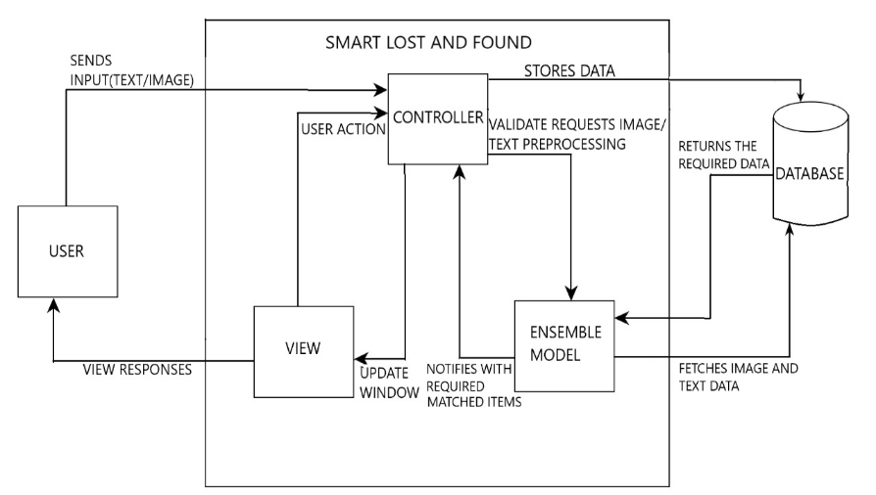
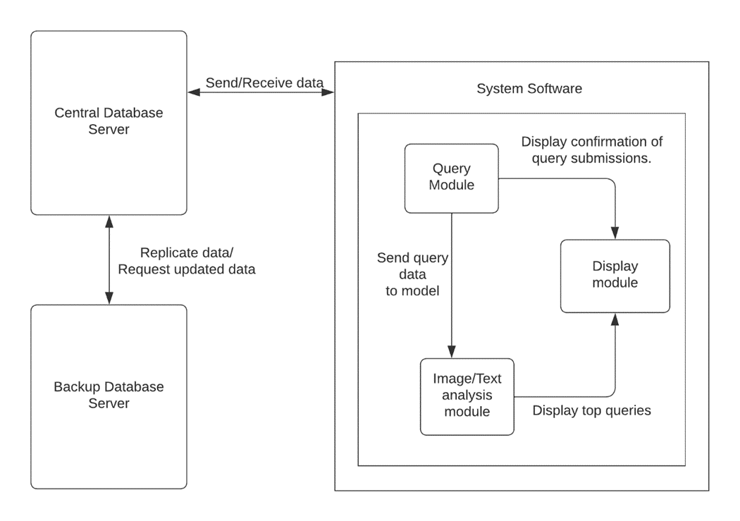
Project Design
Block diagram
MVC Architecture

Slide 7
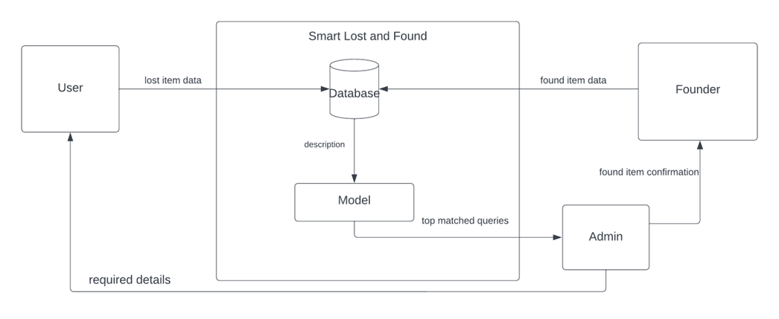
Project Workflow

Slide 8
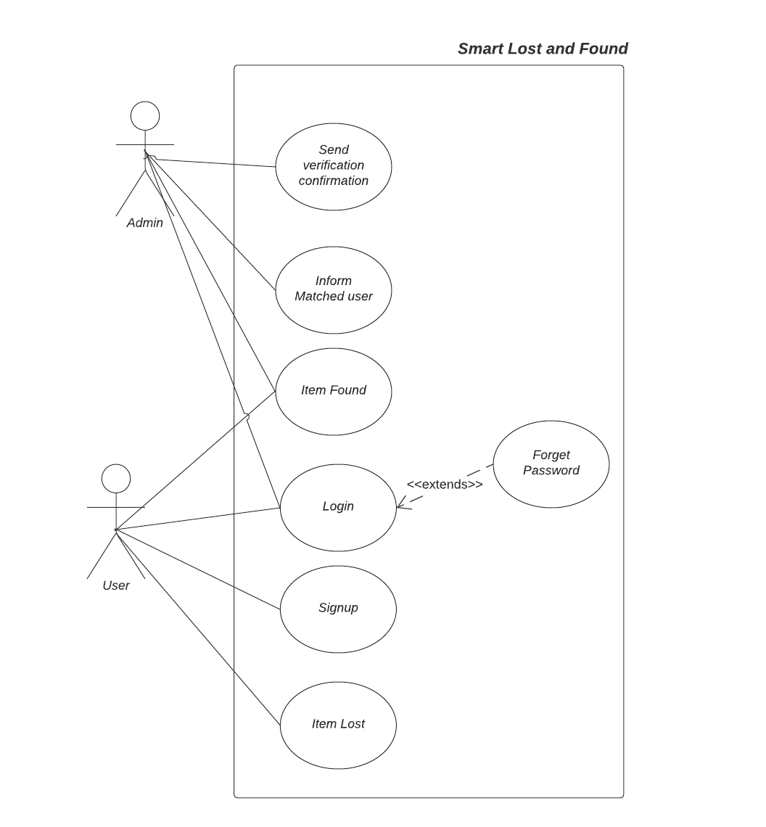
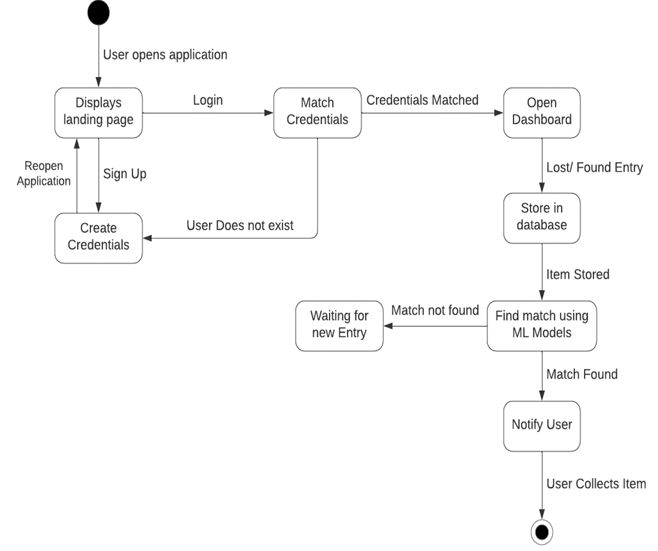
Use Case Diagram
State Chart

Slide 9
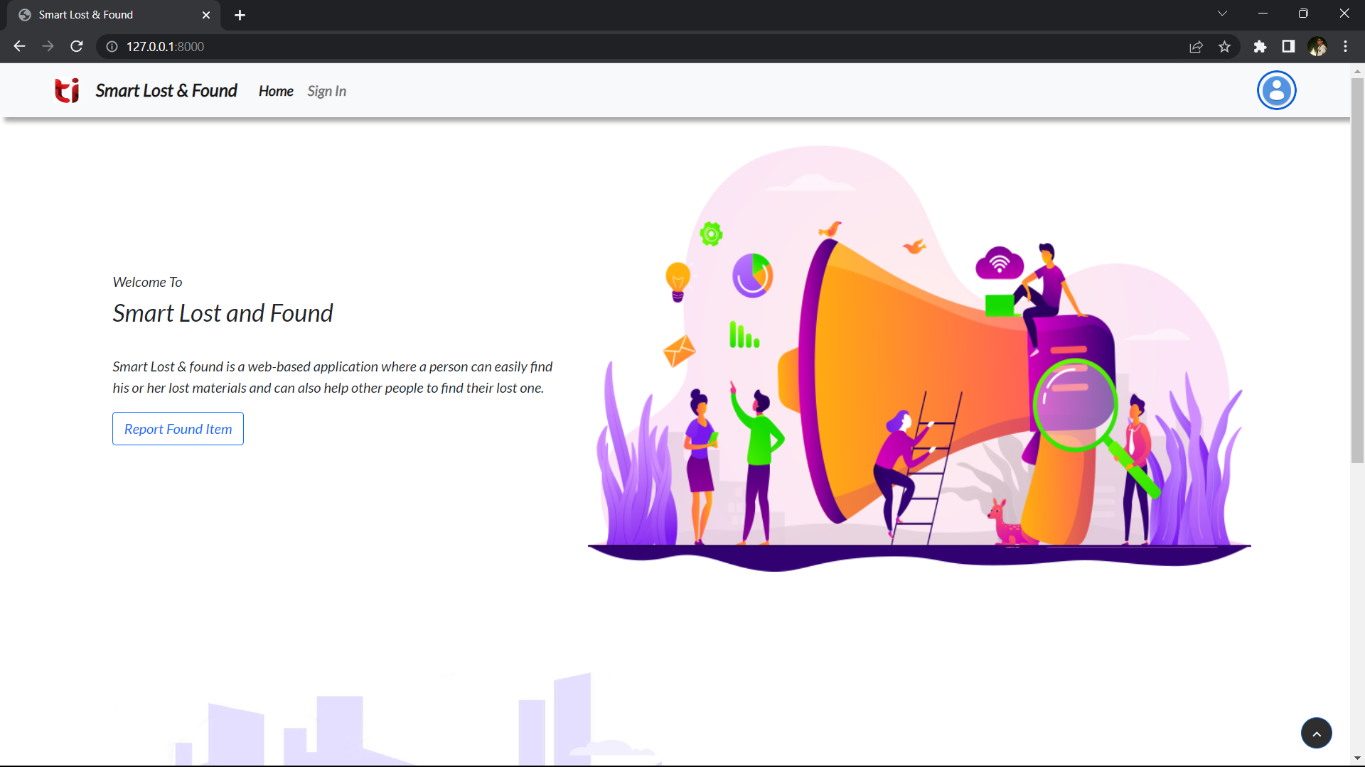
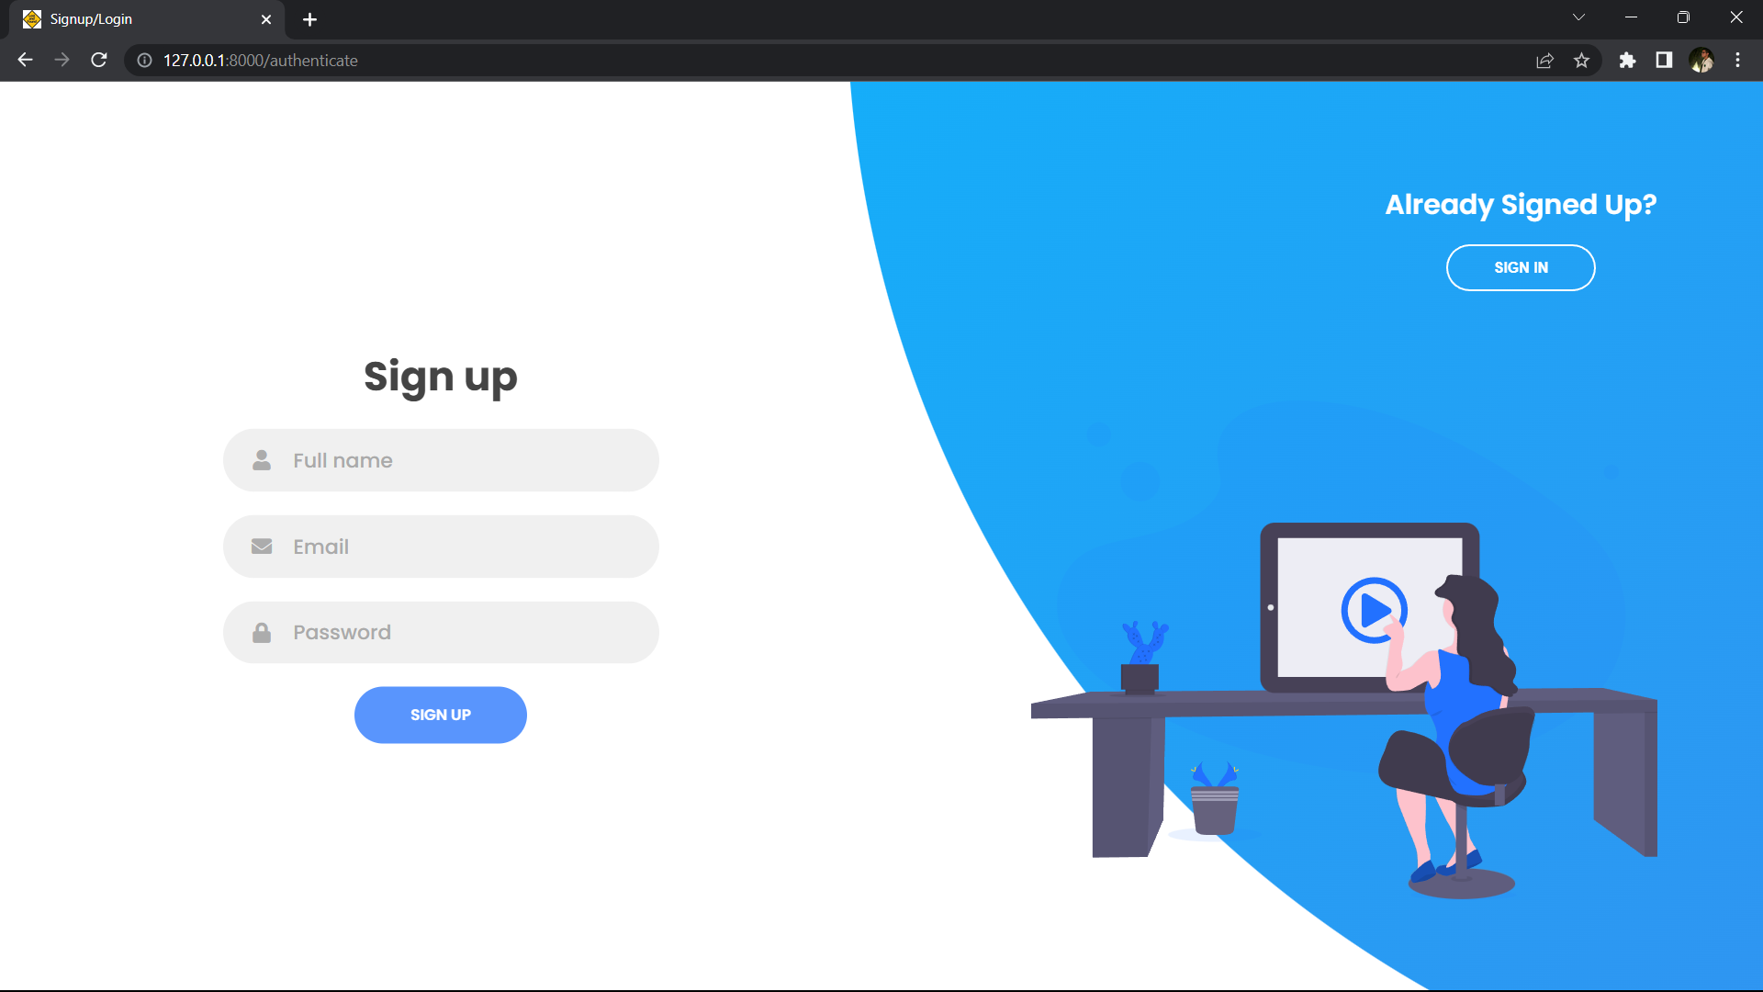
Snapshots

Slide 10
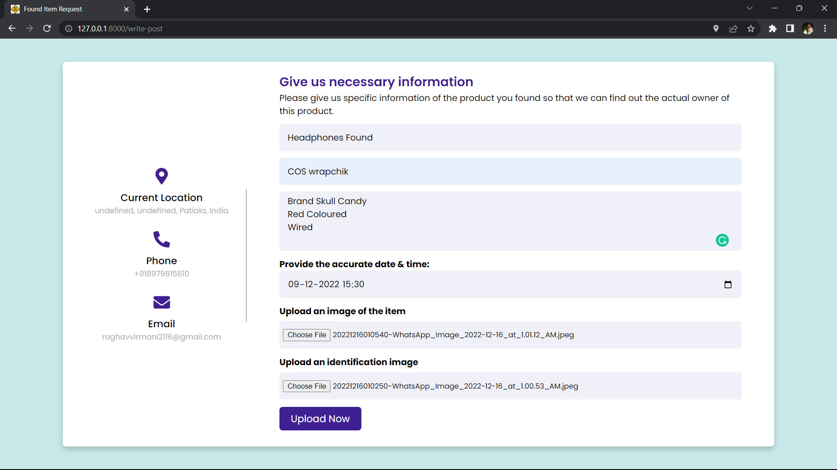
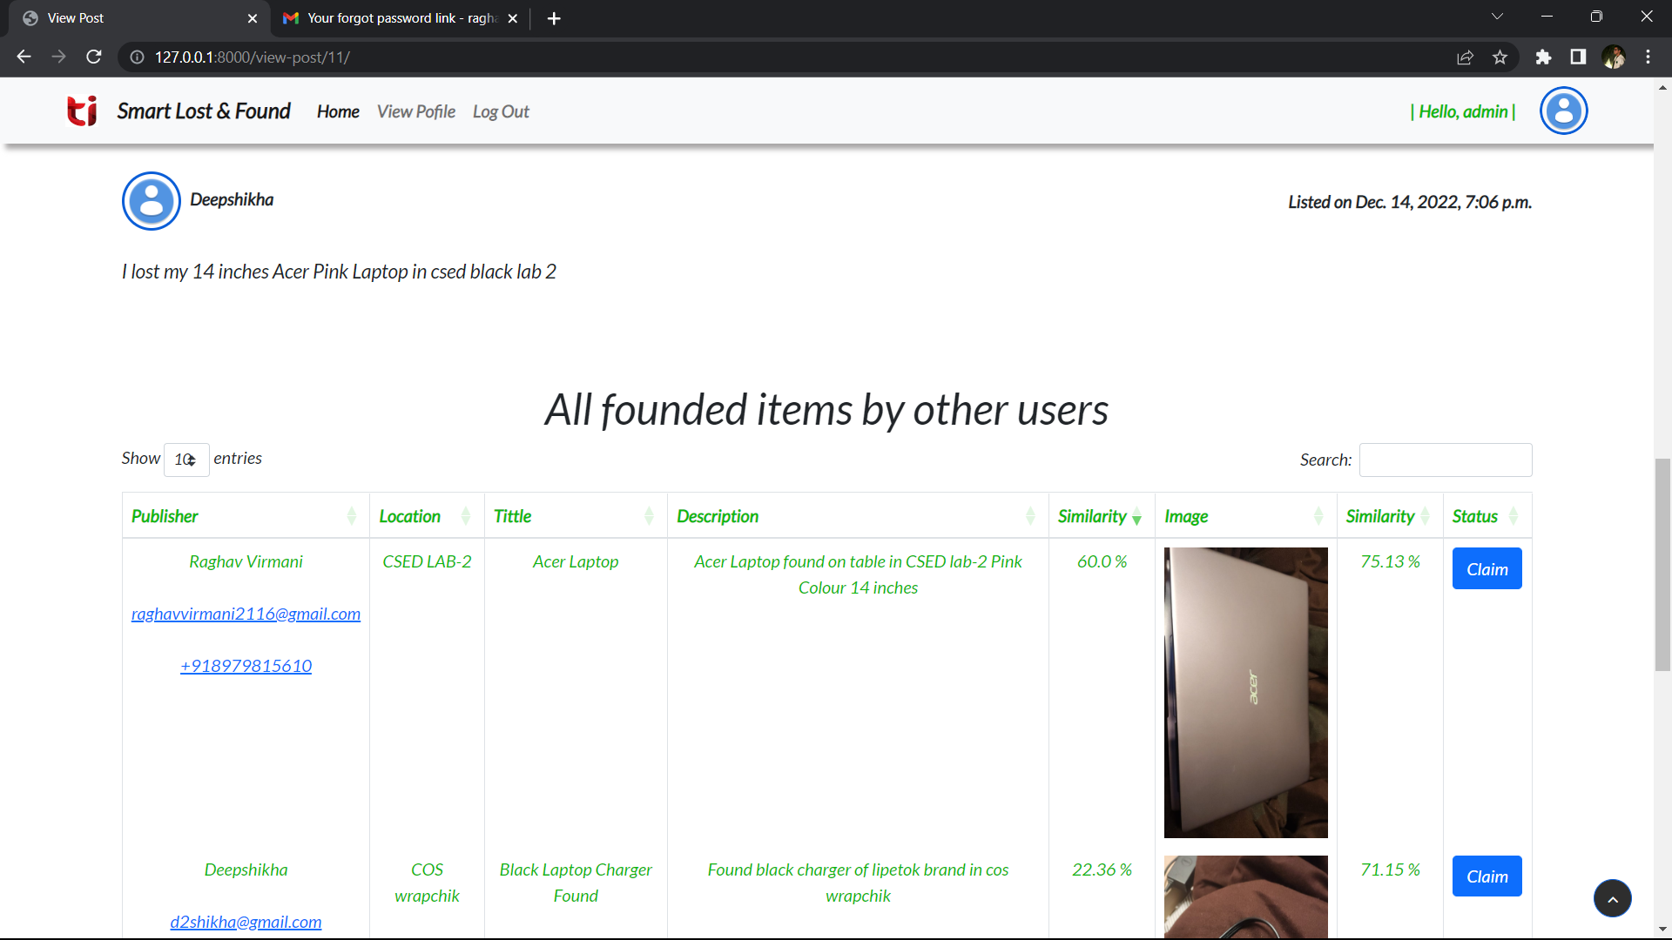
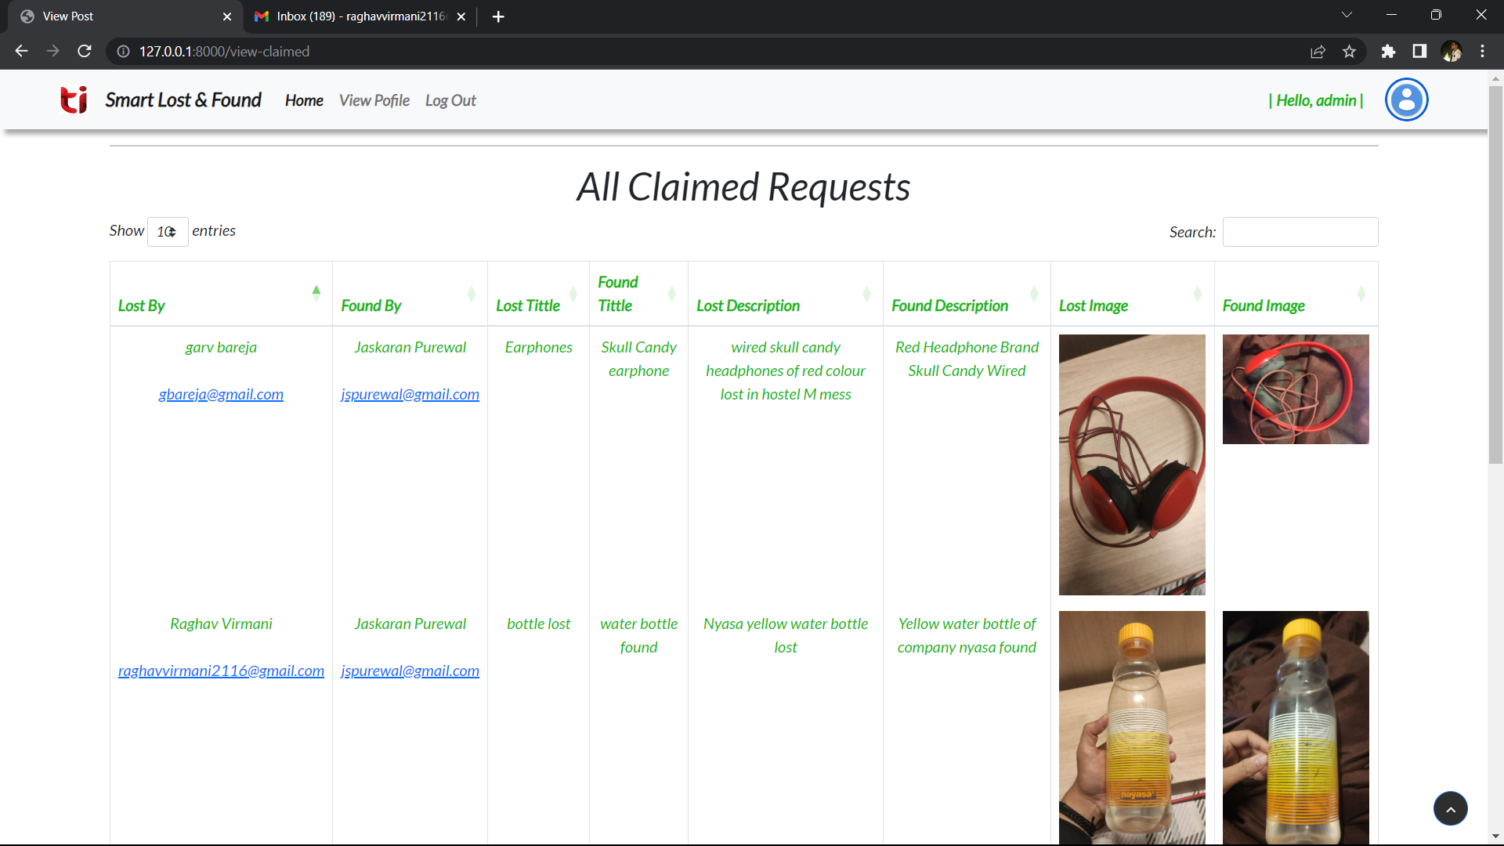

Slide 11
Tools/Platform Used:
Django- Backend for Server-Side Programming
Python
Cosine Similarity Index- For Text Matching
HTML, CSS, JS: - Frontend for Client-Side Programming.
Bootstrap: - For beautifying the Client-Side Interface and making it Mobile Friendly.
MySQL: - For Handling the DB end of the application.

Slide 12
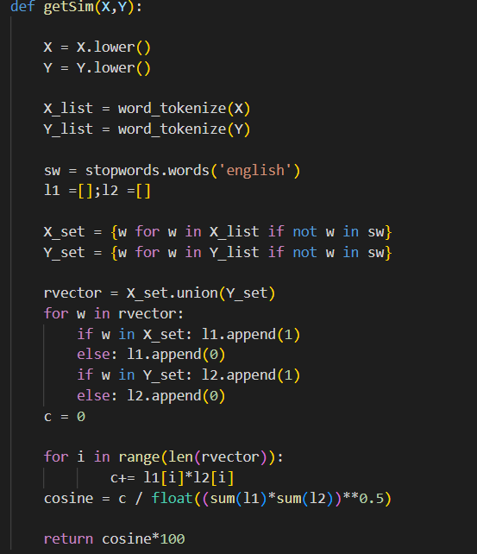
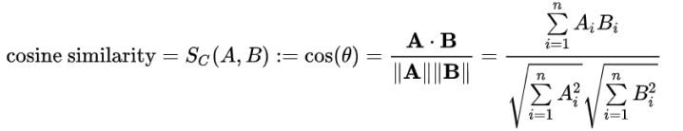
Algorithmic Approach Used:
The similarity in the description between the lost and found items is calculated using cosine similarity index.
We can sort the similar items in descending order of their percentage.
The following code first cleans the input text description data using tokenising, case lowering and stop word removal, then implements the cosine similarity and outputs the value index as percentage.
It can be represented mathematically as :

Slide 13
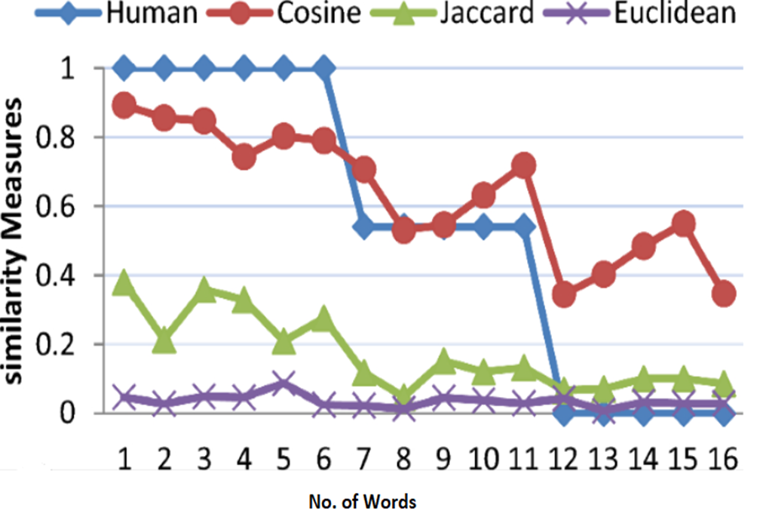
Performance Parameters:
Accuracy: The accuracy measure as depicted clearly by the below graph clearly demonstrates the generalizing feature of cosine similarity as compared to other methods.
Usability of model: The UI is designed quite user friendly, and no prior knowledge or training is required to use the portal, which has all of its key features adequately displayed.

Slide 14
Cost Analysis
Our project is totally software-based, so no hardware equipment or resources are required to be purchased.
We just require a smartphone or laptop in which a user can access the internet using a web browser. So, no extra cost is required and hence this project is cost-efficient.
Project Outcomes
● A fully functional Smart Lost and Found system is created, which is more efficient than the existing manual system.
● The process is automatic, and manual verification is reduced.
● Data privacy is maintained.

Slide 15
Role/ Contributions of Individual Team Members
Name | Contribution
Garv Bareja | Coding – User Interface Designing & Back-end Development Report Documentation
Raghav Virmani | Coding – User Interface Designing & Back-end Development Report Documentation
Deepshikha Dohare | Coding – User Interface Designing, Base Code (Text Preprocessing, training) Report Documentation
Jaskaran Singh Purewal | Coding – Machine Learning Base Code (Text/Image Preprocessing, training, validation and testing) Report Documentation

Slide 16
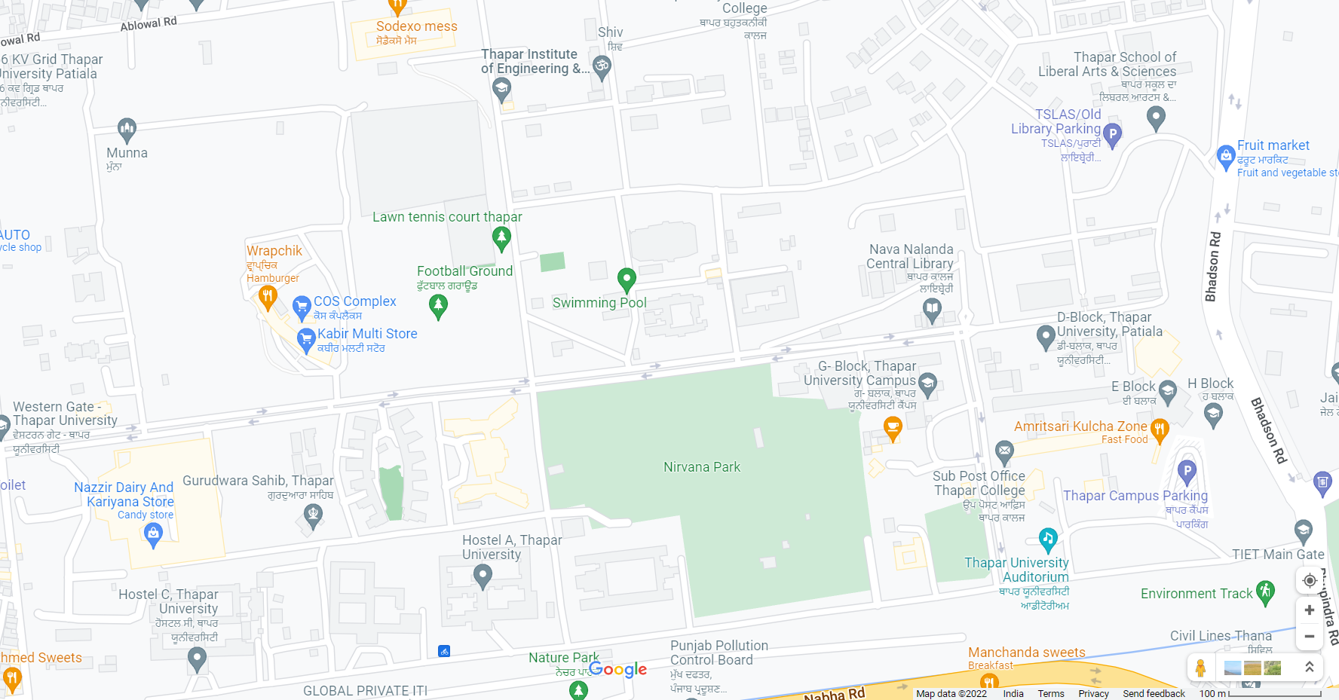
Future Work Plan
Currently the users can access the portal via website only, we plan on deploying an app for the same.
Incorporating two additional features, in our ML model, namely:
Location
Date and Time

Slide 17
THANK YOU

