Slide 1
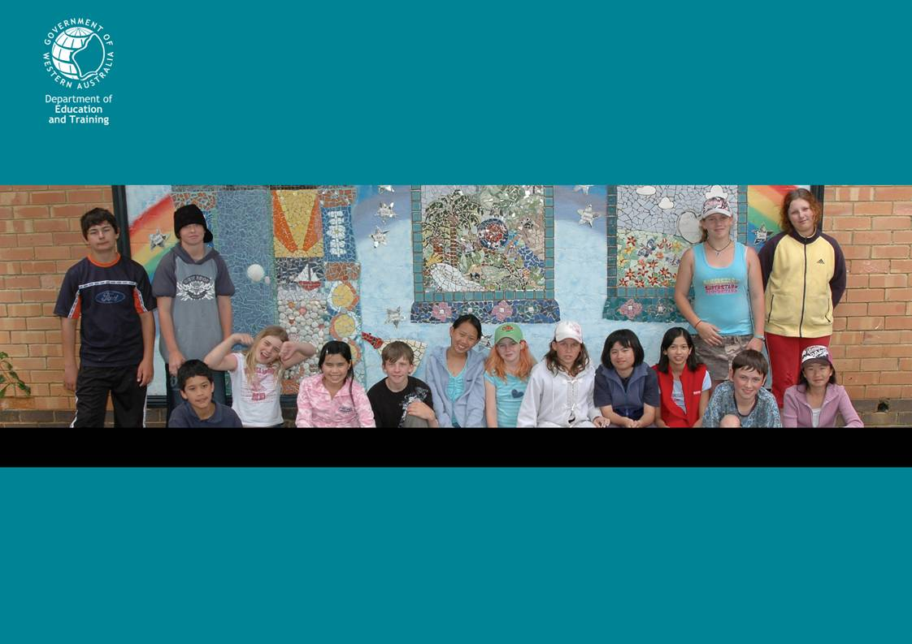
Community Service Program
Get involved!
Make a difference!
Reproduced with the permission of the Behaviour Standards and Wellbeing Directorate, Department of Education and Training

Slide 2

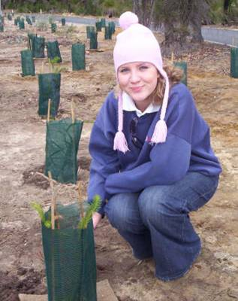
What is community service?
Getting involved in activities that benefit or help others
in your school
in your local community
for the wider or global community
Image is replaceable.
Please insert different image if required
Reproduced with the permission of the Behaviour Standards and Wellbeing Directorate, Department of Education and Training
Notes:
Community service activities involve (mainly unpaid) activities for not-for profit organisations.
You can participate in a range of activities that vary in scale:
make a difference to the people in your school,
contribute to your local community by helping community organisations, or
undertake action for national or international causes.

Slide 3

What could you be doing?
“I got more confidence and patience, it is nice because instead of being taught you’re teaching someone”
Student, metropolitan high school
In your school:
Improve your school environment
  Design and paint a mural
  Make-over part of the school grounds
Organise or contribute to school events
  Drama and music performances
  Social and sporting activities
Be a leader
  Participate in the student council
  Mentor or support other students
  Teach community members computer skills
Reproduced with the permission of the Behaviour Standards and Wellbeing Directorate, Department of Education and Training
Notes:
There are a wide range of activities you can engage in for your school community, for example:
be creative and design and paint a mural or beautify part of the school grounds,
be an entertainer by organising or contributing to school events, or
make changes happen by being a member of the school council or make a difference to students by being their mentor.

Slide 4
What could you be doing?
“We learned about people who we didn’t know even lived in our town”
Student, country high school
In your local community:
Help a disabled person play a sport
Help in environmental projects
Join the CadetsWA, eg Fire and Emergency Services Authority / St John’s Ambulance cadets
Nominate for your Youth Advisory Council
Volunteer for fund-raising events
Identify something you would like to improve in your community and work with others to achieve this
Reproduced with the permission of the Behaviour Standards and Wellbeing Directorate, Department of Education and Training
Notes:
There are numerous activities you can participate in in your local community, some of which are listed here.
ask friends and family about ideas for community service activities and browse the paper for events in your local community.
help the coordinator by telling him/her of your ideas.

Slide 5
What could you be doing?
“It gives kids a different option – beyond sports, music and the other usual stuff”
Student, metropolitan high school
For the wider or global community:
Adopt a school in a developing country
Participate in environmental campaigns
Fundraise for overseas aid projects
Advocate for human rights
Participate in service projects overseas
Reproduced with the permission of the Behaviour Standards and Wellbeing Directorate, Department of Education and Training
Notes:
The wider or global community offers an even greater range of causes to contribute to. A few examples are listed here. Global issues are often large in scale and complex, eg global warming, but you can contribute in a small way.

Slide 6
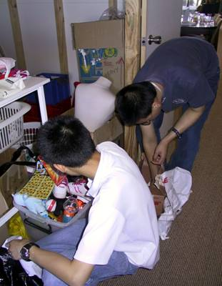
What is in it for you?
The big picture
Doing community service gives you the opportunity to:
make a difference for your community
be inspired by others
have new experiences
learn to lead
meet and work with new people
And: get recognised for the great things you do!
Image is replaceable.
Please insert different image if required
Reproduced with the permission of the Behaviour Standards and Wellbeing Directorate, Department of Education and Training
Notes:
Students who have been involved in community service activities have been very enthusiastic about their experiences. Even though some students were reluctant in the beginning, they really enjoyed helping people, learning new skills and discovering new talents within themselves.

Slide 7
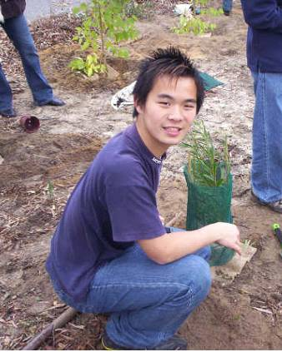
What is in it for you?
Your future
Adds to your CV
Impresses prospective employers
May spark ideas for future careers
Connects you to your community
Contributes to your WACE
Image is replaceable.
Please insert different image if required
Reproduced with the permission of the Behaviour Standards and Wellbeing Directorate, Department of Education and Training
Notes:
These new skills and talents can be referred to in your CV.
Your work for your community will impress your future employers.
You may even like some of your activities so much that you want to explore career opportunities in those areas.
Another benefit for you is that you will meet new people in your community who could become good friends or mentors in the future.
And last, but not least, your 20 hours of community service contribute to your WACE.

Slide 8
What are your rights and responsibilities?
Rights
“I liked being recognised for something I was good at”
Student, country high school
Worthwhile activities
A safe environment
Preparation and support
Recognition and feedback
The right to say ‘no’
Insurance cover
Reproduced with the permission of the Behaviour Standards and Wellbeing Directorate, Department of Education and Training
Notes:
Many of the skills and attitudes you can list on your CV will be developed by being mindful of your responsibilities while doing service. Through participating in community service activities you will also further develop your skills. While doing service, you have a right to be involved in worthwhile activities which take place in a safe environment. You are entitled to sufficient preparation, support and feedback and you should be recognised for your work. You have the right to say no if an activity is not appropriate.
You are covered for personal accident and liability insurance for community service activities which are endorsed or organised by the school, through DET’s insurance.

Slide 9
What are your rights and responsibilities?
Responsibilities
“It was good to help a kid who wanted help and to learn something while doing it”
Student, metropolitan high school
Being dependable
Following instructions
Working in a team
Doing training
Being careful
Getting help if needed
Respecting others’ rights
Reproduced with the permission of the Behaviour Standards and Wellbeing Directorate, Department of Education and Training
Notes:
While you are serving your community you need to be dependable, follow instructions, work in a team, do training, be careful and get help if needed and respect others’ rights.

Slide 10
When will you do community service
“When I went back it felt nice to be remembered”
Student, metropolitan high school
It could be in or out of school hours
This will depend on how the Community Service Program is organised in your school and your interests and skills
Reproduced with the permission of the Behaviour Standards and Wellbeing Directorate, Department of Education and Training

