Slide 1

JDBC Insights
By Chetan, newfound systems, Nov-12-2020

Slide 2
Session Topics
Introduction to Database and JDBC
Usage of SQLite and H2 Databases
SQL CRUD Process – Create Read Update Delete
How to Write and Read Image Data
Usage of log4j – Logging Framework
JDBC Connection Pool using HikariCP
Concepts to JPA with Spring JPA
Introduction to Database Trigger, Views
Usage of Google Guava Cache for Static Data
Q & A

Slide 3
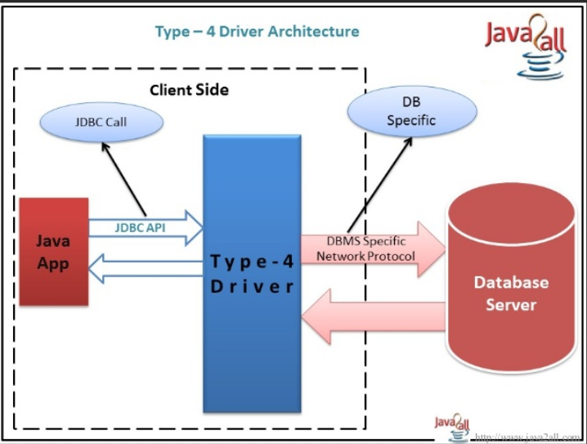
JDBC Insights
JDBC
JDBC stands for Java DataBase Connectivity. JDBC is a Java API to connect and execute database queries. JDBC API uses JDBC drivers to connect with database. Each vendor will have their own JDBC Drivers for Client Exchange of Data.
What is an API
API (Application Programming Interface) is a service that describes on features of a product or software for communications. It represents on how client can exchange data.
Popular Database(s)
Oracle, Informix, MySQL, Microsoft SQL Server, H2, SQLite ……
Notes:
Vendor Specific JDBC Drivers are required to downloaded for your Application

Slide 4
What is Database and Table
Database
A database is an organized collection of table(s). Each table is collection of column(s). Table data can then be easily queried or manipulated using SQL Statements over JDBC API.
Table
Data is logically organized in a row-and-column format similar to a spreadsheet. Each row represents a unique record, and each column represents a field in the record.
e.g.
Excel File is a Database, and Each Sheet is a Table.
Query
SELECT
Manipulation
INSERT
UPDATE
DELETE
customer_id | fname | lname | open_dt | addr_ln_1 | addr_ln_2 | addr_ln_3 | city_nm | state_cd | ctry_cd | zip_cd
1 | John | Smith | 2020-11-01 | 1, W Wilmington Street |  |  | Phoenix | AZ | US | 85260
2 | Tom | Moody | 2020-11-02 | 1, E Hillery Way |  |  | New York | NY | US | 89553
3 | George | Glen | 2020-11-03 | 1, N Wilford Garden |  |  | Scottsdale | AZ | US | 83456
4 | Kevin | Spacey | 2020-11-04 | 1, E Glen Way |  |  | Glendale | AZ | US | 85263
5 | Tracy | Guest | 2020-11-05 | 85, Tai Seng Drive | Ang Ko Moi |  | Singapore | SG | SG | 34560
state_id | state_cd | state_nm
1 | AZ | Arizona
2 | CA | California
3 | NY | New York
4 | SG | Singapore
ctry_id | ctry_cd | ctry_nm
1 | IN | India
2 | US | United States of America
3 | SG | Singapore

Slide 5



Q & A

Slide 6
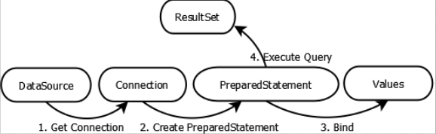
Cycle
The JDBC classes are contained in Java package java.sql and javax.sql.
The java.sql package contains classes and interfaces for JDBC API.
Driver interface
Connection interface
PreparedStatement interface
ResultSet interface
JDBC connections support creating and executing statements. Data manipulation statements such as CREATE, INSERT, UPDATE and DELETE, or query statements like SELECT.
Statement – the statement is sent to the database server each and every time.
PreparedStatement – the statement is cached and then the execution path is pre-determined on the database server allowing it to be executed multiple times in an efficient manner.
CallableStatement – used for executing stored procedures on the database.
Update statements such as INSERT, UPDATE and DELETE return an update count that indicates how many rows were affected in the database. These statements do not return any other information.
Query statements return a JDBC row result set. The row result set is used to iterate data rows. Individual columns in a row are retrieved either by name or by column number. There may be any number of rows in the result set. Row Result has meta information about column name and associated types

Slide 7
Data Types
Char
Decimal
Varchar
NVarchar
Datetime
Date
Byte
Boolean
Integer
Text
https://www.sqlite.org/datatype3.html
Notes:
Some of the Data Types are Vendor Specific

Slide 8
How to Create Database in SQLite
Install SQLite from https://sqlite.org/download.html
Assuming Database to be Created in D:\WebService\Project\JdbcExample\database
SQLite e.g. is Installed in D:\SQLite-330
Create Database
D:\> cd D:\WebService\Project\JdbcExample\database\
D:\> \sqlite\sqlite-330\sqlite3 customer.db
This will create a BLANK Database customer-sqlite.db
SQLite version 3.33.0 2020-08-14 13:23:32
Enter ".help" for usage hints.
sqlite> CREATE TABLE customer (
[customer_id] INTEGER PRIMARY KEY AUTOINCREMENT NOT NULL,
[ctry_cd] [char](2) NOT NULL,
[customer_name] [text] NOT NULL,
[phone_no] [varchar](18) NOT NULL,
[phone_type] [varchar](12) NOT NULL,
[email_ad] [varchar](65) NOT NULL,
[customer_guid] [uniqueidentifier] NOT NULL,
[init_insert_ts] [datetime] NOT NULL,
[last_mdfy_ts] [datetime] NOT NULL,
[last_mdfy_user] [varchar](65) NOT NULL,
[last_mdfy_prog] [varchar](65) NOT NULL
);
sqlite>SELECT * FROM customer;
This is to ensure table is created and you can select though no records
sqlite>.schema TO List Schema
sqlite>.quit
Notes:
Latest SQLite Version is 3.33.0.00, Show Action

Slide 9
Q & A

Slide 10
JDBC Action - Register Driver Class
When a Java application needs a database connection, one of the
DriverManager.getConnection() methods is used to create a JDBC connection.
The URL depends on particular database and JDBC driver.
It will always begin with the "jdbc:“ which is the protocol, but the rest is up to the
Vendor specific.
Connection conn = DriverManager.getConnection(JDBC_URL, DB_USER, DB_PASSWORD);
e.g.
jdbc:sqlserver://localhost:1433;databaseName=testdb;integratedSecurity=true;
jdbc:sqlserver://[serverName[instanceName][:portNumber]][;property=value[;property=value]]
serverName: Host name or the IP address of the machine on which database server is running.
instanceName: Name of the instance to connect to on a serverName. If this parameter is not specified, the default instance is used.
portNumber: The default port number for connecting to SQL server is 1433. In case this parameter is missing, the default port is used as per database vendor. For Sqlite, there is no user / password or port as it is running off local host pointing to directory.
property=value: This parameter specifies one or more additional connection properties. To see the properties specific to the database server, you need to google vendor specifics
Notes:
Show Action

Slide 11
Connection & Finally Close
/**
* Get Connection
*
* @return
* @throws SQLException
*/
public Connection getConnection() throws SQLException {
System.out.println("---Connecting to Db...");
Connection conn = DriverManager.getConnection(JDBC_URL, DB_USER, DB_PASSWORD);
return conn;
}
/**
* Close Connection
*
* @param conn
* @throws SQLException
*/
public void close(Connection conn) throws SQLException {
System.out.println("---Closing Db Connection...");
conn.close();
}

Slide 12
CRUD Process – C(reate) R(read) U(pdate) D(elete) Create
/**
* Get Connection
*/
conn = SimpleDbManager.getConnection(autoCommit);
String sql = " INSERT INTO customer (ctry_cd, customer_name, phone_no, phone_type, email_ad, customer_guid, "
+ " last_mdfy_user, last_mdfy_prog, init_insert_ts, last_mdfy_ts) "
+ " VALUES (?, ?, ?, ?, ?, ?, ?, ?, CURRENT_TIMESTAMP, CURRENT_TIMESTAMP) ";
/**
* Prepare Statement
*/
pstmt = conn.prepareStatement(sql);
/**
* Set Values for INSERT
*/
pstmt.setString(1, customer.getCtry_cd());
pstmt.setString(2, customer.getCustomer_name());
pstmt.setString(3, customer.getPhone_no());
pstmt.setString(4, customer.getPhone_type());
pstmt.setString(5, customer.getEmail_ad());
pstmt.setString(6, customer.getCustomer_guid());
pstmt.setString(7, customer.getLast_mdfy_user());
pstmt.setString(8, customer.getLast_mdfy_prog());
int rowsUpdated = pstmt.executeUpdate();
success = rowsUpdated > 0;
Notes:
Show Action

Slide 13
CRUD Process – C(reate) R(read) U(pdate) D(elete) Read
/**
* Get Connection
*/
conn = SimpleDbManager.getConnection(autoCommit);
String sql = " SELECT customer_id, ctry_cd, customer_name, email_ad, phone_no, customer_guid "
+ " FROM customer WHERE email_ad = ? ";
/**
* Prepare Statement
*/
pstmt = conn.prepareStatement(sql);
pstmt.setString(1, emailAd);
/**
* Get Result Set
*/
rs = pstmt.executeQuery();
Customer customer = null;
while (rs.next()) {
customer = new Customer();
success = true;
customer.setCustomer_id(rs.getLong("customer_id"));
customer.setCtry_cd(rs.getString("ctry_cd"));
customer.setCustomer_name(rs.getString("customer_name"));
customer.setEmail_ad(rs.getString("email_ad"));
/**
* You can also use Query Column Number - Not Recommended though
*/
customer.setCustomer_guid(rs.getString(5));
System.out.println(customer);
}
Notes:
Show Action

Slide 14
CRUD Process -Update
/**
* Get Connection
*/
Connection conn = SimpleDbManager.getConnection();
String sql = " UPDATE customer SET phone_no = ?, last_mdfy_ts = CURRENT_TIMESTAMP WHERE email_ad = ? ";
/**
* Prepare Statement
*/
PreparedStatement pstmt = conn.prepareStatement(sql);
/**
* Set Value for Delete
*/
pstmt.setString(1, phoneNo);
pstmt.setString(2, emailAd);
int rowsUpdated = pstmt.executeUpdate();
success = rowsUpdated > 0;
Notes:
Show Action

Slide 15
CRUD Process - Delete
/**
* Get Connection
*/
Connection conn = SimpleDbManager.getConnection();
String sql = " DELETE FROM customer WHERE email_ad = ? ";
/**
* Prepare Statement
*/
PreparedStatement pstmt = conn.prepareStatement(sql);
/**
* Set Value for Delete
*/
pstmt.setString(1, emailAd);
int rowsUpdated = pstmt.executeUpdate();
success = rowsUpdated > 0;
Notes:
Show Action

Slide 16
CRUD Process – C(reate) R(read) U(pdate) D(elete) Create Image
/**
* Get Connection
*/
conn = SimpleDbManager.getConnection(autoCommit);
String sql = " INSERT INTO customer_image (customer_id, image_type, image, last_mdfy_ts, last_mdfy_user, last_mdfy_prog) "
+ " VALUES (?, ?, ?, CURRENT_TIMESTAMP, 'SYSTEM', ?) ";
/**
* Prepare Statement
*/
pstmt = conn.prepareStatement(sql);
/**
* Set Values for INSERT
*/
pstmt.setLong(1, customerImage.getCustomer_id());
pstmt.setString(2, customerImage.getImage_type());
byte[] imageBytes = ImageService.encodeAsBytes(imageFile);
pstmt.setBytes(3, imageBytes);
pstmt.setString(4, CLAZZ);
/**
* Execute
*/
int rowsUpdated = pstmt.executeUpdate();
success = rowsUpdated > 0;
Notes:
Show Action

Slide 17
Image Service
/**
* Encode
*
* @param imageFile
* @return
* @throws IOException
*/
public static byte[] encodeAsBytes(String imageFile) throws IOException {
logger.info("Encoding Image: {} to Bytes...", imageFile);
byte[] fileContentAsBytes = FileUtils.readFileToByteArray(new File(imageFile));
return fileContentAsBytes;
}
Notes:
Show Action

Slide 18

Read Image from Customer Image Record
conn = SimpleDbManager.getConnection(autoCommit);
String sql = " SELECT * FROM customer_image WHERE customer_id = ? ";
pstmt = conn.prepareStatement(sql);
pstmt.setLong(1, customer_id);
rs = pstmt.executeQuery();
CustomerImage customerImage = null;
while (rs.next()) {
customerImage = new CustomerImage();
success = true;
customerImage.setCustomer_image_id(rs.getLong("customer_image_id"));
customerImage.setCustomer_id(rs.getLong("customer_id"));
customerImage.setImage_type(rs.getString("image_type"));
/**
* Saving Image from Stored byte Array
*/
byte[] imageBytes = rs.getBytes("image");
/**
* Assign Base64 for Client Transport
*/
customerImage.setImage(Base64.getEncoder().encodeToString(imageBytes));
String imageOutFile = "images/customer_image_" + customerImage.getCustomer_id() + "_"
+ customerImage.getCustomer_image_id() + ".png";
/**
* Read back to ensure Image is correct
*/
try (OutputStream out = new BufferedOutputStream(new FileOutputStream(imageOutFile))) {
out.write(photo_bytes);
}
System.out.println("Check Image: " + imageOutFile);
System.out.println(customerImage);
}
Output Image
Notes:
Show Action

Slide 19




REMEMBER To CLOSE Resources Finally
Process
Open
Connection
Close Connection
Any resources opened for database should be CLOSED WITHOUT FAIL
e.g.
ResultSet
PreparedStatement
Connection
DataSource
try {
if (rs != null) {
rs.close();
}
if (pstmt != null) {
pstmt.close();
}
if (conn != null) {
conn.close();
}
} catch (SQLException e) {
e.printStackTrace();
}
Notes:
Failed to Close will Create Database Leak and Eventually Server Crash, Show Action

Slide 20
Q & A

Slide 21
Database Transaction
A database transaction symbolizes a unit of work performed within a database management system against a data set(s) and treated in a logical work. A transaction generally represents change to data table(s) like UPDATE and/or DELETE and/or INSERT.
In a database management system, a transaction is a single unit of logic or work, sometimes made up of multiple operations. e.g: Transfer from one bank account to another: the complete transaction requires subtracting the amount to be transferred from one account and adding that same amount to the other.
Example
boolean success = false;
Boolean autoCommit = false; // Commit on Demand
Connection conn = SimpleDbManager.getConnect(autoCommit);
/**
* Add Customer
*/
success = add(conn, customer);
if(success) {
/**
* Update Customer
*/
success = update(conn, "test@somewhere.com", "1-800-CALL-HELP");
}
if (success) {
System.out.println("Commit Transaction...");
conn.commit()
} else {
System.out.println("Rollback Transaction...");
conn.rollback();
}
conn.close();
Notes:
Show Action

Slide 22
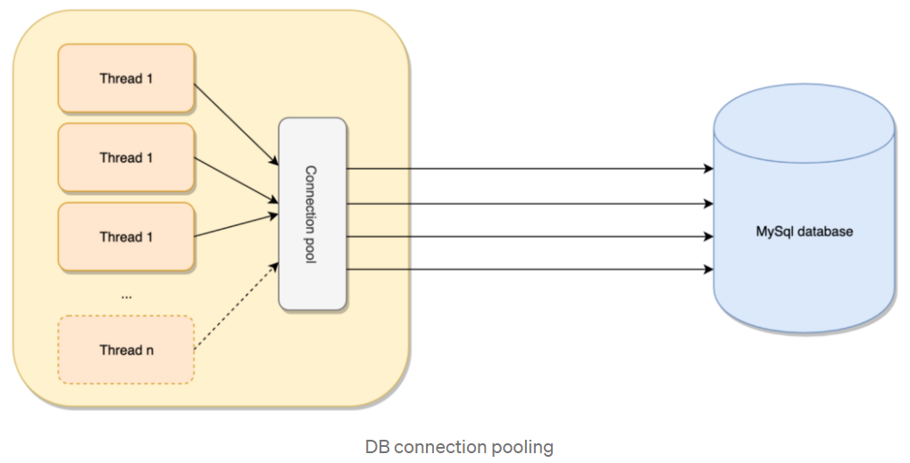
Database Connection Pool
Traditional Database Connection Trip
Opening a connection to the database using the database driver
Opening a TCP socket for reading/writing data
Reading / writing data over the socket
Closing the connection
Closing the socket
A connection pool is a cache of database connection objects. The objects represent physical database connections that can be used by an application to connect to a database. At run time, the application requests a connection from the pool.
Implementing a database connection container, which allows us to reuse a number of existing connections, we can effectively save the cost of performing a huge number of expensive database trips, hence boosting the overall performance of our database-driven applications.
Notes:
Show Action

Slide 23
Database Connection Pool using HikariCP
private static HikariConfig hcfg = new HikariConfig();
private static HikariDataSource hds = null;
static {
logger.info("BEGIN - Creating Connection Pool...");
try {
InputStream is = new FileInputStream(new File(DB_H2_PROP_FILE));
Properties props = new Properties();
props.load(is);
hcfg.setPoolName(props.getProperty("jdbc.poolName"));
hcfg.setJdbcUrl(props.getProperty("jdbc.url"));
hcfg.setUsername(props.getProperty("jdbc.username"));
hcfg.setPassword(props.getProperty("jdbc.password"));
hcfg.setMaximumPoolSize(Integer.parseInt(props.getProperty("jdbc.maxPoolSize")));
hcfg.setMinimumIdle(Integer.parseInt(props.getProperty("jdbc.initialSize")));
hcfg.setAutoCommit(false);
hcfg.setDriverClassName(props.getProperty("jdbc.driverClassName"));
hcfg.addDataSourceProperty("cachePrepStmts", "true");
hcfg.addDataSourceProperty("prepStmtCacheSize", "10");
hcfg.addDataSourceProperty("prepStmtCacheSqlLimit", "128");
hds = new HikariDataSource(hcfg);
logger.info("Created DataSource: " + hds);
} catch (Exception e) {
e.printStackTrace();
} finally {
logger.info("END - Creating Connection Pool DataSource: " + hds);
}
}
public static HikariDataSource getDataSource() {
return hds;
}
Notes:
Show Action

Slide 24
Popular Connection Pool Frameworks
Apache Commons DBCP
HikariCP – Most Preferred for Light Weight and Fast
C3PO

Slide 25
Q & A

Slide 26
Object Relational Mapping using Apache DbUtils
Traditional Approach
String sql = " SELECT customer_id, ctry_cd, email_ad, phone_no, customer_guid FROM customer WHERE email_ad = ? ";
/**
* Prepare Statement
*/
PreparedStatement pstmt = conn.prepareStatement(sql);
pstmt.setString(1, emailAd);
/**
* Get Result Set
*/
ResultSet rs = pstmt.executeQuery();
Customer customer = null;
while (rs.next()) {
customer = new Customer();
customer.setCustomer_id(rs.getLong("customer_id"));
customer.setCtry_cd(rs.getString("ctry_cd"));
customer.setEmail_ad(rs.getString("email_ad"));
customer.setCustomer_guid(rs.getString(“customer_guid"));
System.out.println(customer);
}
Notes:
Show Action

Slide 27
Object Relational Mapping using Apache DbUtils
Object Mapping Approach using Apache DbUtils
String sql = " SELECT * FROM customer WHERE email_ad = ? ";
/**
* Handler Bean for ResultSet
*/
BeanListHandler<Customer> beanListHandler = new BeanListHandler<>(Customer.class);
/**
* Fetch Data
*/
List<Customer> customers = new QueryRunner().query(conn, sql, beanListHandler, new Object[] { emailAd });
for (Customer customer : customers) {
System.out.println(customer);
}
Notes:
Show Action

Slide 28
Introduction to JPA (Java Persistence API)
The Java Persistence API (JPA) is a Java specification for accessing, persisting, and managing data between Java Entity Classes and a Relational Database.
JPA allows POJO (Plain Old Java Objects) to be easily persisted.
A JavaBean is a POJO that is serializable, has a no-argument constructor, and allows access to properties using getter and setter methods that follow a simple naming convention.
In our example: Customer.java / Country.java is a POJO which can be converted to Entity Class for Object Relational Map.
Notes:
Show Action

Slide 29
Entity Bean
@Entity
@Table(name = "country")
/**
Using Lombok which is a java library tool which is used to minimize/remove the boilerplate code. @Data will generate Constructor, Getter / Setter / toString() by Default
*/
@Data
public class Country implements Serializable {
private static final long serialVersionUID = 9120997940945205046L;
@Id
@GeneratedValue(strategy = GenerationType.IDENTITY)
private Long country_id;
private String ctry_cd;
private String ctry_nm;
@Temporal(TemporalType.TIMESTAMP)
private Date last_mdfy_ts;
private String last_mdfy_prog;
private String last_mdfy_user;
}
Notes:
Show Action

Slide 30
Query Entity Country, Customer Using JPA with Spring Boot
Sample Methods
/**
* Find by Country Code
*
* @param ctry_cd
* @return
*/
@Query(" SELECT o FROM Country o WHERE o.ctry_cd = ?1 ")
@Cacheable("country")
Country findByCtryCd(@Param("ctry_cd") String ctry_cd);
/**
* Find All
*
* @return
*/
@Query(" SELECT o FROM Country o ORDER By o.ctry_cd ")
List<Country> findAll();
/**
* Find Customer by Email
*
* @param email_ad
* @return
*/
@Query(" SELECT o FROM Customer o WHERE o.email_ad = ?1 ")
List<Customer> findByEmail(@Param("email_ad") String email_ad);
Notes:
Show Action

Slide 31
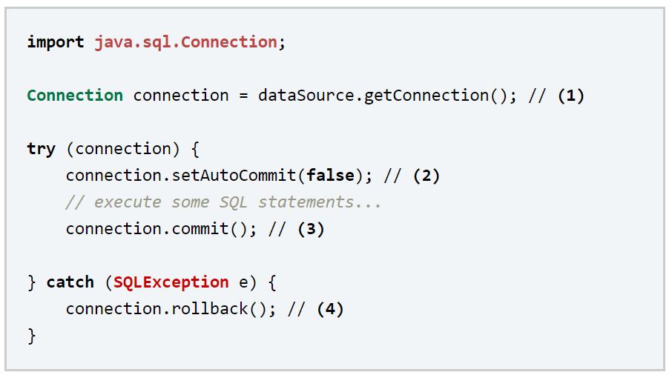
Traditional JDBC Transaction

Slide 32
Spring JPA Transaction using Annotations
@Transactional(propagation = Propagation.REQUIRES_NEW, readOnly = false, rollbackFor = { Exception.class })
public synchronized boolean persist(Customer customer,
CustomerAddress customerAddress) throws RuntimeException, Exception {
boolean success = false;
try {
customer = customerRepository.saveAndFlush(customer);
customerAddress = customerAddressRepository.saveAndFlush(customerAddress);
if (customerAddress != null) {
updateCustomerLastMdfyTs(customer);
success = true;
}
} catch (Exception e) {
e.printStackTrace();
}
return success;
}
@Transactional(propagation = Propagation.MANDATORY, readOnly = false, rollbackFor = { Exception.class })
private boolean updateCustomerLastMdfyTs(Customer customer) {
customer.setLast_mdfy_ts(new Date());
customer.setLast_mdfy_prog(CLAZZ);
/**
* Update
*/
customerRepository.save(customer);
return true;
}
Notes:
Show Action if Required

Slide 33
Introduction to TRIGGER
A database trigger is procedural code that is automatically executed in response to certain events on a particular table or view in a database. The trigger is mostly used for maintaining the integrity of the information on the database.
Trigger Types
INSERT
UPDATE
DELETE
Trigger can be BEFORE or AFTER Trigger Type
Trigger Action can be either Execute an SQL(s) or Stored Procedure (SPL)
Notes:
Show Action if Required

Slide 34
UPDATE Trigger Example
CREATE TABLE customer_audit (
[customer_audit_id] INTEGER PRIMARY KEY AUTOINCREMENT NOT NULL,
[customer_id] INTEGER NOT NULL,
[ctry_cd] [char](2) NOT NULL,
[customer_name] [text] NOT NULL,
[phone_no] [varchar](18) NOT NULL,
[phone_type] [varchar](12) NOT NULL,
[email_ad] [varchar](65) NOT NULL,
[customer_guid] [uniqueidentifier] NOT NULL,
[init_insert_ts] [datetime] NOT NULL,
[last_mdfy_ts] [datetime] NOT NULL,
[last_mdfy_user] [varchar](65) NOT NULL,
[last_mdfy_prog] [varchar](65) NOT NULL
);
CREATE TRIGGER update_customer BEFORE UPDATE ON customer
BEGIN
INSERT INTO customer_audit (customer_id, customer_id, ctry_cd, customer_name, phone_no, phone_type, email_ad, customer_guid, init_insert_ts, last_mdfy_ts, last_mdfy_user, last_mdfy_prog)
VALUES (old.customer_id, old.customer_id, old.ctry_cd, old.customer_name, old.phone_no, old.phone_type, old.email_ad, old.customer_guid, old.init_insert_ts, old.last_mdfy_ts,
old.last_mdfy_user, old.last_mdfy_prog);
END;
Notes:
Show Action if Required

Slide 35
DELETE Trigger Example
CREATE TRIGGER delete_customer BEFORE DELETE ON customer
BEGIN
INSERT INTO customer_audit (customer_id, customer_id, ctry_cd, customer_name, phone_no, phone_type, email_ad, customer_guid, init_insert_ts, last_mdfy_ts, last_mdfy_user, last_mdfy_prog)
VALUES (old.customer_id, old.customer_id, old.ctry_cd, old.customer_name, old.phone_no, old.phone_type, old.email_ad, old.customer_guid, old.init_insert_ts, old.last_mdfy_ts,
old.last_mdfy_user, old.last_mdfy_prog);
END;
Notes:
Show Action if Required

Slide 36

Introduction to VIEWS
View is the result set of a stored query on the data, which the database users can query using SELECT. View is a virtual table computed or collated dynamically from physical tables. You can combine from several tables which has relations.
e.g
CREATE VIEW vw_customer
AS SELECT customer_id, customer.ctry_cd,
country.ctry_nm, customer_name,
phone_no, email_ad, customer_guid,
last_mdfy_ts
FROM customer
INNER JOIN country ON customer.ctry_cd = country.ctry_cd;
To Query Views
SELECT * FROM vw_customer;
SELECT customer_id, customer_name, ctry_cd, ctry_nm FROM vw_customer;
Notice that column ctry_nm is derived from country Table.
Notes:
Show Action if Required

Slide 37
Q & A

Slide 38
Project Tools & Technologies
Java 1.8.x
Eclipse IDE - https://www.eclipse.org/
Apache Maven as Build Tool - https://maven.apache.org
GitHub – Source Control Management - https://github.com
DBVisualizer – Database tool - https://dbvis.com
SQLite - https://sqlite.org/
H2 - http://www.h2database.com/html/main.html
Apache DbUtils – https://commons.apache.org/proper/commons-dbutils/index.html
Lombok - Automate BoilerPlate Code - https://projectlombok.org/

Slide 39
References
Project Source - https://github.com/newfound-systems/JdbcExample
Build Tool Maven - https://maven.apache.org/
Log4J Tutorials - https://mkyong.com/logging/apache-log4j-2-tutorials/
SQLite - https://sqlite.org/
SQLite Tutorials - https://www.tutorialspoint.com/sqlite/index.htm
SQLite Tutorials - https://www.sqlitetutorial.net/
SQLite Trigger - https://www.sqlitetutorial.net/sqlite-trigger/
JDBC Wiki - https://en.wikipedia.org/wiki/Java_Database_Connectivity
Spring Boot - https://spring.io/projects/spring-boot
Spring Boot with JPA - https://www.javatpoint.com/spring-boot-jpa

Slide 40

Thank You
Stay and Keep Safe
Project is posted in github
https://github.com/newfound-systems
https://github.com/newfound-systems/JdbcExample
Notes:
Show GitHub

