Slide 1
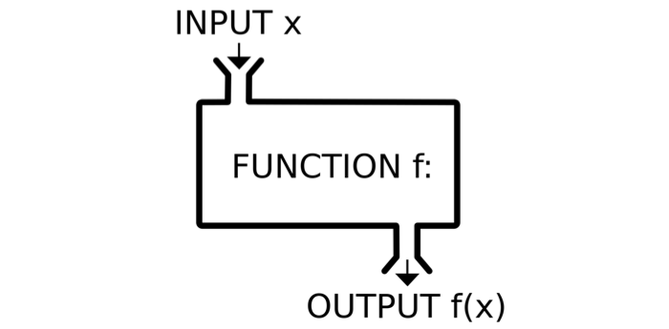
Functions

Slide 2


Slide 3


Slide 4
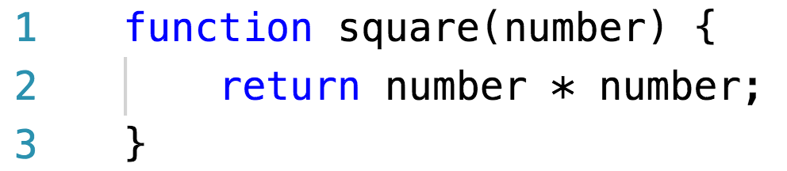
Function declarations/statements

Slide 5


Slide 6
Function expressions

Slide 7
Function as a value
A function value can do all the things that other values can do:
You can use it in arbitrary expressions, not just call it
It is possible to store a function value in a new variable
Pass it as an argument to a function
Variable that holds a function is still just a regular variable and can, if not constant, be assigned a new value

Slide 8
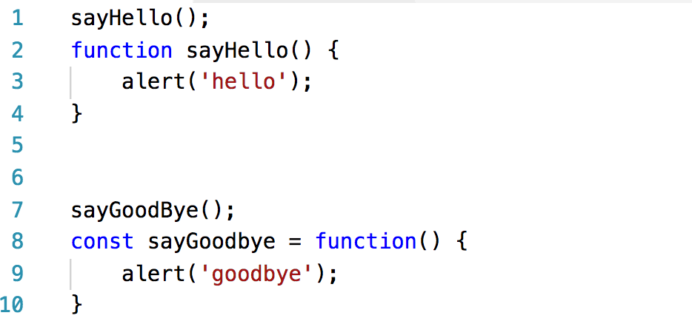
Exercise
Let’s create index.html and myScript.js in one folder
Link script file to index.html
Try to add this code to your script file:

Slide 9
Hoisting
JavaScript Declarations are Hoisted
Hoisting is JavaScript's default behavior of moving all declarations to the top of the current scope (to the top of the current script or the current function)
JavaScript Initializations are Not Hoisted

Slide 10


Slide 11
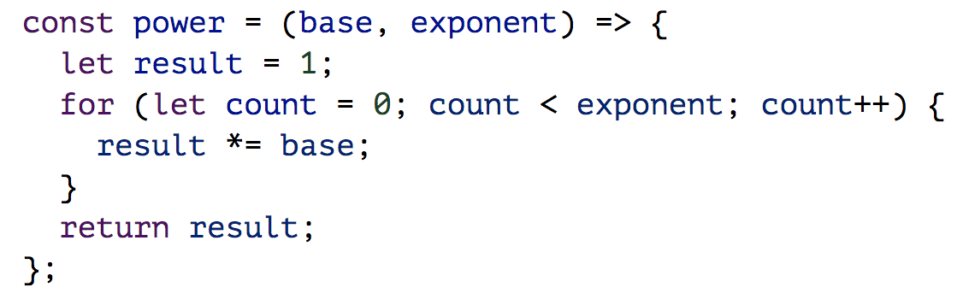
Arrow functions
Arrow functions were added in 2015, mostly to make it possible to write small function expressions in a less verbose way.

Slide 12
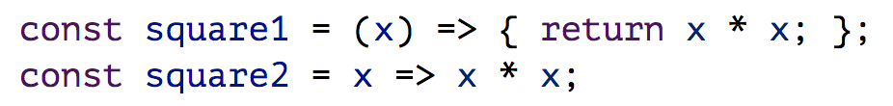
Arrow functions

Slide 13
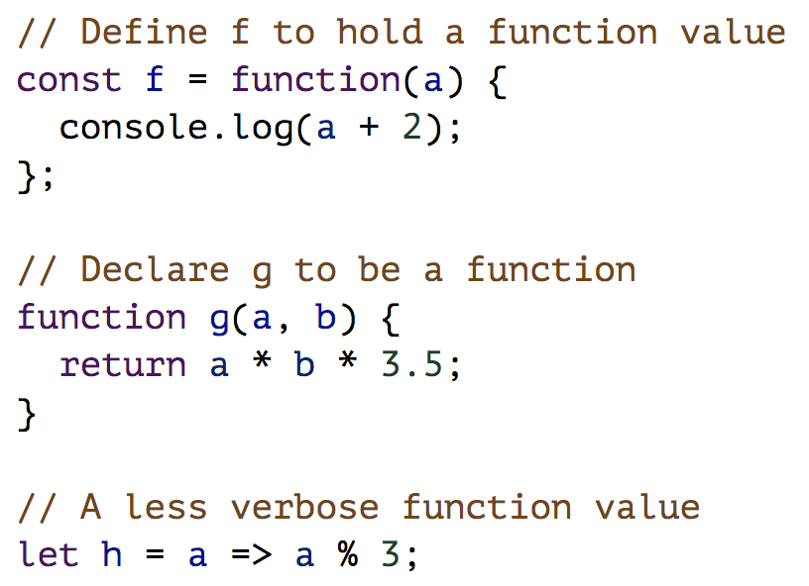

Slide 14
Function scope
Variables defined inside a function cannot be accessed from anywhere outside the function, because the variable is defined only in the scope of the function.
However, a function can access all variables and functions defined inside the scope in which it is defined.

Slide 15
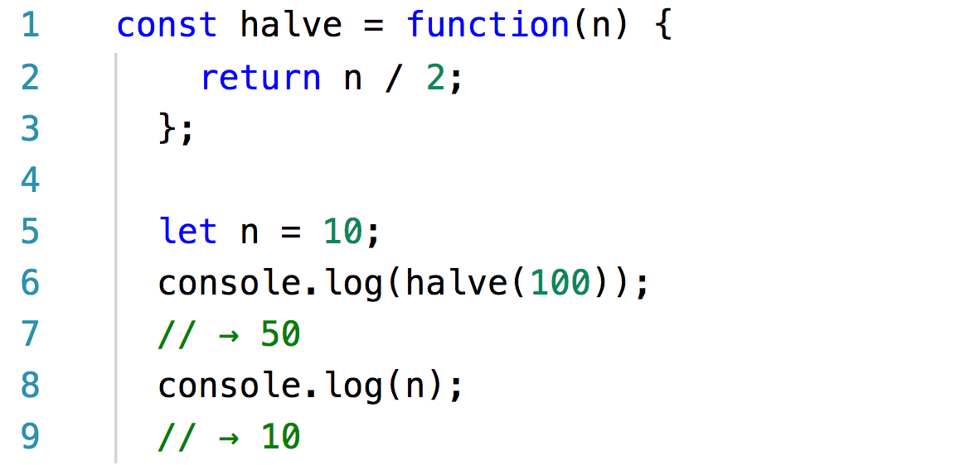
Function scope

Slide 16
Nested scope
Blocks and functions can be created inside other blocks and functions, producing multiple degrees of locality.
Each local scope can also see all the local scopes that contain it, and all scopes can see the global scope.

Slide 17
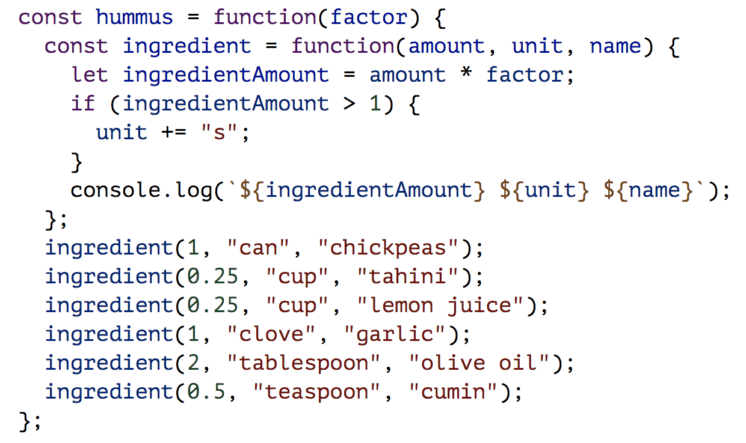
Nested scope

Slide 18
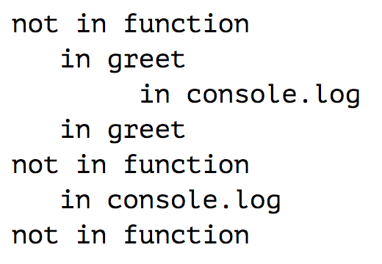
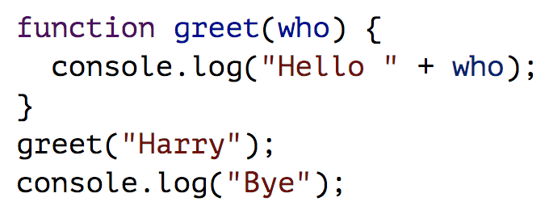
The call stack

Slide 19
The call stack
Because a function has to jump back to the place that called it when it returns, the computer must remember the context from which the call happened
The place where the computer stores this context is the call stack
Every time a function is called, the current context is stored on top of this stack. When a function returns, it removes the top context from the stack and uses that context to continue execution.

Slide 20
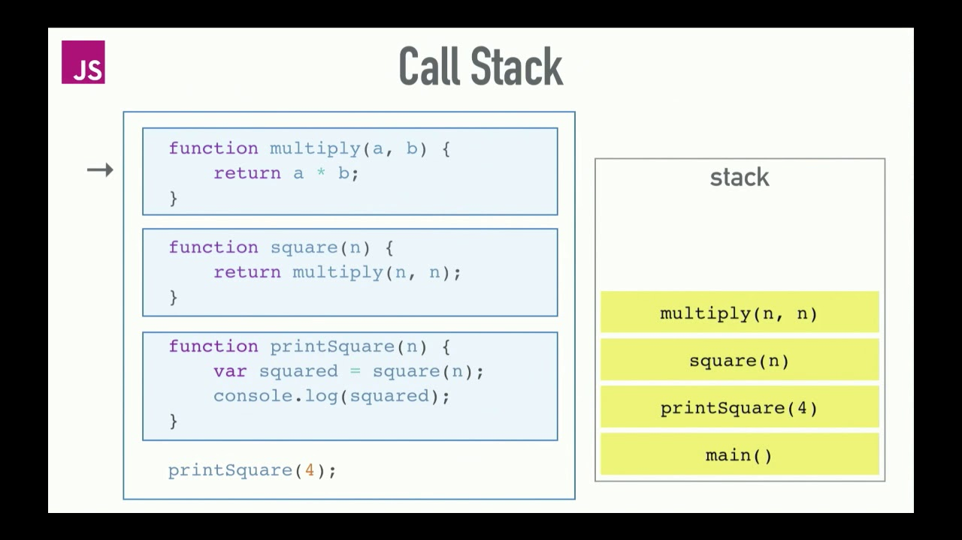

Slide 21
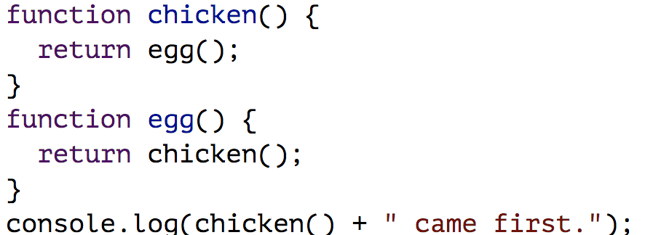
Exercise

Slide 22
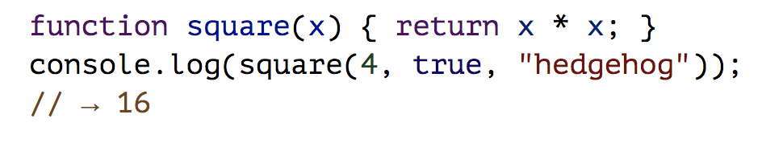
Optional Arguments
If you pass too many, the extra ones are ignored

Slide 23
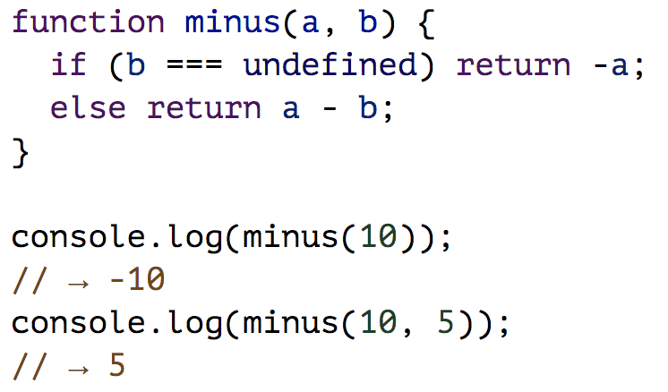
Optional Arguments
If you pass too few, the missing parameters get assigned the value undefined.

Slide 24
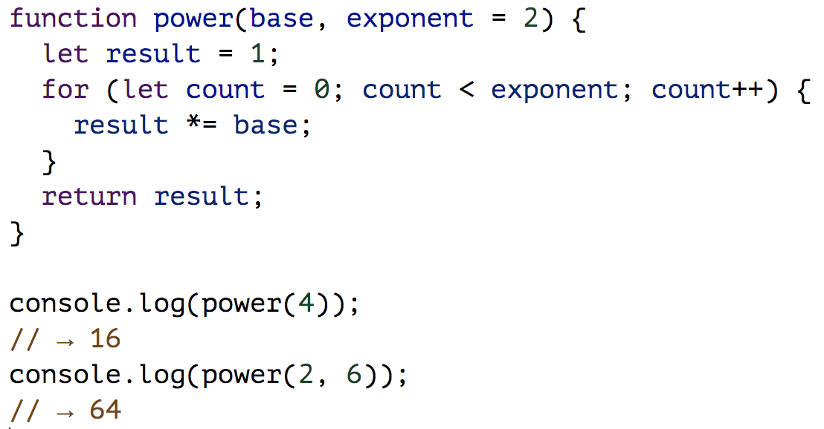
Optional Arguments
If you write an = operator after a parameter, followed by an expression, the value of that expression will replace the argument when it is not given.

Slide 25
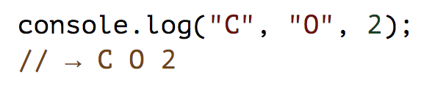
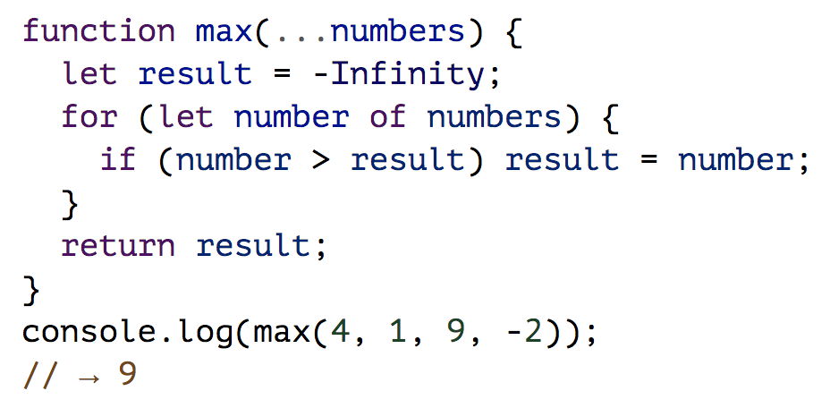
Unlimited number of arguments

Slide 26
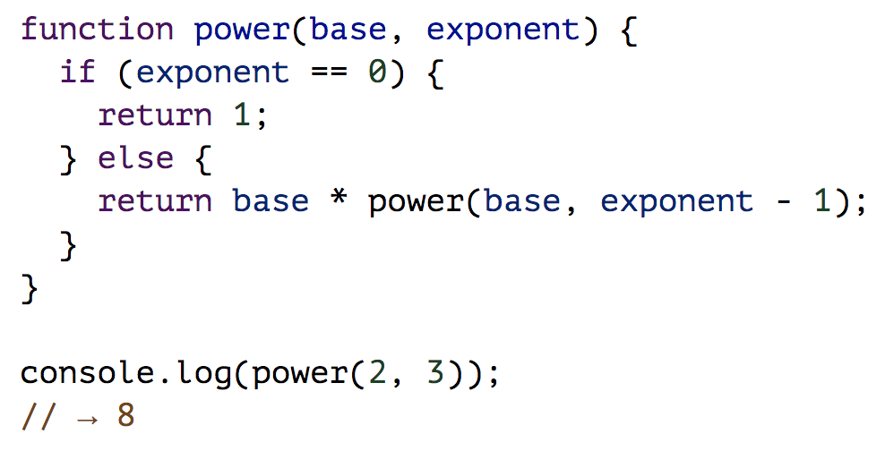
Recursion
It is perfectly okay for a function to call itself, as long as it doesn’t do it so often that it overflows the stack. A function that calls itself is called recursive.

Slide 27
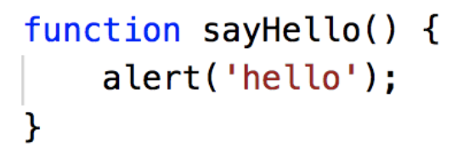
Functions and side effects
Functions can be roughly divided into those
that are called for their side effects
those that are called for their return value.

Slide 28
Pure functions
A pure function is a specific kind of value-producing function that not only has no side effects but also doesn’t rely on side effects from other code—for example, it doesn’t read global variables whose value might change
When called with the same arguments, it always produces the same value (and doesn’t do anything else)
You can test it by simply calling it and know that if it works in that context, it will work in any context
Side effects are often useful
Nonpure functions tend to require more scaffolding to test

Slide 29
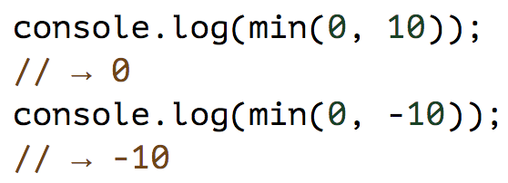
Minimum
Write a function min that takes two arguments and returns their minimum.
Write it using three different notations:
Function declaration
Function expression
Arrow function

Slide 30
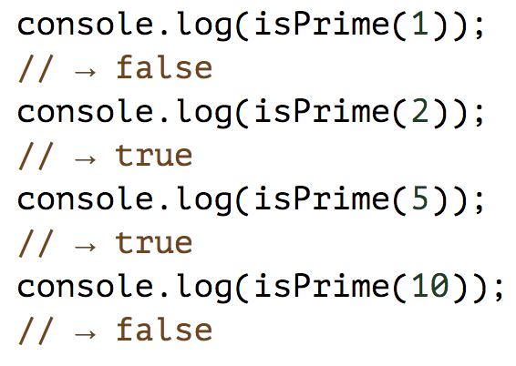
Prime number
Write a JavaScript function that accepts a number as a parameter and check the number is prime or not. Note : A prime number (or a prime) is a natural number greater than 1 that has no positive divisors other than 1 and itself.

