Slide 1



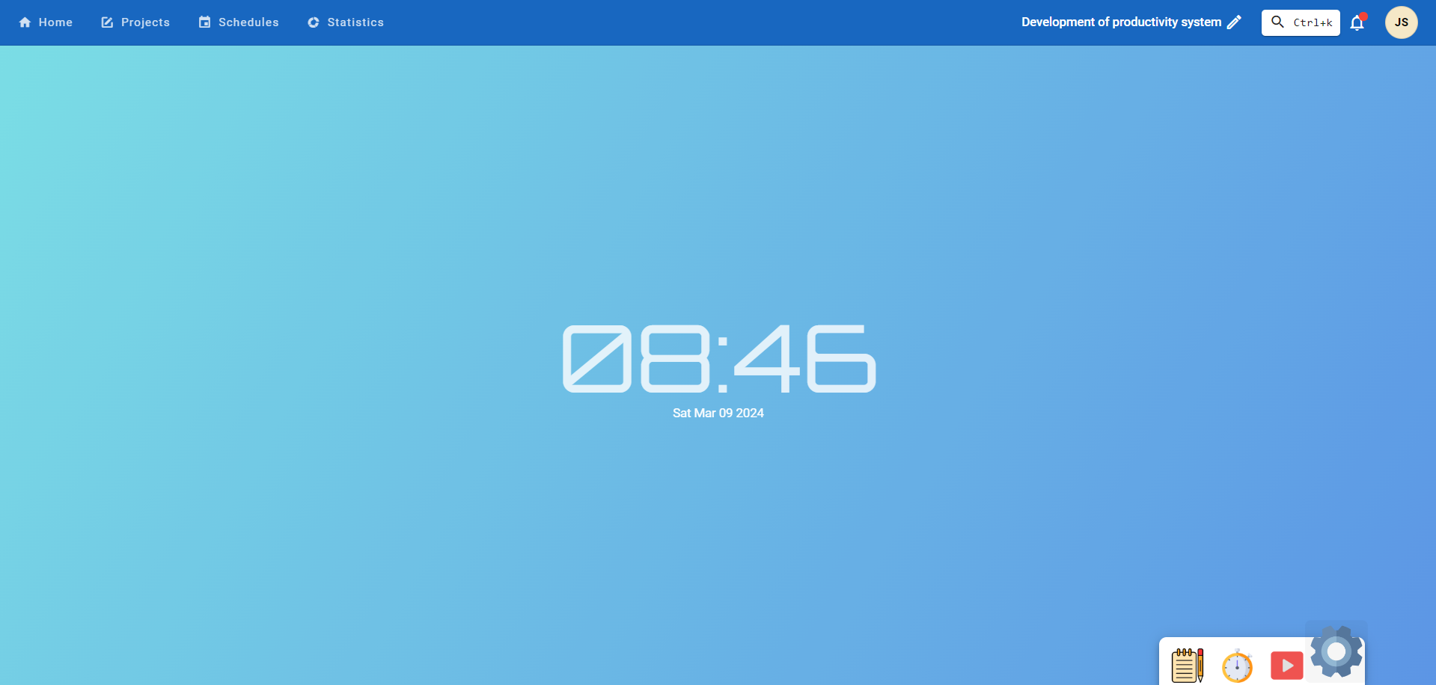
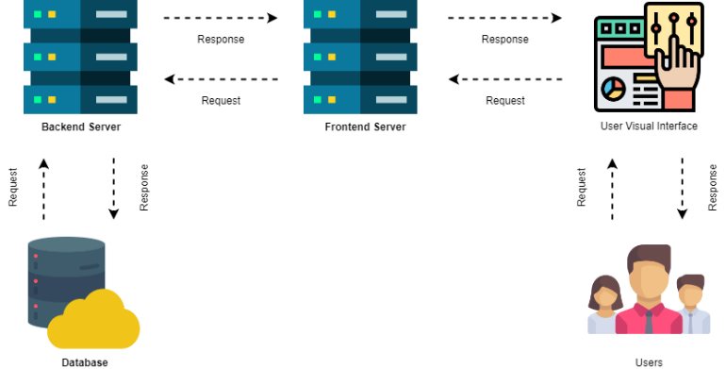
DEVELOPMENT OF WEB-BASED PRODUCTIVITY SYSTEM IN ARELLANO UNIVERSITY – JOSE RIZAL CAMPUS
AUTHORS: JOSHUA P. SOTTO, CLEYRE C. CATADA, JOANNA FRANCESCA G. TOLENTINO
ABSTRACT: With the growing prevalence of online and blended learning in the modern post-pandemic educational curriculum, the ramifications posed by online distractions has ever been more rampant than ever. This leads to procrastination and decreased levels of productivity within students.Efficiently application features productivity and anti-procrastination tools which helps in combating these adverse effects. It can also aid in boosting student productivity. It offers task organizers, scheduling tools, and focus mode. It is developed using JavaScript, Nuxt.js, Veutify, and MongoDB as frameworks, languages, and database management programs. Additionally, it uses Visual Studio Code as text editor for the code and Postman as API Testing. Using these various software technology, the researchers are able to formulate a web-based productivity application which academically helps student navigate learning in the digital age.
Keywords Coronavirus Pandemic, Online Learning, Asynchronous learning, physical distraction
INTRODUCTION
RESULTS & DISCUSSION
The COVID-19 pandemic has significantly impacted the learning landscape, leading to the introduction of online learning and blended learning. This approach combines both traditional and online learning methods for optimized learning. However, students face challenges such as online distractions, self-supervision struggles, and time management issues, which can lead to procrastination. Researchers have developed a Web-Based Productivity Application System to provide a focus-supporting environment and an anti-procrastination feature. The system uses programs like Portman, Visual Studio Code, Node.js, and MongoDB to provide these features on a user-friendly, visually appealing interface. This system aims to help students adapt to the new learning environment and improve their academic performance.
Figure 12: Home Page
The figure 12 show the home page of authenticated user, where the page gives user a relaxing background and customizable colors and theme
METHODOLOGY
The system's evaluation results, based on survey questionnaires, show an overall satisfaction rate of 4.6 out of 4.6. Usability is the highest satisfaction rate, followed by Functional Suitability at 4.64. Performance Efficiency is the lowest, followed by Reliability at 4.53. Security is rated "Very Good" for confidentiality, integrity, accountability, authenticity. Usability is rated "Excellent" for operability, user interface aesthetics, learnability, error protection, performance efficiency, and functional suitability.
Figure 1: System Architecture
Figure 1 illustrates a system architecture consisting of two web servers, two visual interfaces, users, and a database. The backend server secures, stores, deletes, updates, and retrieves data, while the frontend server handles user interface and requests. The database stores data, while users are the application's users.
CONCLUSIONS & RECOMMENDATIONs
The application provided users with the quality software features in creating calming digital environment, managing tasks, managing their schedules, and generating progress reports.
The application was recommended to make it accessible to mobile devices, the integration of a scanning for malicious files, optimize the background for a faster display, and to make the performance report more entertaining.
SIGNIFICANT REFERENCES
Simplilearn. (2022, April 1). What is Productivity? How to Define and Measure It? | Simplilearn. Simplilearn.com. https://www.simplilearn.com/what-is-productivity-and-how-to-define-and-measure-it-article
Zaitun, Z., Hadi, M. S., & Harjudanti, P. (2021). The Impact of Online Learning on the Learning Motivation of Junior High School Students. Bisma the Journal of Counseling, 5(1), 56. https://doi.org/10.23887/bisma.v5i1.35980
Distractions: an obstacle to online education. (2019, February 26). Observatory.tec.mx. https://observatory.tec.mx/edu-news/distraction-an-obstacle-to-online-education/

