Slide 1
ASP.NET Application
&
Page Life Cycle

Slide 2
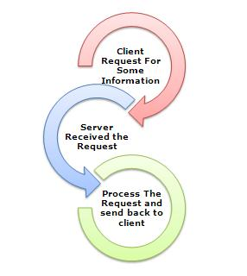
Web Server
“software that helps to deliver web content that can be accessed through the Internet. The most common use of web servers is to host websites, but there are other uses such as gaming, data storage or running enterprise applications”

Slide 3
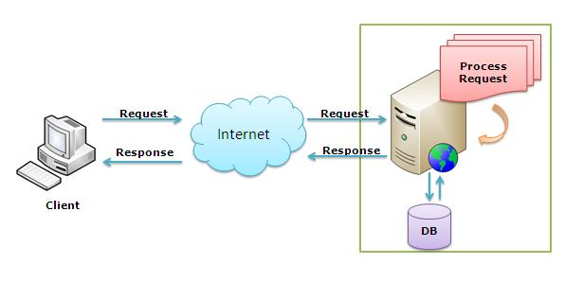
What is IIS??

Slide 4
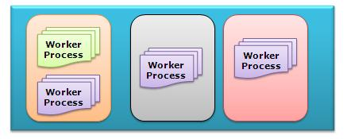
Worker Process &
Application Pool

Slide 5
HTTP Modules
HTTP module is an assembly that is called on every request made to your application. HTTP modules therefore give you the opportunity to examine incoming requests and take action based on the request.
Security
Logging
Custom headers or footers

Slide 6
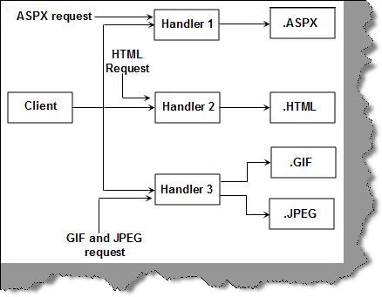
HTTP Handler
ASP.NET HTTP handler is the process (frequently referred to as the "endpoint") that runs in response to a request made to an ASP.NET Web application.

Slide 7
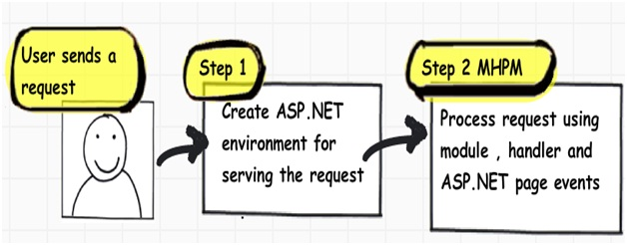
Two Step Process

Slide 8
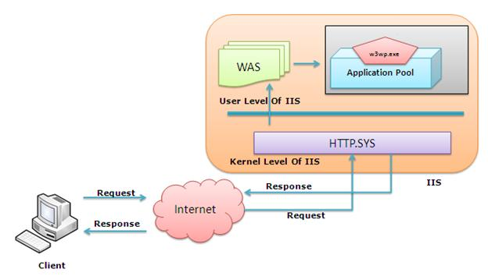
Step 1: ASP.NET Environments

Slide 9
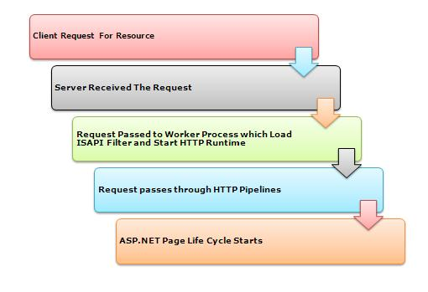
Step 2: Process Request

Slide 10
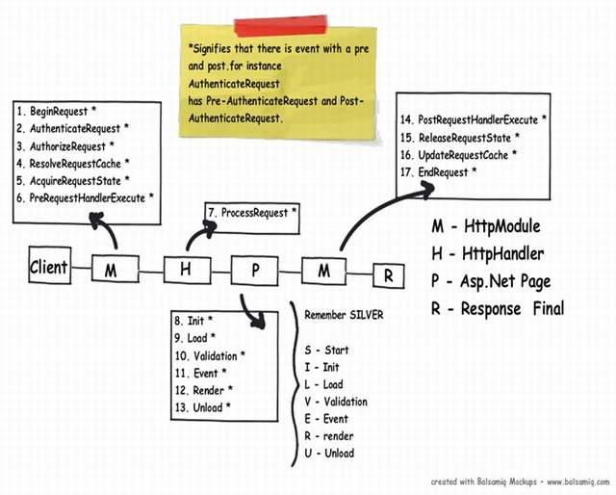
Continue….

