Slide 1
Dominion AI using Monte carlo tree search (mcts)
Jonathan Sarasua

Slide 2

Overview
Introduction
Previous Work
Monte Carlo Tree Search
Dominion
Results
Artifact Demo
Implementation
Conclusion

Slide 3
Overview
Introduction
Previous Work
Monte Carlo Tree Search
Dominion
Results
Artifact Demo
Implementation
Conclusion

Slide 4
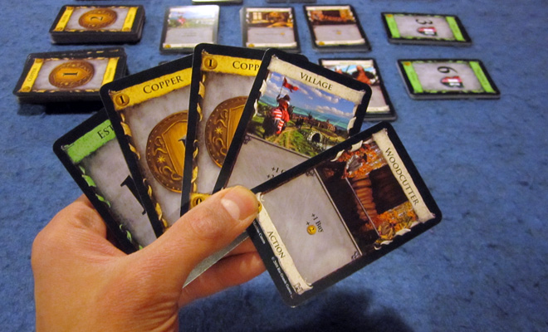
Introduction
Why Dominion?
Why MCTS?
Notes:
Here I’ll talk about my interest in boardgames and how I came to choose MCTS. I’ll mention I had no prior experience with AI, so MCTS made sense since the concept is simple but still pops up in conjunction with other AIs like Alpha Zero and Hierarchical Portfolio Search

Slide 5
Overview
Introduction
Previous Work
Monte Carlo Tree Search
Dominion
Results
Artifact Demo
Implementation
Conclusion

Slide 6
Previous work
MCTS with other AIs
Alpha Zero
Hierarchical Portfolio Search (HPS)
MCTS with Dominion
Jansen and Tollisen
Used simple set of cards
~68% winrate against common state machine AIs like Single Witch

Slide 7
Overview
Introduction
Previous Work
Monte Carlo Tree Search
Dominion
Results
Artifact Demo
Implementation
Conclusion

Slide 8


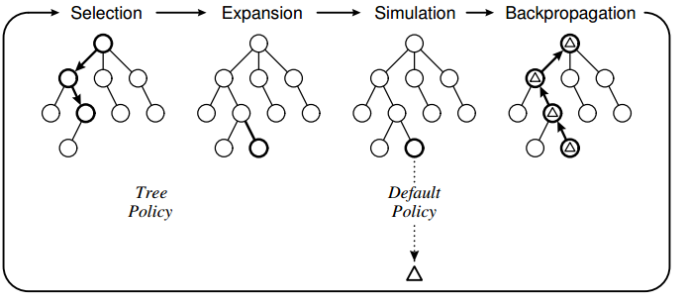
MCTS
UCT
Xj = winrate
C = Exploration parameter
N = parent simulations
Nj = current nodes simulations
Build the best incomplete tree of gamestates
Selection
Uses Upper Confidence Bounds Applied To Trees (UCT) to select the best node to expand
Expansion
Add unexplored child node to selected node
Simulation
Plays a game using a specified policy and returns 0, 0.5, or 1 for loss, tie, or win
Backpropagation
Take the result from simulation and backpropagate relative to the current player
Notes:
Here I’ll talk about the basic theory of Pure MCTS

Slide 9
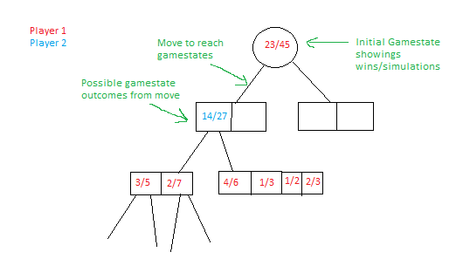
MCTS in a card game
Each move may have multiple outcomes
Whichever move has been simulated the most (sum of each outcome’s simulations is the best move)

Slide 10
Overview
Introduction
Previous Work
Monte Carlo Tree Search
Dominion
Results
Artifact Demo
Implementation
Conclusion

Slide 11
Dominion
Start of game
Shuffle deck
Draw 5 cards
Each turn
Play one action (grey cards)
Buy one card
End Turn
Discard all cards in hand, play area, and what you bought
Draw 5 new cards
If deck is empty, shuffle discard pile and make your deck
Some actions can give you more actions/buys
Cannot play action after buying
Notes:
Here I’ll talk about the basic rules of Dominion

Slide 12
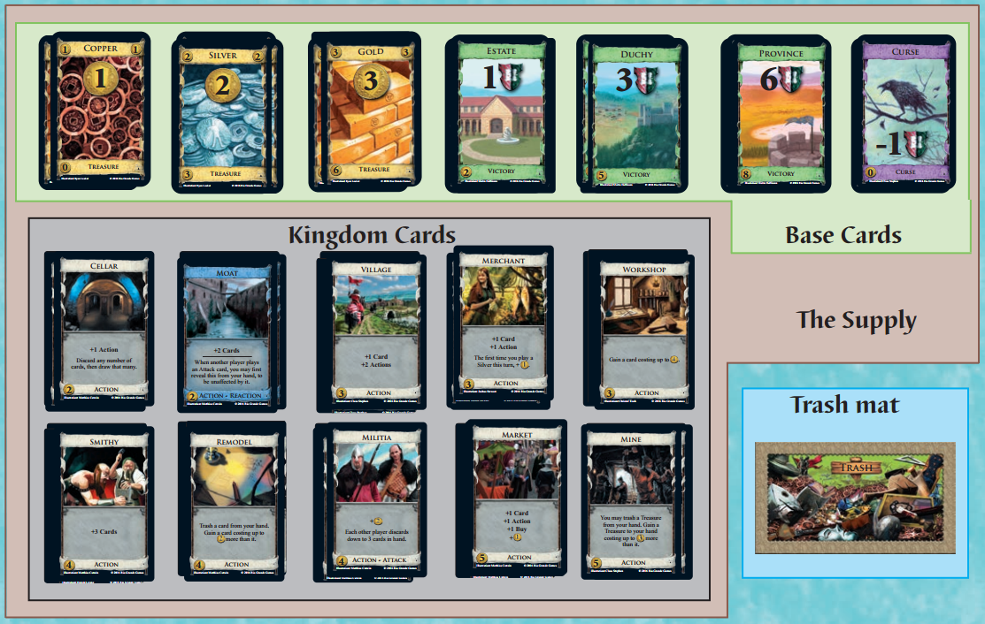
Dominion continued
How to win:
Have more victory points from Green cards
Game Ends when:
3 of the piles are exhausted OR
Province pile is exhausted

Slide 13
Overview
Introduction
Previous Work
Monte Carlo Tree Search
Dominion
Results
Artifact Demo
Implementation
Conclusion

Slide 14
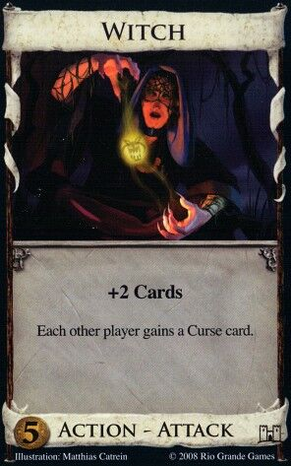
Single State machine test bed
Big Money
Baseline
Single Witch
Double Witch
Sarasua1
Notes:
Here I’ll talk about Dominion strategy theory and explain these state machines

Slide 15
Results with Base MCTS
Failure
0% winrate against Big Money
Sadness

Slide 16
How to tweak mcts
Selection
Change exploration parameter (C) in UCT
Add a victory point nudge to handle any move winning/losing
Expansion
Can expand over only a subset of moves chosen from heuristics to reduce branching factor
Simulation
Can use a heuristic to simulate
Can use heuristic but sometimes choose random (epsilon heuristic)

Slide 17
Results with Tweaked MCTS
Success!
Simulation heuristic
 | Random | Big Money | Single Witch | Sarasua1 | Sarasua1 Epsilon
Big Money | 50 | 50 | 50 | 50 | 60
Single Witch | 50 | 50 | 50 | 50 | 60
Double Witch | 50 | 50 | 50 | 50 | 60
Sarasua1 | 50 | 50 | 50 | 50 | 60

Slide 18
Results with Tweaked MCTS Cont’d
Success!
Expansion Method
Time To settle on a move
 | Random | Big Money | Single Witch | Sarasua1
Big Money | 50 | 50 | 50 | 50
Single Witch | 50 | 50 | 50 | 50
Double Witch | 50 | 50 | 50 | 50
Sarasua1 | 50 | 50 | 50 | 50

Slide 19
Overview
Introduction
Previous Work
Monte Carlo Tree Search
Dominion
Results
Artifact Demo
Implementation
Conclusion

Slide 20
Sick Demo

Slide 21
Overview
Introduction
Previous Work
Monte Carlo Tree Search
Dominion
Results
Artifact Demo
Implementation
Conclusion

Slide 22
Data structure
Node
Moves
Parent Pointer
Move
Data
Possible outcomes for move
Data
Metadata
Metadata
Float wins;
Float simulations
Gamestate

Slide 23
Implementation
Selection
How to calculate score?
Sum all possible outcomes for each move
Add VP Nudge
Expand
Expand over all possible moves
Don’t include duplicates
Expand over subset of moves
Subset gathered using heuristics
Buy Highest VP card
Buy highest Money Card,
Buy highest action card
Node
Moves
Parent Pointer
Data
Data
Metadata
Metadata
Float wins;
Float simulations
Gamestate

Slide 24
Implementation cont’d
Best Move is selected from options
Ask Game for gamestate after playing move
Compare gamestate to stored gamestates
If exists, navigate through stored node
Else expand the current node with this new gamestate
Node
Game
Moves
Best move
Parent Pointer
Data
Gamestate
New Gamestate

Slide 25
Implementation cont’d
Simulation
Take a gamestate
Randomize unknown info
Play game using heuristics
Random
Big Money, Single/Double Witch
Greedy/Sarasua1
Chaos Chance
Chance to forgo heuristic and still play random move
Backpropagation
Take result and backpropagate
Keep relative to player of move

Slide 26
Threads
Spin off thread to do selection and expansion
Spin up five more threads for simulations
Original thread handles backpropagation
Simulation Threads
MCTS Thread
Application Thread

Slide 27
Saving and loading
Binary format
Total Number Of Simulations To Run
NumberOfSimulationsRun
Save Node
Save Data
Save Move Count
First Move Input
Save Child Node Count
Save Child Node
Node
Parent Pointer
Moves
Data
Child Nodes
Data
Metadata
Gamestate

Slide 28
Overview
Introduction
Previous Work
Monte Carlo Tree Search
Dominion
Results
Artifact Demo
Implementation
Conclusion

Slide 29
Conclusion
MCTS needs assistance
Best in combination with other AI/Expert Knowledge

