Slide 1

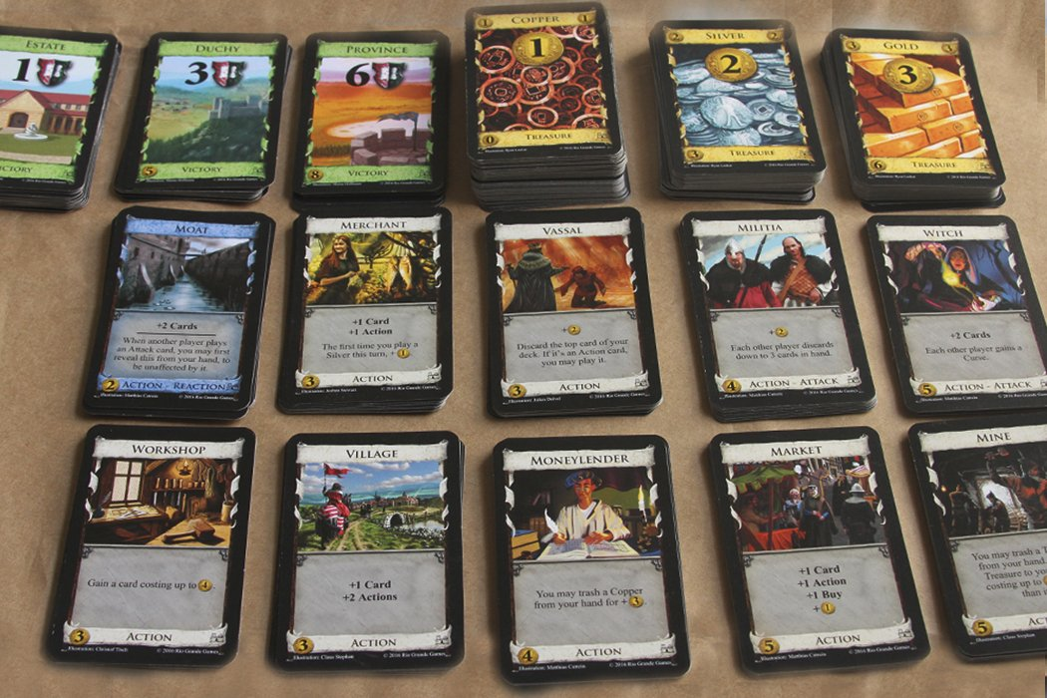
General Deckbuilding Game AI Using Monte-Carlo Tree Search
ARTIFACT DESCRIPTION
Jonathan Sarasua
PROCESS/PIPELINE
The artifact will be a playable Dominion game where you can play against or watch different versions of a Monte-Carlo AI. The game will be 2D showing the bare minimum needed to play game like card text and actions. You will be able to set the number of different cards to see how the AI does in simpler or more complicated versions. You will also be able to tweak the number of simulations and the exploration parameter for Upper Confidence Bounds for Trees (UCT)
There will also be a playable demo of Star Realms (or similar deckbuilder) that will use the same AIs to play the game. This will be an even simpler implementation as a proof of concept that the AI can play different games
Tasks
Research deckbuilding games and their differences as it relates to building an AI
Build Dominion game
Build a baseline Dominion AI strategy like “Big Money” or “Single Witch”
Build AI using MCTS for Dominion while attempting to keep it as general as possible
Build different twists on Monte-Carlo
Play and compare results of the different versions of augmented Monte-Carlo and baseline AI to see which plays best
Attempt to implement AI in a similar deckbuilder like Star Realms
SOFTWARE DEVELOPMENT
Source: https://www.boardgamehalv.com/dominion-review/
FIELD RESEARCH ONE
FIELD RESEARCH TWO
FIELD RESEARCH THREE
MASTERY WHY?
Monte Carlo Tree Search in a Modern Board Game Framework:
The thesis attempts to use MCTS for a proposed General Game Playing (GGP) AI for modern board games. It chooses a non-deterministic boardgame in Settlers of Catan. This is a good reference for making a General AI.
AIs for Dominion Using Monte-Carlo Tree Search:
This paper shows MCTS can be used to play Dominion and is a good reference for strategies in comparing results and finding baselines of expectations. It is also a great resource for all four phases of MCTS: Selection, Expansion, Simulation, and Backpropagation
An MCTS Agent For Ticket To Ride:
This paper is another example of MCTS being used successfully on a tabletop game (Ticket To Ride) with Stochastic elements and hidden information.
This thesis would require me to go broad by building out two deckbuilding games, and it would allow me to go deep by exploring an AI algorithm with challenging elements like hidden information. Using baseline Ais, I would be able to prove the strength of my AI with data. I would also have the chance to confirm my understanding by applying it to a second game
CREDITS:
By: G.J.B. Roelofs
https://project.dke.maastrichtuniversity.nl/games/files/bsc/Roelofs_Bsc-paper.pdf
CREDITS:
By: Robin Tollisen, Jon Vegard Jansen
https://pdfs.semanticscholar.org/28b6/ada13e948cfaee4af5138ee667d404eb01ac.pdf
CREDITS:
By: Carina Huchler
https://project.dke.maastrichtuniversity.nl/games/files/msc/Huchler_thesis.pdf

