Slide 1
Dominion AI using Monte carlo tree search (mcts)
Jonathan Sarasua

Slide 2

Overview
Introduction
Previous Work
Dominion
Monte Carlo Tree Search
Results
Artifact Demo
Implementation
Future Work
Conclusion

Slide 3
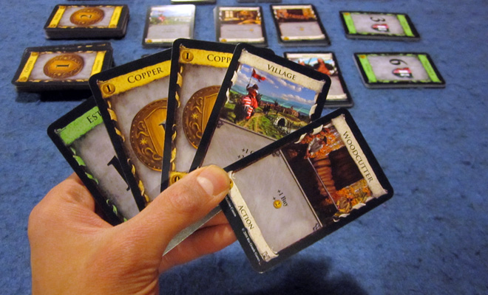
Introduction
Why Dominion?
Why MCTS?
Notes:
Here I’ll talk about my interest in boardgames and how I came to choose MCTS. I’ll mention I had no prior experience with AI, so MCTS made sense since the concept is simple but still pops up in conjunction with other AIs like Alpha Zero and Hierarchical Portfolio Search

Slide 4
Overview
Introduction
Previous Work
Dominion
Monte Carlo Tree Search
Results
Artifact Demo
Implementation
Future Work
Conclusion

Slide 5
Previous work
MCTS with other AIs
AlphaZero
Google’s AI to play Chess, Shogi, and Go
Hierarchical Portfolio Search (HPS)
MCTS with Dominion
Jansen and Tollisen
Used simple set of cards
~68% winrate against common state machine AIs like Single Witch

Slide 6
Overview
Introduction
Previous Work
Dominion
Monte Carlo Tree Search
Results
Artifact Demo
Implementation
Future Work
Conclusion

Slide 7

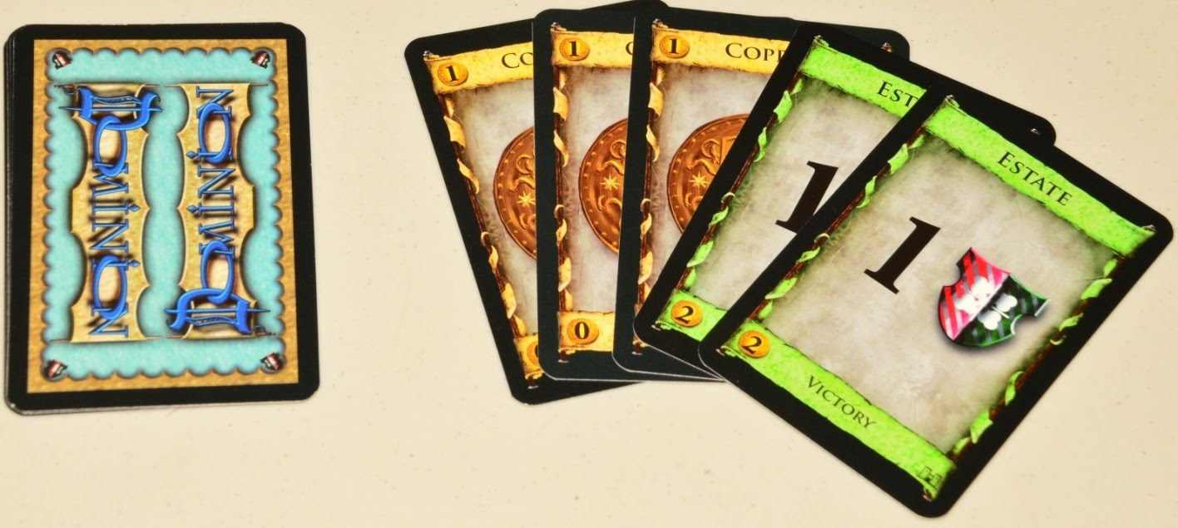
Dominion
Cards
Treasure
Victory
Action
Play Actions and Treasure cards to buy victory cards
Start of game
Shuffle starting deck
Draw 5 cards
Each turn
Play one action (grey cards)
Buy one card
Put Bought card in discard pile
End Turn
Discard all cards in hand, play area, and what you bought
Draw 5 new cards
If deck is empty, shuffle discard pile and make your deck
Some actions can give you more actions/buys
Cannot play action after buying
Notes:
Here I’ll talk about the basic rules of Dominion

Slide 8
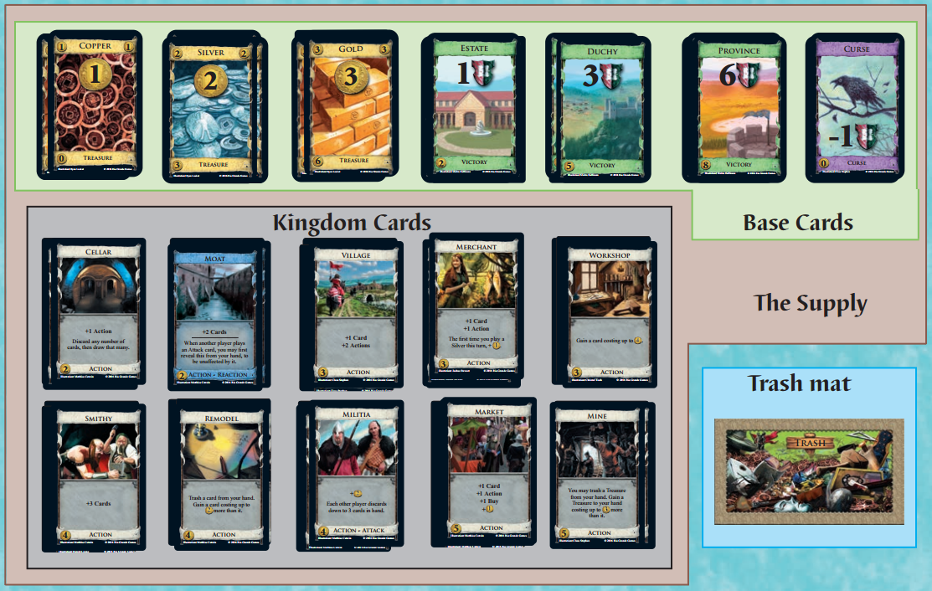
Dominion continued
How to win:
Have more victory points from Green cards
Game ends when:
3 of the piles are exhausted OR
Province pile is exhausted

Slide 9
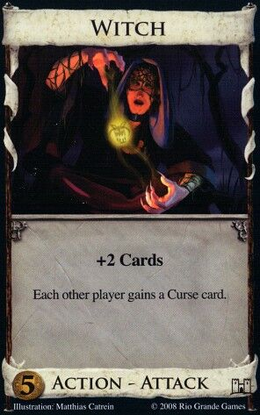
Single State machine test bed
Big Money
Baseline
Single Witch
Double Witch
Sarasua1
Notes:
Here I’ll talk about Dominion strategy theory and explain these state machines

Slide 10
Overview
Introduction
Previous Work
Dominion
Monte Carlo Tree Search
Results
Artifact Demo
Implementation
Future Work
Conclusion

Slide 11
MCTS Background
Goal:
Get the best move at any game state for a given game
Able to always have a result in a limited timeframe
Solution:
Build a complete tree of all game states
Save metadata to nodes in the tree while building to allow giving an answer while incomplete
Nice to have
Keep the solution general enough that expert knowledge isn’t required
Combine with other AIs to make a better AI

Slide 12

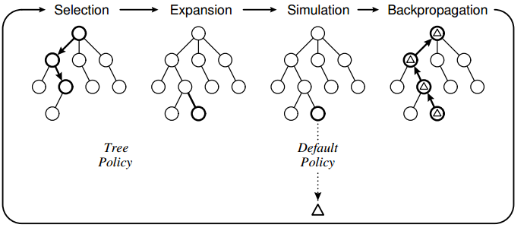
MCTS
UCT
Xj = winrate
C = Exploration parameter
N = parent simulations
Nj = current nodes simulations
Build the best incomplete tree of game states
Selection
Uses Upper Confidence Bounds Applied To Trees (UCT) to select the best node to expand
Expansion
Add unexplored child node to selected node
Simulation
Plays a game using a specified policy and returns 0, 0.5, or 1 for loss, tie, or win
Backpropagation
Take the result from simulation and backpropagate relative to the current player
Notes:
Here I’ll talk about the basic theory of Pure MCTS

Slide 13
MCTS in a card game
23/45
Each move may have multiple outcomes
Whichever move has been simulated the most (sum of each outcome’s simulations is the best move)
Input Move
Input Move
14/27
Wins / Simulations
Input Move
Input Move
Player 1
Player 2
3/5
2/7
4/6
1/3
1/2
2/3

Slide 14
MCTS in a card game
23/45
During Selection how do we choose which outcome?
Sampling?
Possible place for bugs
Ask the game to play the given move
Randomize unknown info
Deck order
Opponent’s hand and deck
Input Move
InputMove
14/27
Input Move
Input Move
3/5
2/7
4/6
1/3
1/2
2/3

Slide 15
Example
Action Phase Options
Play Village
Play Woodcutter
Go To Buy Phase

Slide 16
Steps
Select
Expand
Rollout
Backpropagate
Gamestate
Hand: Estate, Copper, Copper, Vilage, Woodcutter
MetaData
2 Win
3 Simulations
Node
Play Village
End Action Phase
Select step
Can Expand?
Play Woodcutter
+Copper
+2 Actions
+2 Coins
+1 Buy
MetaData
1 Win
1 Simulation
MetaData
1 Win
1 Simulation

Slide 17
Steps
Select
Expand
Rollout
Backpropagate
Gamestate
Hand: Estate, Copper, Copper, Vilage, Woodcutter
MetaData
2 Win
3 Simulations
Node
Play Village
End Action Phase
Expand step
Add Node
Play Woodcutter
+Copper
+2 Action
+2 Coins
+1 Buy
Buy Phase
MetaData
0 Win
0 Simulation

Slide 18
Steps
Select
Expand
Rollout
Backpropagate
Gamestate
Hand: Estate, Copper, Copper, Vilage, Woodcutter
MetaData
2 Win
3 Simulations
Node
Play Village
End Action Phase
Rollout step
Run simulation
Record result
Play Woodcutter
+Copper
+2 Action
+2 Coins
+1 Buy
Buy Phase
MetaData
0 Win
1 Simulation

Slide 19
Steps
Select
Expand
Rollout
Backpropagate
Gamestate
Hand: Estate, Copper, Copper, Vilage, Woodcutter
MetaData
2 Win
4 Simulations
Node
Play Village
End Action Phase
Backpropagation Step
pass result to parent
Play Woodcutter
+Copper
+2 Action
+2 Coins
+1 Buy
Buy Phase
MetaData
0 Win
1 Simulation

Slide 20
Steps
Select
Expand
Rollout
Backpropagate
Gamestate
Hand: Estate, Copper, Copper, Vilage, Woodcutter
MetaData
2 Win
4 Simulations
Node
Select step
Can Expand?
Play Village
End Action Phase
Play Woodcutter
No
Get Best Child
Move
+Estate
+2 Action
+Copper
+2 Action
+2 Coins
+1 Buy
Buy Phase
MetaData
1 Win
1 Simulation
MetaData
1 Win
1 Simulation
MetaData
0 Win
1 Simulation
New Outcome
Notes:
Look at brute force backtracking

Slide 21
Steps
Select
Expand
Rollout
Backpropagate
Gamestate
Hand: Estate, Copper, Copper, Vilage, Woodcutter
MetaData
2 Win
5 Simulations
Node
Play Village
End Action Phase
Expand new outcome
Run simulation
Backpropagate up tree
Play Woodcutter
+Copper
+2 Action
+Estate
+2 Action
+2 Coins
+1 Buy
Buy Phase
MetaData
1 Win
1 Simulation
MetaData
0 Win
1 Simulation
MetaData
1 Win
1 Simulation
MetaData
0 Win
1 Simulation

Slide 22
Steps
Select
Expand
Rollout
Backpropagate
Gamestate
Hand: Estate, Copper, Copper, Vilage, Woodcutter
MetaData
2 Win
6 Simulations
MetaData
2 Win
5 Simulations
Node
Select
Can Expand?
No
Choose Best Child
Play Woodcutter
Can Expand?
Yes
Expand
Add End Action Move
Rollout
Lost, update Metadata
Backpropagate
Add sim and loss to
parent nodes
Play Village
End Action Phase
Play Woodcutter
+Copper
+2 Action
+Estate
+2 Action
+2 Coins
+1 Buy
Buy Phase
End Action Phase
MetaData
1 Win
1 Simulation
MetaData
1 Win
2 Simulation
MetaData
0 Win
1 Simulation
Buy Phase

Slide 23
Overview
Introduction
Previous Work
Dominion
Monte Carlo Tree Search
Results
Artifact Demo
Implementation
Future Work
Conclusion

Slide 24
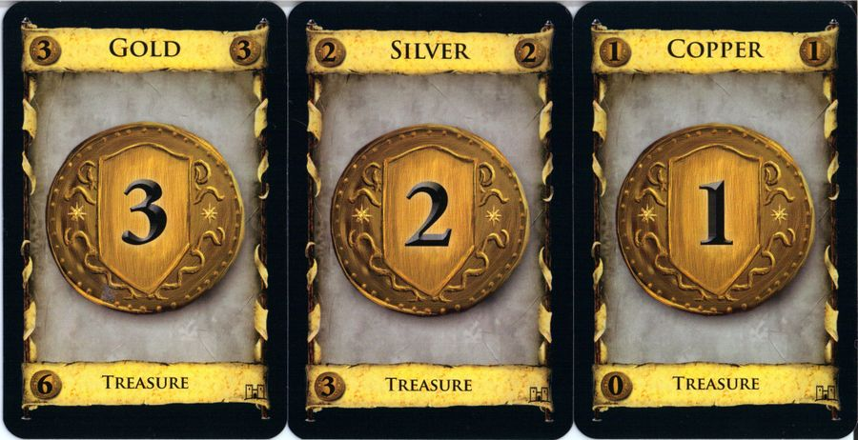
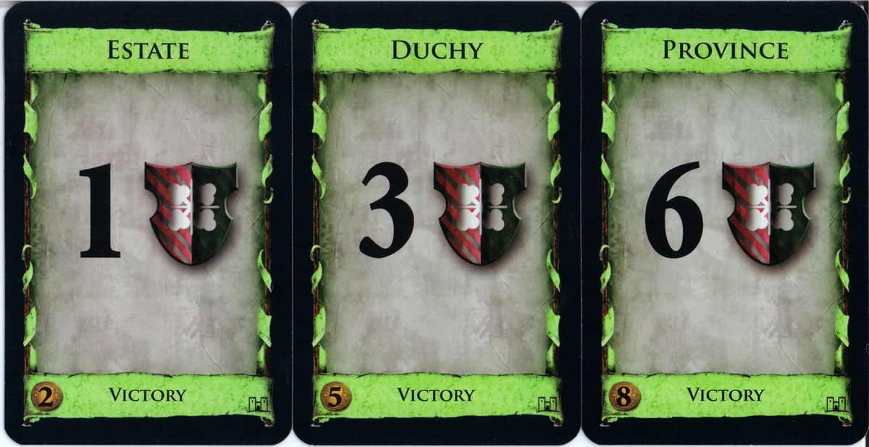
Results with Base MCTS
Random rollouts
Run for a few thousand iterations
Lose every game against Big Money
Check for bugs?

Slide 25
Results with Base MCTS
Test in optimal situation
Opponent Big Money
100,000 iterations per move
20 games
10 as player 1 and 10 as player 2
Won 4
20% winrate
17 GB of RAM used by end of game
Averaged 42 minutes per game
Normal average game length is 30 minutes

Slide 26
How to tweak mcts
Selection
Change exploration parameter (C) in Upper confidence Bounds Applied to Trees
Theoretical value of C is √2

Slide 27
How to tweak mcts
Selection
Change exploration parameter (C) in UCT
Theoretical value of C is √2
C Value | Wins vs C=√2 | Games played | Win %
0.5 | 9.5 | 20 | 0.475
5 | 9 | 20 | 0.45

Slide 28
How to tweak mcts
Simulation step
Can use a heuristic to simulate
Can use heuristic but sometimes choose random (chaos chance)

Slide 29
How to tweak mcts
Simulation step
Can use a heuristic to simulate
Can use heuristic but sometimes choose random (chaos chance)
MCTS Using Big Money | Wins vs Big Money | Games played | Win %
1,000 iterations per move | 85 | 200 | 42.5%
10,000 iterations per move | 162 | 200 | 81%
Chaos Chance | Wins vs 0% Chaos Chance | Games Played | Win%
15% | 27 | 50 | 54%

Slide 30
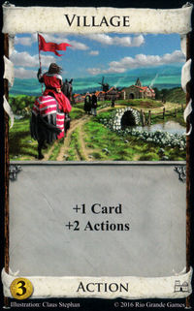
How to tweak mcts
Simulation step
Can use optimized random
RandomPLUS
During action phase, play cards that give extra actions first
Prioritize doing something over do nothing
MCTS RandomPLUS | Wins vs Big Money | Games Played | Win%
20,000 iterations per move | 61.5 | 100 | 61.5%

Slide 31
Other tweaks
Selection
Add a victory point nudge to handle any move winning/losing
Expansion
Can expand over only a subset of moves chosen from heuristics to reduce branching factor

Slide 32
Overview
Introduction
Previous Work
Dominion
Monte Carlo Tree Search
Results
Artifact Demo
Implementation
Future Work
Conclusion

Slide 33
Overview
Introduction
Previous Work
Dominion
Monte Carlo Tree Search
Results
Artifact Demo
Implementation
Future Work
Conclusion

Slide 34
Data structure
Node
Moves
Parent Pointer
Move
Data
Possible outcomes for move
Data
Metadata
Metadata
Float wins;
Float simulations;
Gamestate

Slide 35
Implementation
Selection
How to calculate score?
Sum all possible outcomes for each move
Add VP Nudge
Expand
Expand over all possible moves
Don’t include duplicates
Expand over subset of moves
Subset gathered using heuristics
Buy Highest VP card
Buy highest Money Card,
Buy highest action card
Node
Moves
Parent Pointer
Data
Data
Metadata
Metadata
Float wins;
Float simulations
Gamestate

Slide 36
Implementation cont’d
Best Move is selected from options
Ask Game for gamestate after playing move
Compare gamestate to stored gamestates
If exists, navigate through stored node
Else expand the current node with this new gamestate
Node
Game
Moves
Best move
Parent Pointer
Data
Gamestate
New Gamestate

Slide 37
Implementation cont’d
Simulation
Take a gamestate
Randomize unknown info
Play game using heuristics
Random, RandomPLUS
Big Money, Single/Double Witch
Greedy/Sarasua1
Chaos Chance
Chance to forgo heuristic and still play random move
Backpropagation
Take result and backpropagate
Keep relative to player of move

Slide 38
Threads
Spin off thread to do selection and expansion
Spin up five more threads for simulations
Original thread handles backpropagation
Simulation Threads
MCTS Thread
Application Thread

Slide 39
Threads
Possible problems
MCTS thread out of sync with the sim jobs
Expanded nodes with no meta data
Simulation Threads
MCTS Thread
Application Thread

Slide 40
Saving and loading
Binary format
Total number of iterations to run
Number of iterations already run
Save Node
Save Data
Save Move Count
First Move Input
Save Child Node Count
Save Child Node
Node
Parent Pointer
Moves
Data
Child Nodes
Data
Metadata
Gamestate

Slide 41
Overview
Introduction
Previous Work
Dominion
Monte Carlo Tree Search
Results
Artifact Demo
Implementation
Future Work
Conclusion

Slide 42
Future Work
Change Move architecture
Buy Card and End Turn move
Buy Card Move then End Turn Move
Try more advanced rollout methods
Genetic Algorithm
Add more cards
Implement MCTS on a different deckbuilding game

Slide 43
Overview
Introduction
Previous Work
Dominion
Monte Carlo Tree Search
Results
Artifact Demo
Implementation
Future Work
Conclusion

Slide 44
Conclusion
MCTS needs assistance
Best in combination with other AI/Expert knowledge

