Slide 1
Deckbuilding AI Using Monte Carlo Tree Search
Jonathan Sarasua

Slide 2

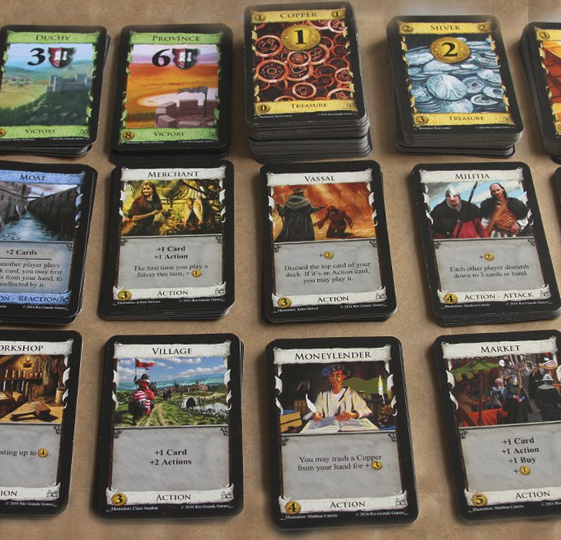
Overview
Building Dominion board game
Restricted to 2 players
Only cards in both 1st and 2nd edition to remove some of the more complicated options
Simple state machine AIs to use as a test bed
“Big Money” and “Single Witch” [2]
AI using Monte Carlo Tree Search (MCTS)
Playable game against all 3 of these AIs
Simulation mode with number of games, what AI, and tweaks to MCTS
Figure 1: Dominion cards [5]

Slide 3

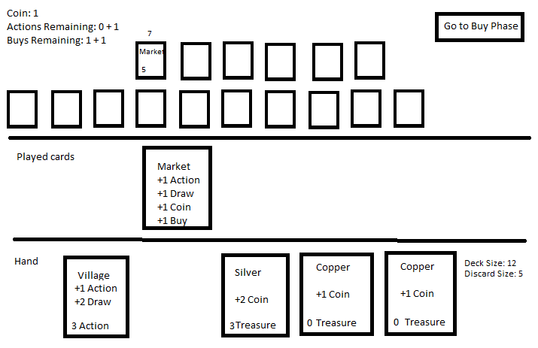
Interface – Human Vs AI
All mouse controls
Hearthstone
Click and Drag to play cards
Next Phase/End Turn
Current Money
Actions Remaining
Buys Remaining
Figure 2: In game mockup

Slide 4
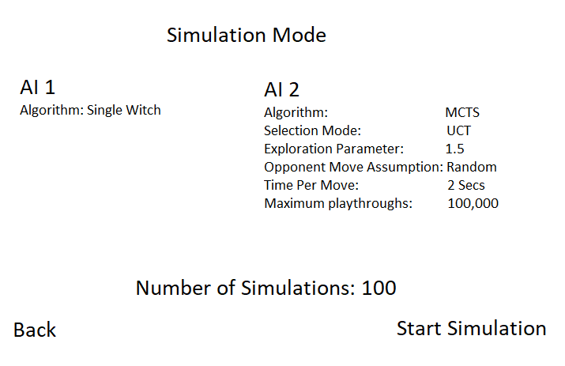
Interface – Simulation Mode
Choose two AIs between Big Money, Single Witch, and the variations of MCTS
For MCTS Variations
Upper Confidence Bounds (UCB) vs Upper Confidence Bounds Applied To Trees (UCT) [3]
Exploration constant (C) changing for UCT [3]
Opponent move assumptions ( Random, Big Money, Single Witch )
Results of games played shown on screen and to text file
Figure 3: Simulation Mode in game mockup

Slide 5
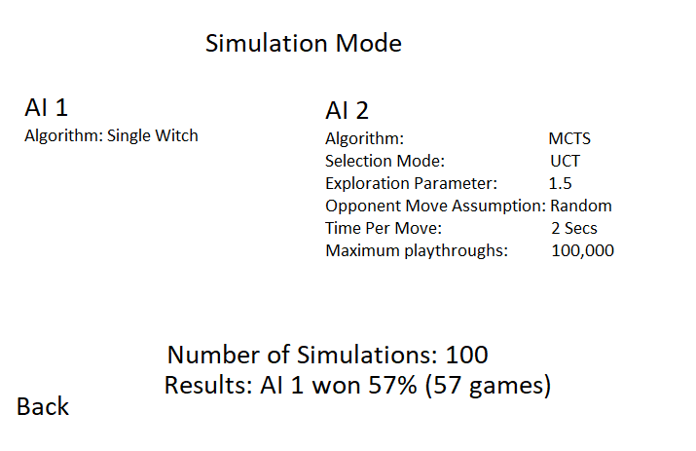
Figure 4: Results screen of Simulation Mode

Slide 6
Functionality AI State Machines
Big Money[2]
Single Witch[2]
If (Money >= 8) Buy Province
Else if( Money >= 6 ) Buy Gold
Else if( Money >= 3 ) Buy Silver
Else End Turn
If( !DoesHaveAWitch && Money >= 5 ) Buy Witch
Else BigMoney

Slide 7
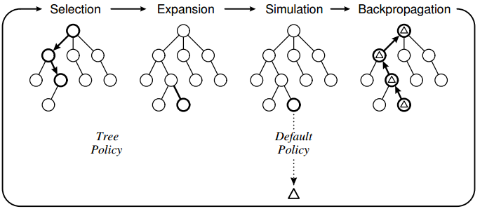
Functionality MCTS
Use chance nodes for random elements like what cards are drawn, played [4]
Selection
UCB or UCT
Expose exploration parameter [3]
Simulation
Assume random moves
Assume you and/or opponent follows Single Witch
Figure 5: MCTS Phases [6]

Slide 8
Showing Mastery
Playable Game for anyone to play against my AI algorithm
Compare results of MCTS against Big Money and Single Witch State Machines
Compare results of different versions of MCTS where selection/simulation method are changed
Compare my results against results against the results of other AIs against Single Witch
MCTS using UCB won 68.5% of games against Single Witch [1]

Slide 9
References
[1] J. V. Jansen and R. Tollisen, "An AI for Dominion Based on Monte-Carlo Methods," 2 June 2014. [Online]. Available: https://pdfs.semanticscholar.org/28b6/ada13e948cfaee4af5138ee667d404eb01ac.pdf. [Accessed 9 July 2020].
[2] "Big Money," 20 October 2018. [Online]. Available: http://wiki.dominionstrategy.com/index.php/Big_money. [Accessed 9 July 2020].
[3] P. Muens, "Game AIs with Minimax and Monte Carlo Tree Search," 3 April 2019. [Online]. Available: https://towardsdatascience.com/game-ais-with-minimax-and-monte-carlo-tree-search-af2a177361b0. [Accessed 9 July 2020].
[4] "Expectiminimax," Wikipedia, 21 April 2020. [Online]. Available: https://en.wikipedia.org/wiki/Expectiminimax. [Accessed 9 July 2020].
[5] Board Game Halv, 2019. [Online]. Available: https://www.boardgamehalv.com/dominion-review/. [Accessed July 2020].
[6] "How Does Monte Carlo Search Tree work?," Stack Overflow, June 2017. [Online]. Available: https://stackoverflow.com/questions/44230911/how-does-monte-carlo-search-tree-work. [Accessed July 2020].

