Slide 1
Dominion AI Using Monte Carlo Tree Search
Jonathan Sarasua

Slide 2
Planned deliverables by Milestone 4
Implement Dominion game
Only money, victory point, and simple action cards
First iteration of MCTS AI
Limited controls using number keys to play game and control AI
Test variations of handling hidden information in MCTS
Simple state machine AIs to test against
Big Money and Single Witch
UI/UX features
Click and drag cards

Slide 3
Changes to deliverable
Reduced focus on UI/UX
Implementing threading to increase speed and usability of game
Final deliverable will only have 1-2 sets of cards

Slide 4
Current state of artifact
Playable game of dominion
14 cards implemented
All 7 basic cards
7 simple actions
Multi threaded usable AI
500 simulations per second
Single
100 simulations per second

Slide 5

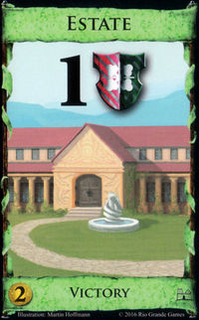
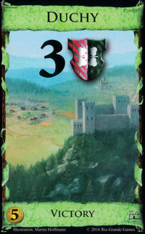
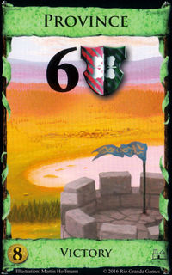
Current state of artifact cont’d
AI loses to Big Money every time
Focuses too heavily on win now cards that hurt it in long run
Buys Duchies and Estates, so it never reaches provinces

