Slide 1

AlwaysCaring
Best for Wyoming submission

Slide 2

Problem
Currently the home care system is ineffective for several reasons
  Lack of transparency/freedom for families ~3-4k
  Lack of organization for care givers
  High health care provider turnover rate

Slide 3
Problem
Example:
  A patient could have a medical emergency and need to be taken to a hospital, but his information isn’t readily available. This is because in times of stress families can not always remember vital information accurately.
  Our solution would provide the ability to quickly provide vital patient information to the doctor in a timely manner potentially saving lives.

Slide 4
Product
Our blockchain system provides a seamless and efficient solution for care providers to help in home patients while providing transparency to the family.
Easy access to patient info stored on our blockchain
Easy transfer of care between providers with connected information
Schedules for care providers created based on all patients

Slide 5
Product
In Wyoming family comes first. This was morally important to us while developing this idea, we wanted families to know that their relatives were in safe and reliable hands always.
Family can actively monitor the patient's status assigned tasks
Caregivers are able to record notes in order to show when anything abnormal, good or bad, occurs.

Slide 6


Customers
Our customers:
  Family
  In-Home Care Providers
  Therapy Clinics
  First Responders
  Hospitals
  Specialists

Slide 7
Market Model
The US home healthcare market: 103 Billion
Annual Growth Rate: 7% annually to $173 billion by 2026
~65% of Medicare beneficiaries reported to have more than one chronic condition
~43% reported to have three or more chronic conditions.
The growing home healthcare service workforce and industrial needs means a higher demand for effective and smart solutions
Sources: https://www.businessinsider.com/the-us-home-healthcare-report-2019
https://www.grandviewresearch.com/industry-analysis/home-healthcare-industry

Slide 8
Competition
Caregiver Scheduling/Management Software: Skedulo, ClearCare
Clinical walk-in Care Software: Intergy
Patient Tracking Software: PatientTrack

Slide 9
Sales and Channel Strategy
Determine customer specific needs
AlwaysCaring benefits/differences
Show how the product would be used by a demonstration
Inform them about pricing plans that would best suit them
Consult and develop a beta per customer needs with the expanding industry

Slide 10
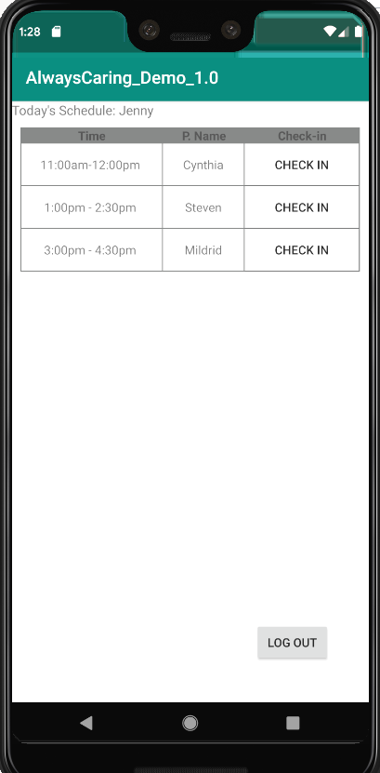
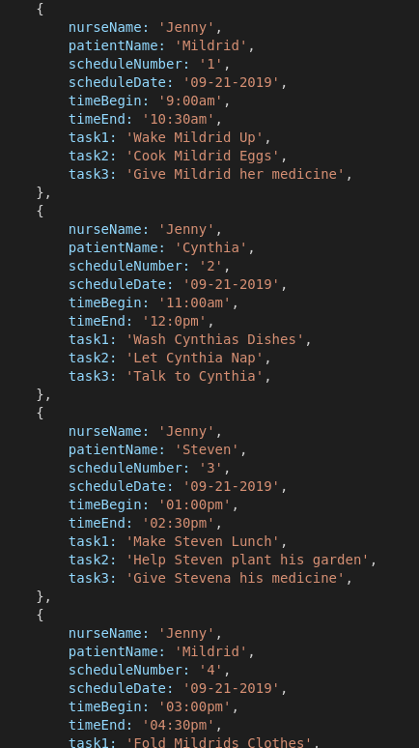
Revenue Model
Licensing Model
Scaling Cost
Affordability

