Slide 1
SQL Agent in the Cloud
Sam Cogan

Slide 2





Sam Cogan
Solution Architect – Willis Towers Watson
Microsoft Azure MVP
samcogan.com
@samcogan
sam-cogan

Slide 3
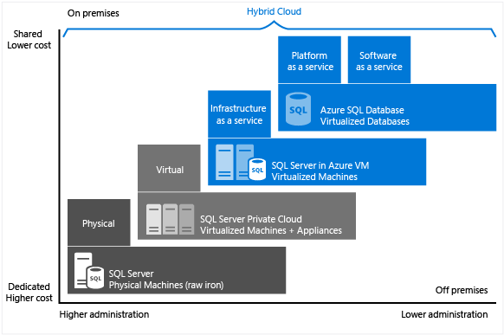

Slide 4





SQL Agent Alternatves
SQL Agent is not present in Azure SQL
Azure SQL Elastics Jobs
Azure Automation
SQL IaaS
Azure SQL
Managed Instance
Azure Functions

Slide 5






Elastic Database Jobs
Write Jobs in T-SQL
Run jobs across databases in parallel
Supports Azure SQL Databases, Servers and Elastic Pools
One-Off or scheduled jobs
Currently in preview
$10-$3000 per month – Depends on job database size

Slide 6

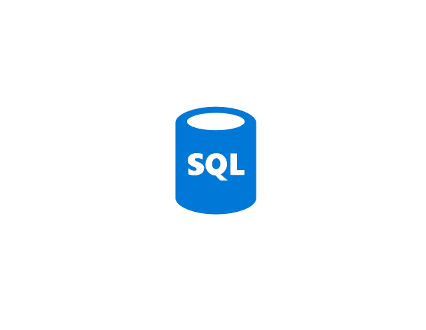
Azure SQL Server
Azure SQL Server
Execute job on targets
Job Agent
Read Job definition
Write Job Status
Job Database
Azure SQL Server
Azure SQL Server
Write Job Output
Elastic Pool
Output Database

Slide 7






Azure Automation
PowerShell & Python 2
On-demand, schedule or web hook
Secure variable storage
3 hour execution window (with resume)
Supports Hybrid Workers
500 Minutes Free, then $0.002 per minute

Slide 8





Azure Functions
Serverless, Event based compute
Multiple Languages, some in preview
Multiple triggers & bindings
Nearly instant start-up
Autoscaling and dynamic memory
5 minute execution window
Large free grant, then $0.000016/GB-s & 0.20 per million executions

Slide 9
 | Elastic Jobs | Automation | Functions
Languages | T-SQL | PowerShell | Multiple Languages
Job Length | Long Running Jobs | Long Running Jobs | Short Jobs
Triggers | Manual or Time Trigger | Manual, Webhook or Timer Trigger | Many Triggers
Input & Output | DB Input & Output | Manual Input & Output | Many Input & Output Bindings
Targets | Multiple concurrent targets | Build your own concurrency | Build your own concurrency
Startup | Fast start | Delayed Start | Instant Start
Resource Access | Azure SQL Only | Hybrid Workers | Web app options
Scale | Scale on Job DB size | No scaling | Dynamic scaling
Cost | Database SKU | Per Job (free grant) | Per second & memory (free grant)

Slide 10
Advanced Functionality
Move Beyond Maintenance
Scaling
Backup/Export
Provisioning
Integration
Event Grid
Azure Scheduler
Azure Monitor/Log Analytics/App Insights
3rd Party Monitoring Systems
Anything that can make a post request

Slide 11
Thank you very much for your attention. Vielen Dank für Eure Aufmerksamkeit.

