Slide 1
SQL Agent in the Cloud
Sam Cogan

Slide 2



Sam Cogan Solution Architect Willis Towers Watson Microsoft Azure MVP samcogan.com @samcogan sam-cogan

Slide 3
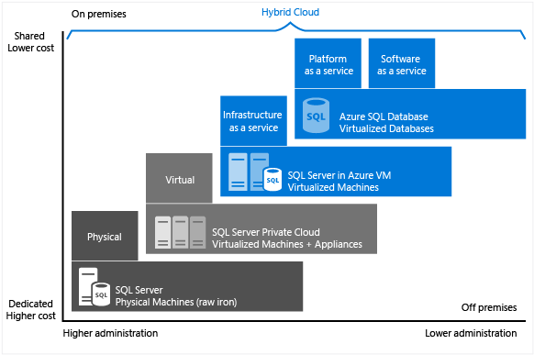

Slide 4





SQL Agent Alternatves
SQL Agent is not present in Azure SQL
Azure SQL Elastics Jobs
Azure Automation
SQL IaaS
Azure SQL
Managed Instance
Azure Functions

Slide 5
ELASTIC DATABASE JOBS
Run jobs in parallel across databases
Jobs written in T-SQL
Supports SQL Databases, Servers and Elastic Pools
Jobs can run across subscription
One-off or scheduled execution
Performance, cost and scale depends on Job DB
Currently in Preview
Administration is all PowerShell or T-SQL (no GUI)
Cost: £10 - £3000 per month

Slide 6
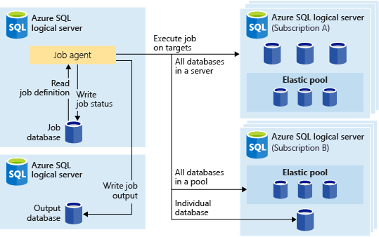

Slide 7

Azure Automation
PowerShell only
Run on schedule or webhook
Secure variable storage
3-hour timeout (with resume)
No output binding
Supports Hybrid Workers
Cost: 500 Minutes Free, then £0.002/minute

Slide 8

Azure Functions
Serverless compute, based on App Service
Multiple Languages, some experimental
Multiple triggers, Input and output bindings
Nearly instant startup
Autoscaling and dynamic memory
5-minute timeout by default
Supports Managed Service Identity
Cost: large free grant, then £0.000012/GB-s and £0.15 per million executions

Slide 9
 | Elastic Jobs | Automation | Functions
Languages | T-SQL | PowerShell | Multiple Languages
Job Length | Long Running Jobs | Long Running Jobs | Short Jobs
Triggers | Manual or Time Trigger | Manual, Webhook or Timer Trigger | Many Triggers
Input & Output | DB Input & Output | Manual Input & Output | Many Input & Output Bindings
Targets | Multiple concurrent targets | Build your own concurrency | Build your own concurrency
Startup | Fast start | Delayed Start | Instant Start
Resource Access | Azure SQL Only | Hybrid Workers | Web app options
Scale | Scale on Job DB size | No scaling | Dynamic scaling
Cost | Database SKU | Per Job (free grant) | Per second & memory (free grant)

Slide 10
Advanced Functionality
Move Beyond Maintenance
Scaling
Backup/Export
Provisioning
Integration
Event Grid
Azure Scheduler
Azure Monitor/Log Analytics/App Insights
3rd Party Monitoring Systems
Anything that can make a post request

Slide 11
Thank you very much for your attention. Vielen Dank für Eure Aufmerksamkeit.

