Slide 1

🔒
Secure Password Vault
A Rust-Based Local Password Manager
Owen Chibanda • Jasmine Sciarillo • Aryan Bhosale
CSCI 6221 • George Washington University

Slide 2

Project Overview
What is it?
Why Build This?
Command-line password manager
Built with Rust for memory safety
Local storage - no cloud dependency
Military-grade encryption
Growing privacy concerns
Cloud breach risks
User data sovereignty
Educational demonstration

Slide 3
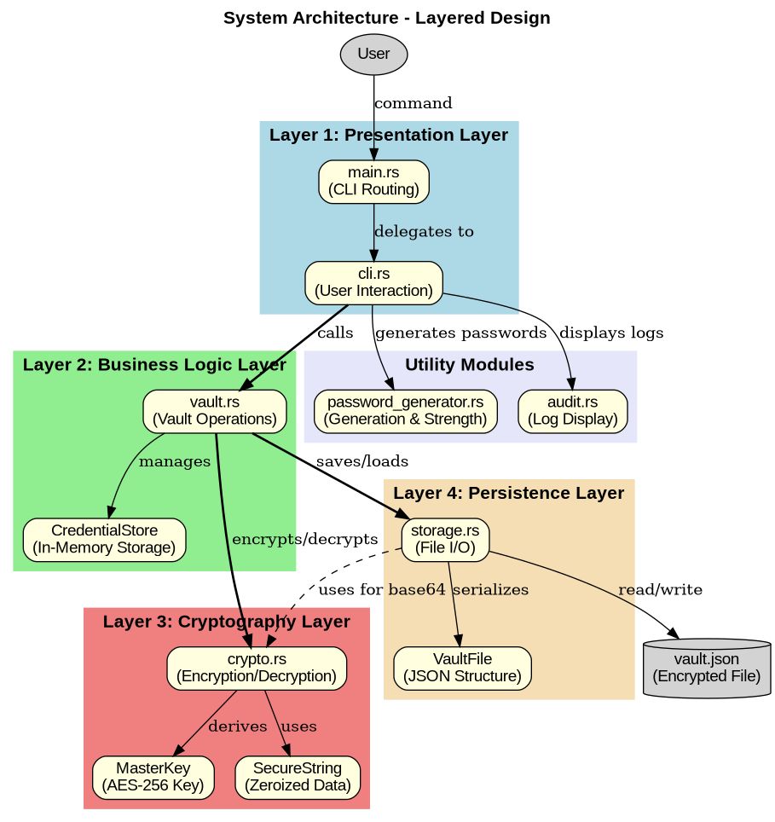
System Architecture

Slide 4
Layered Architecture
Layer 1: Presentation
CLI interface, argument parsing, user interaction (main.rs, cli.rs)
Layer 2: Business Logic
Vault operations, credential management (vault.rs)
Layer 3: Cryptography
AES-256-GCM encryption, Argon2id key derivation (crypto.rs)
Layer 4: Persistence
File I/O, JSON serialization, atomic writes (storage.rs)

Slide 5
Cryptographic Security
AES-256-GCM
Argon2id
256-bit encryption keys
Authenticated encryption
NIST approved standard
Hardware accelerated
Memory-hard algorithm
Resists GPU attacks
Password hashing winner
Side-channel resistant

Slide 6
Key Features
🔐 Zero-Knowledge
🛡️ Memory Safety
Master password never stored on disk
Rust prevents buffer overflows & data races
🔒 Secure Storage
📝 Audit Logging
All data encrypted with AES-256-GCM
Complete operation history tracking
🔑 Password Generator
💾 Backup Support
Cryptographically secure random passwords
Export/import encrypted vault files

Slide 7
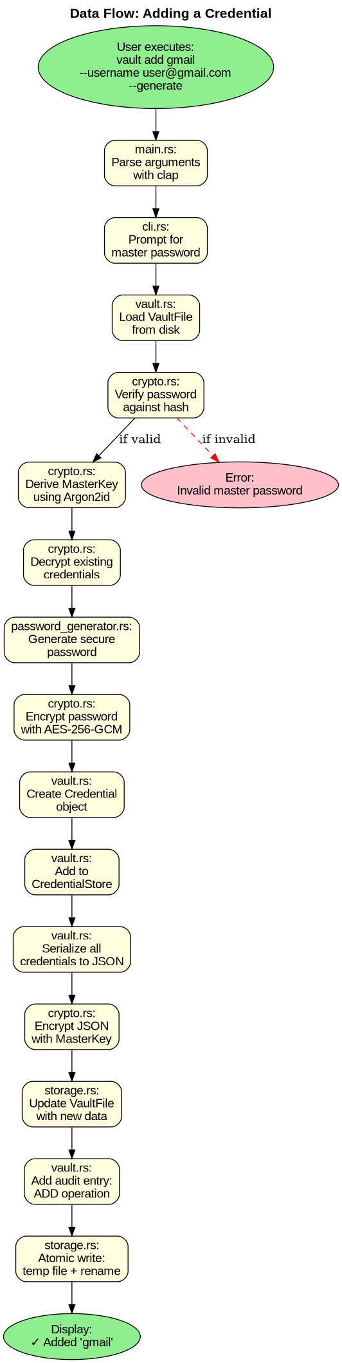
Data Flow: Adding a Credential

Slide 8
Threat Model
Protected Against
Not Protected Against
Stolen vault files
Brute-force attacks
Data tampering
Memory dumps
Buffer overflows
Keyloggers
Host system malware
Physical access (unlocked)
Social engineering
Screen recording

Slide 9
Technology Stack
Core
CLI & UI
Data & Utils
Rust 2021
aes-gcm 0.10
argon2 0.5
rand 0.8
zeroize 1.7
clap 4.5
dialoguer 0.11
colored 2.1
clipboard 0.5
serde 1.0
serde_json 1.0
chrono 0.4
uuid 1.7

Slide 10
Command Line Interface
$ vault init
Initialize new vault with master password
$ vault add gmail --username user@gmail.com --generate
Add credential with auto-generated password
$ vault get gmail --copy
Retrieve password and copy to clipboard
$ vault list --verbose
List all stored credentials with details
$ vault audit
View operation history and security log

Slide 11
Conclusion & Future Work
Key Accomplishments
Production-ready password manager
Enterprise-grade security implementation
Memory-safe architecture
Comprehensive documentation
Future Enhancements
Hardware key support (YubiKey) • Browser integration • Multi-device sync • Password strength monitoring • Breach detection API integration

Slide 12
🔐
Thank You
Questions & Discussion
Owen Chibanda • Jasmine Sciarillo • Aryan Bhosale
George Washington University • CSCI 6221

